Slide 1
Faculty Beliefs and Practices for Inclusive Teaching
Dr. Ryan Bronkema, University of West Georgia
Dr. Michele DiPietro, Kennesaw State University
Dr. Brian Etheridge, Georgia Gwinnett College
Dr. Judy Grissett, Georgia Southwestern State University
Dr. Jamie Landau, Valdosta State University
Notes:
Need sexier title
Inclusion, but make it sexy

Slide 2
Activity!
Aunt Bonnie has come to visit…
Notes:
Aunt Bonnie is silly and bizarre (foolish?) but not crazy
She likes puppies but not dogs
She likes kittens but not cats
She likes spaghetti but not pasta
What else does Aunt Bonnie like?

Slide 3
Learning objectives
By the end of this workshop, you should be able to:
Experience a simulation of feeling excluded and included
Articulate the value of inclusive teaching
Describe dimensions of inclusive teaching
Generate at least one strategy for inclusive teaching that addresses an exclusionary practice
Articulate your own beliefs about inclusive teaching

Slide 4
An inclusive course climate matters for learning!
Perceptions of a “chilly” climate affect student learning, critical thinking, and preparation for a career (Pascarella et al. 1997; Whitt et al. 1999).
Climate regulates the circulation and construction of knowledge.
Climate impacts meta-curricular and citizenship skills. (Brookfield & Preskill 2005).
Climate engenders emotions that impact learning. (Ford, 1992).
Climate can channel energies away from learning or toward it. (Renn, 1998).
Climate communicates expectations placed upon students. (Rosenthal & Jacobson, 1992; Steele & Aronson, 1995).
Climate communicates power dynamics. (Kohl, 1994).
Climate impacts student persistence. (Tinto, 1993).
This is true even for supposedly content-neutral disciplines.

Slide 5
Dynamics of inclusion in the Teaching and Learning Process
4 dimensions matter:
Know Yourself
Know your Students
Interrogate your Content
Interrogate your Teaching Methods
Marchesani & Adams (1992)

Slide 6
I. Know Yourself
Examine your assumptions
Investigate your feeling, both energizing and anxiety-producing
Evaluate your expertise
Be mindful of your intersectional privilege profile (e.g. white, male, cisgender, heterosexual, English-speaking, highly educated, etc.)
Cultivate empathy

Slide 7
II. Know your students
Consider the impact of your students identity, history, and experiences:
Prior knowledge/skills
Beliefs
Motivation
Socialization of marked identities (possible alienation, invisibility, hypervisibility/tokenization, victimization)
Socialization of dominant identities (culture shock, disintegration)

Slide 8
III. Course content
Do students see themselves in the curriculum?
The Exclusive Curriculum.
The Exceptional Outsider.
Understanding the Outsider.
Getting Inside the Outsider.
The Transformed Curriculum.
(Marchesani & Adams 1992)

Slide 9
IV. Pedagogical methods
Here are some examples:
Language (preferred names; pronouns; gendered language)
Tone (punitive vs. encouraging)
Interactions (faculty to students; students to students; microaggressions; stereotypes)
Pedagogies (encouraging participation and multiple perspectives; well-structured collaborative activities; varied examples; ground rules; “dialogic pedagogy”)
Others?

Slide 10
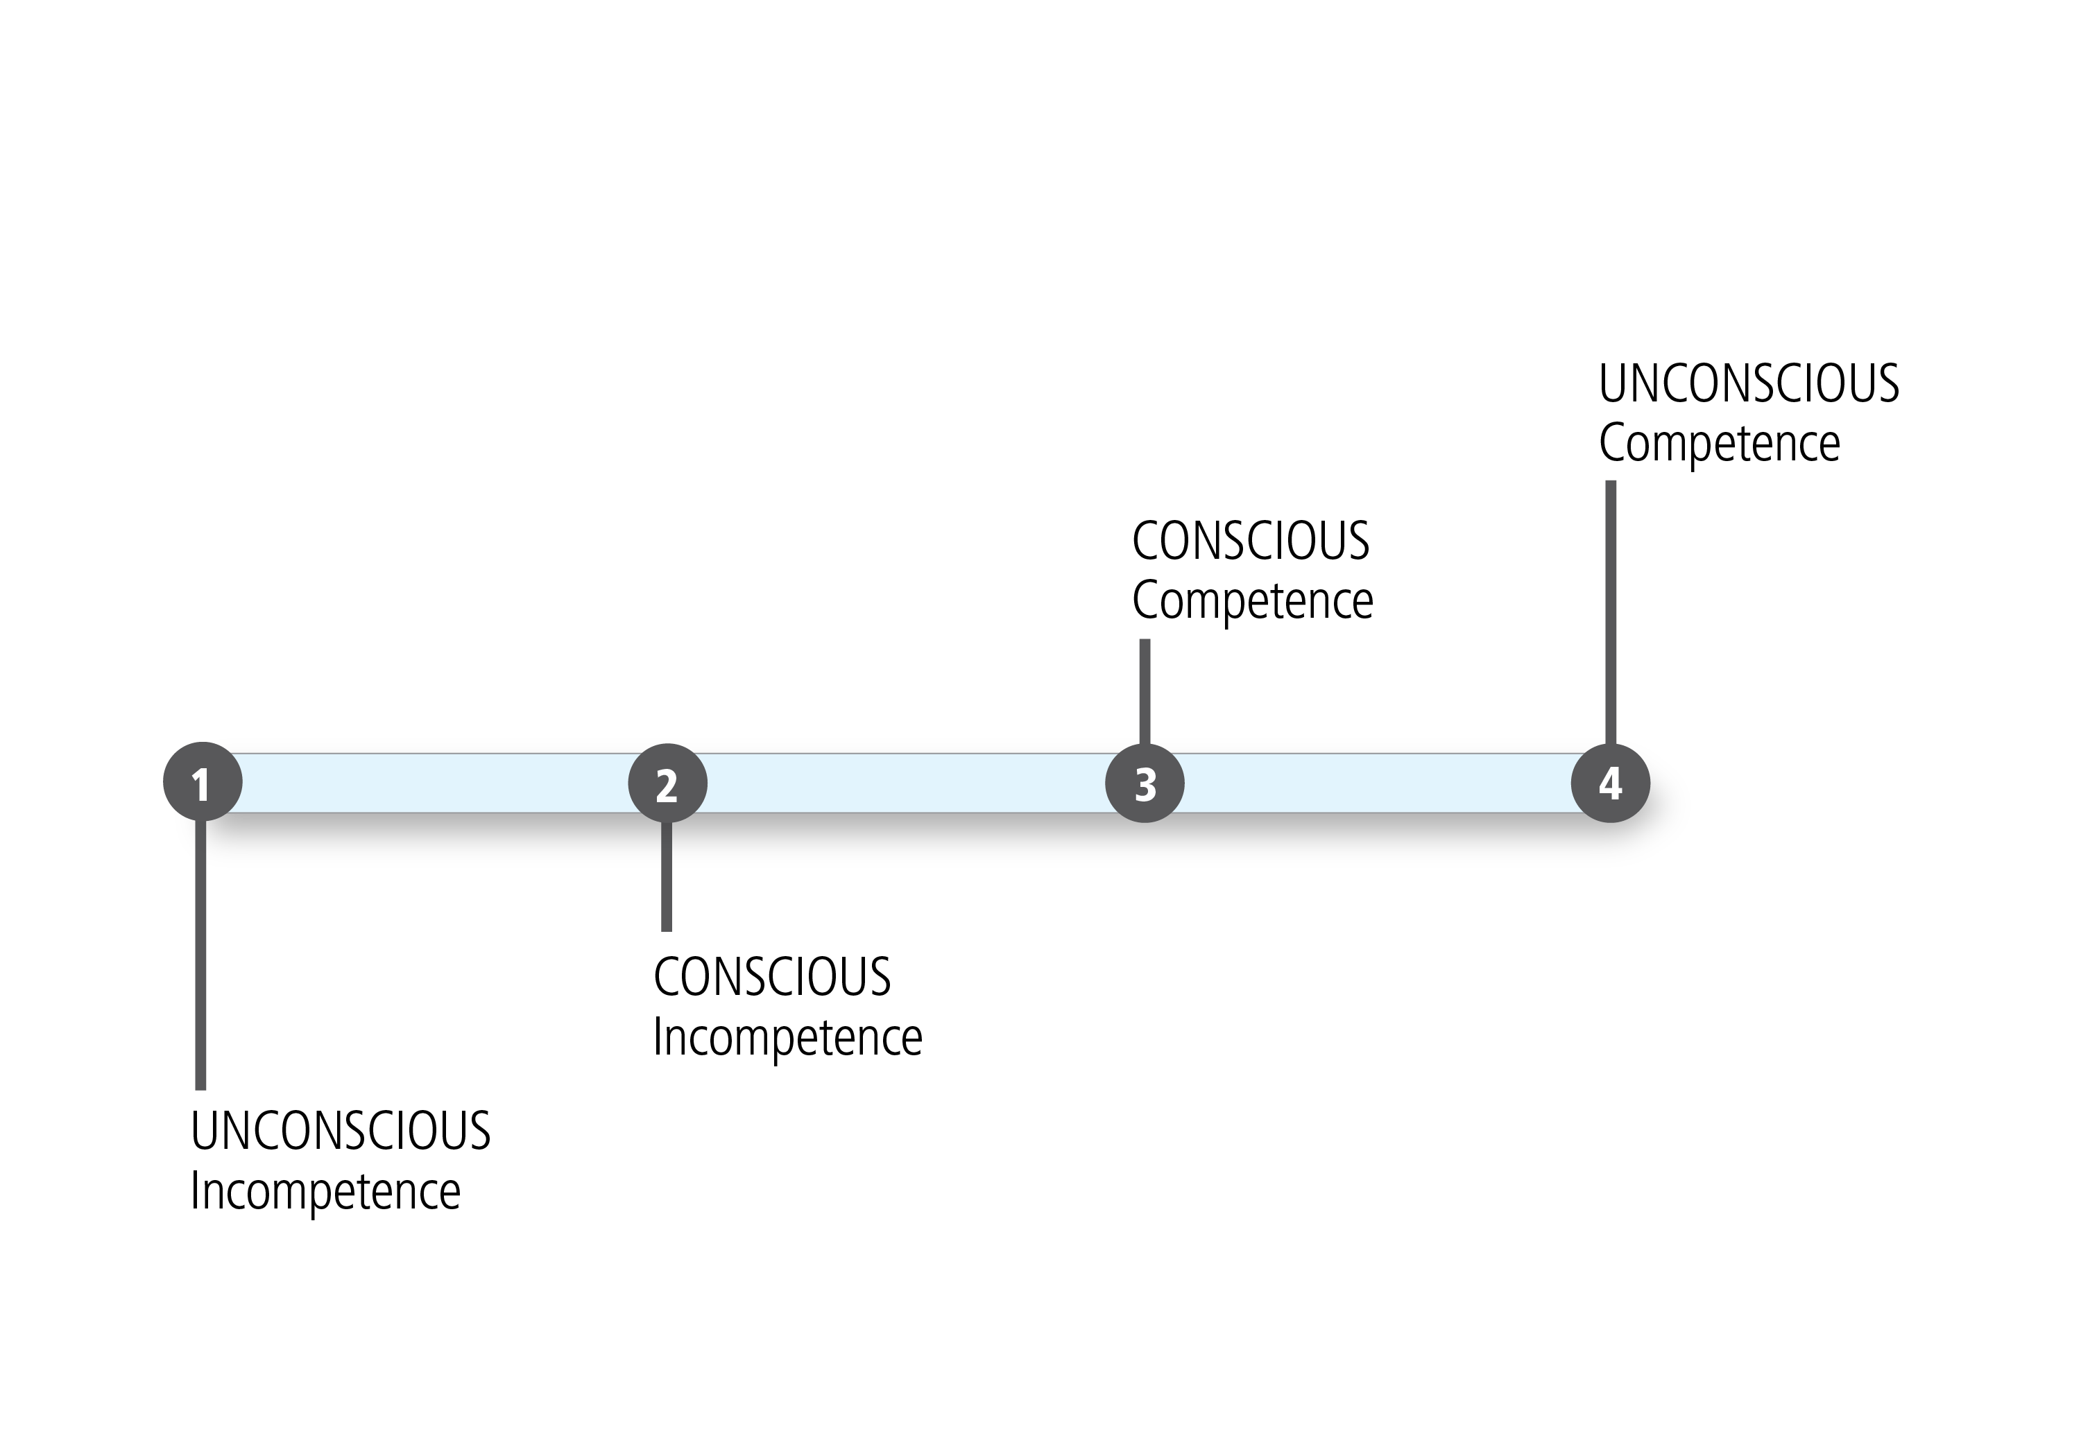
Model of skill development
Expected part of Development
Don’t be discouraged!
Part of Scholarly Teaching
Sprague and Stuart (2000)

Slide 11
Think-Pair-Share
Individually, reflect on the 4 dimensions of inclusion and…
  One way in which you might be involuntarily exclusionary when teaching
  One strategy you can do to make it more inclusive
Pair up with a neighbor and discuss your reflections
Share with the large group
4 DIMENSIONS OF INCLUSION
Know Yourself
Know your Students
Interrogate your Content
Interrogate your Teaching Methods

Slide 12
Inclusive teaching manifesto
Complete one or more of the following prompts:
As an inclusive teacher, I am…
Students in my course feel included when…
My course content is inclusive when…
Inclusive pedagogical methods look like…
I believe inclusive teaching is…
Take 2 minutes
Write legibly
Others will read your work out loud
Read out the most memorable point

Slide 13
Further readings and resources
Inclusive Pedagogy
Ambrose, S. A., et al. (2010) How Learning Works: 7 Research-Based Principles for Smart Teaching. San Francisco: Jossey-Bass.
Brookfield, S., & Preskill, S. (2005) Discussion as a way of Leading (2nd ed.). Jossey-Bass.
hooks, b. (1994). Teaching to transgress: Education as the practice of freedom. New York: Routledge.
Kohl, H. (1994). "I won’t learn from you" and other thoughts on creative maladjustment. New York: The New Press.
Marchesani, L., & Adams, M. (1992). Dynamics of diversity in the teach- ing–learning process: A faculty development model for analysis and action. In M. Adams (Ed.), Promoting diversity in college class- rooms: Innovative responses for the curriculum, faculty, and institutions (Vol. 52, pp. 9–20). San Francisco: Jossey-Bass.

Slide 14
Further readings and resources
Inclusive Pedagogy (continued)
Maxwell K, & Gurin, P. (2017). Using dialogue to create inclusive classrooms: A case study from a faculty institute. AAC&U’s Liberal Education, 103(3/4). Retrieved from: https://www.aacu.org/liberaleducation/2017/summer-fall/maxwell_gurin
Pascarella, E., Whitt, E., Edison, M., & Nora, A. (1997). Women’s perceptions of a “chilly climate” and their cognitive outcomes during the first year of college. Journal of College Student Development, 38(2), 109–124.
Seymour, E., & Hewitt, N. (1997). Talking about leaving: Why undergraduates leave the sciences. Boulder, CO: Westview Press.
Tinto, V. (1993). Leaving college: Rethinking the causes and cures of student attrition (2nd ed.). Chicago: The University of Chicago Press.
Warren, L. (2006). Managing hot moments in the classroom. Derek Bok Center for Teaching and Learning, Harvard University. Retrieved from http://isites.harvard.edu/fs/html/icb.topic58474/hotmoments.html
Whitt, E., Nora, A., Edison, M., Terenzini, P., & Pascarella, E. (1999). Women’s perceptions of a “chilly climate” and cognitive outcomes in college: Additional evidence. Journal of College Student Development, 40(2), 163–177.

Slide 15
Further readings and resources
Gender and Sexuality
Belenky, M. F., Clinchy, B. M., Goldberger, N. R., and Tarule, J. M. (1986). Women's ways of knowing: The development of self, voice and mind. Basic Books.
Campus Pride: https://www.campuspride.org
DeSurra, C., & Church, K. A. (1994). Unlocking the classroom closet: Privileging the marginalized voices of gay/lesbian college students. Paper presented at the Annual Meeting of the Speech Communication Association.
Gay, Lesbian, and Straight Education Network (GLSEN): https://www.glsen.org
Hall, R. (1982). The classroom climate: A chilly one for women? Washington, D.C.: Association of American Colleges.
Rankin, Sue, Warren J. Blumenfeld, Genevieve N. Weber, and Somjen Frazer. 2010. State of Higher Education for LGBT People: Campus Pride 2010 National College Climate Survey. Charlotte, NC: Campus Pride.
Renn, K. (1998). "Lesbian, gay, bisexual, and transgender students in the college classroom." In R. Sanlo (Ed.), Working with lesbian, gay, bisexual, and transgender college students: A handbook for faculty and administrators (231-238). Westport, CT: Greenwood Press.

Slide 16
Further readings and resources
Race
Fries-Britt, S. (2000). Identity development of high-ability black collegians. In M. Baxter-Magolda (Ed.), Teaching to promote intellectual and personal maturity: Incorporating students’ worldviews and identities into the learning process (Vol. 82). San Francisco: Jossey-Bass.
Karkouti, I. M. (2016). Black students’ educational experiences in predominantly White universities: A review of the related literature. College Student Journal, 50(1), 59-70.
Rosenthal, R., & Jacobson, L. (1992). Pygmalion in the classroom: Teacher expectation and pupils' intellectual development (2nd ed.). New York: Ardent Media.
Steele, C. (2010) Whistling Vivaldi: How stereotypes affect us and what we can do. Norton.
Tatum, Beverly Daniel. 2017. Why are All the Black Kids Sitting Together in the Cafeteria? And Other Conversations about Race (2nd ed.). New York: Basic Books.

Slide 17
Further readings and resources
Language & Communication
Inclusive language guide by the National Council of Teachers of English http://www.ncte.org/positions/statements/genderfairuseoflang
Ishiyama, J., and Hartlaub, S. “Does the Wording of Syllabi Affect student Course Assessment in Introductory Political Science Classes?” available at http://www.apsanet.org/imgtest/WordingSyllabiAssessment-Ishiyama.pdf
Pronouns, see GLSEN’s ”Pronouns: A Resource for Educators” and Campus Pride’s “Guide to Common Pronouns and Their Usage”:
  https://www.glsen.org/article/pronouns-resource-educators
  https://www.campuspride.org/resources/what-are-your-pronouns-a-guide-to-common-pronouns-and-their-usage/

Slide 18
Further readings and resources
Stereotypes, Microaggressions, Bias, Privilege, and Diversity in Higher Ed
Implicit Association Test. Available online at http://implicit.harvard.edu
McIntosh, P. (1989). White privilege: Unpacking the invisible knapsack. Peace and Freedom. July/August.
Moody, J. (2011). Faculty diversity: Removing the barriers. New York: Routledge.
National Center for Faculty Development and Diversity: https://www.facultydiversity.org
Steele, C. M., & Aronson, J. (1995). "Stereotype threat and the intellectual test performance of African Americans." Journal of Personality and Social Psychology, 69(5), 797-811.
Sue, D. W. (2010). Microaggressions in everyday life: Race, gender, and sexual Orientation. Wiley.
Sue, D. W. (Ed.) (2010) Microaggressions and Marginality: Manifestations, dynamics, and impact. Wiley.
Wise, T, & Case, K. A. (2013). Pedagogy for the privileged: Addressing inequality and injustice without shame or blame. In K. A. Case (Ed.), Deconstructing privilege: Teaching and learning as allies in the classroom (pp. 17-33). New York: Routledge.

Slide 19
Further readings and resources
Knowing Yourself
Who am I as a Teacher? (https://www.elon.edu/u/academics/catl/inclusiveteaching/who-am-i/)
Identifying your own Attitudes (http://www.crlt.umich.edu/gsis/p3_2)
Awareness of Implicit Biases (https://ctl.yale.edu/ImplicitBiasAwareness)

Slide 20
Further readings and resources
Knowing your Students
Who Are the Students? (https://www.elon.edu/u/academics/catl/inclusiveteaching/who-are-the-students/)
Learning Students’ Names (http://cte.virginia.edu/teaching-tips/not-quite-101-ways-to-learning-students-names/)
Connecting with your Students (https://teaching.cornell.edu/teaching-resources/building-inclusive-classrooms/connecting-your-students)
Teaching International Students (http://www.crlt.umich.edu/internationalstudents)
(https://www.washington.edu/teaching/teaching-resources/inclusive-teaching-at-uw/teaching-im-students/)
Teaching Students with Disabilities (http://www.crlt.umich.edu/publinks/disabilitiesfacinfo)
Teaching Student Veterans (https://www.washington.edu/teaching/teaching-resources/inclusive-teaching-at-uw/teaching-student-veterans-resources-for-instructors/)

Slide 21
Further readings and resources
Interrogating your Content
Features of an Inclusive Syllabus (http://www.slu.edu/blogs/cttl/2017/01/18/features-of-an-inclusive-syllabus/)
Diversity Statements (https://ctl.yale.edu/DiversityStatements)
Gender Pronouns (https://www.elon.edu/u/academics/catl/inclusiveteaching/how-do-we-teach/links-to-gender-pronouns/)

Slide 22
Further readings and resources
Interrogating your Teaching Methods
Classroom Climate (https://teaching.cornell.edu/teaching-resources/building-inclusive-classrooms/classroom-climate)
Establishing Classroom Ground Rules (https://teachingcenter.wustl.edu/resources/inclusive-teaching-learning/establishing-ground-rules/)
Responding to Difficult Moments (e.g., hate speech, microaggressions, incivility) (http://www.crlt.umich.edu/multicultural-teaching/difficult-moments)
Inclusive Strategies (https://docs.google.com/document/d/1QXOsiu5aDsbksadPpt0HqwNLXdLYfQayHa4miQ6PPpM/edit#heading=h.30j0zll)
Universal Design for Learning (https://teaching.cornell.edu/teaching-resources/building-inclusive-classrooms/universal-design-learning)

