Slide 1
Why Does Mindset Matter?
Designed by GA-CTL Workgroup: Crystal Edenfield
Rhonda Porter
Deborah Walker
Joyce Weinsheimer
Lisa Yount

Slide 2
Learning Outcomes:
Participants will:
Identify and apply the concepts of fixed mindset and growth mindset.
Explore the impact of mindset on both students and faculty.
Recognize and discuss effective classroom strategies for encouraging growth mindset.
Build awareness of additional resources and foster an interest in topics related to mindset.

Slide 3
What is mindset?
Mindsets are beliefs and perceptions about learning.

Slide 4
Fixed vs. Growth
A fixed mindset is based on the belief that your qualities are carved in stone
A growth mindset is based on the belief that your basic qualities are things you can cultivate through your efforts, your strategies, and help from others

Slide 5
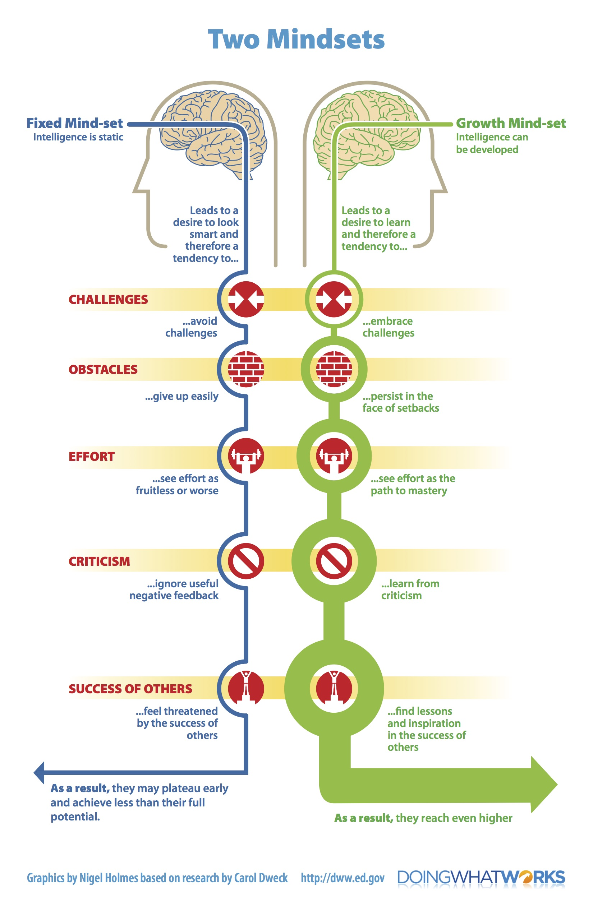
(Handout)
Notes:
Discuss infographic.

Slide 6
(Handout)
Fixed
Growth
“Spending time writing comments on student work is a waste of time. They never use it to improve.”
“Providing structured feedback takes time, but it’s worth the effort because it gives students a sense of direction on what to do to improve.”
Faculty
FEEDBACK
“Look at all of these red marks. The teacher hates me. I guess I can’t do anything right for this teacher. I’m done.”
“These comments are not what I expected, but at least now I know what kind of help to ask for from the Writing Center.”
Students
Notes:
We give example.

Slide 7
(Handout)
Fixed
Growth
Faculty
Your Example
Students
Notes:
1. Come up with your own example of mindset in action. Our example was feedback, but use any classroom or co-curricular example to illustrate fixed or growth mindset. ½ student/ 1/2 teacher. (5 minutes). Now discuss with a partner and categorize based on graphic. Discuss. {Think, Pair, Share}

Slide 8
Notes:
Discuss example. Categorize. (2 minutes). Large group

Slide 9
Scenario Activity: How do you respond if you have a fixed mindset? A growth mindset?
You notice that some students are not participating in classroom discussions. You suspect that it may be either shyness or that they are uncomfortable making mistakes publicly.
You are a student that just got your first test back. You received a D.

Slide 10
Why does mindset matter?
Notes:
To students
To faculty

Slide 11
Strategies for Fostering Growth Mindset
Early
(first weeks)
Use positive language (in syllabi, in conversation)
Add “your learning story” reflective activity
During
(after major assignment)
Use an exam wrapper
Encourage/Incentivize campus resources
End
(prior to finals)
Encourage final exam study plan to minimize stress
Have students reflect about the value/relevance of course
Notes:
Review this strategies worksheet, Others?
Examples of positive language:
“I like how you tried a new way to solve that.”
“You’ve been practicing and I can see it’s paying off.”
“I love mistakes because they’re an opportunity to learn – being challenged is when the brain grows most.”

Slide 12
Going Deeper With Mindset
Topics to consider when developing a series of Mindset discussions
Academic Engagement and Mindset
Growth Mindset
Innovative Pedagogy and Mindset
Learning Strategies and Mindset
Metacognition and Mindset
Motivation and Mindset
Pre-college Experiences and Mindset
Self-Direction, Self-Efficacy, Self-Regulation and Mindset
Sense of/Social Belonging and Mindset
Theoretical Framework
Understanding Your Students’/Colleagues’ Mindsets

Slide 13
Resources
Books
Dweck, C. (2016). Mindset: The new psychology of success. Penguin Random Hofuse, New York, New York.
Major, C. H., Harris, M. S., & Zakrajsek, T. (2016). Teaching for learning: 101 intentionally designed educational activities to put students on the path to success. Taylor & Francis, New York, New York.
McGuire, S. Y. (2015). Teach students how to learn: Strategies you can incorporate into any course to improve student metacognition, study skills, and motivation. Stylus Publishing, Sterling, Virginia.
Websites
https://www.mindsetkit.org/topics/about-growth-mindset/what-is-growth-mindset
http://mindsetscholarsnetwork.org/

