Slide 1
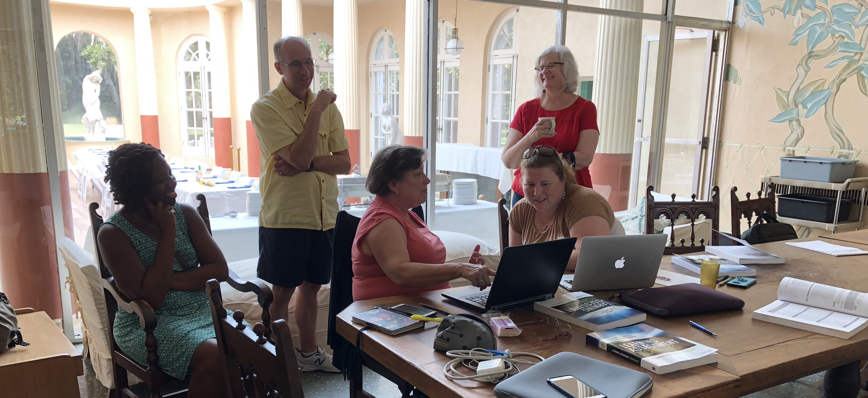
Faculty Learning Communities
Faculty Learning Communities (FLCs) foster active, collaborative conversations about teaching and learning that lead to innovation and change.
What is an FLC?
FLCs are small groups of faculty who have a similar interest or goal. Together, in a supportive community, they explore their topic of interest, set goals, and meet regularly throughout the semester to achieve those goals.
Am I a good fit?
Ideal participants are excited about the opportunity to engage in meaningful conversations around course enrichment that lead to innovation and change in the classroom, and represent a balance of needs and expertise.
How can I apply?
Contact _____CLS or FLC representative____ for more information, or complete an application at ____URL________ by ___Deadline date____.
Add other relevant information here, institution logo, etc.

