Slide 1
Course Design Basics – or better, sexy title
Designed by GA-CTL Workgroup: Mary Carney, Darryl Hancock, Laura Lynch, Deborah South Richardson, Washella T. Simmons
Notes:
Our plan is to introduce you to the basic principles of good course design. You might choose this as your topic or one of your topics for your faculty learning community.
We will go into depth on one “module” of what might make up a learning community focused on course design; we will provide some ideas about applying the basics of course design to the development of your learning community; and we will quickly introduce you to other topics that might be addressed in such a learning community.
As we were preparing this workshop, it occurred to us that this topic could actually incorporate any of the other topics that have been addressed today – small teaching, academic mindset, or inclusive pedagogies could be incorporated into a faculty learning community that addresses course design.
Two primary resources for this workshop – and that might serve well in an FLC:
Barkley and Major’s Learning Assessment Techniques: A Handbook for College Faculty
Fink’s Creating Significant Learning Experiences

Slide 2
The Big Picture: Aspirational Goals
Think-Pair-Share
What would I like the impact of the FLC to be on participants 2 years down the road?
What would distinguish people who have participated in this FLC from people who have not?
Notes:
“ I will give you a few minutes to reflect on these questions that address the “big picture” of how you want the learning experience to impact the learners. After you have reflected on these questions for a few minutes, I will cue you to turn to a neighbor to share your goals for your learners. After you have had a few minutes to share, we will share some of your ideas in an open discussion. Be sure to write down your goals; we will come back to them later.”
What do you want your FLC participants to …
1 minute to think & write
Pair with person next to you for 1 minute each
Share at table for 3 minutes: what is the consistency you are hearing. Someone serves as recorder who should be prepared to report out
Report out from two tables for 2 minutes per table

Slide 3
Significant Learning
Significant Learning Domain | Goal
Foundational Knowledge | Understanding and remembering key concepts, terms
Application of Learning | Applying knowledge to real situations … so that foundational knowledge becomes useful
Integration | Making connections between ideas, learning experiences, and realms of life → context → learning more powerful
Human Dimension | Enhance significance of learning by recognizing social and personal implications of the learning for self and others
Caring Value | Develop interests, feelings, values that help learners care about learning → energy to learn more and make part of own life
Learning How to Learn | Learn about process of learning, including how to become self-directed and maximally effective learner
L. Dee Fink. 2013. Creating Significant Learning Experiences: An Integrated Approach to Designing College Courses.
Notes:
Recommendation to facilitator: Review the domains and ask participants where their goals fit (maybe a show of hands)
Dee Fink argues that significant learning involves multiple domains, some that focus on basic learning and some that address motivation (e.g., value)
From Fink:
Foundational Knowledge
Application
Skills
Managing Complex Projects
Learning how to think
Critical thinking
Creative thinking
Practical thinking
Integration
Interdisciplinary Learning
Learning Communities
Connecting academic work with other areas of life
Personal, social, service learning…
Human Dimension
Learning about self
Journey toward self-authorship
Learning about others
A broader concept of others
The Human dimension of learning and Emotional Intelligence
Reciprocity of learning about self and others
Caring
As a change in feelings, interests or values
Learning how to learn
How to be a better students
How to construct knowledge in different domains of inquiry
How to be a self-directed learner

Slide 4
Example: Learning Goals Inventory: Foundational Knowledge Domain
Answer each question on a Likert Scale:
High | Moderately High | Moderately Low | Low | Not Applicable
As a result of participation in the course, students should develop:
1. Knowledge of central facts in the subject area
6. Recognition of difference between fact and opinion related to this subject area
From Learning Assessment Techniques by Barkley & Major
Notes:
Barkley & Major – Appendix B

Slide 5
Example: Learning Goals Inventory: Application Domain
Answer each question on a Likert Scale:
High | Moderately High | Moderately Low | Low | Not Applicable
As a result of participation in the course, students should develop:
11. Writing skills
15. Critical thinking skills
From Learning Assessment Techniques by Barkley & Major
Notes:
Barkley & Major – Appendix B

Slide 6
Example: Learning Goals Inventory: integration Domain
Answer each question on a Likert Scale:
High | Moderately High | Moderately Low | Low | Not Applicable
As a result of participation in the course, students should develop:
24. The ability to connect a concept to other concepts within this course.
27. The ability to connect course concepts to concepts in other disciplines or fields.
From Learning Assessment Techniques by Barkley & Major
Notes:
Barkley & Major – Appendix B

Slide 7
Example: Learning Goals Inventory: human Domain
Answer each question on a Likert Scale:
High | Moderately High | Moderately Low | Low | Not Applicable
As a result of participation in the course, students should develop:
31. The ability to work productively with others.
36. A commitment to their own emotional health and well-being.
From Learning Assessment Techniques by Barkley & Major
Notes:
Barkley & Major – Appendix B

Slide 8
Example: Learning Goals Inventory: caring (value) Domain
Answer each question on a Likert Scale:
High | Moderately High | Moderately Low | Low | Not Applicable
As a result of participation in the course, students should develop:
38. Openness to new ideas in the subject area.
41. A commitment to success in learning.
From Learning Assessment Techniques by Barkley & Major
Notes:
Barkley & Major – Appendix B

Slide 9
Example: Learning Goals Inventory: learning how to learn Domain
Answer each question on a Likert Scale:
High | Moderately High | Moderately Low | Low | Not Applicable
As a result of participation in the course, students should develop:
49. Study skills and strategies.
52. The ability to self-assess their performance.
From Learning Assessment Techniques by Barkley & Major
Notes:
Barkley & Major – Appendix B

Slide 10
significant learning in a course-design-focused flc
Significant Learning Domain | Goal
Foundational Knowledge | Understand backward design
Application Learning | Use the model to develop a variety of learning experiences (courses, workshops)
Integration | Integrate course design with teaching practice
Human Dimension | Recognize the benefits of learner-centered approach for self and students
Caring Value | Appreciate that good teaching enhances student success
Learning How to Learn | Seek additional resources
Notes:
If, for example, you selected to focus your FLC on course design, you would want to address all of the goals to enhance the participant’s learning experience.
For facilitator: You might want to review this slide, suggesting how an FLC that addresses course design might achieve significant learning by working in each of the domains.

Slide 11
Fink, L. (2003). Creating significant learning experiences : An integrated approach to designing college courses.
Notes:
Research shows that significant, deep learning happens when a learning experience integrates all of the domains
In your FLC, you may want to provide opportunities for participants to develop in all of these domains.
foundational knowledge in the form of reading and discussing seminal research and best practices
participants would be likely to have an opportunity to apply that knowledge as they teach their own courses – and share with one another what works and what does not
they should be able to connect the principles of course design to other learning experiences, to multiple classes

Slide 12
Other topics for your FLC
Notes:
When we do full course design workshops, we consider a variety of components of course design (in this case, based on the Fink model of significant learning experiences). While we don’t have time to address those in any detail today, you can think about how these topics might be incorporated into your learning community, whether your focus is course design, or teaching practices.

Slide 13
Models of Course Design
Notes:
There are a variety of models of course design that all share a similar foundation. You could spend a session or two examining these models and their implications.
We will present two of them. They are very compatible. One is an extension of the other. Both focus on course design.

Slide 14
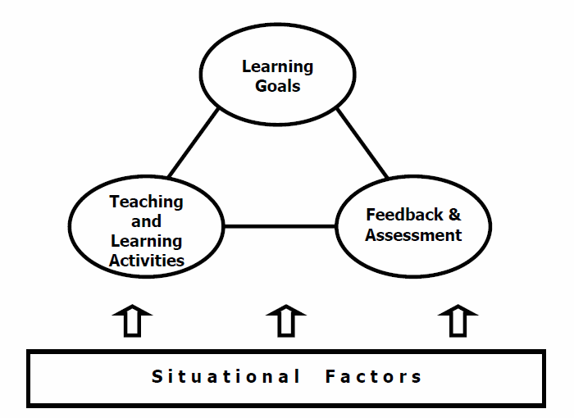
Integrated Course Design
Learning
Outcomes
Fink, L. (2003). Creating significant learning experiences : An integrated approach to designing college courses.
Notes:
Dee Fink expanded on the basic Wiggins and McTighe model suggesting an integrated model that recognizes that one can start anywhere in designing a course, that each component influences the others. This model also recognizes the role of situational factors in contributing to our thinking about instructional design.
Fink, L. (2003). Creating significant learning experiences : An integrated approach to designing college courses (1st ed., Jossey-bass higher and adult education series). San Francisco, Calif.: Jossey-Bass.

Slide 15
+ Significant Learning
Feedback Assessment
Teaching and Learning Activities
Learning Outcomes
Notes:
The models are very similar.

Slide 16
Creating Significant Learning Experiences

Slide 17
Design Phases
INITIAL PHASE
Build Strong Primary Components
INTERMEDIATE PHASE
Assemble the Components into a Coherent Whole
FINAL PHASE
Finish Important Remaining Tasks
Notes:
We won’t be dealing with all of the details of the model, but it may be helpful to see all of the steps that Fink includes in his model. They all play a role in course design, but you could focus on a several topics related to the process.
Facilitator may want to provide copy of Fink Idea paper

Slide 18
INITIAL DESIGN PHASE Build Strong Primary Components
Identify important situational factors
Identify important learning goals and outcomes
Formulate appropriate feedback and assessment procedures
Select effective teaching/learning activities
Notes:
Asks us to reflect on the specific context of the teaching and learning situation and how this will affect course design.
We did this in the opening to this session
Is an essential component in creating a learner-centered experience (in contrast to an instructor- or content-centered experience.)
We have addressed goals; we will soon move to outcomes.
One of the most significant insights we need to understand is that to be effective, it is important that the assessments not only evaluate learning, but that they also foster learning: ie. They include substantive feedback.
Good to ask learners assessments to use the knowledge acquired in a class to complete a task.
Answering the questions: What will the students do and what will the instructor do to foster student learning
Asks us to check that the components in 2-4, work well in the situational context and work well together to create an integrated design.
Again, the essential ingredient is that the outcomes, activities and assessment reflect and support each other, that they are aligned.

Slide 19
Integrated Course Design
Learning
Outcomes
Notes:
L. Dee Fink. 2013. Creating Significant Learning Experiences: An Integrated Approach to Designing College Courses.
This is how these components fit together in Fink’s integrated model.
This is the foundation for course design and our primary focus today.

Slide 20
situational factors
that impact the design of the learning experience

Slide 21
Situational factors that may impact your FLC
Factor | Examples
Context | Number of participants, frequency of meetings, medium (f2f, distance, hybrid)
Expectations of external groups | Your Provost, University System
Characteristics of participant colleagues | Schedule, available time, motivation, prior experience
Characteristics of facilitator -- YOU | Experience, confidence, interest, motivation
Notes:
You might engage a discussion with the members of your community about how these situational factors are or might impact they teaching and learning experience in their courses – past, future, or present.

Slide 22
Developing Learning Outcomes

Slide 23
Integrated Course Design
Learning
Outcomes

Slide 24
Translating Goals to Outcomes
What, specifically, should learners be able to do as a result of participating in the FLC?
What will learners be able to do if the goal is achieved?
Notes:
Your community could discuss moving from conceptual, high-level goals to the more concrete learning outcomes that they would expect their students to achieve by the end of the course. These outcomes should be specific and measureable

Slide 25
Guidelines for Effective Course Outcomes
describe what learners will be able to do -- written in terms of what learners will be able to do at the end of the course.
are actionable, visible, & measurable -- state what learners can do to demonstrate their learning → suggest how you would test achievement of learning outcome
are clear and understandable to learners and external parties – use familiar language; are relevant and useful to learners
require appropriate levels of thinking and learning -- Verbs align with level of learning expected of learners
Notes:
Outcomes of learning experiences are more specific and more measurable than goals. They are likely to address the concrete behaviors that learners will acquire from the learning experience.
You could have members of the community evaluate their own or one another’s learning outcomes to determine if they meet these criteria.

Slide 26
feedback and assessment

Slide 27
Integrated Course Design
Learning
Outcomes
Notes:
Deborah

Slide 28
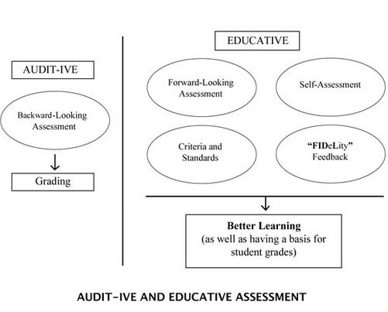
Notes:
An interesting discussion could center on what kinds of assessment they are currently doing, what kind they would like to do, and members of the group could exchange ideas about how they would do each.
Based on Wiggins (1998)
Audit-ive: only function is to audit student learning in order to assign a grade – which is not likely to be relevant for the FLC
e.g., two midterms and a final
backward-looking: exams/assessment looks back on what was covered and determining whether students “got it”
simply recording the results of the learning process
Educative: aims at improving learning→ provides feedback and assessment that will enhance learning.
This kind of assessment can be integrated into the FLC, especially if members of the FLC are trying new approaches in their classes and coming back together to evaluate their experiences. That is the self-assessment aspect of educative assessment

Slide 29
Educative Assessment: FIDeLity Feedback
Feedback should be
Frequent
Immediate
Discriminating
(based on criteria and standards)
Done “lovingly”
(supportively)
performance
feedback
revision
Notes:
Fink
Think about how this could work in your FLC. How could members of the community work together to provide frequent, immediate, discriminating and supportive feedback to one another?

Slide 30
teaching and learning activities
Focus on pedagogy
Notes:
This is where other topics you have been exposed to today might fit into a learning community that addresses course design.

Slide 31
Integrated Course Design
Learning
Outcomes

Slide 32
eBook from many USG Libraries
The LATs are activities that might be incorporated into a course design.
Useful for developing learning outcomes and assessments
Extends Fink’s materials with concrete help

Slide 33
Learning Assessment Techniques
Significant Learning Domain | Examples of LATs
Foundational Knowledge | Entry and Exit Tickets; Team Tests
Application Learning | Prediction Guide; Triple Jump (through real world examples)
Integration | Concept Maps; Case Study
Human Dimension | Free Discussion; Ethical Dilemma
Caring Value | Three-Minute Message; Issue Awareness Ad
Learning How to Learn | Student Generated Rubrics; What? So What? Now What? Journal
From Learning Assessment Techniques by Barkley & Major, which details 7 – 10 activities for each significant learning domain.

Slide 34
other topics beyond foundation
Structuring a course strategy for increasing complexity and challenge (i.e., scaffolding the learning experience).
Developing a grading system
Preparing a learner-centered syllabus
Planning an evaluation of the course and of the instructor’s teaching

Slide 35
What you could do with AN FLC FOCUSED ON COURSE DESIGN
Work with group to design courses
Take all the pieces of this day and incorporate into an FLC on course design
Just about anything you want to
…and you could design your own courses – and your FLC -- according to these principles.

