Slide 1
Building a Culture of Philanthropy
RACSA Spring Conference
University of North Georgia
March 22 - 23, 2023
Victor K. Wilson

Slide 2
Culture of Philanthropy
Everyone is a fundraiser
Have the right team
Clear & deliberate priorities
Have a seat at the table
Sometimes, it’s the little things

Slide 3
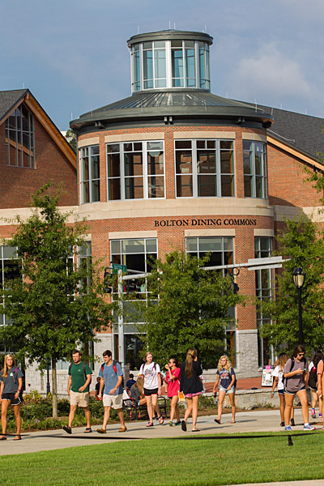
Culture of Philanthropy
Fundraising Advisory Committee
Introduction at all New Hire Meetings
Philanthropy Institute

Slide 4
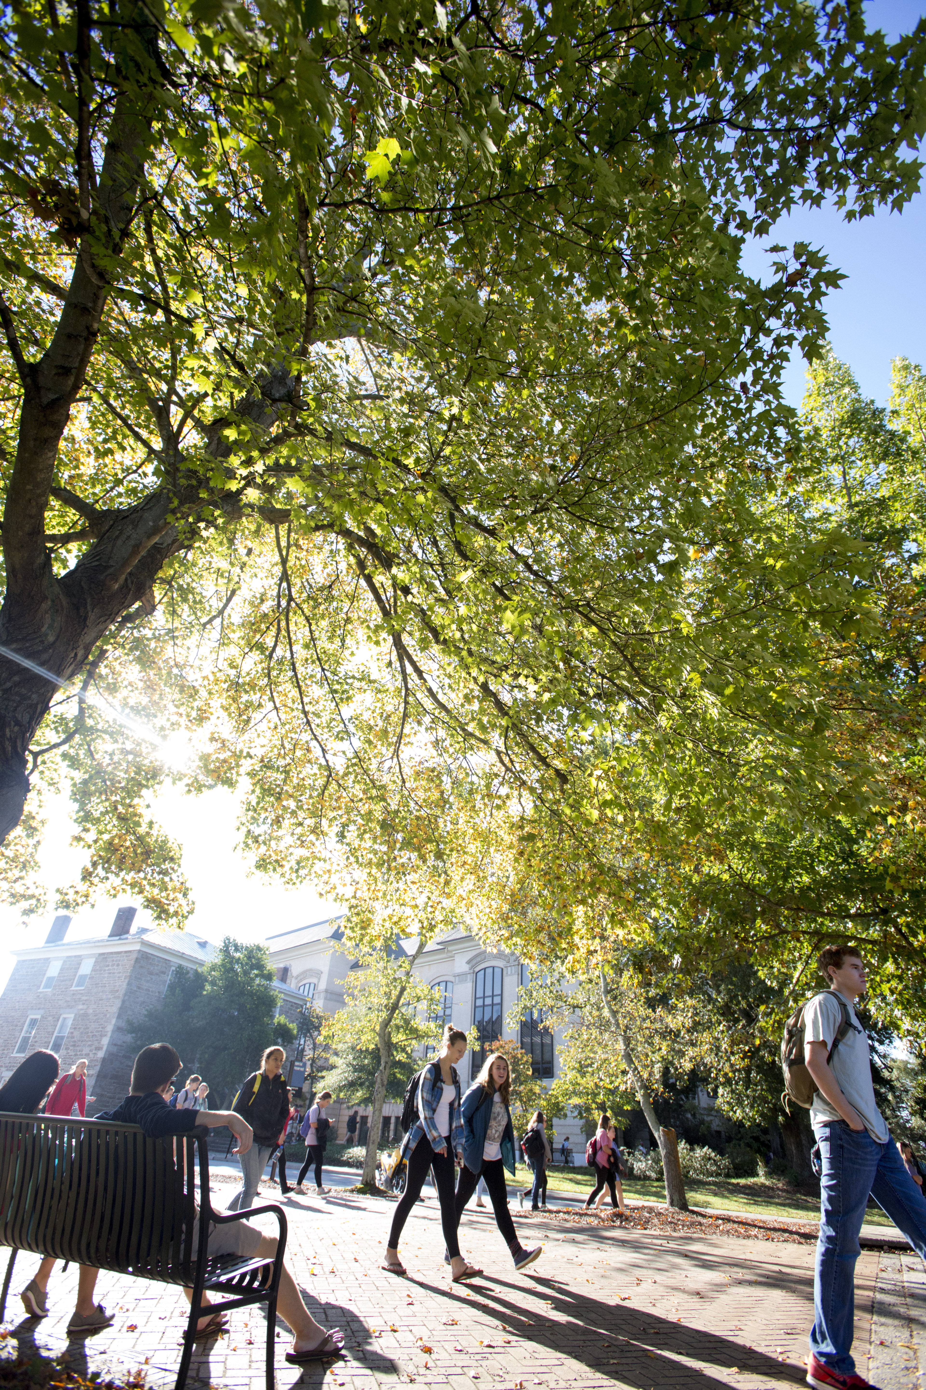
Everyone is a Fundraiser
Just as we are all responsible for diversity, everyone is a fundraiser
Push staff to know and update their fundraising needs

Slide 5
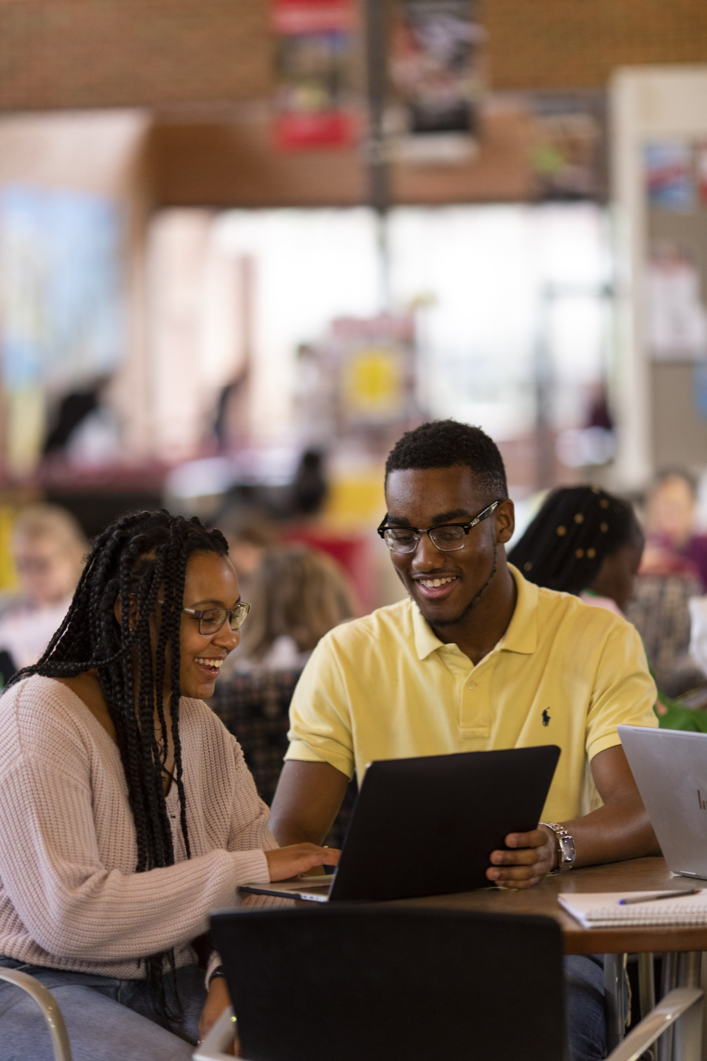
Have the Right Team
Have a team at the top committed and articulate to be the face of the effort
Stretch your time to include more fundraising

Slide 6
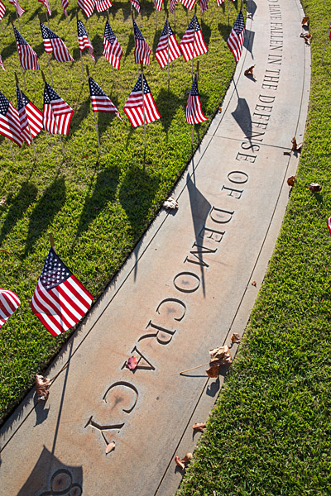
Clear & Deliberate Priorities
Be very clear and deliberate about fundraising priorities.
These are the greatest opportunities to raise the most money.
What are the big ideas that are on the list? Off the list?
Remember the BHAG!
Notes:
Be very clear and very deliberate about what are your fundraising priorities. Those priorities need to be the greatest opportunities to raise the most amount of money. What are the big ideas? Eradicate student hunger, eliminate student homelessness, support our student veterans.

Slide 7
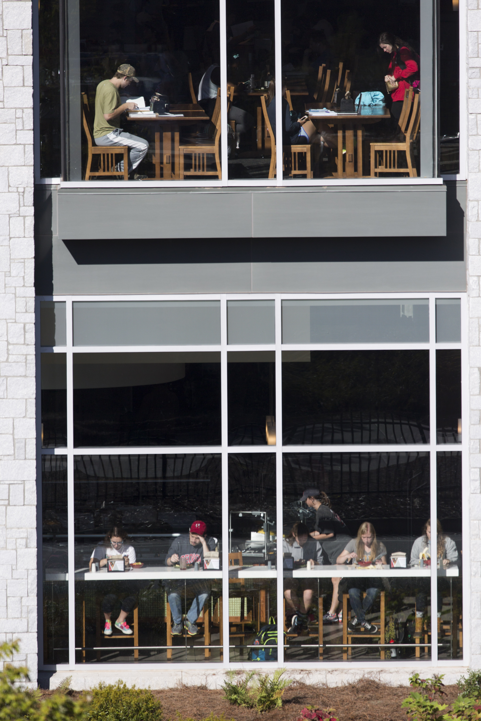
Have a Seat at the Table
Shout from the rooftops!
Trustees
Parents
Boards
Daily collaboration
Equipping and working with Development staff
Create others on campus to “tell your story”
Notes:
Shouting from the rooftops to get a seat at the table to talk about the transformational opportunities of your priorities with Student Affairs.
Get in front of parents, trustees, boards
Daily collaboration with campus colleagues
Equipping and working with student affairs colleagues

Slide 8
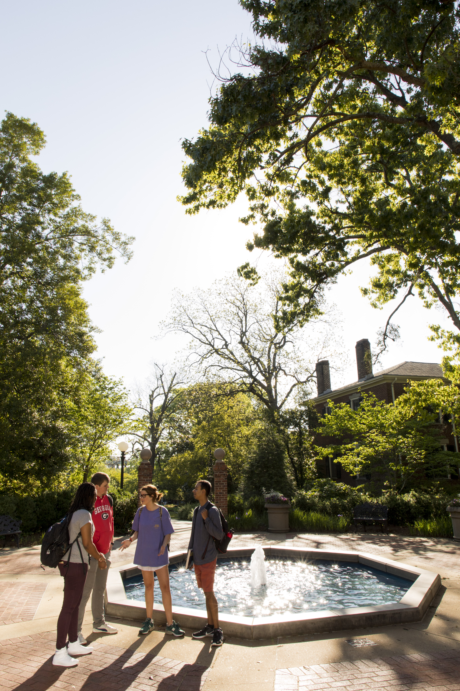
Sometimes, it’s the little things
Stewardship!
Say thanks often and in different ways
Acknowledge birthdays and other life events
Move from a transactional relationship. Donors give to help students, so always share the impact of giving.
Notes:
Stewardship!
Say thank you often and in different ways
Acknowledge birthdays and other life events
This can be a transaction relationship but we have to realize that they are giving to impact students

Slide 9
Questions & Discussion

