Slide 1
International Student and Scholar Regulatory Update 2017
USG Summer Symposium
July 25th, 2017

Slide 2
Presenters
Linnea Tighe, International Student Advisor, UGA
Ashley Johnson, Assistant Director, UGA
Robin Catmur, Director, Immigration Services, UGA

Slide 3
Agenda
General comments about the regulatory climate / Congressional actions
Updates:
F-1 regulatory
J-1 regulatory
SEVP
Travel (CBP and DoS)
USCIS
H-1B / DoL
Questions?

Slide 4
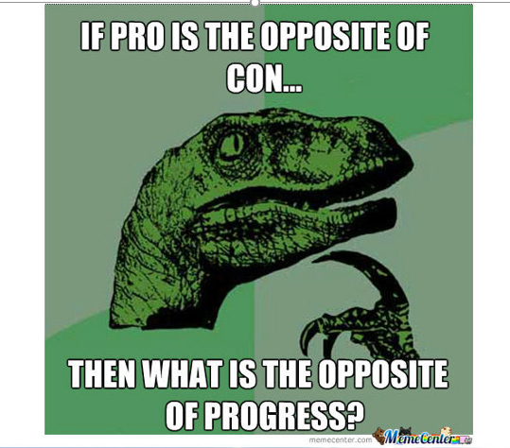
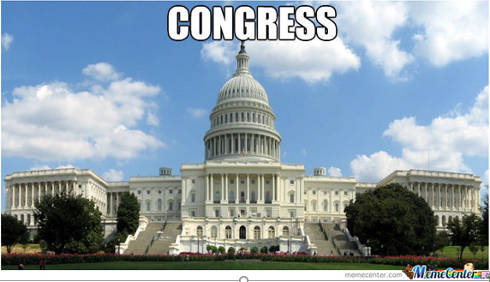

Slide 5
General Context
New Administration
May 23rd 2017 – Congressional statement – Rep. Gerald Connolly (D-VA) welcoming international students:
http://www.nafsa.org/2017/05/25/members_of_congress_welcome_international_students_and_scholars/
Executive Orders
Buy American, Hire American (4/18/2017)
Includes provisions to “protect American workers”; possible changes to H-1B program
Protecting the Nation (aka Travel Ban) (3/6/2017)
Revised from January 2017
Among other things restricts visa issuance and travel to the U.S. for citizens of Iran, Libya, Somalia, Syria, Sudan, and Yemen
Stayed by court actions, and them partially re-imposed due to Supreme Court decision on 6/29/2017
Border Security and Immigration Enforcement (1/25/2017)

Slide 6
General context (continued)
DHS – Agency draft proposal (7/13/2017)
-Increased scrutiny for international students
-Not immediate – could take 18 months to implement
-Schools would need to “vouch” for students
-SEVP fee may be imposed on an annual basis
-Programs of study may have a definitive end date (no more D/S ?)
See: https://www.washingtonpost.com/local/overseas-students-would-face-close-scrutiny-under-proposal-floated-at-dhs/2017/07/10/393b5cc0-6282-11e7-a4f7-af34fc1d9d39_story.html?tid=ss_fb-amp&utm_term=.ded5b8a2f497
Draft Legislation
Merit based reform of legal immigration
Bill giving states legal authority to do their own immigration has been introduced
Immigrant visa backlogs persisting and getting worse
Enrollment trends – generally down

Slide 7
F-1 Students
Correcting Errors on EAD
Starting April 17, 2017
Potomac Service Center
Due to USCIS errors
Return original card with explanation to:
Potomac Service Center
USCIS
2200 Potomac Center Dr. Stop 2425
Arlington VA

Slide 8
F-1 Students (Continued)
Bridge Applications During Change of Status to F-1
Student must file a separate “bridge” I-539 application
Status cannot expire any later than 30 days before F-1 start date
Includes deferring start dates while COS is pending

Slide 9
F-1 Students (Continued)
Fees affecting F-1 Students
Updates to be aware of:
I-539 Application to Extend/Change Nonimmigrant Status
Previously: $290 Now: $ 370 28%
I-765 Application for Employment Authorization
Previously: $380 Now: $ 410 8%

Slide 10
J-1 Exchange Visitors
Bureau of Educational and Cultural Affairs budget cut only 5%
Proposed Budget Cut: 55%
Notes:
Start off with some GOOD-ISH news! The proposed 55% cut to the Department of State’s Bureau of Educational and Cultural affairs was not upheld………the cut in actuality is only 5%.

Slide 11
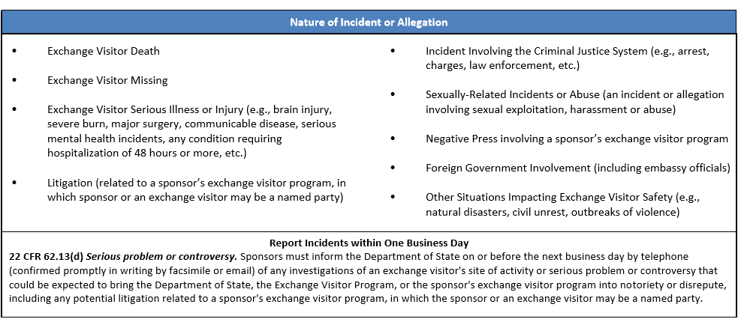
J-1 Exchange Visitors (Continued)
Updated: J-1 incident reporting structure to OPA-AG (Office of Private Sector Admin)
Notes:
List is not exhaustive- there may be other serious situations, not listed below that have or could endanger the health, safety, or welfare of an exchange visitor or otherwise could be expected to bring the Department of State, the Exchange Visitor Program, or the sponsor’s exchange visitor program into notoriety or disrepute.

Slide 12
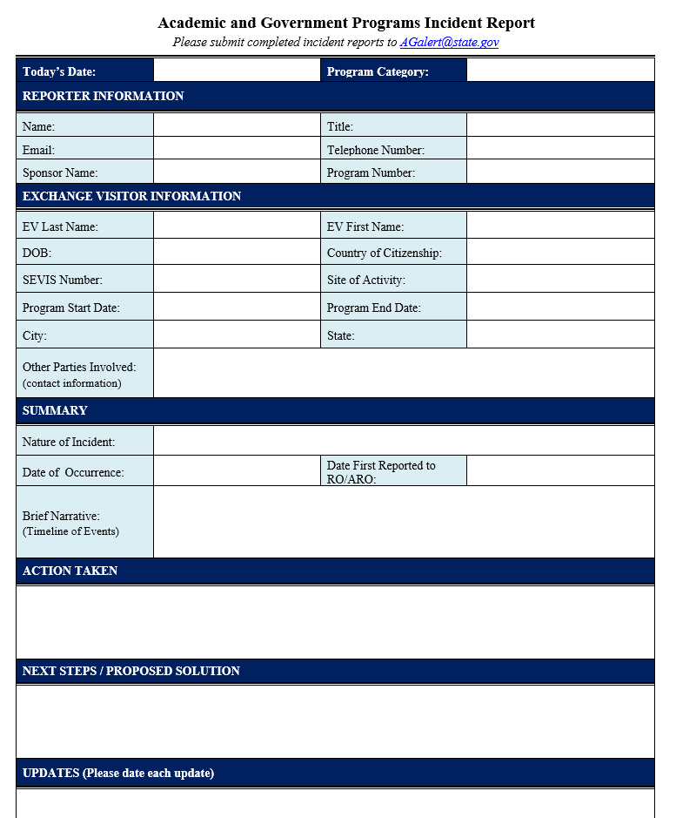
J-1 Exchange Visitors
Reporter Information
Exchange Visitor Information
Summary of Event(s)
Action Taken
Next Steps/Proposed Solution
Updates
MUST REPORT WITHIN 1 DAY OF EVENT

Slide 13
J-1 Exchange Visitors
The Conrad 30 Waiver program allows J-1 medical doctors to apply for a waiver for the 2-year residency requirement upon the completion of the J-1 exchange visitor program
Though the waiver is usually extended by Congress, they have failed to do so
Conrad waivers can still be received for J visitors admitted before 12/9/2016

Slide 14
USCIS
Updated fees as of December 16th, 2016:
https://www.uscis.gov/forms/our-fees
I-765 - $410.; I-129 - $460.; I-539 - $370.
USCIS SCOPS is working to improve the accuracy of posted processing times. (don’t hold your breath)
Premium processing for H-1B cases under suspension Since April 2017. Will be gradually rolled back in over the next two months
Revised I-9 issued 7/17/2017– mandatory after09/18/2017

Slide 15
SEVP
New Director, Rachel Canty
MAVNI program currently under suspension for FY 2017

Slide 16
Travel - DoS
3% decrease in visa apps this year (may in part be due to changing Chinese visa lengths to longer durations)
DoS cable on implementing revised implementation of travel order (6/29/2017)
F-1 students, new and continuing, from the affected countries, should be admissible
Suspension of visa interview waiver program – should NOT affect most of our students renewing a visa in the same category
New social media vetting questions

Slide 17
Travel – DoS (continued)
New social media vetting questions
DS-5535, Supplemental Questions for Visa Applicants. The form asks for the following information:
Countries traveled to in the last 15 years, locations visited, dates visited, source of funds, length of stay
All passports issued
Names and date of birth for siblings, children, and relatives
Last 15 years of residential addresses
Last 5 years of phone numbers and email addresses
Social media platforms used and name/handle
Last 15 years of employer information

Slide 18
Travel - CBP
Electronic I-94: https://i94.cbp.dhs.gov
Biometric exit system coming over the next year
Laptop ban in airplane cabins on flights from some middle eastern countries (Queen Alia (AMM), Cairo (CAI), Ataturk (IST), King Abdul-Aziz (JED), King Khalid (RUH), Kuwait (KWI), Mohammed V (CMN), Hamad (DOH), Dubai (DXB), and Abu Dhabi (AUH))
https://www.dhs.gov/news/2017/03/21/fact-sheet-aviation-security-enhancements-select-last-point-departure-airports
Senate Judiciary – Sub-committee on Border and Immigration (7/12/2017)
https://www.dhs.gov/news/2017/07/12/written-testimony-plcy-cbp-and-ice-senate-judiciary-subcommittee-border-and
Included a statement regarding F-1 overstays – 5.48% (79,874)

