Slide 1
GeorgiaFIRST Financials
September 29, 2022
Payment Request, B Business Unit

Slide 2
Agenda
Introduction
Who Can Implement?
Security Requirements for “B” Payment Requests
Approval Workflow and Security Roles
UAT Testing
Logging into Smartsheet
Notes:
Presenter: Asheley

Slide 3
Introduction
With the move to the SHARE Supplier Setid, Institutions submitted a change request requesting Payment Request functionality in the “B” Business Unit.
Functionality will be available, following application of REL 5.80, Nov 4-7, 2022.
Notes:
Presenter: Asheley

Slide 4
Who Can Implement?
Institutions must already be using Payment Requests in the main Business Unit in order to implement Payment Requests in the “B” Business Unit as part of Release 5.80.
If your institution is not currently using Payment Request functionality and is interested in implementing this functionality, please submit a ticket to the ITS Helpdesk to discuss the implementation process.
Notes:
Presenter: Asheley

Slide 5
Who Can Implement?
If your institution would like to ‘Go Live’ with Payment Request in the “B” Business Unit as part of Release 5.80:
Completion of UAT testing for the “B” Business Unit is required
Upon successful completion of the UAT scenarios, please submit a ticket to the ITS Helpdesk to let us know you would like to turn on the functionality
Notes:
Presenter: Asheley

Slide 6
Security Requirements for “B” Payment Requests
Payment Requesters must have the BOR_BU_XXXXB Primary Permission List assigned to their user profile in order to create payment requests for “B” SetID Suppliers.
Payment Requesters should be trained to pay close attention to which Business Unit they select when entering a Payment Request, as they will have the option to select both the main Business Unit and the “B” Business Unit.
Notes:
Presenter: Asheley

Slide 7
Approval Workflow and Security Roles
Approval Workflow and Security Roles are the same for the “B” Business Unit Payment Requests as they are for the main Business Unit.
No change to approvers or security roles are required.
Approval steps enabled can be different between the “B” Business Unit and the main Business Unit.
Notes:
Presenter: Asheley

Slide 8
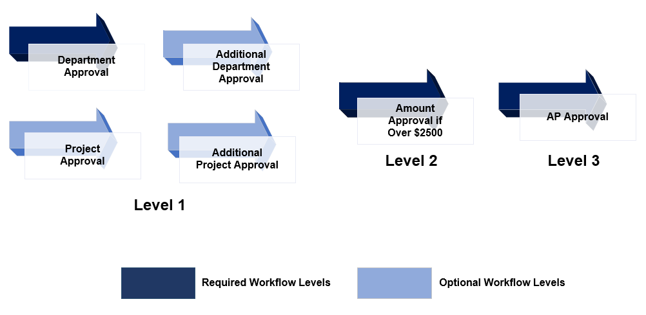
Payment Request Workflow
Notes:
Presenter: Asheley

Slide 9
Payment Request Security Roles
BOR_PAYMENT_REQUEST: Payment Requester creates and submits Payment Requests
BOR_PAYMENT_REQ_APPR: Department Approver, Additional Department Approver, Project Approver, Additional Project Approver, and Ad Hoc Approver role required for approval access
BOR_PAYMENT_REQ_AMOUNT_APPR: Special Approver for Amounts over $2,500.00
BOR_PAYMENT_REQ_AP_APPR: AP Approver (final workflow Approver)
BOR_PR_ADMINxx: Payment Request Administrator
Notes:
Presenter: Asheley

Slide 10
UAT Testing
Testing Scenarios Overview:
Payment requesters are able to create and submit Payment Requests for the “B” Business Unit.
Payment Requests route for approval, as expected, based upon institutional configuration and chartfields specified on the payment request.
Payment Request Approvers are able to successfully approve and deny payment requests created for the “B” Business Unit.
Accounts Payable team is able to run Voucher Build for approved “B” Business Unit payment requests and confirms vouchers are created as expected.
Notes:
Presenter: Asheley

Slide 11
UAT Testing
Testing Environment: FTEST2 – https://core.ftest2.gafirst.usg.edu
Test scripts in Smartsheet via the Payment Release 5.80 Dashboard
Log any defects in the Payment Request B Business Unit Defect Log via the Smartsheet dashboard
Notes:
Presenter: Asheley

Slide 12
UAT Testing
Please finish testing as soon as possible
No later than 5pm on Friday, October 7, 2022
Following satisfactory testing in FTEST2, if your institution would like to implement Payment Request functionality for the “B” Business Unit as part of REL 5.80, please submit an ITS Helpdesk ticket to request this functionality: helpdesk@usg.edu
Notes:
Presenter: Asheley

Slide 13
Logging into Smartsheet
Demo – Logging Into Smartsheet
Notes:
Presenter: Asheley

Slide 14
Logging into Smartsheet
Questions?
Notes:
Presenter: Asheley

Slide 15
37 days
22 days
8 days
32 days
32 days
Notes:
Presenter: Wanda

