Slide 1
The GeorgiaFirst Marketplace: The final piece of the eProcurement puzzle
Friday, September 30th
8:30 to 9:20
Room: Estes A

Slide 2
Agenda
What is the GeorgiaFirst Marketplace?
Current Status of the Marketplace
View From the Front Lines
(Donna Bertrand -Kennesaw State University)
Where Do We Go From Here?

Slide 3
What is the GeorgiaFirst Marketplace?
PeopleSoft ePro
SciQuest – Supplier of the hosted application
Integration / XML between ePro and SciQuest
State Contracts, Items and Pricing
Other Approved Contracts (E&I, Agency etc.)
Institution Specific Configurations for Some Suppliers (i.e. Dell)

Slide 4
Current Status of the Marketplace
Currently LIVE at:
Georgia Perimeter College
Kennesaw State University
Valdosta State University
University of West Georgia
Georgia Gwinnett College
Augusta State Univeristy
Georgia Southern University
Georgia Highlands College

Slide 5
Current Status of the Marketplace
8 GeorgiaFirst Institutions Live
250 POs in September
60 Suppliers
166 Contracts
Hundreds of Thousands of Items on Contract
SciQuest also used by the State, UGA, GA Tech and GHSU

Slide 6
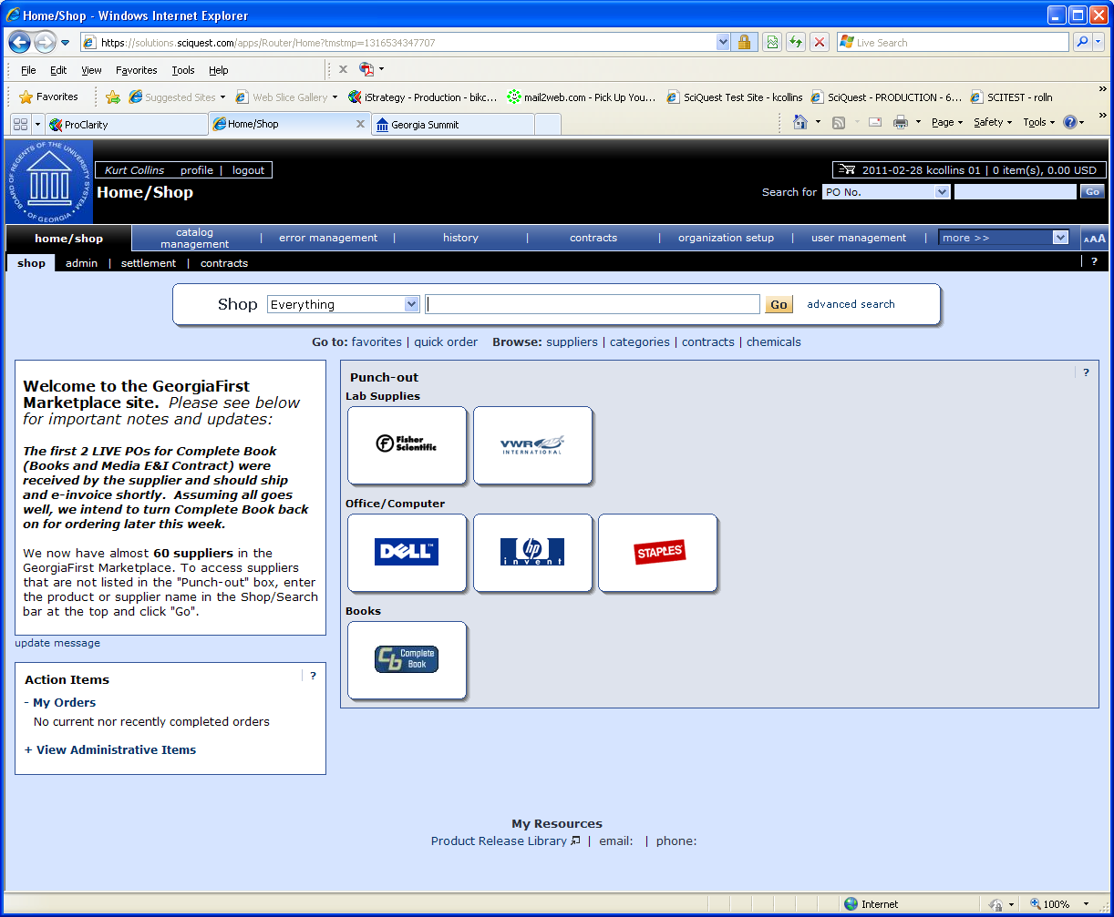
Current Status of the Marketplace
DEMO
Notes:
Contracts – Contract Page, View Dashboard, Search on Tires, Select Goodyear, Edit Details, Click on Pricing
Shopping / Searching – Shop Page, Basic Search on XXXX, Advanced Search ….. Add to Cart, prepare for check out.
Dell Punch-Out
Complete Book Punch-Out

Slide 7
View From the Front Lines Donna Bertrand, KSU
Expected Efficiencies
Less duplication of effort
Better budget management
Less paper, with greater transparency in the approval process
Available spend data for strategic sourcing

Slide 8
View From the Front Lines Donna Bertrand, KSU
Challenges and Opportunities
Change management
Communications
Training
Workflow
Potential for process improvements in Procurement and Account Payable departments
Multiple layers of approvals

Slide 9
View From the Front Lines Donna Bertrand, KSU
Where is KSU Today?
Over 50% of users trained
Approximately 43% of procurement transactions flowing through ePro and the GeorgiaFirst Marketplace
Acceptance by campus
Full rollout planned by December

Slide 10
Where Do We Go From Here?
Rollout Guide in Presentation Format
25 slides, 1 step per slide
Live Training Sessions in Athens
Requester Tuesday, Oct 18th, Buyer Wed, Oct 19th.
Approximately 1 session per month
On-line Documentation and Training Sessions:
http://www.usg.edu/gafirst-fin/training/epro_georgiafirst_marketplace/
Contact Debra.Lasher@usg.edu to get started!

Slide 11
Thank you!
Please send comments or questions to:
Vikki.Williamson@usg.edu Debra.Lasher@usg.edu
April.Harder@usg.edu Kurt.Collins@usg.edu

