Slide 1
PeopleSoft Financials Maintenance - Staying Current in an Ever Changing World
Debora Exum
Information Technology Services
University System of Georgia

Slide 2
Agenda
Why is it important to stay current?
The PeopleSoft Release process
The GeorgiaFIRST Release process
The Release Schedule
An Example

Slide 3
Why Staying Current is Important
Full Vendor Support
Best of Features and Fixes
Ability to focus on opportunities beyond production support

Slide 4
Agenda
Why is it important to stay current?
The PeopleSoft Release process
The GeorgiaFIRST Release process
The Release Schedule
An Example

Slide 5
PeopleSoft Financials Releases
Include both bug fixes and new features
Cumulative
Available every six to eight weeks
Identified by number (i.e. PI13)
Naming conventions
PUM – PeopleSoft Update Manager
PI – PeopleSoft Update Image

Slide 6
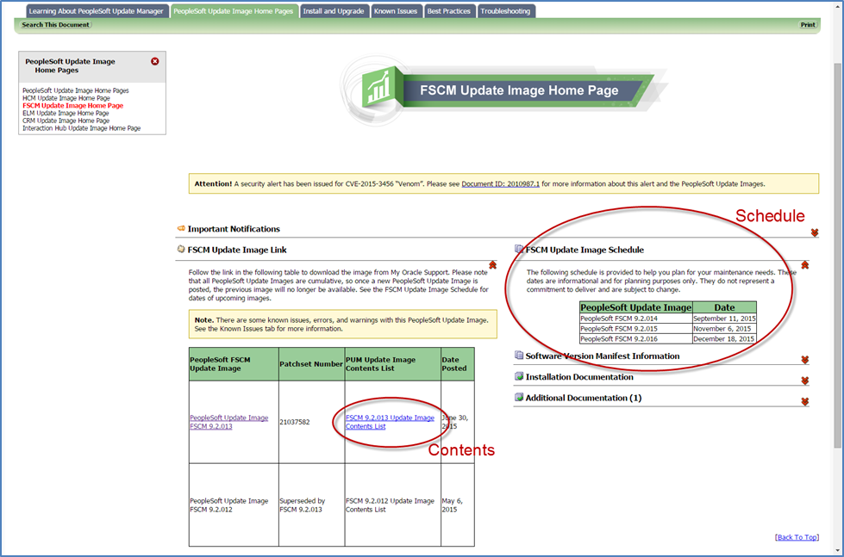
Update Image Home Page

Slide 7
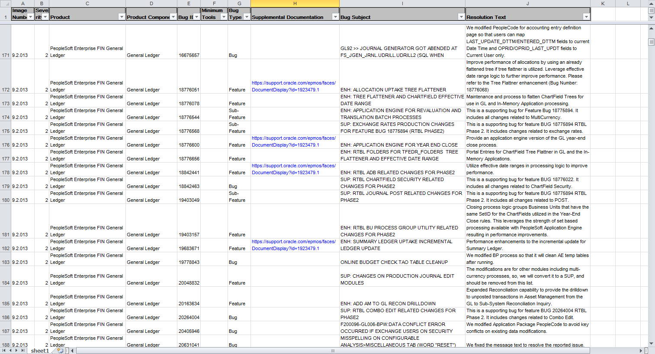
Image Contents List

Slide 8
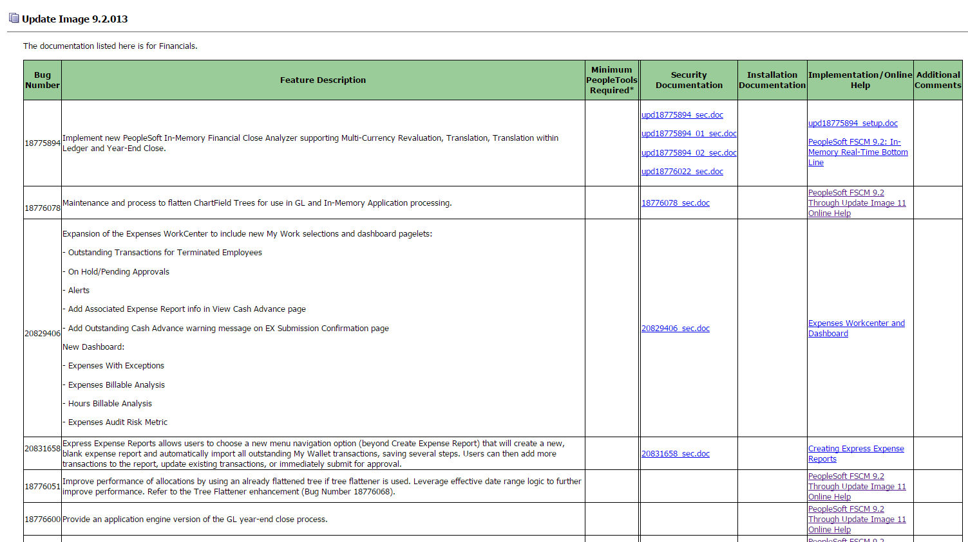
Supplemental Documentation

Slide 9
Trivia
Which of the following numbers is closest to the number of items in the Image Contents List for PI 13?
500
1000
8000
20,000

Slide 10
Trivia
Which of the following numbers is closest to the number of items on the Image Contents List for PI 13?
500
1000
8000 8003 to be exact
20,000

Slide 11
Agenda
Why is it important to stay current?
The PeopleSoft Release process
The GeorgiaFIRST Release process
The Release Schedule
An Example

Slide 12
GeorgiaFIRST Release Process
Release Timing
Goal is to have quarterly releases
With the recent major upgrade to 9.2, the releases have been more frequent
Release Content
Typically, each release focuses on updating our mods
Annually, the focus is on updates from PeopleSoft
In rare and unique situations, a release is a combination of mods and vendor updates

Slide 13
Agenda
Why is it important to stay current?
The PeopleSoft Release process
The GeorgiaFIRST Release process
The Release Schedule
An Example

Slide 14
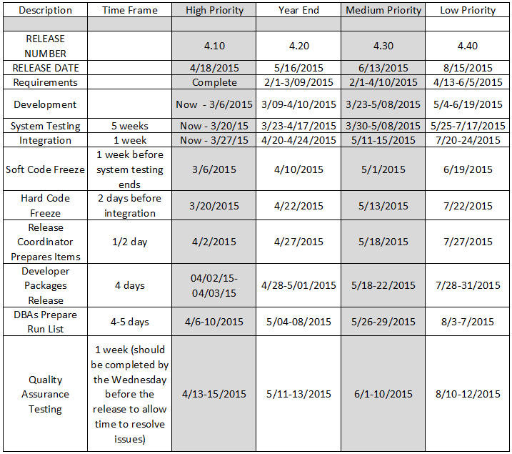
GeorgiaFIRST Release Scheduling

Slide 15
GeorgiaFIRST Next Release
Scheduled for 11/14/2015
In System Testing phase now
Annual maintenance plus
 | Now | November
PeopleSoft Update Image (PI) | 7 | 13
PeopleTools | 8.53.13 | 8.54.13
Oracle Database | 11.2.0.4.0 | 12.1.0.2.0

Slide 16
Agenda
Why is it important to stay current?
The PeopleSoft Release process
The GeorgiaFIRST Release process
The Release Schedule
An Example

Slide 17
A Unique Example – Release 4.40
It seems like just another release from the customer perspective
What made it unique
Select vendor updates included for high priority fixes
Cascading impact – each singular update is associated with both pre-requisite and post-requisite updates.
Four updates for Purchasing yielded 35 additional updates
Two updates for Expenses yielded 110 additional updates
More updates means greater impact on mods
More updates means more testing
Important to consider priority and value of adding select vendor updates to a release

Slide 18
The Importance of Staying Current
Full vendor support
Fewer DBIs
Reduced resource constraints
No more major upgrades
More opportunity to add new features
Improved quality

Slide 19
??Questions??
Debora.Exum@usg.edu
706-583-2120

