Slide 1
Other Duties As Assigned: ePro Tips and Tricks
Presented by
Addie Edwards ~ Georgia Southern University
Christy Bohannon ~ Kennesaw State University

Slide 2
Got Questions?
What’s the status of my GFM order?
The Supplier said they never received my PO!
How do I know if this item is on a contract?
What’s my PO number?
I know I marked this as ‘received’. Didn’t I?
The Supplier called wanting to know about payment…

Slide 3

ePro has Answers!
Not only is ePro the paperless system,
it’s self-service on demand!
You just have to know where to look…

Slide 4
GeorgiaFIRST Marketplace
GFM isn’t just a place to get contract pricing on items or to shop, it can also be used as a valuable resource.
View/Research Statewide Contracts
Confirm if a purchase order was dispatched and also ensure that the Supplier received it
Look into the status of the invoice / payment for an order

Slide 5
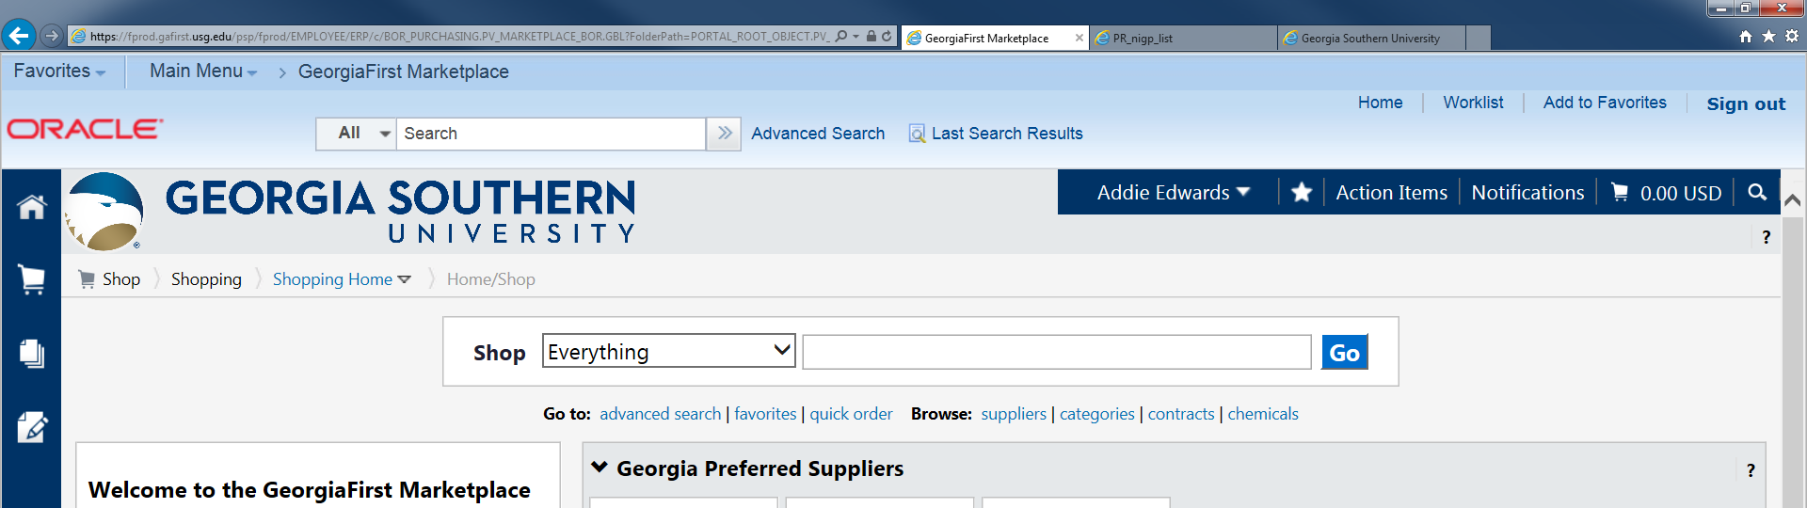
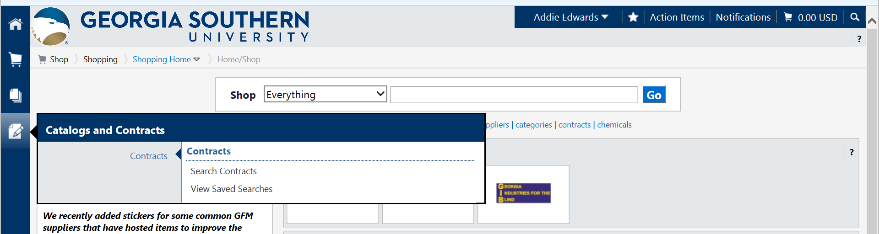
GFM
Let’s start by locating Statewide Contracts:

Slide 6
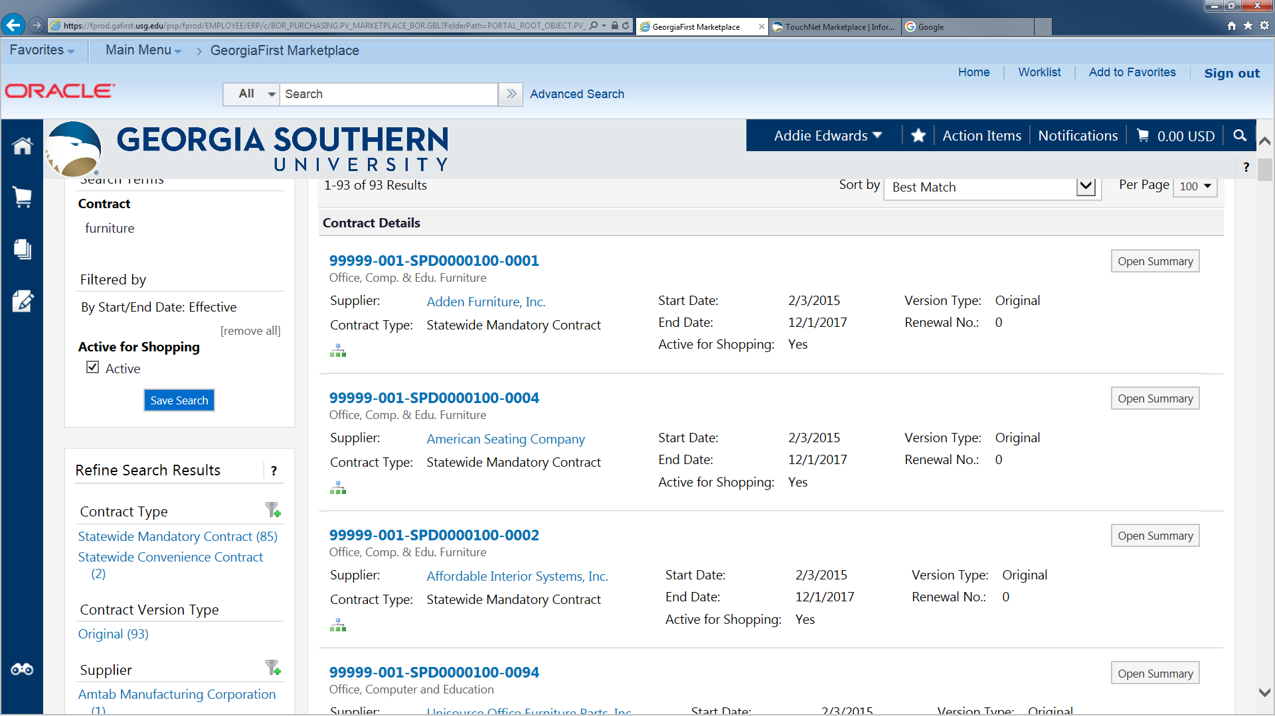
GFM

Slide 7
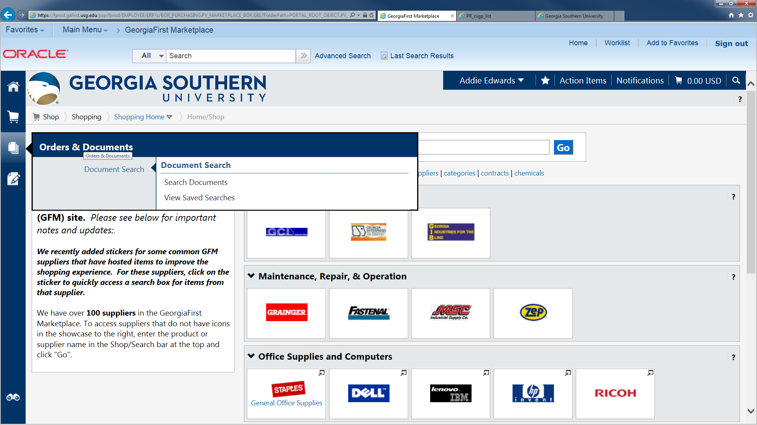
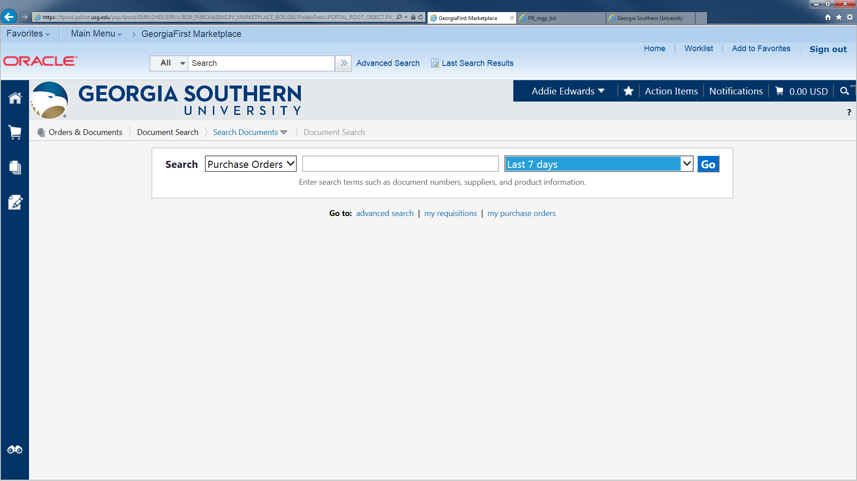
GFM
The Document Search allows you to ensure orders were successfully submitted to the suppliers and much more.

Slide 8
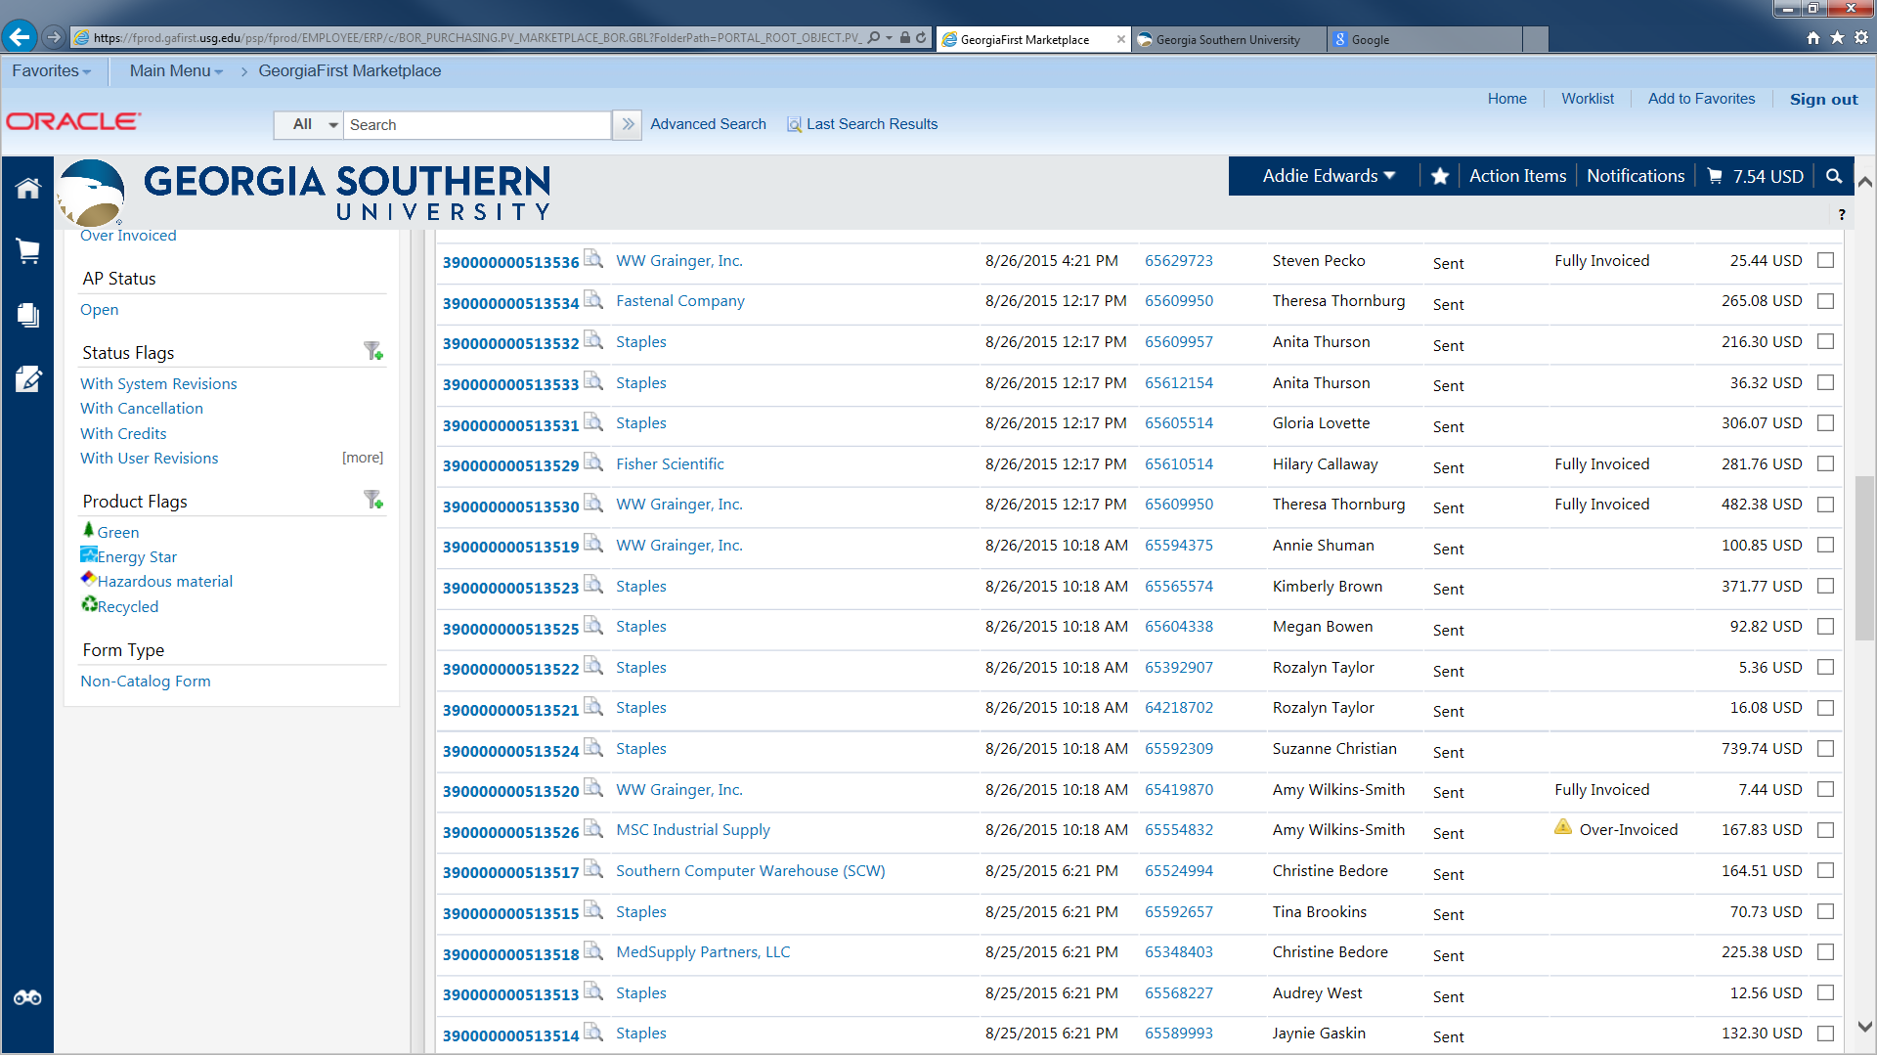
GFM

Slide 9
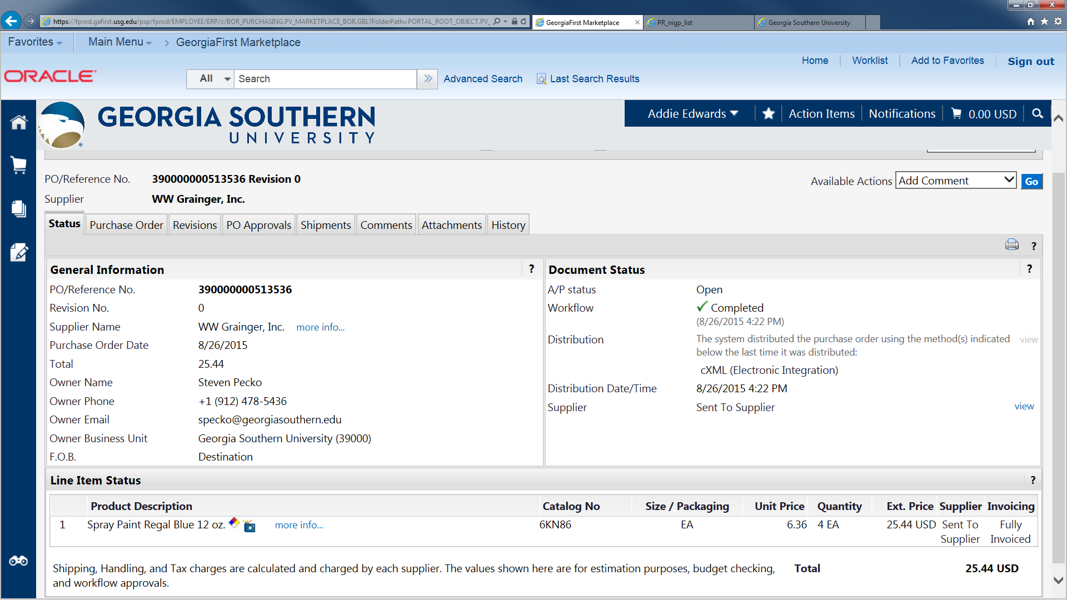
GFM
By selecting one of the tabs displayed, you can view critical information about any GeorgiaFIRST Marketplace order.

Slide 10
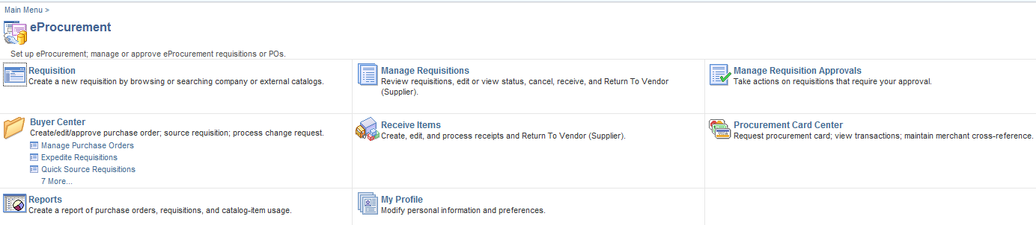
‘Manage Requisitions’
The forgotten assistant…

Slide 11
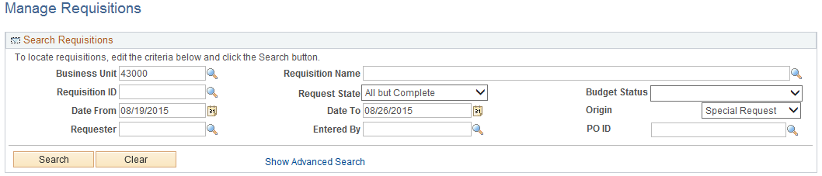
Searching for Information can sometimes be tricky
Often the system default settings can create speedbumps for Users:
‘Request State’ set to “All but Complete”
Range in ‘Date From’ to ‘Date To’ is only a 7-day window
‘Origin’ set to “Special Request”

Slide 12
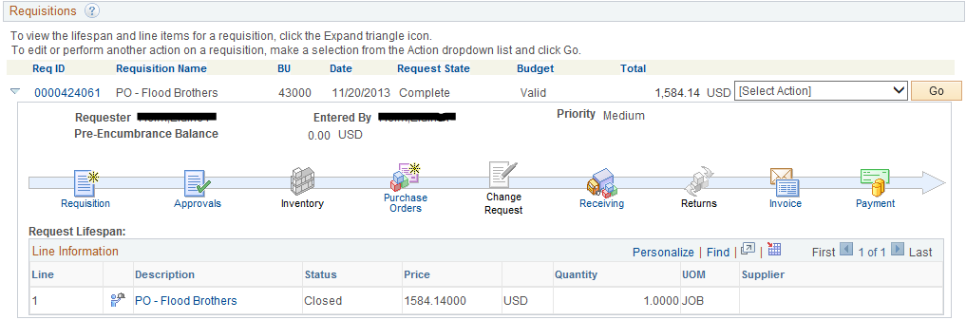
‘Manage Requisitions’
Lifecycle Information

Slide 13
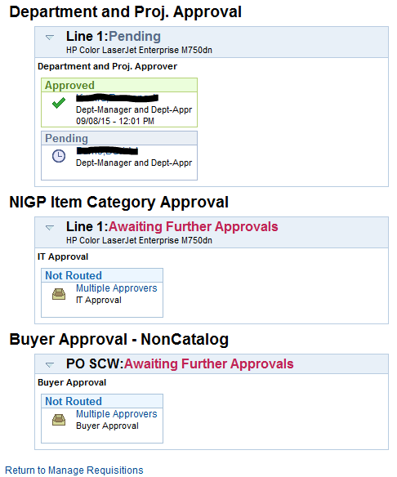
Approvals:

Slide 14
‘Manage Requisitions’
Lifecycle Information

Slide 15
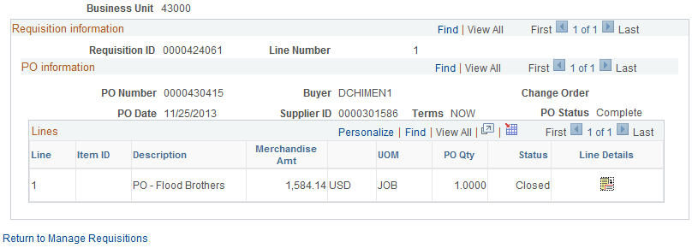
Purchase Orders:

Slide 16
‘Manage Requisitions’
Lifecycle Information

Slide 17
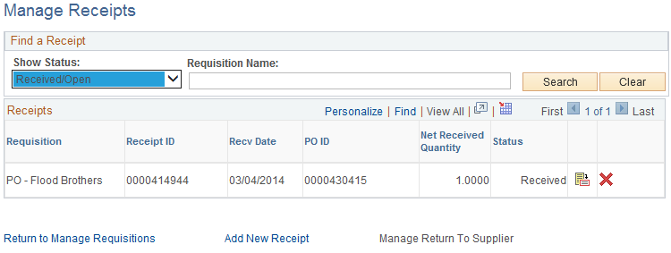
Receiving:

Slide 18
‘Manage Requisitions’
Lifecycle Information

Slide 19
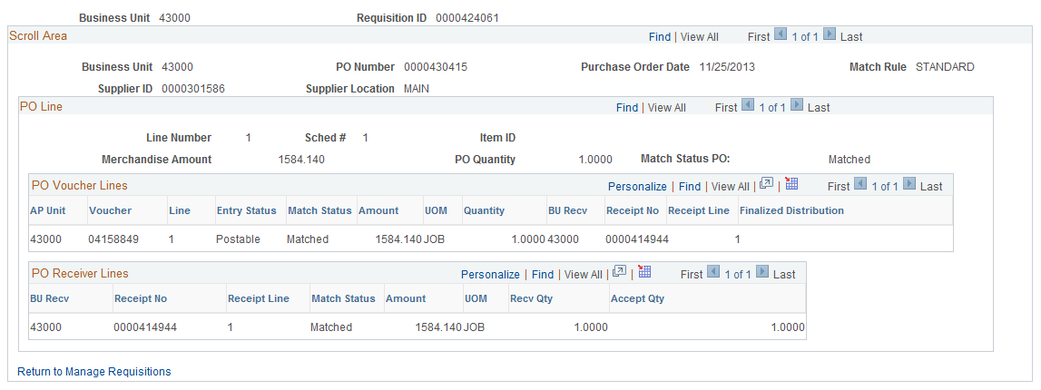
Invoice:

Slide 20
‘Manage Requisitions’
Lifecycle Information

Slide 21
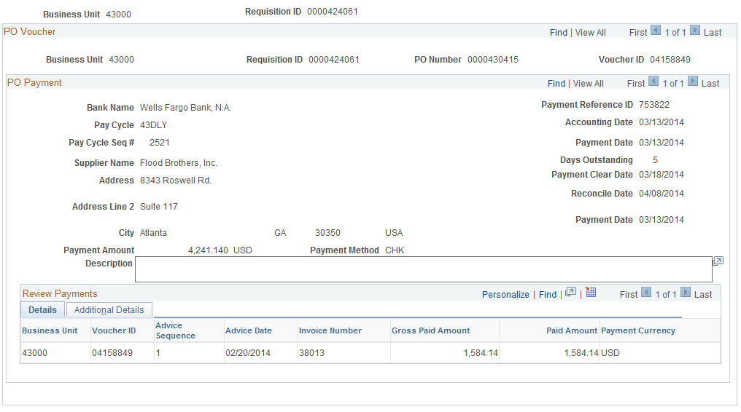
Payment:

Slide 22

You’ll train your Campus like a Pro and
Your Users will be self-sufficient!

Slide 23
Questions?

Slide 24
Thank you!

