Slide 1
Budgeting for Projects
Julie Thompson, ITS

Slide 2
Commitment Control Configuration – 2015 and prior
APPROP
PRMST_EXP
Carries only project id
700000 level
ORG
PROJ_GRT
714000 level
714000 level
714100 level
DETAIL
714100 level
Funds 10000, 10500, 10600, 10900, 12xxx, 13000, 14000, 15000, 16000, 50000
Any transaction with a project id

Slide 3
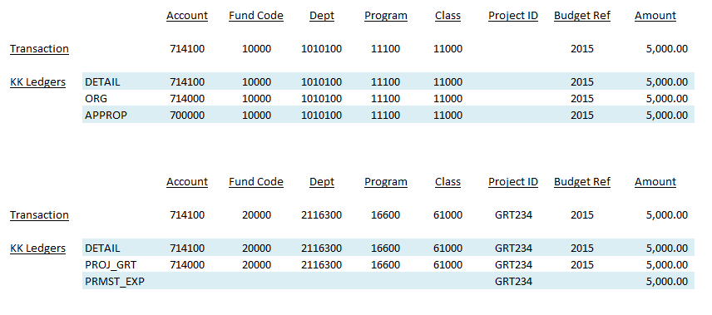
Example Transactions – 2015 and prior

Slide 4
Example Transactions – 2015 and prior
Institutions had to have funds available at the department level in APPROP. Budgets could also be added at PROJ_GRT to control the spending for that particular project.

Slide 5
Commitment Control Configuration – 2016
APPROP
PRMST_EXP
Carries only project id
700000 level
ORG
PROJ_GRT
714000 level
714000 level
714100 level
DETAIL
714100 level
Funds 10000, 10500, 10600, 10900, 12xxx, 13000, 14000, 15000, 16000, 50000
Grants Only – determined by Project/Grant flag in set up pages

Slide 6
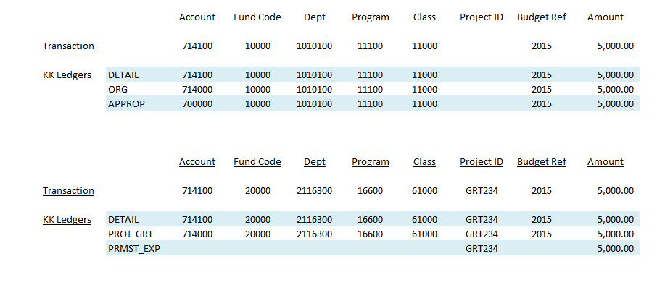
Example Transaction – 2016 and after
No changes here

Slide 7
Example Transaction – 2016 and after
Because APPROP is always set to control, budgets have to be added with a project_id to the APPROP ledger at a minimum. Institutions can add a budget at ORG if desired, but most institutions are tracking without budget at ORG.

Slide 8
How is that working?
Discussion

Slide 9
Options
Leave it the way it is
Option to use Budget Attributes to set to track without budget for specific chartstrings
Put it back the way it was
Remove project_id from APPROP level, leave at ORG
ORG currently set to ‘Track without Budget’ for all institutions, so no control with project_id unless Budget Attributes are used

Slide 10
Options
Add an additional ledger for projects only, similar to the PRMST_EXP ledger to control on project basis
Other options/suggestions?

Slide 11
Next Steps?

