Slide 1
Accounts Payable Lessons Learned, Tips and Tricks
Friday, September 18th
Jason Beitzel

Slide 2
Agenda
Release Items – Lessons Learned
Common Tickets and Resolution
News to Use….Tips and Tricks
What’s Next for AP?
Questions/Feedback
Notes:
Jason

Slide 3
4.10 Release Items
EFT Payment Advice Report (APX2027)
The BOR_AP_DUE query
Enter Bank Statements
Import Bank Statements page
Notes:
Blank for Expense Payments, Updated to add the approval status field, Added security to Enter Bank Statements page, Updated to allow users to view and delete files with a file name extension .TXT (all caps)

Slide 4
4.10 Release Items
EFT Payment Advice Report (APX2027)
The BOR_AP_DUE query
Enter Bank Statements
Import Bank Statements page
Notes:
Blank for Expense Payments, Updated to add the approval status field, Added security to Enter Bank Statements page, Updated to allow users to view and delete files with a file name extension .TXT (all caps)

Slide 5
4.20 Release Items
Payment Options Message
Watermark on the AP check file copies printed as VOID
Open Item secured by SetID
Notes:
Messages were causing check spacing issues, Watermark updated to print FILE COPY,

Slide 6
4.30 Release Items
E-mail advices not including the Institution name.
Positive Pay by pay cycle and sequence number, only the most recent sequence number of the pay cycle was displaying.
The Payment History by Payment report not showing the correct totals when overflow checks were included in the pay cycle.
BOR EFT Formatting page - The search on this page allowed you to leave these fields blank and would return results for all Institutions.
Notes:
RST001 – shared pay cycles, Updated the Search Edit checkbox to now require entry of the Institution’s SetID.

Slide 7
4.40 Release Items
Positive Pay format 8 (Wells Fargo) was producing files in a .txt format
Updated the BOR_AP_STAGED_INVOICES query
For consolidated Institutions, bank recon query results were being doubled.
The TIGA Vendor Obligation report (BORIF037A) unique constraint
New query BOR_AP_BUD_REF_Review
Notes:
Institution’s having to manually manipulate their file to meet bank file requirements, Query not returning results for any AP Business Unit utilizing the SHARE vendor file, BOR_BR_AP_EX_OSCK and BOR_BR_AP_OSCK_ASOFDATE,
unique constraint error due to new commitment control CLOSED_VALUE field, Will return all non-PO voucher lines where the budget reference is not equal to the fiscal year of the voucher and also return any PO voucher line where the budget reference is different from the corresponding line on the Purchase Order.

Slide 8
Highest Volume of Tickets by Category
Pay cycle
Configuration questions
TIGA
ACH/EFT
Voucher
Positive Pay

Slide 9
Pay Cycle
Pay cycle produced only file copy and no check.
Typically this happens if a user kicks off the print checks process and then kicks off print file copy process before the print checks process runs to SUCCESS. Be sure to check the process monitor before kicking off the print file copy process.
These processes share the same application engine – AP_APY2015.

Slide 10
Pay Cycle

Slide 11
Pay Cycle
Payment Selection is not picking up a payment. The payment is in the BOR_AP_DUE query. Why isn’t it being picked up?
The majority of the time this has to do with withholding on the voucher. A quick way to see if there are any withholding issues on your pay cycle is to click on the withholding link on the Pay Cycle Manager.
Other common reasons include payment selection criteria, Entry Status, Closed Status, Approval status, Pay Group, and Due Date.

Slide 12
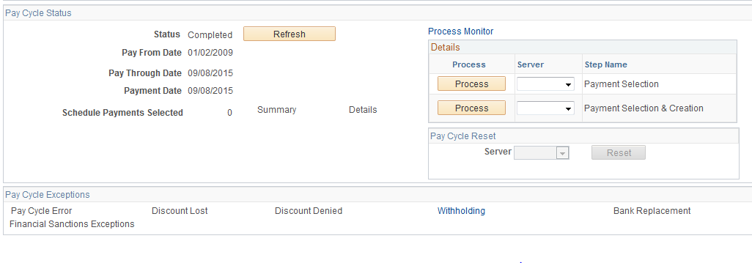
Withholding

Slide 13
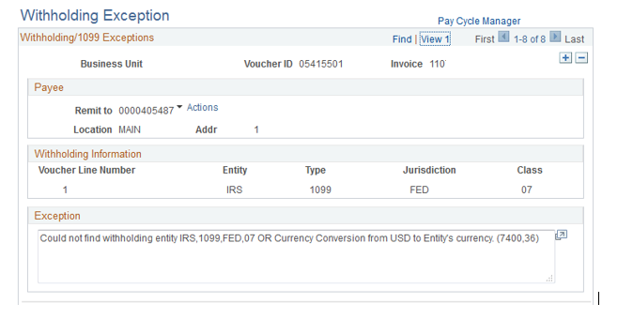
Withholding Message

Slide 14
Configuration
Is there a way to look at the email sent history for our ACH/EFT payments?
Yes, the Process Name is AP_EMAIL_ADV. You can look this process up in the process monitor and it will display the email address that each voucher was sent to.

Slide 15
Configuration
Tip – You can also set up your own e-mail address along with the suppliers e-mail on the supplier’s e-mail.

Slide 16
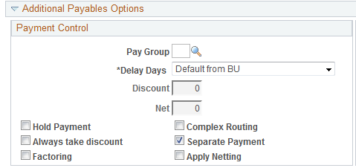
Configuration
I would like all payments to supplier xxx to separate payment by default. What is the best way to do this?
This can be done at the Payables Option for the supplier.

Slide 17
TIGA
I have a journal that was generated from AP that has the wrong open item key. How do I correct this? The fiscal year has been closed.
For TIGA purposes, you can correct open item keys using open item maintenance. The navigation is General Ledger > Open Items > Maintenance
Notes:
Note – this will not actually update the journal. Will only update the TIGA report.

Slide 18
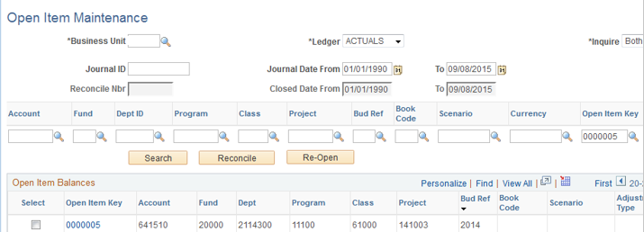
TIGA

Slide 19
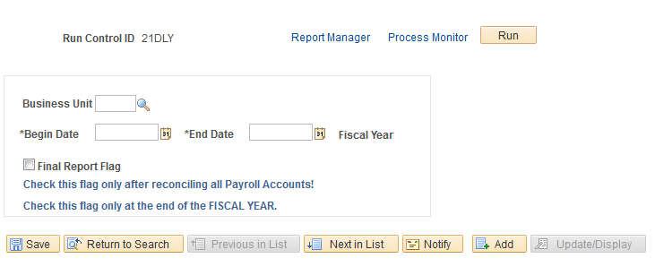
TIGA
ITS is also researching whether we want to allow edits after the final report flag is selected.
Notes:
Users can change lines on the site manually after submitting their file now.

Slide 20
ACH/EFT
A couple of Institutions have recently put in tickets due to their bank not accepting our CTX file. This is due to the entry hash totals being incorrect.
This issue is not happening for all banks.
CTX format should be used if you are paying multiple vouchers (addenda records) for the same supplier in one payment. CCD+ is not designed to accommodate that functionality.
Oracle’s delivered CTX file is not NACHA compliant. We are working with Oracle to fix this problem.

Slide 21
ACH/EFT
I noticed in my ACH file that I have a prenote line where the bank account information is missing. Why?
This is due to the remit address not pointed to the correct location.

Slide 22
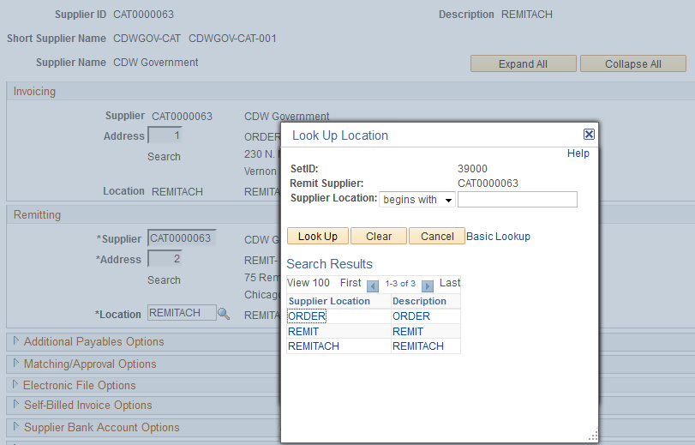
ACH/EFT

Slide 23
Voucher
I closed a PO voucher but the encumbrance didn’t restore back to the PO. Can you help me understand why?
The query below may help. If KK_PROCESS_PRIOR = Y then the encumbrance was selected to be restored to the PO.
SELECT BUSINESS_UNIT, VOUCHER_ID, VOUCHER_LINE_NUM, DISTRIB_LINE_NUM, KK_PROCESS_PRIOR FROM PS_VCHR_ACCTG_LINE WHERE BUSINESS_UNIT = 'XXXXX’ AND VOUCHER_ID = '053XXXXX’ AND APPL_JRNL_ID = 'CLOSURE’

Slide 24
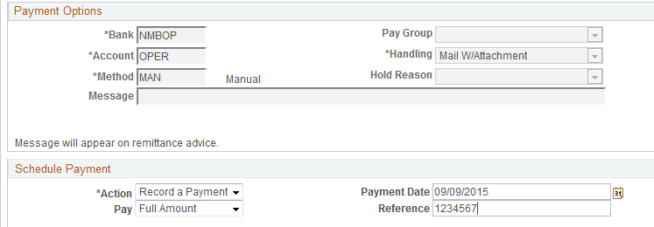
Voucher
How do I record a wire payment on a voucher?

Slide 25
Positive Pay
Positive pay didn’t pick up my checks created today. Can you help me figure out why?
When running positive pay users have the option to run by date or by pay cycle.
The payment table will help you determine which pay cycle and sequence number the payments were processed in. It will also show if the payments were picked up in positive pay by another user.
If payments are re-created with a new reference then you will need to run positive pay for one of the RST (restart) pay cycles instead of your DLY pay cycle.

Slide 26
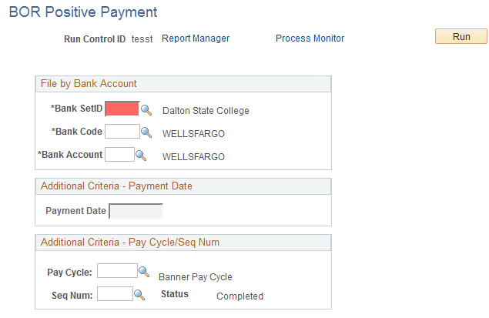
Positive Pay

Slide 27
Payment Table
Select * from ps_payment_tbl where pymnt_id_ref (check #) = ‘xxxxxx’
Banking Information
Supplier and location information
OPRID associated with the payment process and the pay cycle that the payment was processed in
Payment Method – CHK, EFT, ACH (CTX and CCD+)
Has the payment been reconciled?
Auto-recon vs. Manual and OPRID associated with recon
Positive Pay status and date
Voucher payments vs. other payments (Expenses)
Date/Time Stamps

Slide 28
News to Use…
Date fields – “T” for today’s date
Payment Selection
Queries
Positive Pay
Other pages

Slide 29
News to Use…
AP Batch processes run 3 times per day
10:00 am – new for 9.2
3:00 pm – new for 9.2
6:00 pm.
Vouchers are “in process”
Matching
Budget Checking
Doc Tolerance
Submit Voucher for Approval
Voucher Post
Notes:
Curious to see how this is working for the Institutions?

Slide 30
News to Use…
All vouchers that are built via voucher build are built as pre-approved vouchers. They will not require additional approval unless changes are made to the vouchers after building them.

Slide 31
News to Use…
Institution’s have the option to customize the voucher approval process as needed.
Example - if you wanted to set up additional approval for all vouchers that are over a certain monetary amount then that is configurable through security roles.
Library Collections workflow
Don’t tell Shelia I told you about this….
Notes:
GCSU did library collections workflow

Slide 32
News to Use…
If a voucher is already approved (non-PO), running voucher post on the voucher will run all three processes below.

Slide 33
Upcoming
Release 5.0 testing is underway.
People Tools 8.54, image 13
We will have more information very soon regarding how the 1099 Process has changed for PeopleSoft 9.2.
Notes:
Looking into Voucher Mass Maintenance and Quick Invoice process groups for future release.

Slide 34
Questions/Feedback
How would you say things are working overall in 9.2?
Other questions - Jason.Beitzel@usg.edu

