Slide 1
The ABC’s (and don’t forget D!) of Asset Management Reconciliation
April Harder
Christy Todd
GaFIRST Financials

Slide 2
Agenda
Asset Creation
  Prevent reconciling issues right from the start
Asset Maintenance
  Avoid trouble when there’s a need for change
Month End Processing
  What, When, Where, and How
AM Reconciliation Points

Slide 3
Asset Creation
Interfacing Assets
  Five Part Process
  Review/Update/Delete Transactions on PRE-AM pages
  Review/Update on INTFC pages
Manual Additions
  Key dates and fields

Slide 4
Process Flow of Interfacing Assets
Create PO for Asset & Dispatch
Create PO Receipt
Create Voucher from PO Receipt
Post Voucher
Run BORQM002 Query
Push Receivers
Load Vouchers
Review Pre AM Pages
Run Payables/ Purchasing Interface
Review Interface Pages & Make Changes if Necessary
Consolidate and/or Unitize Assets if Necessary
Run Transloader Process

Slide 5
Reviewing the Pre-AM Pages
Review Pre AM Pages:
  after loading vouchers and pushing receivers
  before running the PO/AP interface
  Record the Pre-Interface ID
Navigation: Asset Management > Send/Receive Information > Preview AP/PO Information
Business Process: AM.020.015

Slide 6
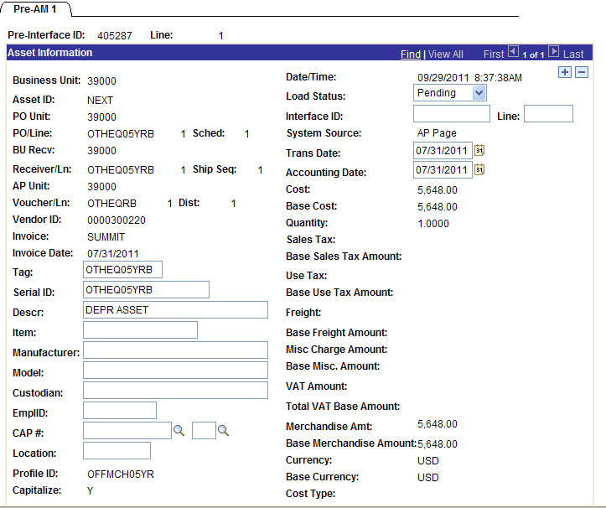

Slide 7
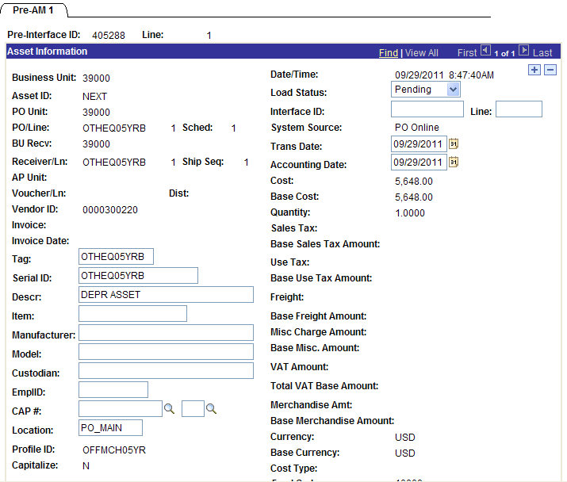

Slide 8
When can transactions be deleted from
Pre-AM tables?
If an asset will be added manually, transactions pushed to Pre-AM tables can be deleted to prevent duplicate assets:
  after the voucher & receipt have been pushed/moved
  only delete rows with a status of “Pending” or “Errored”
  Be sure to delete all related rows for receipt & voucher

Slide 9
Process Flow of Interfacing Assets
Create PO for Asset & Dispatch
Create PO Receipt
Create Voucher from PO Receipt
Post Voucher
Run BORQM002 Query
Push Receivers
Load Vouchers
Review Pre AM Pages
Run Payables/ Purchasing Interface
Review Interface Pages & Make Changes if Necessary
Consolidate and/or Unitize Assets if Necessary
Run Transloader Process

Slide 10
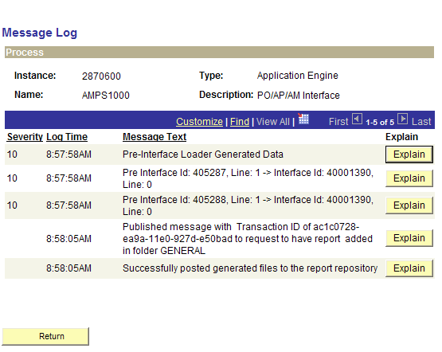

Slide 11
Review Interface Pages
Review Interface pages
  After running the Payables/Purchasing Interface
  INTFC_PHY_A – Physical attributes (derived from the receipt)
  INTFC_FIN - Financial attributes (derived from the voucher)
Update available fields if needed
Navigation: Asset Management > Send/Receive Information > Approve Financial Information > Review
Business Process: AM.020.016
Notes:
AP/PO Push can be run by specifying it to run for all pending entries, voucher/receipt id, profile or system source to pick up all vouchers or all receipts.
Unlike the Voucher Load/Receipt Push processes, the Process Monitor provides excellent information on results of running the PO/AP/AM Interface such as the Pre Interface and line numbers processed successfully.
Again, you’ll want to notate the Interface IDs. These along with the originating Pre-Interface IDs loaded into the Interface Tables can be identified in the Process Monitor – Message Log when the load process is run.

Slide 12
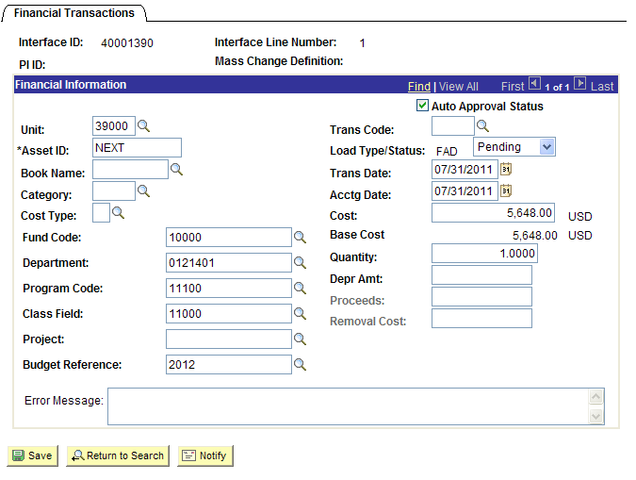
Notes:
If you find information that is incorrect on the INTFC_FIN, depending on your AM user preferences, certain or all fields will be available for modification while the transaction is in a ‘Pending’ Status.
If there were transactions that errored, the error message will be viewable on the INTFC_FIN page. Depending on the issue, duplicate tag, acctg date, etc., you may need to make the change on either the INTFC_FIN, INTFC_PHY_A, or both pages.

Slide 13
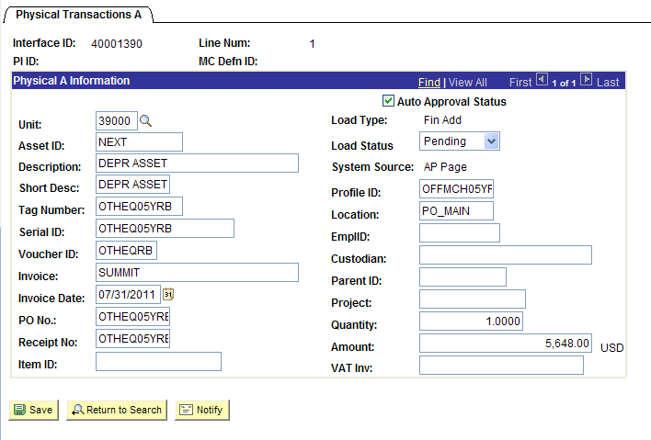
Notes:
And finally, after confirming all the physical asset data is correct and unitizing, or consolidating interface lines, if needed, you’re ready to create assets within the AM (ABC) tables.

Slide 14
Process Flow of Interfacing Assets
Create PO for Asset & Dispatch
Create PO Receipt
Create Voucher from PO Receipt
Post Voucher
Run BORQM002 Query
Push Receivers
Load Vouchers
Review Pre AM Pages
Run Payables/ Purchasing Interface
Review Interface Pages & Make Changes if Necessary
Consolidate and/or Unitize Assets if Necessary
Run Transloader Process

Slide 15
Manual Additions
Manual Asset Additions should be performed for:
  Assets with Multiple Chartstrings
  Capital Leases
  Donations
  Partial Payment Assets
  PO Lines marked as ‘Amount Only’ (multiple vouchers)

Slide 16
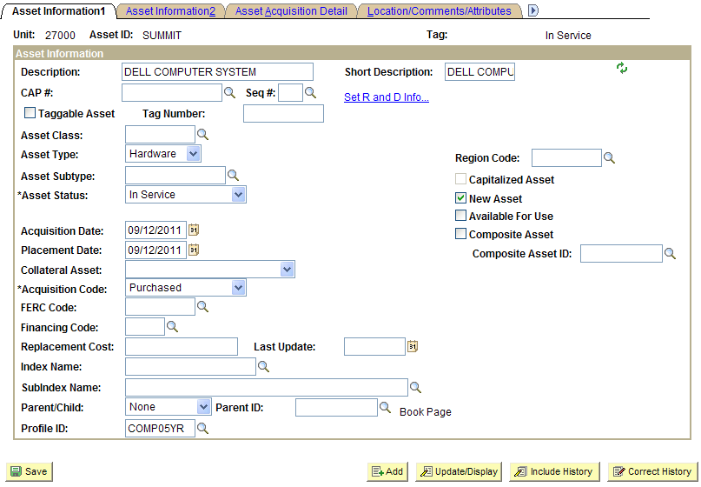
Begin with the end in mind: Asset > Book > Cost > Depreciation
\

Slide 17
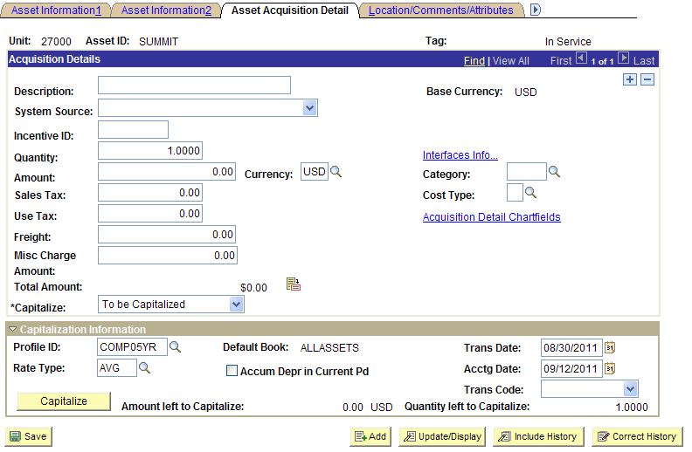
Specifying a Prior Period In Service Date

Slide 18
Asset Maintenance
Updating Assets
  Physical vs Financial updates
Updating Asset Transactions
  Reviewing the Open Trans page
  Using the Change/Delete Pending Trans page

Slide 19
The “Open Trans” page:
  AM > Depreciation > Open Transactions
  contains any transaction, pending depreciation calculation.
  No updates allowed on this page
  Business Process AM.060.050
  Review all open trans by running the BOR_AM_OPEN_TRANS query

Slide 20
The “Change/Delete Pending Trans” page:
  Used to update financial transactions only
    Able to make changes to, or delete, pending transactions before running depreciation calculation.
    Asset additions, adjustments, transfers and re-categorizations can be modified
    Retirement and/or parent/child assets may not be modified or deleted (Tran/Acctg dates may be modified)
    Business Process AM.020.240
    AM > Asset Transactions > Financial Transactions

Slide 21
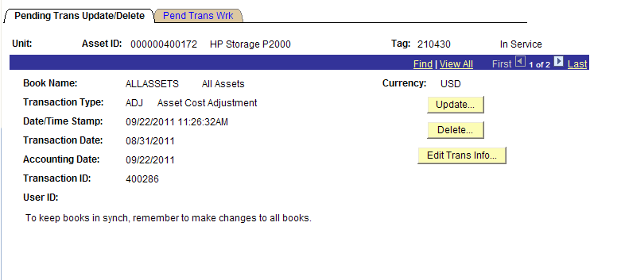
Change/Delete Pending Trans
Edit Trans Info box – allows you to modify Accounting Date, Transaction Date, and Transaction Code

Slide 22
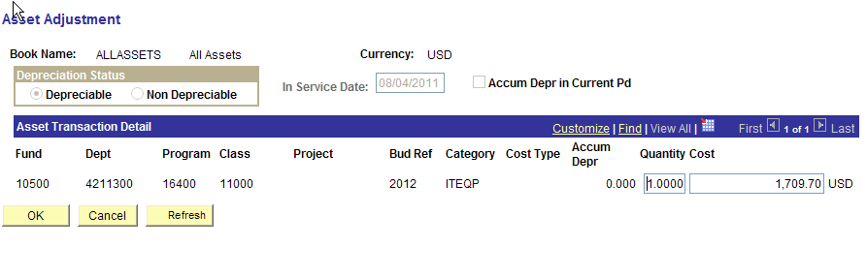
Change/Delete Pending Trans

Slide 23
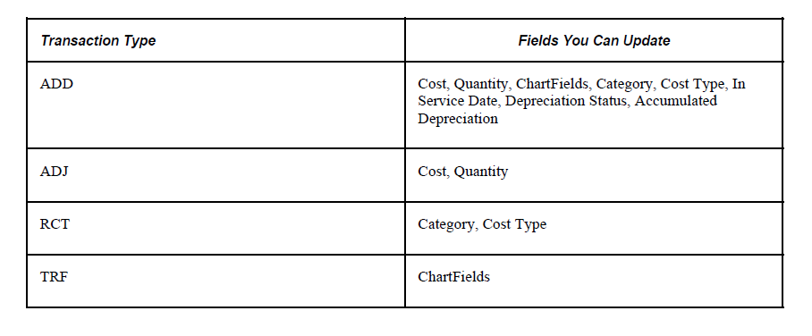
Change/Delete Pending Transactions -- Editable fields by Transaction type

Slide 24
Asset Management Month End Processing

Slide 25
Month End AM Processing
Running Depreciation Calculation
  Ready to Load Depreciation & NBV Reporting Tables
Running Accounting Entry Creation
Running Depreciation Close
  Run NBV Report
  Ready to begin Reconciliation process

Slide 26
Month End Processes
  What transactions are processed and when?
  Where can I review the results after running each?
  What if the results are incorrect?

Slide 27
Depreciation Calculation
  Builds the Depreciation Table (DEPRECIATION) for new depreciable assets
  Processes Open Transactions against existing assets & rebuilds the DEPRECIATION for existing
  If asset corrections are required, this process can be re-run for a single asset.
  Prerequisite for Loading the Reporting Tables

Slide 28
2. Accounting Entry Creation
  Creates accounting entries for Open Transactions
  Accounting entries are inserted into DIST_LN
    Review accounting entries
  If corrections to asset(s) need to be performed, this process can be re-run for a single asset

Slide 29
3. Depreciation Close
  Processes normal monthly depreciation for ALL assets
  Inserts PDP and DPR entries into DIST_LN accordingly
  Review Depreciation entries
  If corrections to asset(s) is necessary, this process can be re-run, for one or all assets, provided journal generate has not been run.

Slide 30
AM Load Reporting Tables

Slide 31
BIG PICTURE: Information Flow &
Reconciliation Points
Net Book Value
DIST_LN
JRNL_LN
LEDGER
You
are
here!
Recon Pt. #1
4 AM
Source Tables
ASSET
BOOK
COST
Load Reporting Tables – 3 Steps
Recon Pt. #2
DEPRECIATION
Recon Pt. #3 (AM, AP & GL activity)
Recon Pt. #4 (CAPITAL & ACTUALS)

Slide 32
  Step 1/3: Load Depreciation Reporting Table
      Pulls data from the Depreciation Table.
      Depreciation Calculation must be run prior to loading this table and must be 100% up-to-date
      Run Control parameters important

Slide 33
AM Load Depreciation
Reporting Table
Depreciation Reporting Table
Depreciation
DIST_LN
ENTERPRISE:
NON-SVP
DEPRECIABLE
x

Slide 34
  Step 2/3: Load NBV Reporting Table
      Pulls data from the Depreciation Reporting & Cost Tables.
      Load Depreciation Reporting Table must be complete prior to loading this table
      Run Control Parameters extremely important!

Slide 35
AM Load NBV Reporting Table
NET BOOK VALUE
DEPR_RPT_ TBL
COST
DIST_LN
ENTERPRISE:
NON-SVP
DEPRECIABLE
ALLASSET:
SVP
NON-DEPREC.
DEPRECIABLE
x

Slide 36
  Step 3/3: Run NBV Report
  Run control Parameters are extremely important here!
  Reflects Cost, Current/YTD/LTD Depr & NBV amounts
  Alternative to running report is querying the reporting tables. They are:
    ASSET_NBV_TBL
    DEPR_RPT_TBL

Slide 37
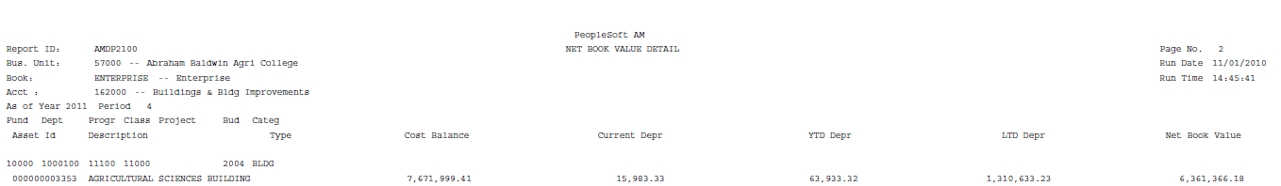
  NBV Report by Account (AMPD2100) Total by CF Combination (see Run Control parameters)
    1 - Cost Balance = ADD & ADJ transactions
    2 - Current Depr = Current Period DPR & PDP transactions
    3 - YTD Depr = Current Fiscal Year DPR & PDP transactions
    4 - LTD Depr = All Fiscal Years DPR & PDP transactions
    5 - Net Book Value = [1 minus 4]
1
2
3
4
5

Slide 38
AM Reconciling Points
  Reconciling NBV to DIST_LN
    Prerequisites: Running Depreciation Calculation , Depreciation Close, & Populating Reporting Tables
  Reconciling DIST_LN to JRNL_LN
  Reconciling JRNL_LN to LEDGER
  Reconciling CAPITAL to ACTUALS LEDGERS

Slide 39
  Recon Point #1:
  Reconciling NBV to DIST_LN

Slide 40
  Recon Point #1:
  Reconciling NBV to DIST_LN
  Prerequisites:
    Depreciation Calculation
    Report tables loaded
    Accounting Entry Creation
    Depreciation Close

Slide 41
Recon Pt. #1 – NBV & DIST_LN
BIG PICTURE: Information Flow &
Reconciliation Points
Net Book Value
DIST_LN (AM)
JRNL_LN (AM)
LEDGER
You
are
here!
Recon Pt. #1
ASSET
BOOK
COST
Recon Pt. #2
4 AM
Source Tables
Load Reporting Tables Processes
Recon Pt. #3 (AM, AP & GL activity)
DEPRECIATION
Recon Pt. #4 (CAPITAL & ACTUALS)

Slide 42
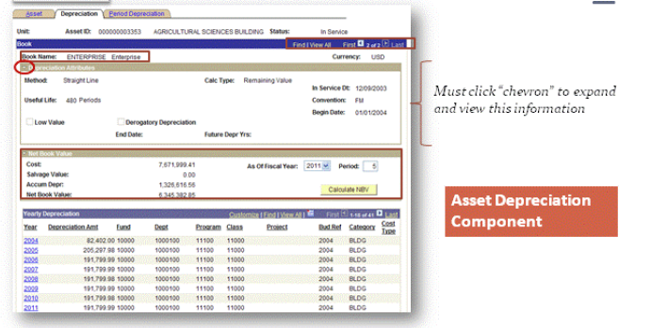

Slide 43
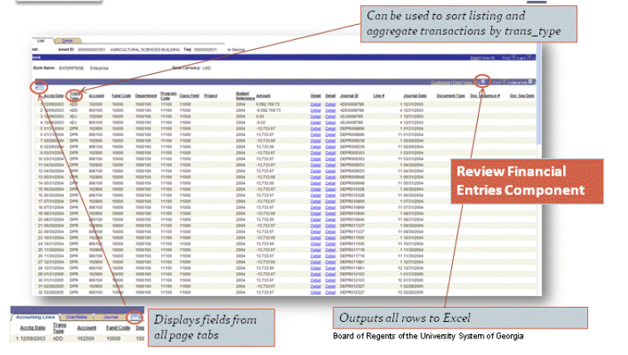

Slide 44
Queries for Reconciling NBV to DIST_LN
  BOR_AM_LTD_SUMM
    Asset Summary by asset, account and transaction type (DIST_LN only)
    quick account-level (or asset-level) compare with NBV Rpt
  BOR_AM_LTD_DETAIL
    Asset Detail by asset, account and transaction type, plus journal id and accounting period (DIST_LN only)
    identify transactions for an asset which comprise differences with NBV Rpt
  BOR_AM_NBV_COMPARE
    Asset Compare by asset and account (ASSET_NBV_TBL and DIST_LN tables)
    identify assets causing differences with NBV Rpt

Slide 45
  Recon Point #1 – Typical Variances
      #1 - The NBV and DIST_LN have different accumulated depreciation or net book values for an asset:
        Failed to run one of the “pre-requisite” processes
        Depreciation Close was not run for a previous period/year
        Asset was retired and Accumulated Depreciation is not zero
        Consolidation/conversion issues

Slide 46
  Recon Point #1 – Typical Variances
      #2 - The NBV omits an asset:
        Asset has been retired and Include Retirements check box was not selected on the run control for NBV Report
        Asset was just recently added … the Depreciation and Net Book Value reporting tables have not been loaded for the period

Slide 47
  Recon Point #1 – Typical Variances
      #3 – NBV has “outdated” or no information for one or more assets:
        Load Reporting Table process probably was not run for the desired period
        Depreciation Calc was not run after making a change and/or before running Load Reporting Table process

Slide 48
  Recon Point #2:
  Reconciling DIST_LN to JRNL_LN

Slide 49
Recon Pt. #2 – DIST_LN & JRNL_LN
BIG PICTURE: Information Flow &
Reconciliation Points
Net Book Value
DIST_LN (AM)
JRNL_LN (AM)
LEDGER
You
are
here!
Recon Pt. #1
ASSET
BOOK
COST
Recon Pt. #2
4 AM
Source Tables
Load Reporting Tables Processes
Recon Pt. #3 (AM, AP & GL activity)
DEPRECIATION
Recon Pt. #4 (CAPITAL & ACTUALS)

Slide 50
Recon Pt #2 – Typical Variance
      #1 - If the DIST_LN and JRNL_LN have different account balances for an asset:
        Ran Depr. Close, but failed to run Journal Generator
        Deleted the AM journal-generated journal prior to posting
        Altered an AM journal-generated journal in GL
        Booked a transaction directly in GL to the Actuals or Capital Ledger, using AM as the Source

Slide 51
    Variances between DIST_LN and JRNL_LN may be investigated using this query:
      BOR_AM_DIST_JRNL_RECON – shows NBV by asset and looks at DIST_LN, and JRNL_LN tables.

Slide 52
  Recon Point #3:
  Reconciling JRNL_LN to LEDGER

Slide 53
Recon Pt. #3 – JRNL_LN & LEDGER
Net Book Value
DIST_LN
JRNL_LN
LEDGER
BIG PICTURE: Information Flow &
Reconciliation Points
Recon Pt. #1
ASSET
BOOK
COST
Recon Pt. #2
4 AM
Source Tables
Load Reporting Tables Processes
Recon Pt. #3 (AM, AP & GL activity)
You
are
here!
DEPRECIATION
Recon Pt. #4 (CAPITAL & ACTUALS)

Slide 54
Recon Pt #3 – Typical Variances
      #1 - If the JRNL_LN & LEDGER have different account balances for an asset:
        Failed to post a journal
        Entry directly to the LEDGER table
        Note: These should always balance because the JRNL_LN feeds right into the LEDGER

Slide 55
    Variances between JRNL_LN and LEDGER may be investigated using query:
      BOR_AM_CY_RECON – reconciles transactions from all sources, recorded in the CAPITAL, ACTUALS and GAAP ledgers.

Slide 56
  Recon Point #4:
  Reconciling CAPITAL to ACTUALS
  Ledgers

Slide 57
Recon Pt. #4 – CAPITAL & ACTUALS
BIG PICTURE: Information Flow &
Reconciliation Points
Net Book Value
DIST_LN (AM)
JRNL_LN (AM)
LEDGER
Recon Pt. #1
ASSET
BOOK
COST
Recon Pt. #2
4 AM
Source Tables
Load Reporting Tables Processes
You
are
here!
Recon Pt. #3 (AM, AP & GL activity)
DEPRECIATION
Recon Pt. #4 (CAPITAL & ACTUALS)

Slide 58
Recon Pt #4 – Typical Variances
      #1 - If the JRNL_LN & LEDGER have different account balances for an asset:
        Failed to post a journal
        AP journal posted ACTUALS ledger but asset hasn’t been added/journal generated or online jrnl in one and not the other

Slide 59
    Variances between CAPITAL and ACTUALS ledgers may be investigated using query:
      BOR_AM_CAP_ACT_RECON – reconciles transactions from all sources, recorded in the CAPITAL and ACTUALS ledgers for Periods 1 through 12.

Slide 60
Additional Training Material
http://www.usg.edu/gafirst-fin/training/archives/
Interfacing Assets
  http://67.202.210.69/launcher.cgi?room=PSFIN_TRNG_2010_0609_1430_44
Updating and Maintaining Assets
  http://gbor.wimba.com/launcher.cgi?room=PSFIN_TRNG_2010_0914_1430_07
AM Reconciliation
  http://gbor.wimba.com/launcher.cgi?room=PSFIN_TRNG_2011_0125_1430_02

Slide 61
Questions?

