Slide 1
PeopleSoft Financials Security
Presenter: Shelia Sloan
September 23, 2021

Slide 2
Agenda
Creating User IDs
Basic User ID and Role Administration
Other Areas of Responsibility
Module Specific Security
IT Audits
Q&A

Slide 3
Creating User IDs
Self Registration – User Can Self Register and Create their own account
- www.usg.edu/gafirst-fin
- Click on Register For My Account
- User will need to enter Birthday, Zip Code, last 4 of SSN
https://www.usg.edu/gafirst-fin/documents/New_User_Self-Registration.pdf

Slide 4
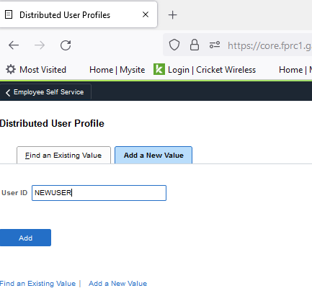
Creating User IDs
Security Admins Can Manually Create Account
Peopletools, Security, User Profiles, Distributed User Profiles

Slide 5
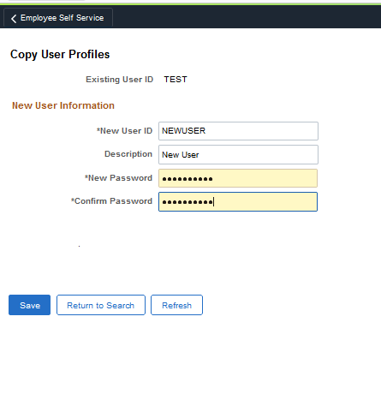
Creating User IDs
Security Admins Can Copy an Existing Account
Peopletools, Security, User Profiles, Copy User Profiles

Slide 6
Basic User ID and Role Administration
User ID Administration General Tab
Always ensure the account is unlocked for new and current accounts; Locked for Terminated
Ensure the EMAIL ID is correct
The Process profile should default in and the Primary Permission List Defaults (may need to change to B business unit)
For Terminated Accounts, On the General tab,Userid Alias Field, put their EMPLID-USERID in that box.

Slide 7
General Tab

Slide 8
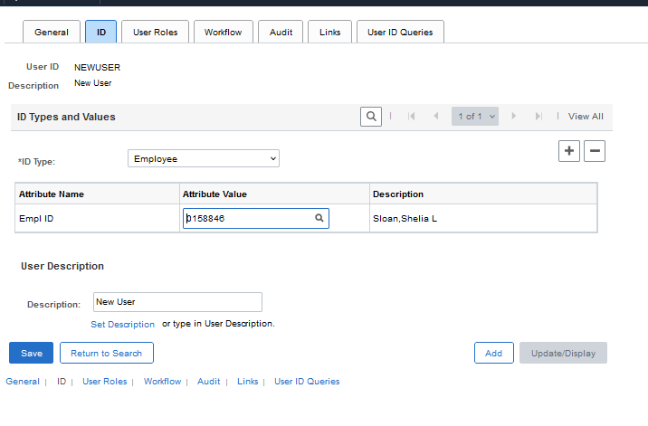
Basic User ID and Role Administration
User ID Administration ID Tab
For New/Current Employees, Change the ID Type to Employee and Add the EMPLID in the Attribute Value box.
For Terminated Employees change the ID Type to NONE.

Slide 9
Basic User ID and Role Administration
User ID Administration User Roles Tab
Add the Appropriate Security Roles; There are three base roles (see spreadsheet); If they are a core user provide additional role access as appropriate.
For terminated users, remove the BOR PeopleSoft User base roles, and any workflow/approval roles.
The only dynamic role in Financials is BOR_EX_APPROVAL (added dynamically when user id is placed on the Approver Assignments Pages in Expenses)

Slide 10
User ID Administration User Roles Tab

Slide 11
Basic User ID and Role Administration
User ID Administration Workflow Tab
Ensure the routing Preferences boxes are selected for Worklist and Email User
Alternate User ID is used if the user is an approver and will be out of office
Transactions will route to the User ID here while the employee is out on leave.
Once the date range has expired, it is best practice to remove the User ID and date range from the user profile.
Reassign Work can be used to move ALL transactions waiting on the users approval, to a new approver (be careful with this)

Slide 12
User ID Administration Workflow Tab

Slide 13
Other Areas of Responsibility
Security Administration is more than assigning roles and maintaining the UserID
There are other areas in the application that Security Administrators may be responsible for depending on how your institution is organized
User Preferences is most Always Security Administrator’s Responsibility and is included in the Local Security Admin role
Setup Financials Supply Chain, Common Definition, User Preferences, Define User Preferences

Slide 14
Other Areas of Responsibility
Commitment Control Rules
Commitment Control, Define Budget Security, Assign Rule to User ID (BOR_KK_SETUP role)
Commitment Control, Define Budget Security, Request Build (BOR_KK_PROCESSES role)
Requester/Buyer Setup
Setup Financials Supply Chain, Product Related, Procurement Options, Purchasing, Buyer Setup
Setup Financials Supply Chain, Product Related, Procurement Options, Purchasing, Requester Setup
(BOR_EP_CONFIG_SETUP for both)

Slide 15
Other Areas of Responsibility
Maintaining Department/Project Approvers for ePro/other Modules
Setup Financials Supply Chain, Common Definitions, Design Chartfields, Define Values, Chartfield Values
Department Link – Add manager’s emplid next to department they will approve transactions for
Project Link – Add manager’s emplid next to the project they will approve Transactions for
Setup Financials Supply Chain, Common Definitions, Design Chartfields, Define Values, Department Approver
Define Secondary Department Approvers here for ePro/other modules
Setup Financials Supply Chain, Common Definitions, Design Chartfields, Define Values, Project Approver
Define Secondary Project Approvers here for ePro/other modules
(BOR_GL_CHARTFIELDS role has access to all the above)

Slide 16
Other Areas of Responsibility
Updating Dashboard Security
PeopleTools, Security, User Profiles, Dashboard Department Security
(BOR_MNGR_DASHBOARD_DEPTS role)
PeopleTools, Security, User Profiles, Dashboard Project Security
(BOR_MNGR_DASHBOARD_PROJECT role)

Slide 17
Other Areas of Responsibility
Kennesaw State University ONLY
Concur User Profiles
PeopleTools, Security, User Profiles, Concur Employee Profile
(BOR_PT_CONCUR_USER role)

Slide 18
Other Areas of Responsibility
EXPENSES Schools
Travel And Expenses, Manage Expenses Security, Authorize Expense Users
There is a Batch process that populates this 5xs a day, but for a critical hire that needs access prior to the batch run, it can be manually update. This allows and employee to enter expense transactions on behalf of themselves or other employees.
(BOR_EX_ADMINISTRATION role)
This is probably handled by the expenses administrator on your campus

Slide 19
Other Areas of Responsibility
EXPENSES Schools
Travel And Expenses, Manage Employee Information, Update Profile
This is where default chartfields are configured for expense transactions, but also it is where you can setup an expenses Designate approver
(BOR_EX_ADMINISTRATION role)
This is probably handled by the expenses administrator on your campus

Slide 20
Other Areas of Responsibility
EXPENSES Schools
Setup Financials Supply Chain, Product Related, Expenses,Management, Approval Setup, Approver Assignments
This is where approvers for Expenses are defined by approval level.
(BOR_EX_ADMINISTRATION role)
This is probably handled by the expenses administrator on your campus

Slide 21
Module Specific Security
New Spreadsheet – Financials Security Roles
Use as a Guide
https://www.usg.edu/gafirst-fin/documentation/category/security
Here under Business Processes is the Security Administrator User Guide and Under Job Aids is the 9.2 Security Roles & User Preferences Suggestions by Module Area
https://www.usg.edu/gafirst-fin/training/epro_georgiafirst_marketplace
Here you can find helpful guides on how to configure each type of ePro User in the system.

Slide 22
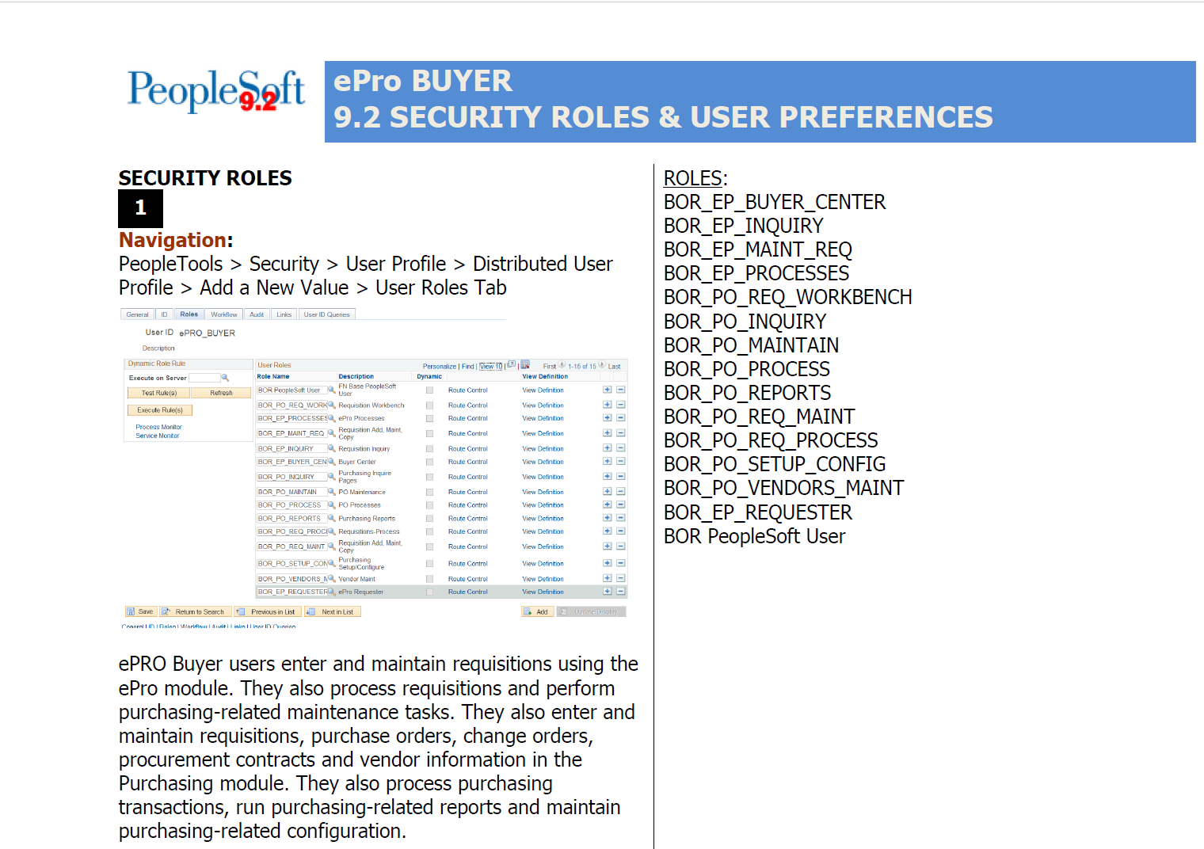
Module Specific Security
The 9.2 Security & User Preferences Job Aids should be taken and customized by Each Institution to be helpful
Each Institution is Staffed differently; The guides should reflect how your employees are setup.

Slide 23
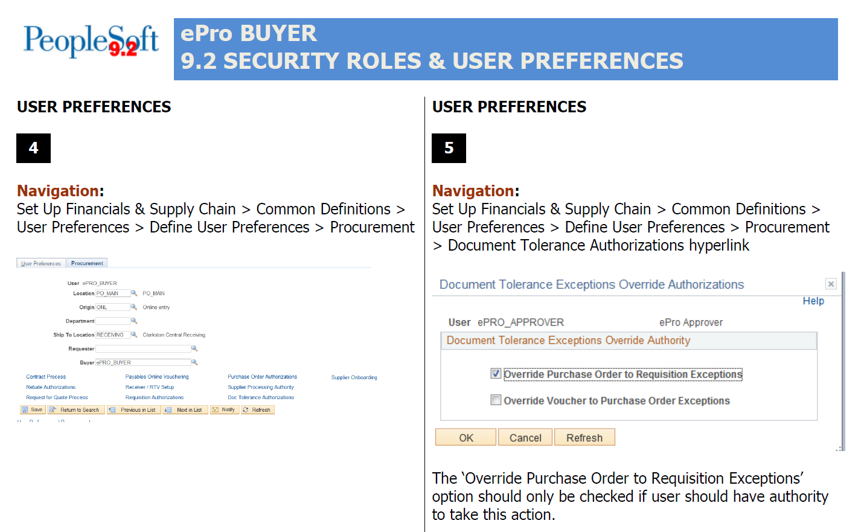
Module Specific Security

Slide 24
Module Specific Security

Slide 25
Module Specific Security
Create a Custom Security Request Form for your Institution based on the Job Aids that you customize to make it easier
We deliver a Sample Request Form
Lets Jump into Application and Walk through some Module Specific Security Here

Slide 26
IT Audits
Why are Audits Important?
Decreases Risk Associated with IT
Enhances Internal Control Environment
Improves Internal Operations
Identifies Potential Vulnerabilities
Areas we will focus on today
New User Access
Current User Access
Terminated User Access
Tools

Slide 27
New User Access
Document Procedures and Follow them
Always Document the Request, Gain Approvals and Save
Be able to Show that What was Requested was granted
Never accept Phone Calls as a form of authorization.
Store for Auditors
Ensure Access is Appropriate and limited to only what they need.

Slide 28
Current User Access
Periodically Review Current Users Access, at least twice a year. Look at the USG handbook or institutional IT handbook
If job duties change, so should their access in the application.
Document the changes, gain authorization.
Ensure no segregation of duties issues are in place.

Slide 29
Terminated User Access
This should be handled on demand as users terminate but at least weekly.
Review Terminated users and confirm with HR that they are in fact terminated.
Lock the User id and update the user id alias as shown on General id tab slide and update the ID tab.

Slide 30
Tools
SEGREGATE_DUTY_BOR Query checks for Segregation of Duties issues. Run at least twice a year
Cross check with user preferences
BOR_SEC_TERMINATED_USER_HCM Query checks for terminated Users
BOR_SEC_USER_ROLES Query lists User IDs and their role assigments
BOR_SEC_ROLES_BY_MENU_ITEM finds role name based on Menu
BOR_SEC_ACCESS_BY_ROLE shows what menu items a role has access to.

Slide 31
Tools
AUDIT_OPRAL_BOR - shows changes to the ID tab on Distributed User Profiles
AUDIT_OPRDF_BOR - Shows changes to the Distributed User Profiles; such as account locks, Userid alias changes, password changes, primary permission list changes
AUDIT_ROLCL_BOR - Shows any changes for roles and their permission lists
AUDIT_ROLDF_BOR - Shows changes to a role definition
AUDIT_ROLUS_BOR - shows changes to Users roles

Slide 32
Tools
User Preference Report
Setup Financials Supply Chain, Common Definitions, User Preferences, User Preferences Report
BOR Menus, BOR Utilities, BOR Security, Commitment Control Budget Security Report

Slide 33
Q&A

