Slide 1
Stress Tolerance and What to Do When You Don't Have Any More
Karen Schwind
Information Technology Services

Slide 2

Paper

Slide 3
I. Stress Tolerance

Slide 4
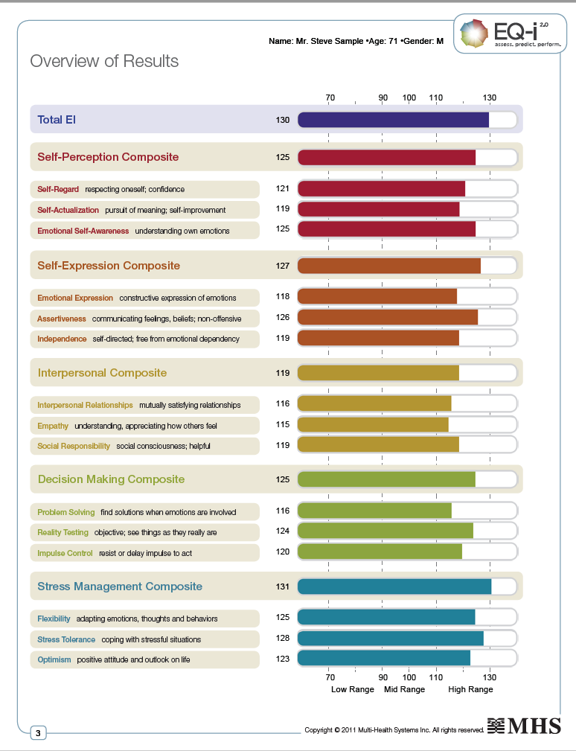

Slide 5

History of Stress
“…for over 200 years, stress primarily referred to what happened when you put a load on a bridge. Then in the 1920s, physician Hans Selye . . . defined stress as the body’s nonspecific response to any demand made upon it (pg. 110).”
The Stress Effect, Henry Thompson, PhD.

Slide 6
Neither good nor bad

Slide 7
Complete freedom from stress is death.
Hans Salye

Slide 8
Stress Tolerance

Slide 9
Stress Tolerance

Slide 11
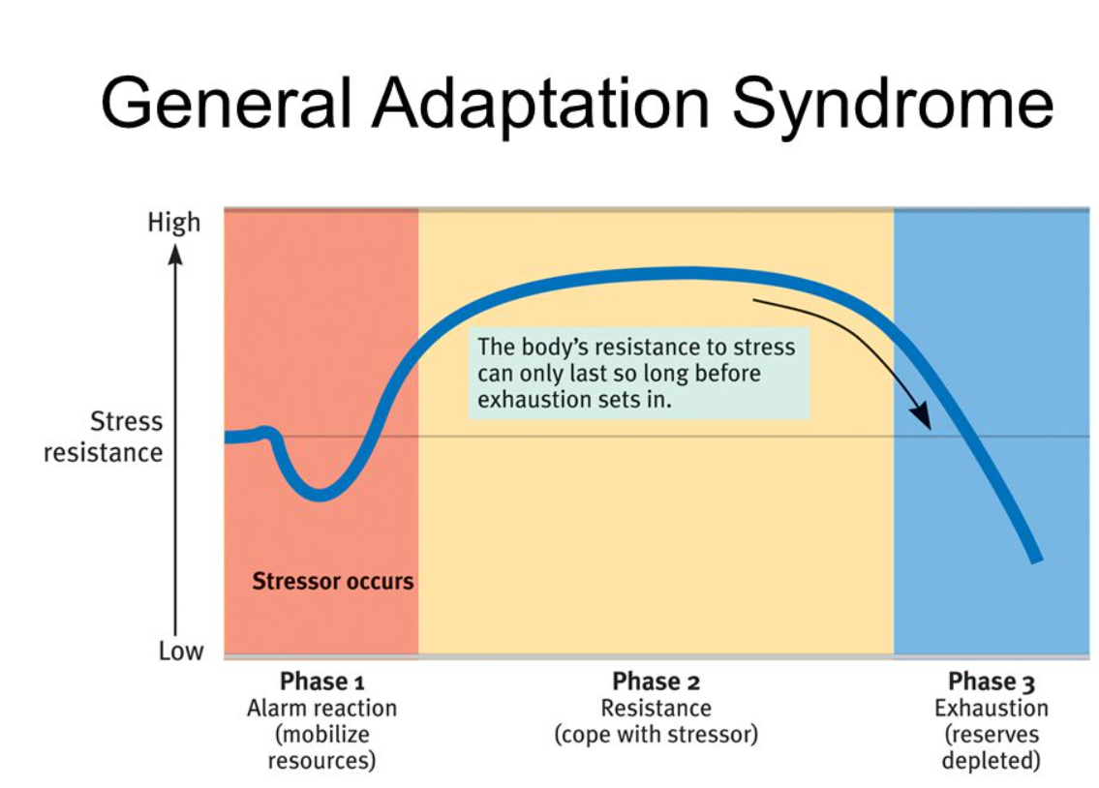

Slide 12
Stress is linked to the 6 leading causes of death in the United States:
Heart disease
Cancer
Lung ailments
Accidents
Cirrhosis of the liver
Suicide
p. 112, The Stress Effect, Henry Thompson, PhD.

Slide 13

II. Basic Strategies

Slide 14
What can we do when we spend too much time in the burnout zone?
The basics: sleeping, eating, exercising
Create a bubble sheet to determine what your stressors are
Change your attitude towards stress
Techniques to burst bubbles

Slide 15
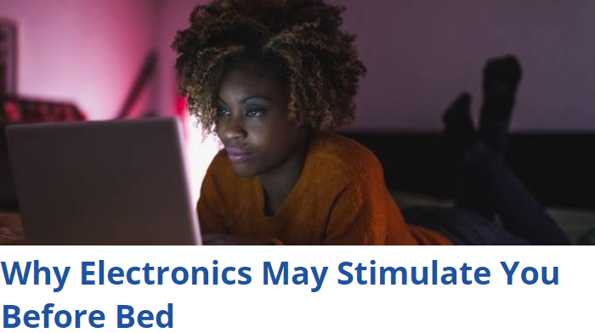
Sleep

Slide 16

Food

Slide 17
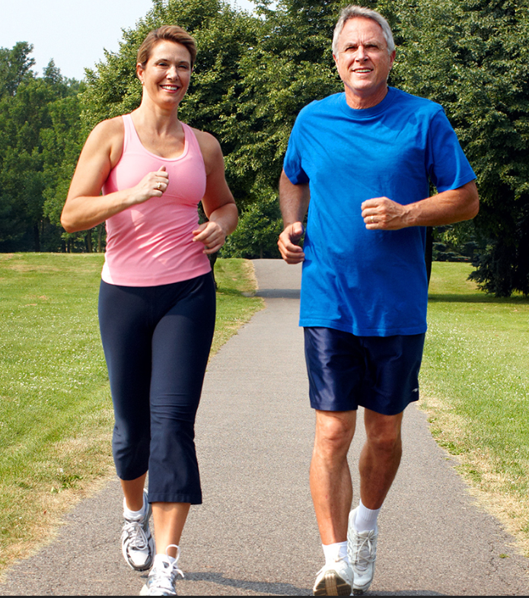
Exercise

Slide 18
Identify Your Stressors
Cooking
Dinner
6-mth project at work
Burnout Zone
Aging Parents
Comfort Zone

Slide 19
Which ones are you most likely to be able to do something about?
Cooking
Dinner
6-mth project at work
Aging Parents

Slide 20
Attitude
During the past 12 months, would you say that you experienced:
  A lot of stress
  A moderate amount of stress
  Relatively little stress
  Almost no stress at all
How much effect has stress had on your health?
  A lot
  Some
  Hardly any
  None
Notes:
While we know that stress is associated with health problems, plenty of people with high-stress lives are thriving. How is that possible? In 2012, researchers from the University of Wisconsin-Madison published a seminal study looking at how 28,000 people perceived stress in their lives. People in the study answered these two questions:
During the past 12 months, would you say that you experienced:
A lot of stress
A moderate amount of stress
Relatively little stress
Almost no stress at all
How much effect has stress had on your health?
A lot
Some
Hardly any
None
The researchers looked at death rates in the study group over nine years. The results are startling. The study found that having a lot of stress in your life was not linked with premature death. But having a lot of stress in your life and believing it was taking a toll on your health increased risk of premature death by 43 percent.
Changing your perception
With stress, the mind and the body are intrinsically linked. You can view stress as something that is wreaking havoc on your body (and it can) or as something that is giving you the strength and energy to overcome adversity. Here’s a quick way to think about these two very different views of stress. Read the statement, and then think about your own reaction to the biological changes that occur during times of stress.1. When I’m stressed, my body releases adrenaline and cortisol. My heart is beating faster. This means that:
Common View: Stress is increasing my risk for cardiovascular disease and heart attack.
Alternative View: My heart is working harder and my body is mobilizing its energy to get ready for this challenge.
2. When I’m stressed, my stress response is causing my breathing rate to increase. This means that:
Common View: My fast breathing is a sign of anxiety. I worry about how stress is affecting my mental and physical health.
Alternative View: I should take a deep breath. My faster breathing means more oxygen is getting to my brain so I can think more clearly.
3. When I’m stressed, my heart and circulatory system respond, causing my blood pressure to rise. This means that:
Common View: I can feel my blood pressure rising. This can’t be good for my health.
Alternative View: Circulatory changes are allowing more oxygen and nutrients to fuel my muscles. I’m feeling stronger and ready for the challenge ahead.
How to Be Better at Stress
By Tara Parker-Pope @nytimes

Slide 21
Attitude

Slide 22
Attitude
Example: When I have to attend meeting with my least favorite coworker, my stress response causes my breathing rate to increase. This means that:
Common View: My fast breathing is a sign of anxiety. Working with this coworker is negatively affecting my mental and physical health.
Alternative View: I should take a deep breath. My faster breathing means more oxygen is getting to my brain so I can think more clearly and answer his rapid-fire questions more accurately.
Your stressor:
Your typical view:
Alternative view:
(from How To Be Better at Stress, Tara Parker-Pope, New York Times )

Slide 23
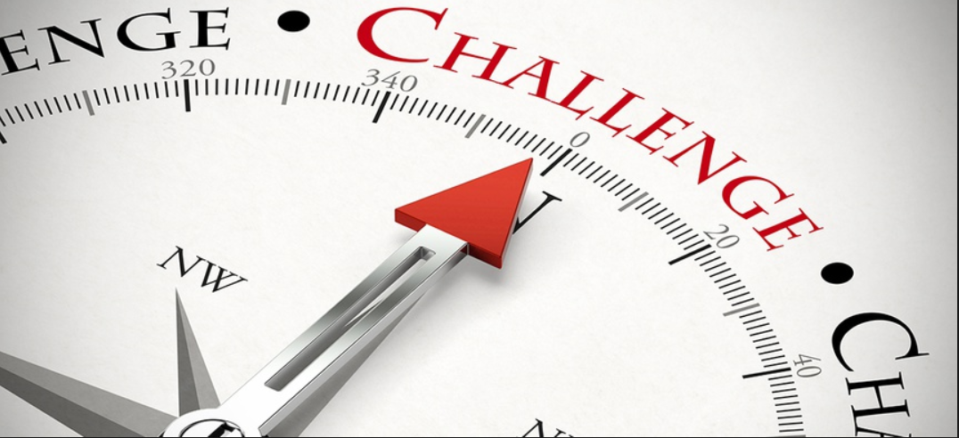
Stress Inoculation--Don’t avoid stress. Face it down!
Tell a story in front of a crowd to get used to public speaking.
Set a goal to have input on at least one topic in your next meeting if speaking in meetings causes you stress.
Take a leadership position in a volunteer organization to prepare for leadership at work.
Notes:
It’s probably clear to you that the alternative view is the better choice for thinking about stress. It may be hard to believe that such a small shift in thinking could make a difference, but that’s what Harvard researchers found when they paid 50 study subjects $25 each to take part in a lab experiment designed to induce stress. The test involves giving a talk in front of a group of unfriendly evaluators, followed by a tricky word test. (Researchers have consistently found that this formula of public speaking plus testing in front of a hostile crowd is incredibly uncomfortable and stress-inducing for the poor people who agree to take part in the study.)
Before the social stress test, one group was allowed to play video games; another was taught to simply ignore stressful feelings if they experienced them during the test. But a third group was given advice similar to the quiz above. They got a primer about the physical stress response and were told how a higher heart rate, faster breathing and internal jitters were all tools for making you strong during a stressful event. They were told how the body’s stress response evolved to help us succeed, and that the increased arousal symptoms of stress can aid your performance during times of stress. The bottom line of the lesson was this: In a tough situation, stress make you stronger.
The group that learned to rethink the role of stress in their lives did far better on the test. They gave better speeches and were rated as more confident. They smiled more and had more-positive body language. And physiological indicators showed that their bodies were also managing the stress response better than those of test subjects who were taught to ignore stress or given no advice at all.
The Stanford psychologist Kelly McGonigal has been a champion of rethinking stress, noting that the right approach can make you smarter and stronger. Her TED talk on the subject, “How To Make Stress Your Friend,” has been viewed 14 million times.
“What I learned from these studies, surveys and conversations truly changed the way I think about stress,” Dr. McGonigal wrote in her book “The Upside of Stress: Why Stress Is Good for You, and How to Get Good at It.” “The best way to manage stress isn’t to reduce or avoid it, but rather to rethink and even embrace it.”
Mind over Matter: Reappraising Arousal Improves Cardiovascular and Cognitive Responses to Stress
Jeremy P. Jamieson, Matthew K. Nock, and Wendy Berry Mendes
https://www.ncbi.nlm.nih.gov/pmc/articles/PMC3410434/

Slide 24
Make Choices
Instead of cooking dinner five nights a week, I could . . . .
Form a dinner group in which we share meals
Order out one night a week
Cook twice as much two nights a week and serve leftovers two nights a week

Slide 25

Make Choices
Problem: I spend all of my time answering questions and helping others. As a result I struggle to meet my own deadlines.
Choice: Make an appointment with myself 1 hour each day or 2 hours 3 days a week. (This is time I spend in my office with my door closed, unavailable except in case of a true emergency.)

Slide 26
Say No
Social
Responsibility

Slide 27

Say No with a Smile
Person’s name, thank you for thinking of me. I appreciate the compliments. I won’t be able to run the raffle table this Saturday. I appreciate your asking, though. Maybe next time. Keep me on your list.

Slide 28
Delegate
7 Strategies for Delegating Better and Getting More Done
By Jayson DeMers
Being a good leader involves delegating tasks to employees. This can be difficult to do for many people, but there are tricks to make it easier and more effective.
https://www.inc.com/jayson-demers/7-strategies-to-delegate-better-and-get-more-done.html

Slide 29
Karen Schwind
Communications and Training Professional
Administrative Services l GeorgiaFIRST
Karen.Schwind@usg.edu

