Slide 1
Simplifying and Securing Vendor Information
Antolina Pilgrim– Director of Accounting and Procurement, Valdosta State University
Taylor Nemeth – VP of Product, PaymentWorks

Slide 2
About Valdosta State University (VSU)
Founded in 1906, VSU is located in Valdosta, Georgia
About VSU:
Over 11,000 students enrolled
Part of the University System of Georgia
56 undergraduate degree programs
40 graduate programs
Home of the Blazers

Slide 3
About Valdosta State University (VSU)
A member of the University System of Georgia, along with the University of Georgia, Georgia Tech, and 23 other schools
Procurement at VSU consists of the following areas:
Purchasing/ePro, Supplier Information, Risk Insurance,
IT Procurement, P-Card, Travel Expenses
All of the functions are housed together, allowing us to collaborate and work together to streamline efforts, create efficiencies in daily tasks, yet maintain checks and balances within our pool of staff

Slide 4
About PaymentWorks
PaymentWorks is a Supplier Network.
Focus:
Driving compliance
Reducing risk in your supplier relationships
Operational Efficiency / Security around the vendor management process
What can PaymentWorks provide:
For Suppliers – gives suppliers a secure place to provide and update their information in real-time. Suppliers can also view their invoice/payment status within the tool.
For Campus End Users – allows departmental users to invite suppliers and see real-time status of their request as it moves toward completion. Departmental users are no longer required to obtain and submit W9 information directly to Disbursements.

Slide 5
Outlining the Problem
Secure Vendor Management in Higher Ed

Slide 6
What is Supplier Information Management:
A BIG CHALLENGE TODAY IN UNIVERSITIES
Input Manually
Supplier Information Management (or SIM) is the collection, verification, and monitoring of vendor information. The security of this process and validation of information is imperative for both suppliers and universities.
Touches Many
Hands
Poor
Control
Supplier
Profile &
Credentials
Collected
via
email
Impossible
Update /Maintain
Difficult to
Analyze
No Ongoing
Verification
Financial / Procurement Systems poorly suited

Slide 7
Vendor Management Challenges
Departments
Inbound Calls Share Updates
Purchasing
Information:
New Vendor Form
W9
Bank validation
ERP
Form
Manual Tasks:
TIN Check
Sanction Check
Create ERP Vendor Master Record
Data & Forms in Document Store
Fax | Paper | Email
Supplier
Update Information?

Slide 8
Time Intensive
Inaccurate Data
Unsecure Info Exchange

Slide 9
The Before Picture at VSU
The VSU vendor onboarding and management process was a paper based manual process from gathering banking information to W9 collection.
Departmental staff from all over campus were collecting W9 information on the vendors they wanted to purchase from monthly.
The collected data was not secure and being sent through campus mail, fax or email.
The turnaround time to have a vendor set up at VSU was 7-14 days from request of data to setup in our finance database.

Slide 10
Why VSU Chose PaymentWorks
Introduce a significant change of vendor detail procedures and establish a process for obtaining, handling, and changing sensitive information.
Formal automated validation process of supplier information against national and federal databases for TINS, addresses, and banking information.
Reduce paper/scanned information on vendors into our finance database, helping to reduce any fraud from inside.
Vendors have confidence that their information is more secure and not “floating” around campus.

Slide 11
The Solution!
Adopting Vendor Management Best Practices through a Network Approach

Slide 12
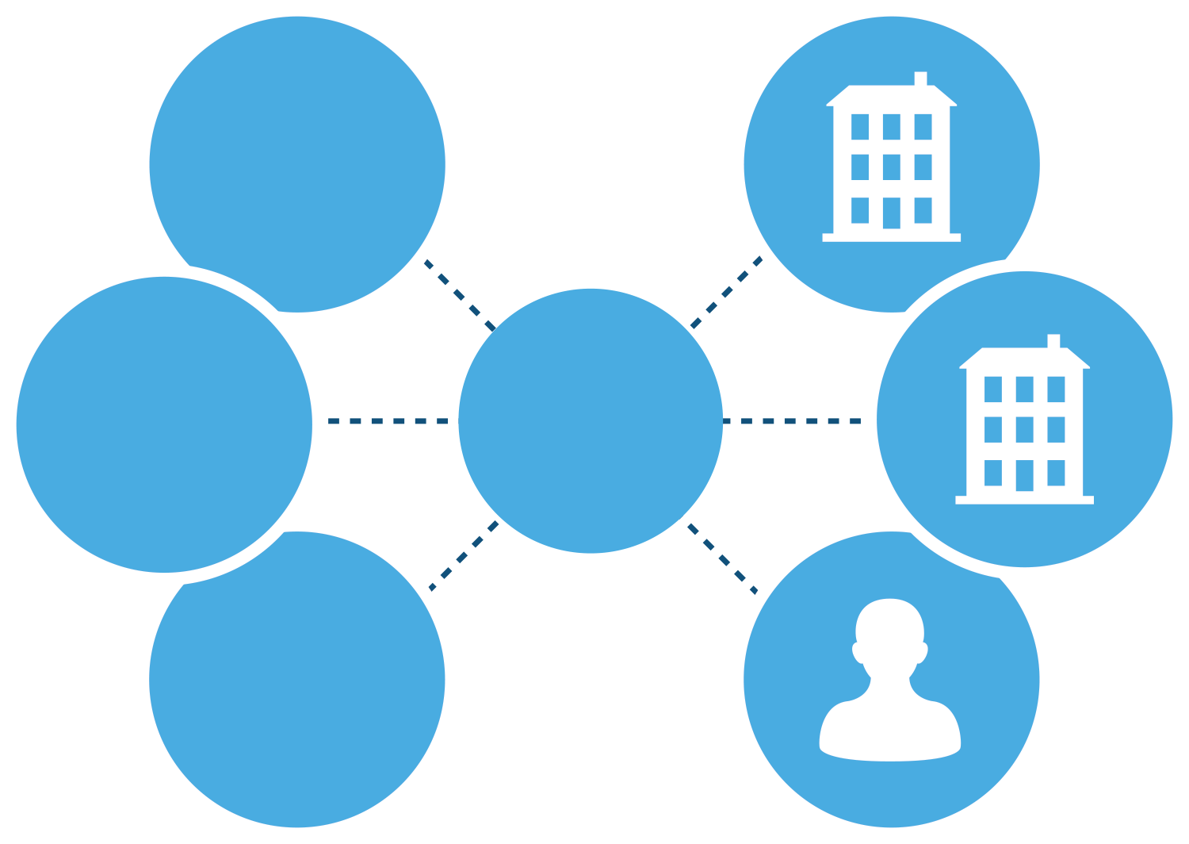
Network Approach Leads to Best Practices
“PaymentWorks will normalize / standardize the process across the the UC System and all higher-ed and healthcare.”
- CPO, UC Davis
“As the network grows, every school and health system will have no reason to not use PaymentWorks”
- CPO, Johns Hopkins
Supplier Identity & Credential Management
Network

Slide 13
Compliance
Insurance
Diversity
Sanction Monitoring
Conflict of Interest

Slide 14
Everything is Backed up by Business Controls
Single Sign On
Trackable Record of all Activity
Payment Visibility /
Analysis
Business Controls
Workflow / Approval Processes
Vendor Compliance
Bank Account Controls
Hiding Sensitive Information

Slide 15
VSU-After Implementation of PaymentWorks
Invites are sent to potential vendors by our campus departments who have attended training and gained access to PaymentWorks.
The invite is the extent of involvement by the campus departments.
Supplier completes all registration information through the PaymentWorks tool including W9 information and banking details.
Validation is completed on the TINS, address and banking information by PaymentWorks.

Slide 16
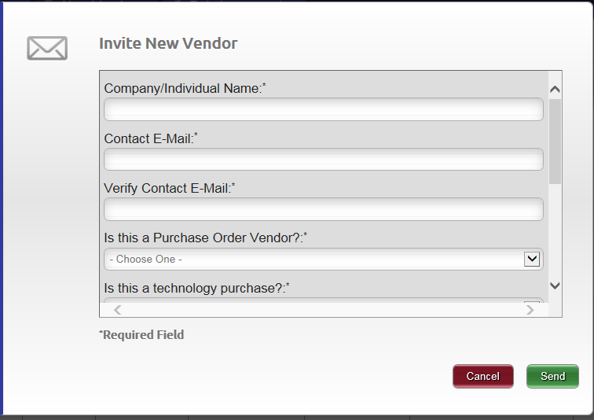
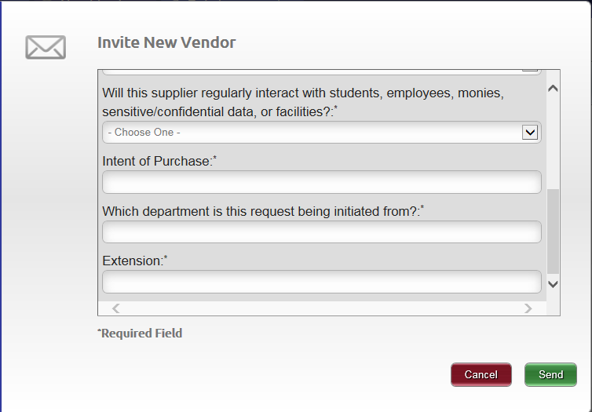
VSU Supplier Invite Example

Slide 17
VSU-After Implementation of PaymentWorks
All new suppliers are set up through PaymentWorks.
Workflow was set in PaymentWorks for approval levels based on standard vendor setup, bank change requests, etc.
Invites can include a personal statement from the invitee so vendors recognize the person sending the request.
Process time for has been reduced for vendor setup!

Slide 18
VSU-After Implementation of PaymentWorks
We now have transparency into the vendor onboarding process and can see how much progress the vendor has made in completing the registration.
PaymentWorks support team works with suppliers who may have difficulty in the registration process.
Reduced number of calls from vendors inquiring about how to complete registration forms, freeing up time for our staff to deal with more critical tasks.

Slide 19
Summary
The Higher Ed industry is realizing the need to come together and shape best practices around vendor management. Much of this has been driven by fraud and lack of compliance.
Defined controls and processes around vendor management will lead to risk mitigation.
A network approach that accommodates these best practices will help to affect change in the industry.

Slide 20
Summary
If a vendor updates their information in PaymentWorks it is visible by all of their customers that they are connected to within the network. This saves them time and effort to update with each individual customer, since so many vendors are used by multiple schools.
Vendors update their own information within the PaymentWorks network for change of address, bank changes, etc. as it requires a login to a secure site thus reducing the opportunity for fraudsters to request changes directly to your staff via phone, email or company letterhead.

Slide 21
Thank you!
Antolina Pilgrim
anedwards@Valdosta.edu
Taylor Nemeth
taylor.nemeth@paymentworks.com

