Slide 1
IT Procurement
& Ethics
Jim Barnaby
USG Strategic Sourcing Director
Jim.Barnaby@usg.edu

Slide 2
Technology Procurement Process
Best Practices
Ethics

Slide 3
Technology Procurement Process

Slide 4
Procurement Rules

Slide 5
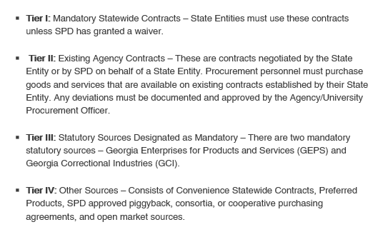
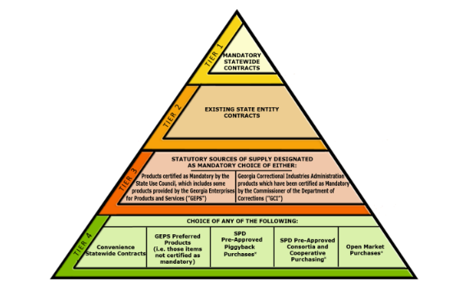
Order of Precedence

Slide 6
Procurement Basics
Less than $25K (Best practice to get three quotes) Must purchase through mandatory source if available
$10,001 -$24,999 requires two quotes or sole source justification (Federal Grant Money Only)
$25K or greater requires a solicitation unless there is an exemption
Exemptions can be located at:
http://doas.ga.gov/assets/State%20Purchasing/NEADocumentLibrary/NIGPExemptList.pdf

Slide 7
Types of Solicitations
Request for Quotes - Normally for non-complex goods
Request for Proposals (RFP) - Services and complex goods
Sole-Source - Used when only one source is available, significant cost to change, or unique knowledge

Slide 8
Request For Quotes (RFQ)
The institution prescribes both the specifications and
solution to its own needs.
Institutions should use a Request for Quotations if the project
lends itself to the creation of clear and accurate specifications and the objective of the solicitation is to identify a supplier who can provide the required specifications at the lowest possible cost.

Slide 9
Request for Proposals (RFP)
A Request for Proposals (RFP) is a formal solicitation method that seeks to leverage the creativity and knowledge of business organizations in order to provide a solution to a unique procurement.
The state entity should use an RFP if the end user wishes to evaluate the experience
of the supplier and the quality of the supplier response to either a clear
and accurate statement of work or to identify a supplier who can offer the best possible
solution to the state entity’s identified needs.
Delegated Purchasing Authority is $1 million

Slide 10
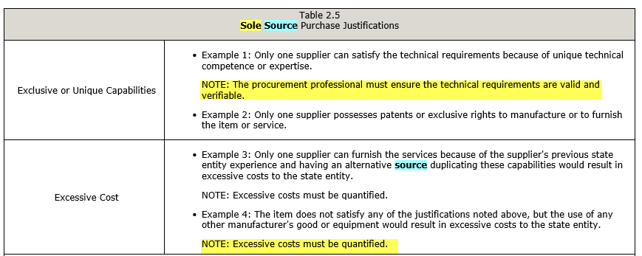
Sole-Source
For purchases with a value of $25,000 or more, sole source purchases are prohibited unless the state entity establishes justification for why the needed goods or services should not be procured through open competition.

Slide 11
IT Projects
Gallup Business Journal-
Only 2.5% of the companies successfully complete 100% of their projects.
The failure rates of projects over $1M is 50% higher than the failure rate of projects below $350K.
IBM-
Only 40% of projects meet schedule, budget and quality goals.
Portland Business Journal-
Between 65% and 80% of IT projects fail to meet objectives.
One study actually stated: “Bad communication is the cause of IT project failures in 57% of the cases.”

Slide 12
Solicitation Best Practices
RFP
Initial Evaluation
and Validation
Post RFP Bidder’s ConferenceQ&A
Receive Proposals
Negotiations
Gather requirements
Award Suppliers
Evaluate Responsive Bids
&
Validate Bids
Negotiate with Selected Suppliers
Planning & Preparation are key to a successful RFP and contract execution.
What we do in the development impacts contract management.

Slide 13
Solicitation Best Practices
Involve Procurement in the process as soon as possible.
Start planning and development for complex solicitation 12 months out.
Invite all stakeholders to assist in the development (Include those with boots on the ground).
Research Georgia Procurement Registry (GPR), don’t assume the solicitation is correct and duplicate
(Check Accuracy).
If software requires implementation, consider posting as an RFP.
a) Evaluate Time Lines and Bench Marks
b) Company Experience
c) References (Past performance is a strong predictor of future performance)
d) Support and Customer Services

Slide 14
Solicitation Best Practices
Contract Kickoff Meetings
Periodic Progress Meeting for Implementation
Inform Contract Administrator when problems occur
(Don’t wait until the problem becomes bigger)
Consider having the supplier provide an implementation checklist or punch-out to track progress (Don’t pay until the punch-out is complete)

Slide 15
P-Card Purchases
The State of Georgia Purchasing Card (P-Card) program streamlines payments for goods and services for State business use by eliminating the administrative burdens and costs associated with traditional methods of payment. Per the State Accounting Office, the P-Card may be used as the method of payment for unplanned, non-routine, or urgent point of sale purchases under $1,000 and for purchases under $5,000 that are preapproved and go through the requisition process prior to completing the purchase. Point of sale transactions include purchases made at a physical store, in person, online, or over the phone. This policy can be found on the State Accounting Office website at www.sao.georgia.gov.

Slide 16
Immigration & Tax Compliance
3.5.1.2. Tax Compliance
Prior to awarding any contract exceeding $100,000.00, the state entity must verify through the Department of Revenue (DOR) that the selected supplier (including any of the supplier’s affiliates) is not a prohibited source as defined by (O.C.G.A.) Section 50-5-82.
Tax Compliance must be verified upon each renewal.
3.5.1.3. Immigration and Security Compliance – Service Contracts
Suppliers and state entities shall comply with the requirements of (O.C.G.A.) §13-10-90 et seq. Additional information
regarding Immigration and Security Compliance can be found on the Georgia Department of Audits and Accounts
website.
At the time of renewal, the contract administrator must also request any updated documents which may be necessary to support the new contract term, including, but not limited to:
Department of Audits and Accounts Immigration and Security Form (as applicable)
Insurance Certificate (as applicable)
Performance Bond (as applicable)
Payment Bond (as applicable)
Letter of Credit (as applicable)
Any other document required by contract or the State Entity’s policy

Slide 18
When you’re facing a choice that has ethical implications, you may
be unsure of how to make a decision.
I recommend you reconsider a decision if you are:
Wondering if it’s legal. If you find yourself scrambling to find out whether the action you’re
contemplating is legal, chances are that it isn’t ethical.
Trying to keep it secret. If you are concerned about what will happen if your decision
becomes widely known, reconsider the choice you’re making.
Making Rationalizations. Phrases such as “They owe me” or “No one will ever know” are
usually signs that you are trying to rationalize something you know isn’t right.
Feeling in your gut that it’s wrong. Listen to what your inner voice is telling you.
Doing the right thing may not always be easy, but it is always right!

Slide 19
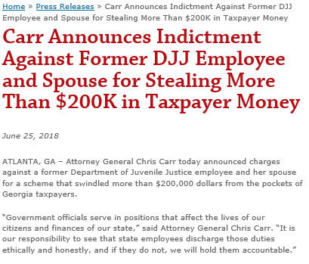
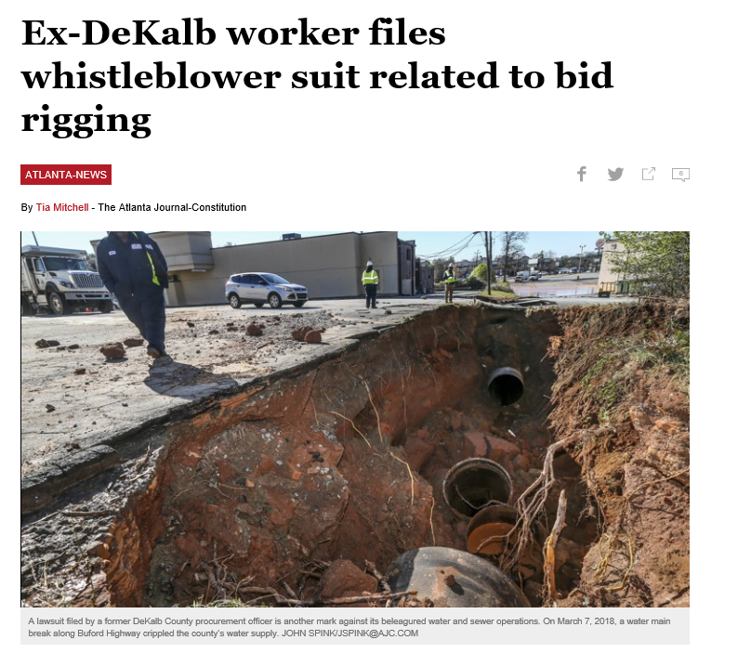
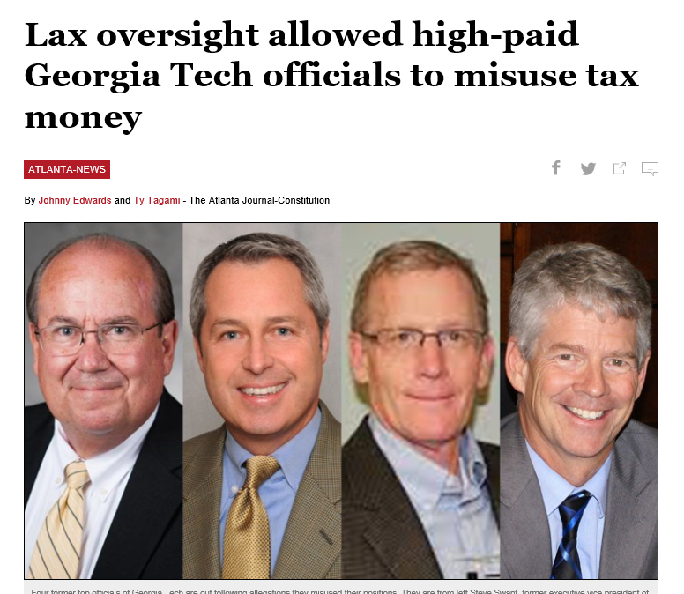
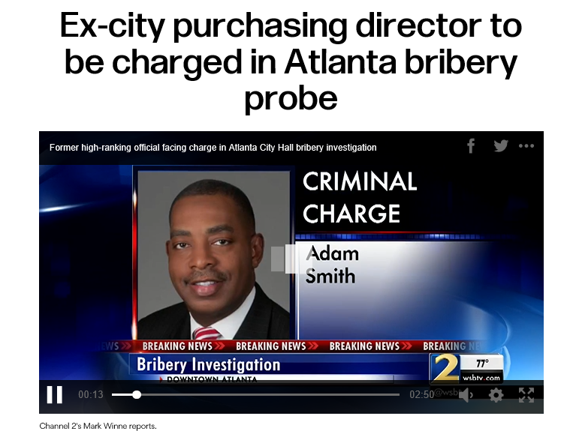
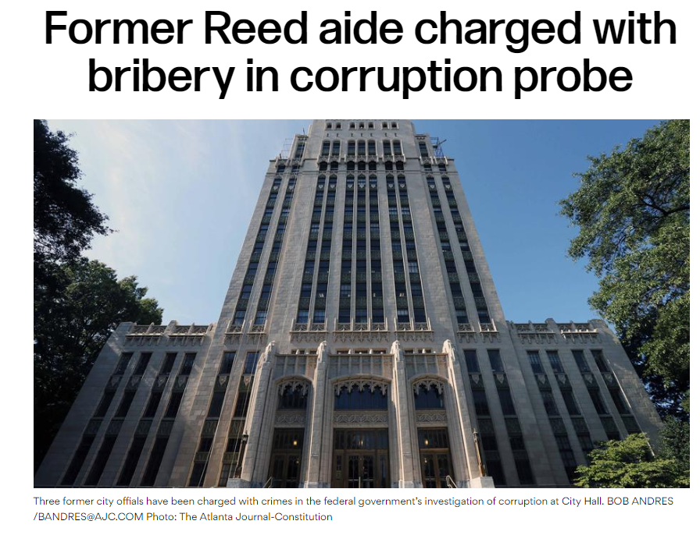
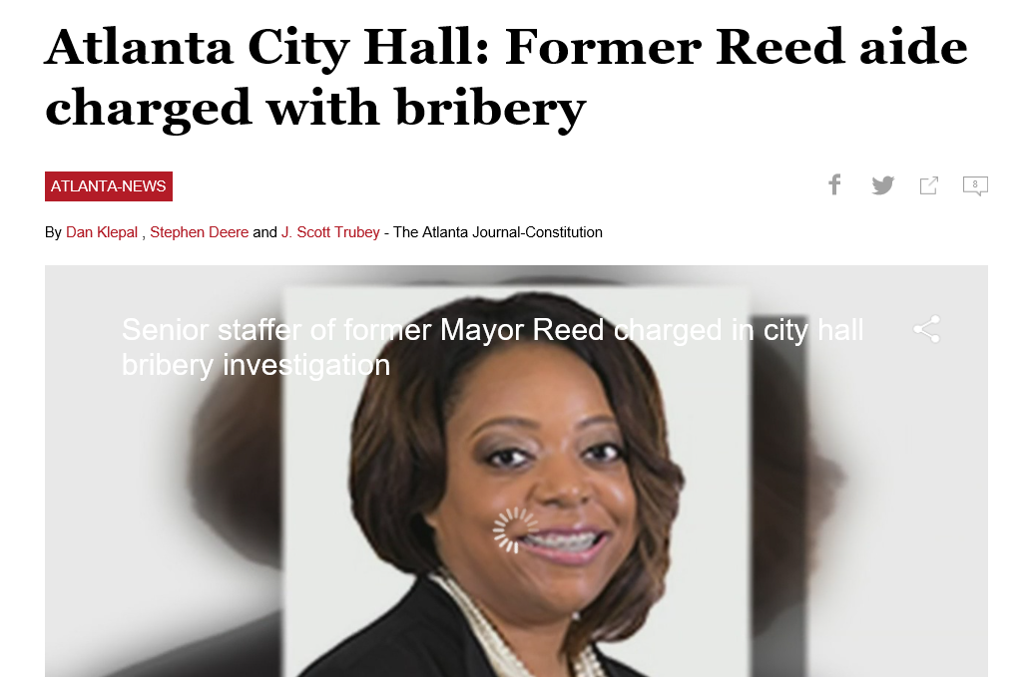

Slide 20
News Clip
https://www.youtube.com/watch?v=I1bJ3W74l0g

Slide 21
8.2.18.4 Gratuities
A University System of Georgia (USG) employee shall not directly or indirectly solicit, receive, accept, or agree to receive a thing of value by inducing the reasonable belief that the giving of the thing will influence his or her performance or failure to perform any official action. The acceptance of a benefit, reward, or consideration, where the purpose of the gift is to influence an employee in the performance of his or her official functions, is a felony under O.C.G.A. § 16-10-2.
A USG employee, or any other person on his or her behalf, is prohibited from knowingly accepting, directly or indirectly, a gift from any vendor or lobbyist as those terms are defined in Georgia statutes (O.C.G.A. §§ 21-5-70(6) and 45-1-6(a)(5)). If a gift has been accepted, it must be either returned to the donor or transferred to a charitable organization.

Slide 22
O.C.G.A. 45-1-6 Gifts to employees by vendors; disclosure; reports
a) As used in this chapter, the term: (1) "Commission" means the Georgia Government Transparency and Campaign Finance Commission created under Code Section 21-5-4. (2) "Gift" means a gratuity, subscription, membership, trip, meal, loan, extension of credit, forgiveness of debt, advance or deposit of money, or anything of value.
Any vendor who, either directly or through another person, makes a gift or gifts to one or more public employees exceeding in the aggregate $250.00 in value during any calendar year shall file a disclosure report with the commission in the form specified by the commission listing the amount and date of receipt, the name and mailing address of any vendor making the gift, and the name, address, and position of each public employee receiving such a gift.

Slide 23
8.2.20.5 Code of Conduct
We will:
Act as good stewards of the resources and information entrusted to our care.
Report wrongdoing to the proper authorities; refrain from retaliating against those who do report violations; and cooperate fully with authorized investigations.
Disclose and avoid improper conflicts of interest.
Refrain from accepting any gift or thing of value in those instances prohibited by law or Board of Regents policy.
* Procurement staff should never take gifts, go to lunch or do things that give the appearance of wrong doing.

Slide 24
Questions:
USG employees can attend conferences, meetings and demonstrations related to official or professional duties but must first obtain approval in writing from the Chancellor or designee if an outside party is covering expenses associated with the trip.

Slide 25
True
The USG Gratuities Policy permits vendors and lobbyist to pay for the actual and reasonable expenses for food, beverages, travel, lodging and registration provided to permit participation in a meeting, demonstration, or training related to official or professional duties so long as participation has been approved in writing by the Chancellor or his/her designee. The Executive Vice Chancellor for Administration and the Vice Chancellor for Organizational Effectiveness are both designated approvers for USO employees. For additional information, please reference the USG Gratuities Policy.

Slide 26
Questions:
Which of the following statements are true?
USG employees have an affirmative duty to report wrongdoing and unethical practices in a timely manner.
USG policy prohibits retaliation against those who report wrongdoing or assist with authorized investigations.
It is the policy of the USG to refer all criminal acts to law enforcement for investigation.
It is preferred that employees report wrongdoing to their immediate supervisors; however, other reporting avenues are available to include the HR, Legal and Audit Departments; wrongdoing can also be reported confidentially on the Ethics & Compliance Reporting Hotline.
All of the Above

Slide 27
Correct Answer: E. All of the above. USG employees do have an affirmative duty to report wrongdoing and unethical practices in a timely manner and must also refrain from retaliating against those who do. The USG also refers all criminal acts to law enforcement and maintains an Ethics hotline as an additional way to report wrongdoing. For additional information, please see USG Policy - Reporting Wrongdoing.

Slide 28
8.2.18.2. Conflicts of Interest and Conflicts of Commitment
Each University System of Georgia (USG) employee shall make every reasonable effort to avoid actual or apparent conflicts of interests and also the appearance of a conflict of interest. An appearance of a conflict exists when a reasonable person would conclude from the circumstances that the employee’s ability to protect the public interest, or perform public duties, is compromised by a personal, financial, or business interest. An appearance of conflict can exist even in the absence of a legal conflict of interest. USG employees are referred to State Conflict of Interest Statutes O.C.G.A. § 45-10-20 through § 45-10-70 and institutional policies governing professional and outside activities.

Slide 29
References:
Georgia Procurement Manual
http://pur.doas.ga.gov/gpm/MyWebHelp/GPM_Main_File.htm
Board of Regents Policy Manual
https://www.usg.edu/policymanual/
Business Procedures Manual
https://www.usg.edu/business_procedures_manual/

Slide 30
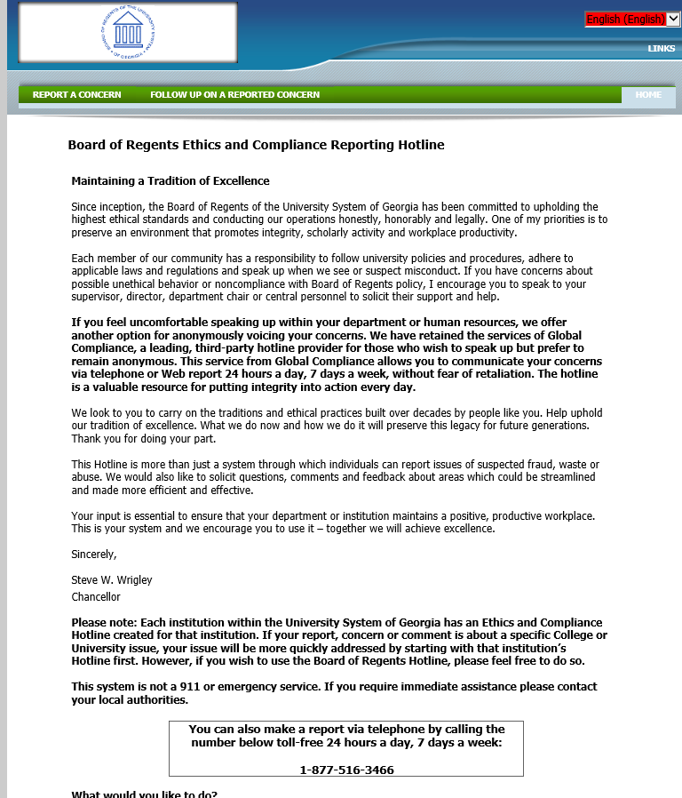

Slide 31
Questions
?

