Slide 1


Georgia Highlands College
Center for STEM Learning
Presenters:
Gregory D. Ford, Ph.D.
Sharryse Henderson, M.S.
Jillian Petro
-------------------------------
Acknowledgement:
Tim Floyd, Laura Ralston, Erin Kingston, Camille Pace, & Jayme Wheeler

Slide 2
Mission Statement
Georgia Highlands College, a state college of the University System of Georgia under the governance of the Board of Regents, was founded in 1970 to provide educational opportunities for the physical, intellectual, and cultural development of a diverse population through pre-baccalaureate associate degree transfer programs, career associate degree programs, and targeted baccalaureate degree programs that meet the economic development needs of the region.

Slide 3
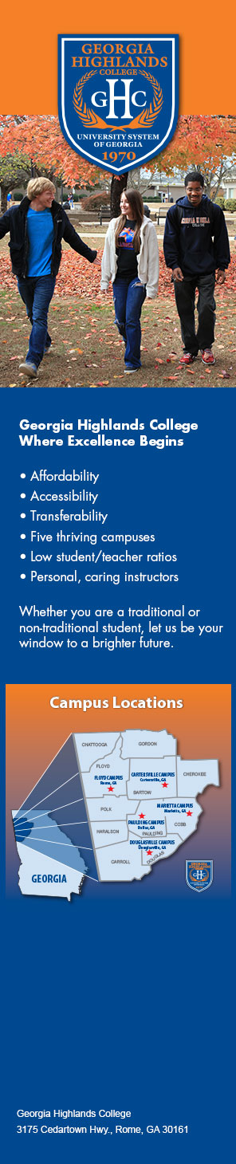
Main Campus and Instructional Sites
Our main campus, six instructional sites serve the students throughout Northwest Georgia:

Slide 4
Student Demographics: 2016-17

Slide 5
GHC Additional Fact Book Data
GHC is one of only two colleges in Georgia listed in a 2015 national database as the “best value” and “best return on investment” in the state.

Slide 6
USG STEM Initiative Goals
In order to address these challenges in Georgia, the USG STEM initiative works aggressively with USG institutions and K-12 partners to increase:
The number of K-12 students who are prepared for and are interested in majoring in STEM disciplines in college
The success and completion rates of college students majoring in STEM disciplines
The number of qualified K-12 STEM teachers.

Slide 7
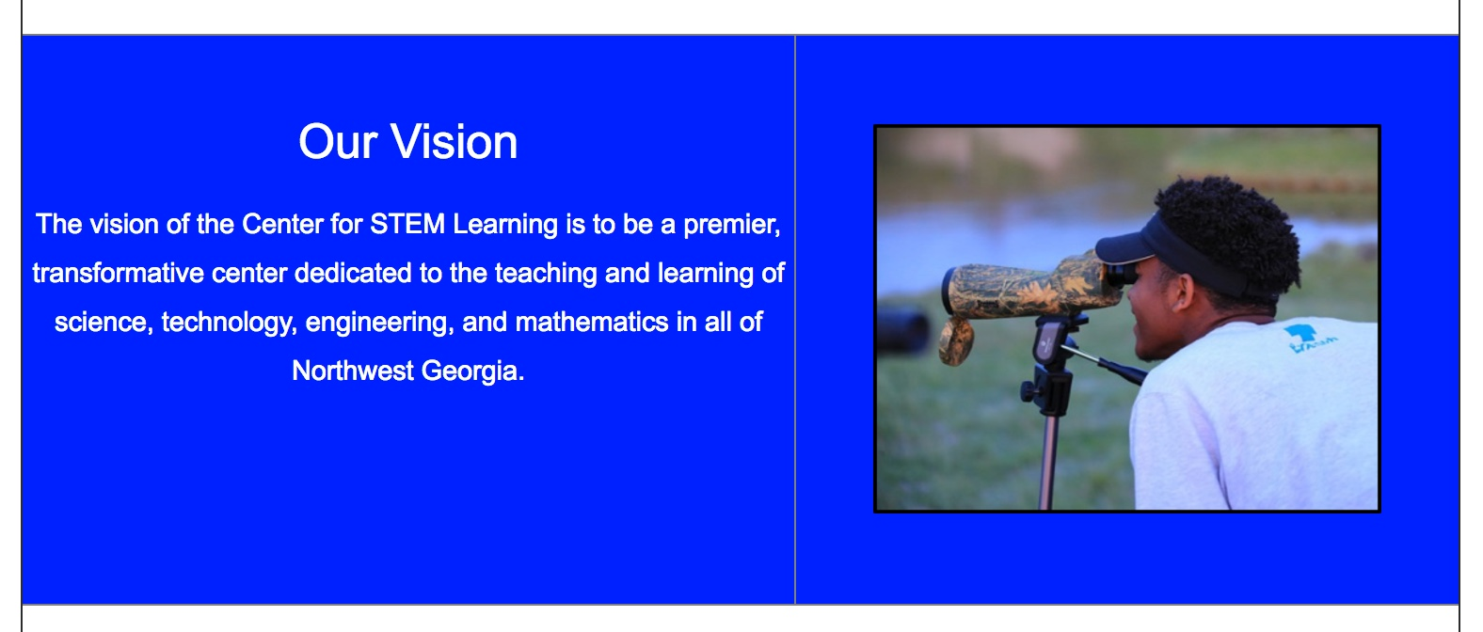
Georgia Highlands College Center for STEM Learning –Vision Statement

Slide 8
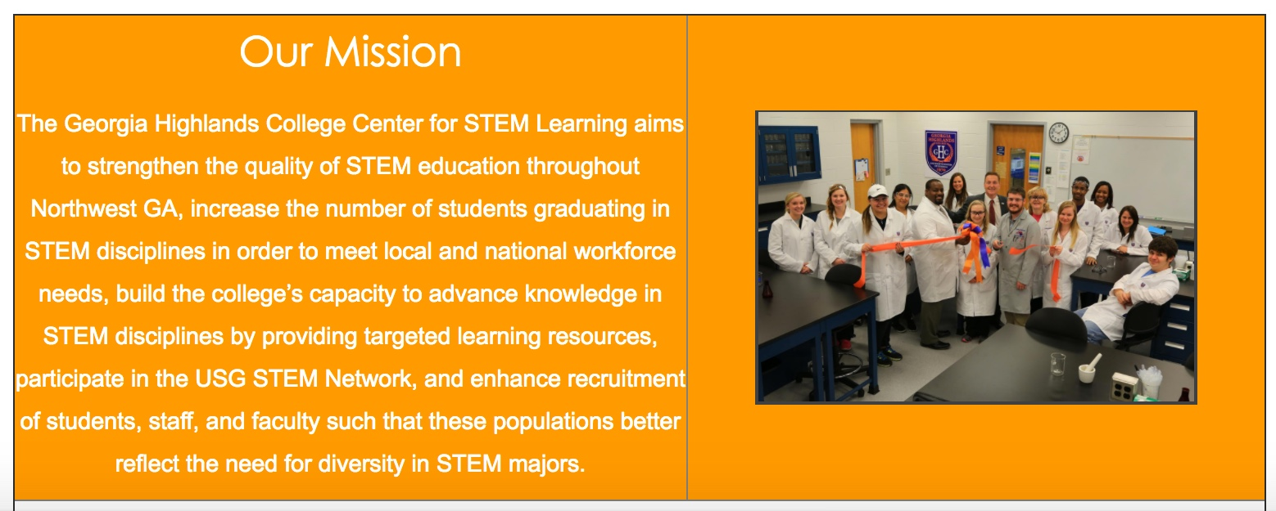
Georgia Highlands College Center for STEM Learning –Mission Statement

Slide 9
GHC – CSL Goals for 2016-17
To inspire students to consider STEM pathways
To support retention efforts to increase the number of STEM graduates
To develop new co-curricular materials, instructional approaches, and technology-based learning environments that can promote equity and enhance STEM learning
To strengthen collaborative STEM partnerships with key community partners.

Slide 10
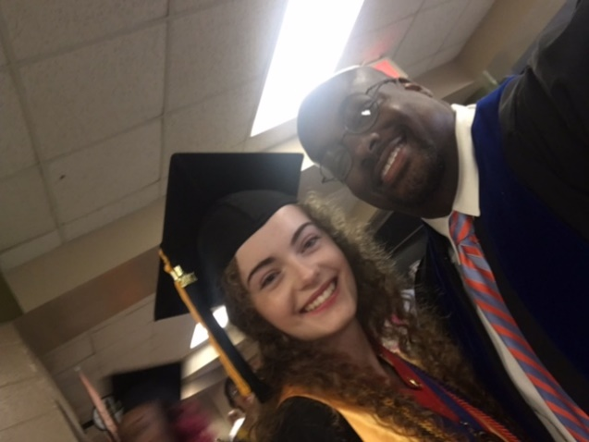
Goal 1. To inspire students to consider STEM pathways
We offered classes at three satellite facilities to better serve MOWR students:
Bartow County College and Career
Academy – CHEM 1211K/1212K
Floyd County College and Career Academy – BIOL 2017/2018
Polk County College and Career Academy – CHEM 1211K/1212K

Slide 11
Goal 2. To support recruitment and retention efforts to increase the number of STEM graduates
We are targeting local school in all five of our service areas working with our professional advisors.
We have created marketing products to drive home the message of “STEM READY”
Marketing folders are being distributed to school councilors at the GHC Counselor Workshop

Slide 12
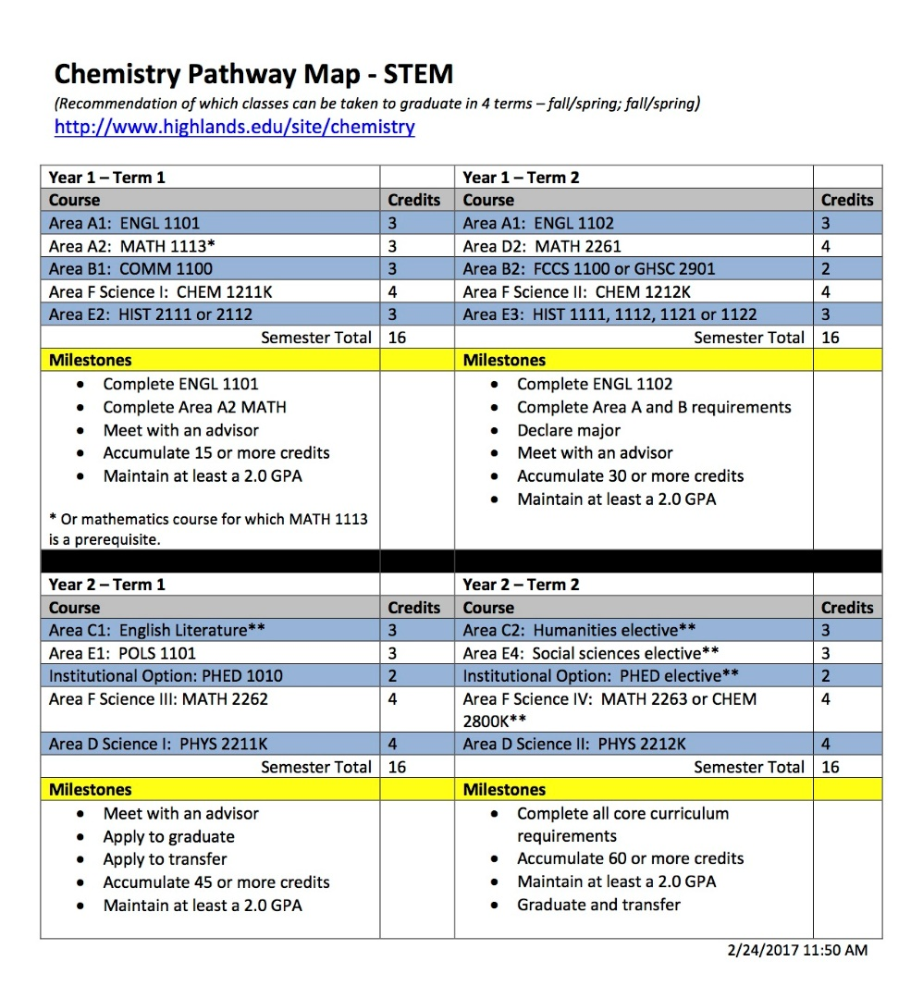
Goal 2. To support recruitment and retention efforts to increase the number of STEM graduates
Developed program maps with common STEM first semester experience.
We have put a focus on Chemistry as a common first-year Area D science sequence.

Slide 13
Goal 2. To support recruitment and retention efforts to increase the number of STEM graduates
Success in Chemistry Courses at GHC
Percentage of Students that Receive an A, B, or C in STEM Core Courses
Chemistry 1151 | 40.20% | 67.80% | 72.70% | 74.60% | 56.00% | 63.50%
Chemistry 1152 | 76.50% | 94.40% | 95.20% | 89.50% | 75.70% | 91.50%
Chemistry 1211 | 55.30% | 45.40% | 40.80% | 58.90% | 55.40% | 62.00%
Chemistry 1212 | 85.60% | 72.20% | 52.90% | 75.90% | 75.40% | 70.30%
…a success story, all data is good data

Slide 14
Goal 3. To develop co-curricular materials to enhance STEM Learning
Introducing the Georgia Highlands College Center for STEM Learning Website (Prototype)

Slide 15
Goal 4. To strengthen collaborative STEM partnerships with key community partners - KSU

Slide 16
Next Steps

Slide 17
Goal 4. To strengthen collaborative STEM partnerships with key community partners
Our Newest Project is in collaboration with Cartersville High School and 100 Black Men of Northwest Georgia
Georgia Highlands College Robotics is a comprehensive STEM program created to motivate and expose students to STEM opportunities and careers. The program consists FIRST robotics, coding, STEM activities and field trips.
The FIRST LEGO™ League Program (FLL) is considered the “little league” of the FIRST Robotics Competition, and extends the FIRST concept of inspiring and celebrating science and technology to children aged 9 through 14.

Slide 18
Contact Us
Gregory D. Ford, Ph.D., PI
gford@highlands.edu
Sharryse Henderson, M.S., Director
shenders@highlands.edu

