Slide 1
Broadening Participation through K-12 and Community Partnerships
Patrick J. Enderle & Natalie S. King
Department of Middle & Secondary Education
Georgia State University
USG STEM Conference – Macon, GA
May 18, 2017

Slide 2
Building Capacity for 3D Content, Practices & Crosscutting Integration
Math/Science Partnership (MSP) Grant funded by GA DOE
Collaboration with Fulton County Schools, Georgia State University, and CEISMC group at Georgia Tech
Working with 30 middle school teachers in enhance their understanding and ability of scientific practices and how to teach with them
Collaboration between university scientists and science educators to introduce and support teachers’ learning about inquiry lessons and the scientific practices underlying this approach to instruction

Slide 3
Teacher Enhancing Achievement & Mastery Through 3-DimensionaL Learning (TEAM 3D)
MSP Grant funded by GA DOE
Collaboration between Rockdale County Schools and Georgia State University
Working with 30 secondary science teachers in enhance their understanding and teaching of scientific practices and their content knowledge in their particular discipline
Collaboration between university scientists and science educators to support teachers’ learning about the scientific practices and experiences with learning content in their certified discipline

Slide 4
Atlanta’s Professional Preparation for enhancing argumentation through laboratories (APPEAL)
Improving Teacher Quality State Grant collaboration involving Atlanta Public Schools, GSU College of Education & Human Development and College of Arts & Sciences
Week long summer intensive workshop and several follow-up meetings during the 2016-2017 school year.
Teachers experienced several ADI labs and work with GSU scientists to understand the evidence behind science concepts

Slide 5
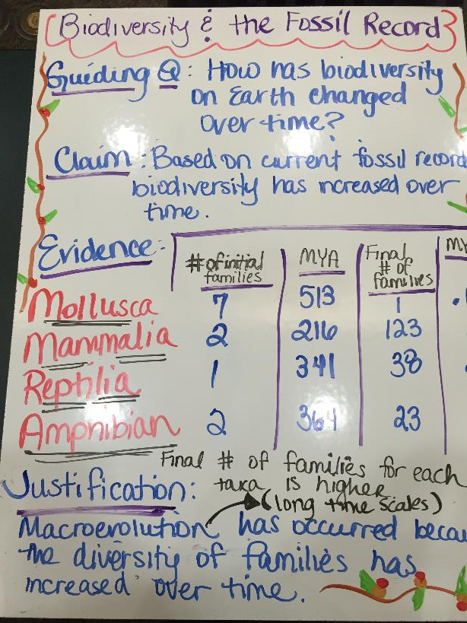
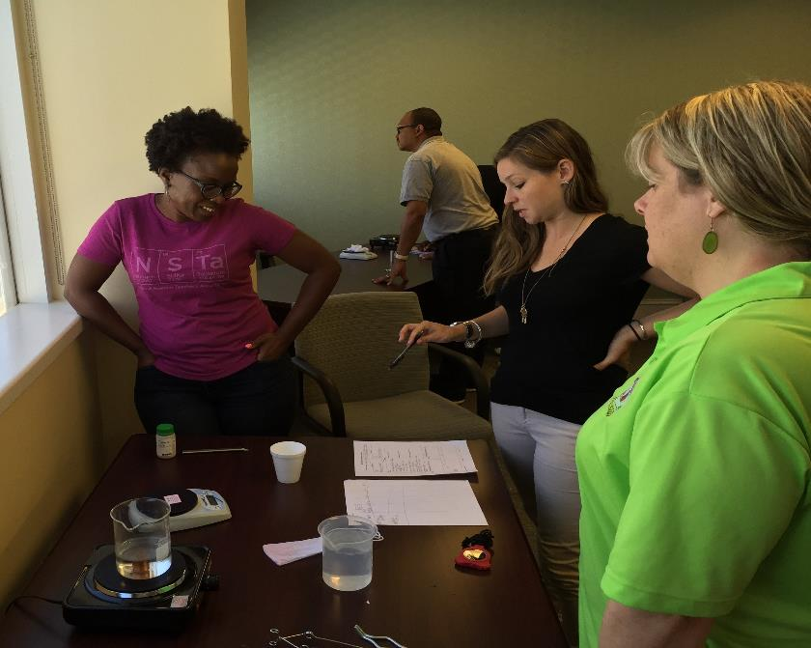

Slide 6
APPEAL REsults
Participating teachers (n = 12) received stipends, materials, and support for implementation; Schools received supply kits to support teachers’ implementation
Participants demonstrated improvement in their content knowledge, understanding of argumentation instruction, and the understanding of nature of science concepts over the course of summer activities
Delayed-post data collection ongoing
Contextual challenges limited the amount of argumentation investigations implemented by the teachers in their classrooms

Slide 7
Bio-Bus Teacher Quality Project
Partnership between GSU’s Colleges of Education and Arts and Sciences and DeKalb, Henry, and Cobb County Schools and Atlanta Public Schools
Preparing Georgia’s high school science teachers to integrate interdisciplinary, inquiry-based, hands-on research modules in the classroom
Deepen 20 high school teachers’ content knowledge and laboratory skills in biology, chemistry, microbiology, environmental science, biotechnology, and engineering through the use of bioreactors – using interdisciplinary development approach
Follow up visits throughout school year from the 30-foot mobile instructional laboratory (Bio-Bus)

Slide 8
Community Partnership Project
Partnership between GSU College of Education (Department of Middle and Secondary Education) and The Study Hall (afterschool and summer camp serving K-5 students in Peoplestown Community in Atlanta, GA)
Partnership with The Study Hall’s STEAM Initiative - Camp Exploration
Introduction to Secondary Teaching Science Methods Course – GSU MAT students develop and implement inquiry-based science lessons that engage elementary students in 3D teaching and learning
Alternative placement – experience teaching in informal contexts
Expanding future collaborations with non-profit and industry partners
Working with GSU Urban Literacy Clinic to connect students and their identity development within the context of science focused literature

Slide 9
Building K-12 Partnerships – Key ideas
Critical Colleagues
University Faculty with necessary disciplinary experience
K-12 District Personnel who focus on supporting teachers
Engaged Teachers & Administrators
Synergistic relationships amongst institutional entities internal and external to the university
Contextual Influences
External Funding Mechanisms
GA Standards of Excellence for Science
Focal curricula and instructional materials, but allow for teacher adaptation

Slide 10
Broadening Access – Key Ideas
Involve the communities where students live
Be open to working with new types of organizations
Students must experience higher quality science teaching involving scientific practices
Teachers must be supported in their understanding of how students’ science identity develops

Slide 11
Critical Challenges
Having all stakeholders informed about a particular effort
Many competing initiatives in any one district
Opportunity for project to develop over time and make meaningful impacts

Slide 12
Thank you!! Questions?
penderle@gsu.edu
natalieking@gsu.edu

