Slide 1
ADP Reconciliation
Training
Transitioning balances from Banner
into new Recon Processes

Slide 2
Agenda
Review Previous Model and Define Problems
Review New Phase II Processes
Moving balances from Banner into new Recon System
There are no stupid questions…..

Slide 3
ADP Reconciliation Training
Retiree Receivables
Review Previous Model and Define Problems

Slide 4
Review Previous Model
(prior to March 2011)
Step 1
Record retiree receivables in Banner (epop046-a)
Step 2
Record retiree benefits expense, accrue liabilities and zero Banner clearing (epop046-b)
Step 3
Pay benefits liability (CES Accounting)
Step 4
Record employee payment – clear receivable balance (direct bill)

Slide 5
Review Previous Model and Define Problems
Establishing Retiree Receivables & Issues
  Using ePop046 process
    Created an AR file we loaded into Banner
    Receivables were dependent upon the accuracy of Winflex
    ADP Benefits Direct is the authentic source since they are actually processing the ‘coupons’ and receiving payments
    Benefits Direct and Carrier Enrollment Services (CES) makes changes to retiree transactions that are not interfacing into Banner
    These Retro-active changes do not get picked up by the ePop046
    Also, epop046 process doesn’t handle our Cobra ARs

Slide 6
Review Previous Model and Define Problems
Clearing Retiree Receivables & Issues
  Direct Bill File Interface to Banner
    Not all Retirees are accounted for in the file (if they had no activity)
      (Cobra Payments are not included in the DB file)
    Receivable payments are not recorded in the general ledger at the employee level – the detail is in Banner
    Has Retro-active transactions not picked up/posted via epop046 process
    The Open Coupon Report from Benefits Billing is really our source for Outstanding Receivables at the end of each month
  Supplemental PDR
    Macon Check is recorded at the account level - No employee level detail in the general ledger

Slide 7
ADP Reconciliation Training
Retiree Receivables
Review New Phase II Processes

Slide 8
Review New Phase II Processes
Solutions to Defined Problems
  A process to record retiree benefit expense and receivables based on what is paid by CES (not Winflex)
    Retiree Benefit Accounting
  A process to record Supplemental PDR payments and cash at an employee deduction code level
    Supplemental PDR Accounting
  A process to systematically correct payroll liability variances while maintaining employee level detail
    Automated Payroll Adjustment

Slide 9
Review New Phase II Processes
Solutions to Defined Problems (cont’d)
  Built an online page to allow institutions to correct accounting issues at an employee / deduction code level
    Online Payroll Adjustment
  Built reports to assist in accounting for cash and receivables reconciliation
  Retired ePop046 process in EV5
  Retired Direct Bill Interface into Banner
  Remove unneeded (redundant) data from Banner

Slide 10
ADP Reconciliation Training
Moving Balances from Banner into New Recon System

Slide 11
Background
Current State of Retiree Receivables/Pre-Payments
  Located in Banner under RETR Detail Code
  Detail recorded by Retiree/LOA/Disability, Benefit & Amount
  Amounts should total to AR balance in GL account 129xxx (debit)
  Pre-payments under the DDBT Detail Code (some schools may another)
    Note: Direct Bill only interfaces one month of pre-payments
  Prepayments recorded in Unapplied Cash liability account 219xxx
  Detail balances for prepaids can be reconciled back to Direct Bill
  CES/Benefits Billing makes adjustments to retiree balances without notifying the institution

Slide 12
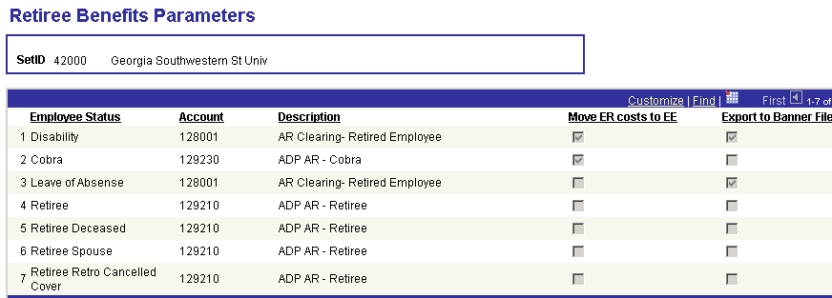
Background
  Retiree Benefit Accounting Parameters
    New AR accounts have been created
      129210 – Retirees
      129220 – LOA & Disability
      129230 - Cobra

Slide 13
Conversion Steps
Step 1: Banner – Load the Direct Bill for February
  Run the AR Load Process (ZSRINLD).
  Make sure that the Application of Payments process (TGRAPPL) is run after the file is successfully loaded. This ensures all payments and transactions have been applied before attempting to balance.
  This should have been the last transaction file posted in Banner under the previous processes. No transactions for March should have been loaded into Banner. (We will be using the new processes for March transactions.)

Slide 14
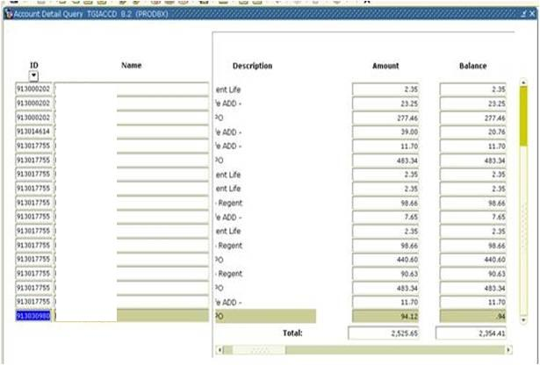
Conversion Steps
Step 2: Reconcile Banner
  Run an Account Detail Query (TGIACCD) for Detail Codes RETR, DDBT & SLOA for balances <> 0
  Validate against balances in GL accounts
    Can use the February Supplemental PDR to help validate pre-payments

Slide 15
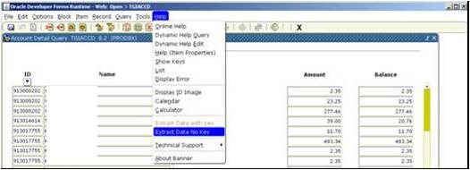
Conversion Steps
Step 3: Extract Data into Excel

Slide 16
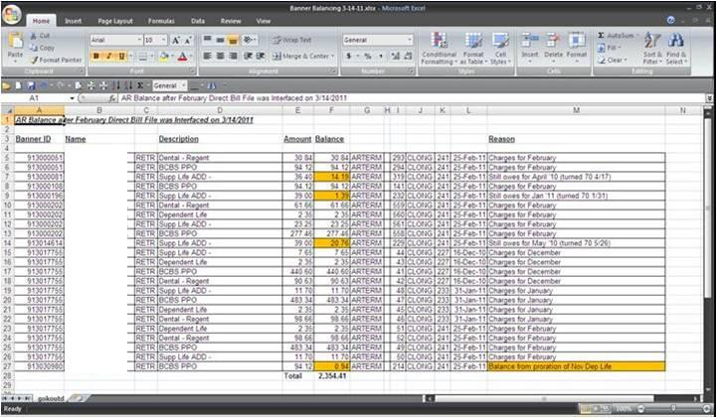
Conversion Steps
Sample of RETR data:

Slide 17
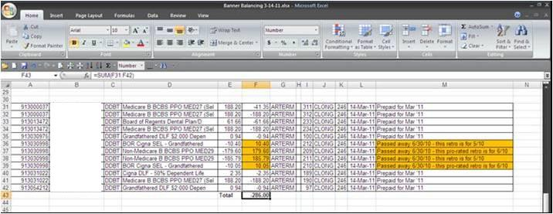
Conversion Steps
Step 4: Validate the detail/amounts for Retirees because of the way Banner applies charges/payments. (may have to unapply/reapply transactions (individual basis) to get good balance detail)

Slide 18
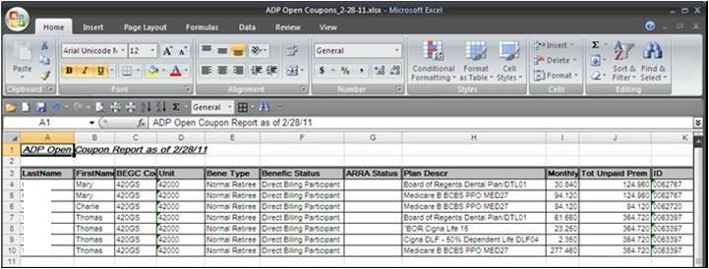
Conversion Steps
Step 5: Run the open coupon report from ADP Recon Environment for 2/28/2011
  Query - BOR_ADP_COBRARET_RECV

Slide 19
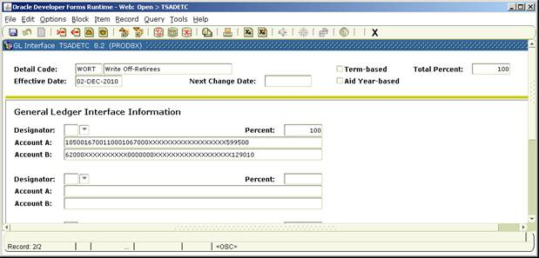
Conversion Steps
Step 6: Compare Banner to the Open Coupon Report
  Some balances may need to be investigated with SSC
  There may be balances that have to be expensed off
    Suggestion: Create a new Detail Code in Banner - WORT: Write-Off Retiree

Slide 20
Conversion Steps
Step 7: In Banner - Using TFADETL
  Reverse the legitimate ARs/Prepays via the RETR/DDBT Detail Codes (some institutions may have used other Detail Codes)
  Write off/Expense any uncollectable or immaterial ARs

Slide 21
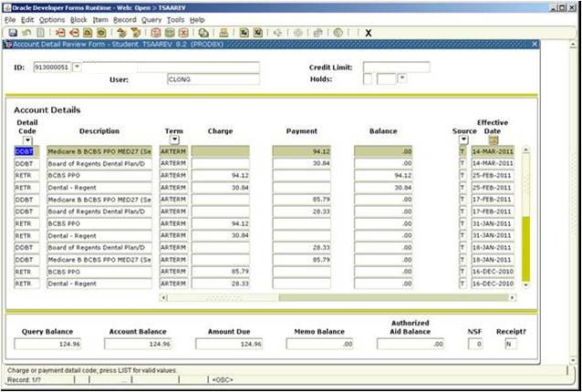
Conversion Steps
Step 7 (cont’d) TSAAREV detail prior to reversals

Slide 22
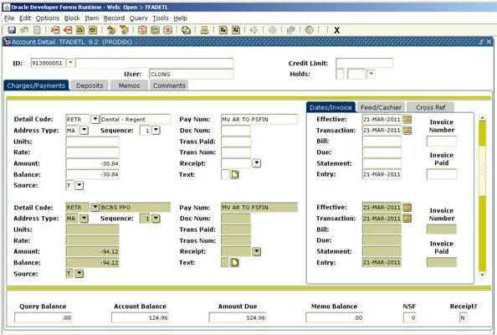
Conversion Steps
Step 7 (cont’d) TFADETL performing reversals

Slide 23
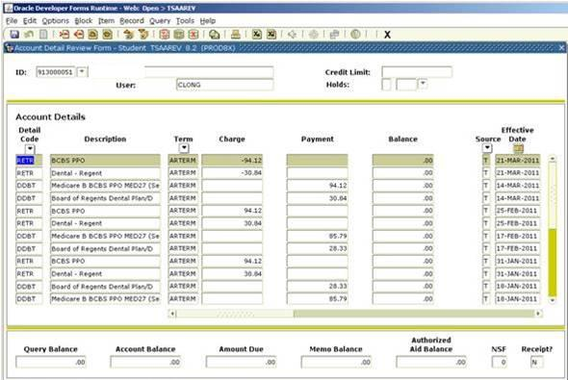
Conversion Steps
Step 7 (cont’d) TSAAREV Detail after reversal & transactions applied

Slide 24
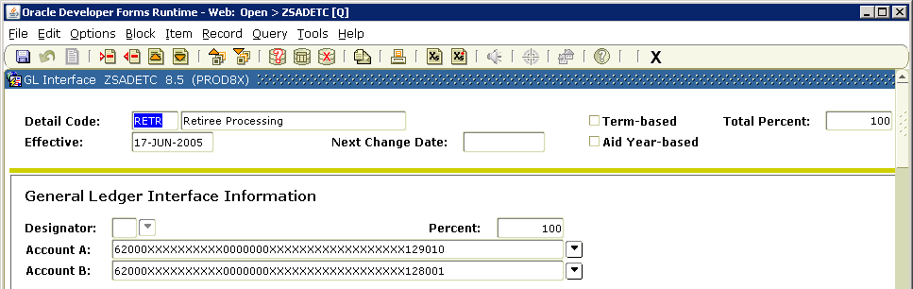

Conversion Steps
Step 8: Be aware of what accounts are behind your Detail Codes. They will be needed when re-establishing the ARs/prepayments in the new recon system. Can look them up using ZSADETC.

Slide 25
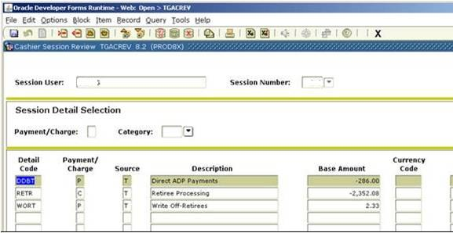
Conversion Steps
Step 9: Close Banner and Interface to PS Financials.

Slide 26
Conversion Steps
Step 10: Journal Generate, Edit, Budget Check and Post the Banner journal.
  Note: This is a good opportunity to verify GL Balances again.

Slide 27
Conversion Steps
For demonstration purposes…..
RETR Detail Code accts:
  128001/62000 = $2,352.08
  129010/62000 = 0.00
DDBT Detail Code accts:
  219859/10500 = 0.00
  118197/10500 = ($286.00)
Note: After the transactions are posted using the Payroll Adjustment Process, the ending net affect/balance in the new 129210 account will be $2,066.08.

Slide 28
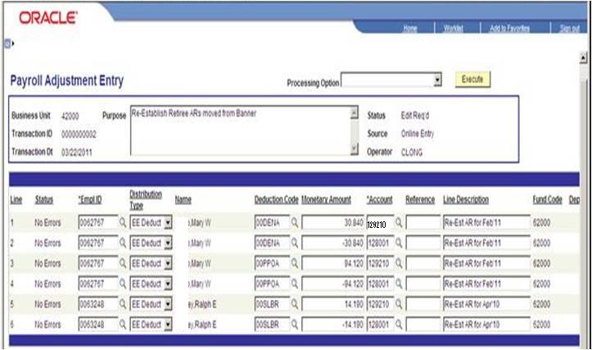
Conversion Steps
Step 11: Use the online payroll adjustment process to reestablish AR Balances in PERS_SERV_BOR.
  Note: Use new AR accounts (See Parameters Page)

Slide 29
Helpful Info …
Do NOT run the EPOP046 for March forward!
Run the CES Accounting Process in PS Fin for March, for Active Employees only .
  Click OFF the Process Retirees option.
Run the new Retiree Benefits Accounting process.
From the CES file, identify any retro-active transactions.
  For Retirees, EE costs were posted to the AR account and the ER costs were expensed.
  For Cobra, both the EE & ER costs posted to a separate AR account.
29

Slide 30
Helpful Info …
Depending on type of Retro transactions, may have to perform Online Payroll Adjustments to move funds between accounts.
  Find out how the original transaction was booked.
May have received pre-payments for Cobra. Will need to move these (in detail) to credit the new Cobra AR account using PR Adjustment process.
May have outstanding Cobra ARs tracked via other methods/accounts. Will need to move.
30

Slide 31
ADP Reconciliation Training
Transaction Type by Source
Job Aid

Slide 32
Transaction Type by Source
Payroll Interface
  PIEX-Payroll Interface Expense
  PIEN-Payroll Interface Encumbrance
EPOP046 (Retired)
  BNBL Benefits Billing to GL
Carrier Enrollment
  ERC-Employer Benefit Cash Payment
  EEC-Employee Benefit Cash Payment
  EED-Employee Benefit Distribution
  ERD-Employer Benefit Distribution
32

Slide 33
Transaction Type by Source
Payroll Adjustments
  REC-Systematic Payroll Adjustment
  ONL-Online Payroll Adjustment
Retiree Benefit Accounting
  RRC-Retirement Benefits ER Cash
  RRE-Retirement Benefits ER Expense
  RER-Retirement Benefits EE Recv.
  RES-Retirement Benefits EE Cash
Supplemental PDR Accounting
  SPC-SUP Employee Cash Contribution
  SPR-SUP Employee Receivable Relief

Slide 34
ADP Reconciliation Training
Questions?

