Slide 1
Welcome to the eProcurement & Purchasing Jungle: Navigate your way through Requisitions & Purchase Orders
Teresa Page & Melissa Gooch
Information Technology Services
Board of Regents of the University System of Georgia

Slide 2
We are here for you!
ITS Support Team
GeorgiaFirst Marketplace, eProcurement, Purchasing
April Harder
Teresa Page
Melissa Gooch

Slide 3
Agenda
Training Resources
Benefits of using eProcurement
Life cycle of eProcurement and Purchasing Transactions
Review PO & Req Reconciliation Workbench options
Month End Cleanup Processes for Purchase Orders and Requisitions
Troubleshooting techniques
User Questions

Slide 4
Training Resources
Access the GAFIRST Financials website to find these recommended resources:
http://www.usg.edu/gafirst-fin/training/archives/
Using the PO Workbench and Monthly PO Cleanup Processes Wimba, March 23, 2010 archive: http://67.202.210.69/launcher.cgi?room=PSFIN_TRNG_2010_0323_1430_53
PSFIN v8.9 UPK’s for eProcurement and Purchasing
http://www.usg.edu/gafirst-fin/documentation/
eProcurement Business Processes
Purchasing Business Processes

Slide 5
What is eProcurement?
eProcurement is a module within the PeopleSoft Financials system which integrates with the Purchasing module.
In the ePro module, Requesters create & submit electronic requisitions. The Requisition is routed for Approval, electronically, and can then be processed into a Purchase Order.
3 Primary Roles that play a part in eProcurement:
Requesters
Approvers
Buyers

Slide 6
Benefits of eProcurement
Reduction of manual effort required by Procurement staff
The Requisition is automatically tied into all of its related Documents.
Flexible Approval Workflow
Confirmation of available funds
Ability to track the requisitions lifecycle
Multiple sourcing options

Slide 7
Processing Task | ePro | Purchasing
Create & Submit Requisition
Approve Requisition
Budget Check Req*
Source Req to PO*
Approve PO*
Budget Check & Doc Tol PO*
Dispatch PO*

Slide 8
Procure to Pay Process Flow
Create a Requisition (REQ) and submit it for approval
Requisition is approved
Budget Check the Requisition to create a pre-encumbrance
Source the REQ into a Purchase Order (PO)
Budget Check PO to relieve pre-encumbrance and create encumbrance
Dispatch PO to Vendor
If Original PO changes, Create Change Order and Dispatch to Vendor
Receive Goods or Services
Receive Invoice from Vendor
Create Voucher to pay Invoice
Run Matching Process
Run Document Tolerance Process
Budget Check Voucher to relieve encumbrance and Create expenditure
Post Voucher
Journal Generate Voucher
Run pay cycle to produce payment from Voucher
Post Payment
Reconcile PO
Close the PO
Reconcile the Requisition
Close the Requisition

Slide 9
Procurement Process Flow
Create Requisition and submit for approval
PO Dispatch
Requisition is Approved
Budget Check the Requisition (to create a pre-encumbrance)
Source the Requisition into a Purchase Order (PO)
PO Receive
AP Processing
Reconcile PO
Close the PO
Reconcile the Requisition
Close the Requisition

Slide 10
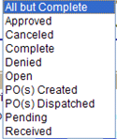
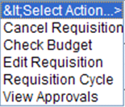
Where Am I?

Slide 11
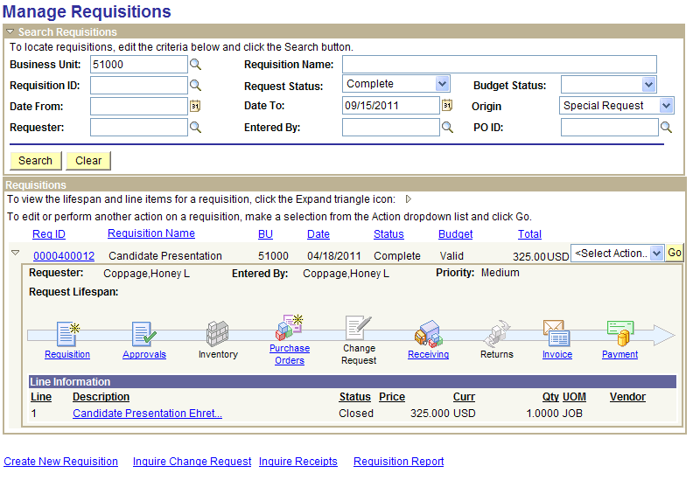
Where is my Request?

Slide 12
PO Reconciliation Workbench
What’s the Use?
Analysis
Flexible Filter Options page allows you to search for POs based upon the criteria that you specify

Slide 13
Action
Select the POs that you want to work with, then select the Action that you wish to take

Slide 14
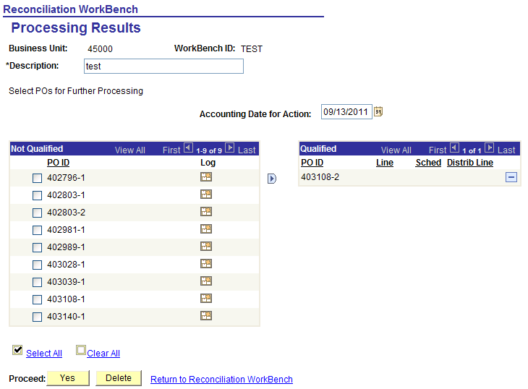
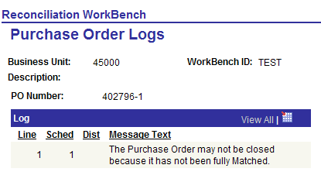
Review & Proceed
Not Qualified, Why?
‘Force’ to Qualified side
Qualified

Slide 15
PO Reconciliation Workbench Tips
A PO should NOT be forced to close if:
Active vouchers exist
Budget exceptions exist
Reasons a PO will not close:
PO is tied to an Active Voucher
PO is not fully matched (if set to Full Match)
PO with Receiving Required set, but nothing has been received
PO has a due date less than or equal to the Calculated Close Date

Slide 16
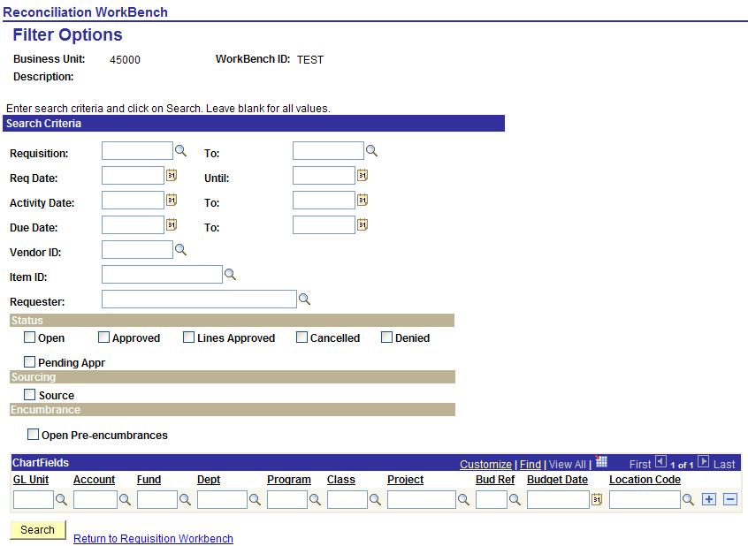
Requisition Reconciliation Workbench
What’s the Use?
Analysis
Flexible Filter Options page allows you to search for REQs based upon the criteria that you specify

Slide 17
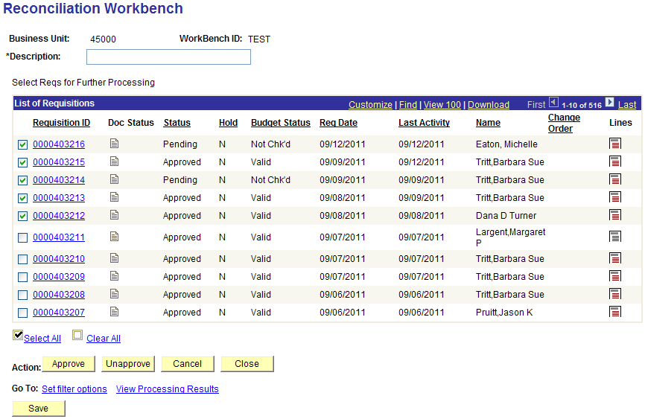
Action
Select the REQs that you want to work with, then select the Action that you wish to take

Slide 18
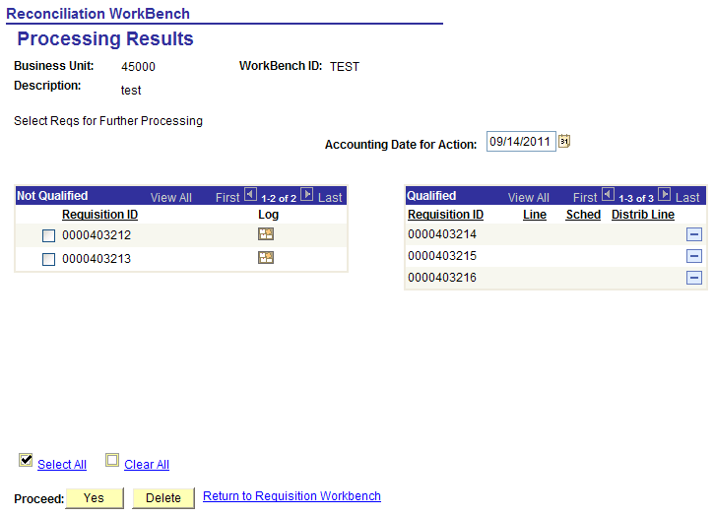
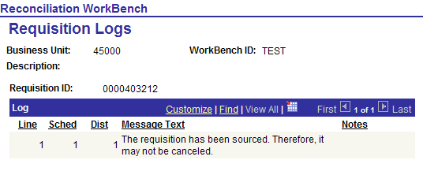
Review & Proceed
Not Qualified, Why?
‘Force’ to Qualified side
Qualified

Slide 19
Req Reconciliation Workbench Tips
Common Reasons a requisition will not close:
Requisitions are not fully sourced.
Requisition line with unchecked or error Budget Status
POs are not closed
POs are not successfully budget checked

Slide 20
Month End PO & Req Clean Up
Purchase Orders
Review Partially Matched POs:
Additional vouchers needed?
Close & Liquidate PO?
Requisitions
Ensure all ‘Approved’ requisition lines are sourced to PO’s.
Cancel any requisitions or requisition lines that are not needed.
Run the PO Close Process
Run the REQ Close Process

Slide 21
Troubleshooting Req & PO Issues
I sourced my Req to a PO, but the Req is still available for sourcing, why?
Amount Only vs Quantity PO – what’s the difference?
Why did my PO close when I ran the Batch PO Close process?
Is the PO Fully Matched?
Is Receiving Required?
Has the Due Date Passed?

Slide 22
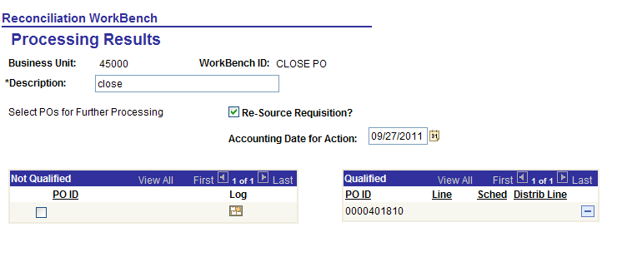
I cancelled my PO, but it did not re-source the req…
If Cancelling online, you will receive the following message:
If Cancelling via the Reconciliation Workbench, then you MUST check the box:

Slide 23
User Questions
Question: Best way to know what Requisitions need to be processed?
Answer: We suggest Running the Batch Requisition Close process monthly; however, you can run it as often as you like. This will ensure that only Req's currently in process or waiting to be processed remain in the Manage Requisitions search results.

Slide 24
Question: Is it possible to change the UOM, Vendor, etc. without closing and re-creating a PO?
Answer: It is NOT possible to change the UOM or Vendor once a PO has been dispatched. The PO has to be cancelled/closed and a new PO created.
Reason: A PO is an official document sent to the vendor. Upon dispatch the vendor can not be changed on the PO.

Slide 25
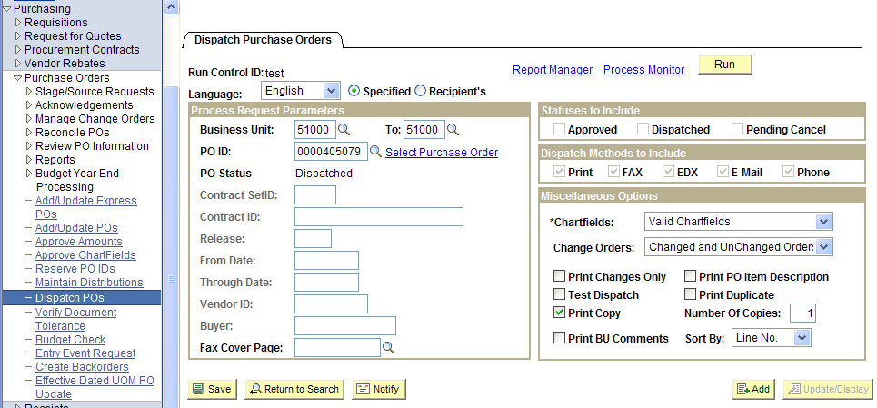
Question: What is the easiest way (fewest keystrokes) to print a PO WITH the signature box?
Answer: Run the Batch Dispatch POs process. Navigation: Purchasing>Purchase Orders>Dispatch PO's. Make sure to select the ‘Print Copy’ check box.

Slide 26
GeorgiaFirst Marketplace
Increased visibility to Contract information
Reinforces Contract Spend
Allows tracking and reporting of spend data
Leverage volume spend for better pricing
Common SHARE catalog vendors
Desktop Receiving
Summit Session, Friday @ 8:30am
The GeorgiaFirst Marketplace – The Final Piece of the eProcurement Puzzle

Slide 27
Additional Documentation Available on GeorgiaFIRST Financials Website
Known Issues
http://www.usg.edu/gafirst-fin/known_issues/
Announcements
http://www.usg.edu/gafirst-fin/announcements/
Release Notes
http://www.usg.edu/gafirst-fin/release_info/
Business Processes
http://www.usg.edu/gafirst-fin/documentation/

Slide 28
Questions?

