Slide 1

Setting Up New Employees in
PeopleSoft Expenses
Presented by
Daphne Burch – Armstrong Atlantic State University
Kate Smith – Information Technology Services

Slide 2
Introduction
Daphne Burch
Purchasing Manager
Armstrong Atlantic State University
Kate Smith
Business Systems Analyst
Information Technology Services
Creating the User ID
Multi Campus User Tips
Updating Bank Information

Slide 3
Expense Setup
Registering for a User ID in Financials
Setting up User Defaults
Training
Notes:
DAPHNE

Slide 4
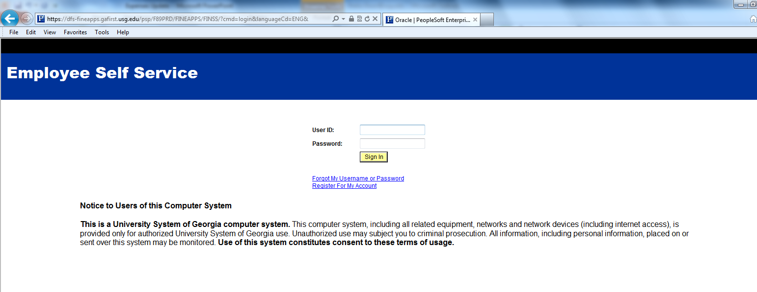
Registering for a User ID
https://dfs-fineapps.gafirst.usg.edu/psp/F89PRD/FINEAPPS/FINSS/?cmd=login&languageCd=ENG&
Click Register for My Account.
Notes:
DAPHNE

Slide 5
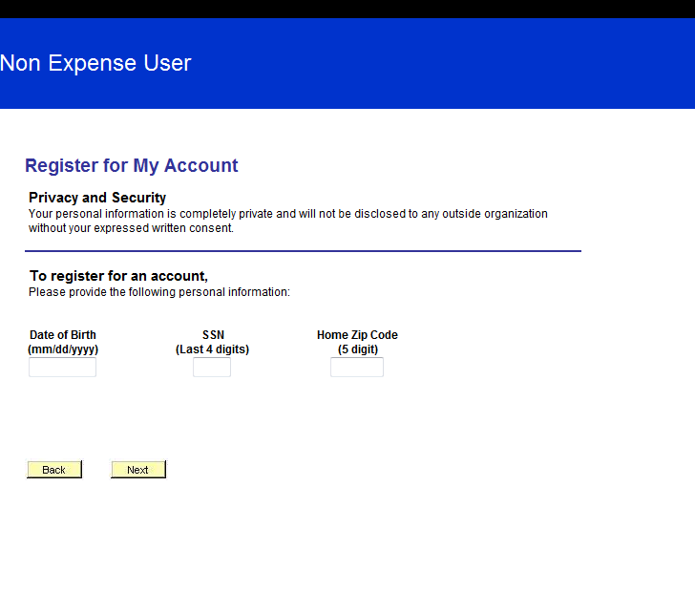
Registering for a User ID
Fill in the required fields and click Next.
Notes:
DAPHNE

Slide 6
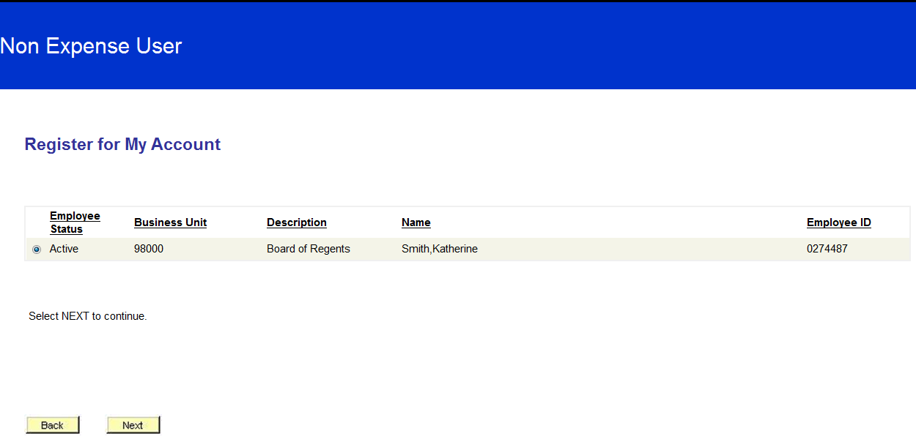
Registering for a User ID
It will pull up the job row and ask if you want to create an account for the specified institution. Click Next.
Notes:
DAPHNE

Slide 7
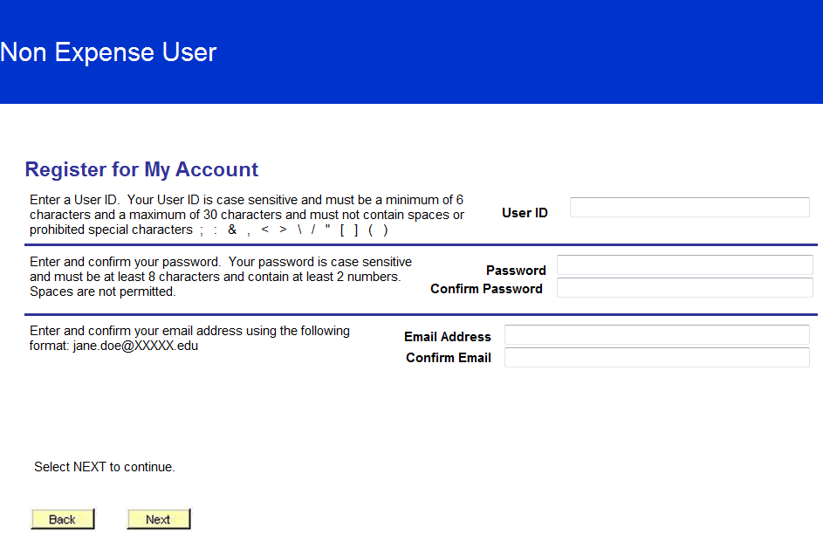
Registering for a User ID
Add a User ID, Password, and Email Address, then click Next.
Notes:
DAPHNE

Slide 8
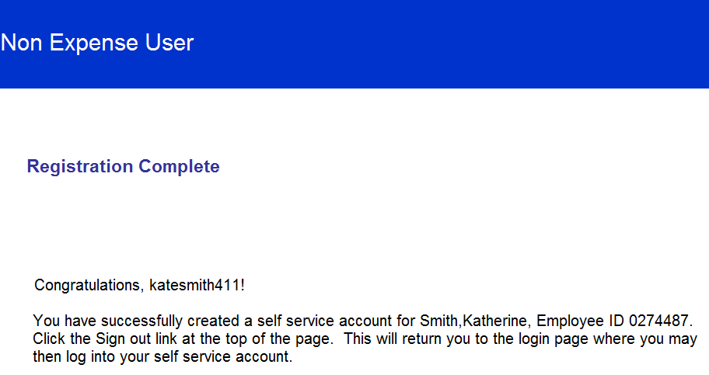
Registering for a User ID
Registration is complete.
Sign out after completion, then log back in with your new user ID.
Notes:
DAPHNE

Slide 9
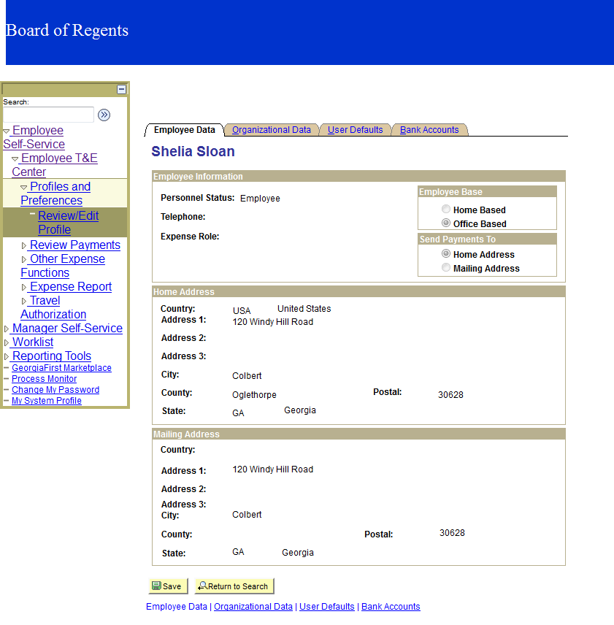
Setting Up User Defaults
Employee Name
Notes:
DAPHNE

Slide 10
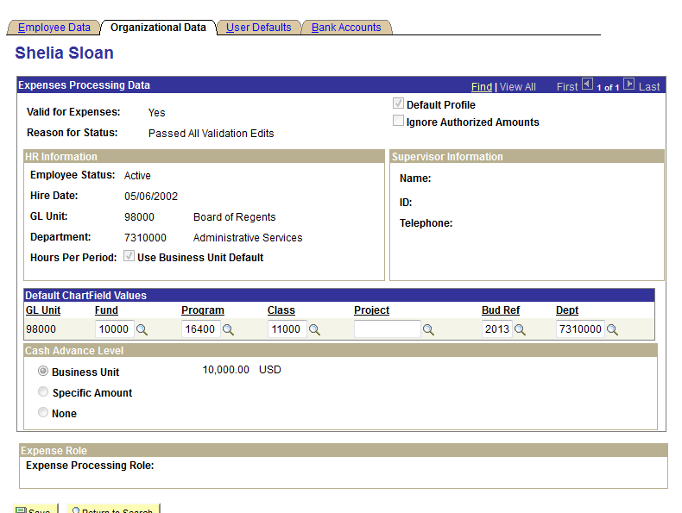
Setting Up User Defaults
Employee Name
Notes:
DAPHNE

Slide 11
Training
Types of Expenses training provided:
Phone
One on One
Classroom
Notes:
DAPHNE

Slide 12
Multi Campus Users
A multi campus user is an employee that works for two institutions or has worked at another USG institution in the past.
Notes:
KATE

Slide 13
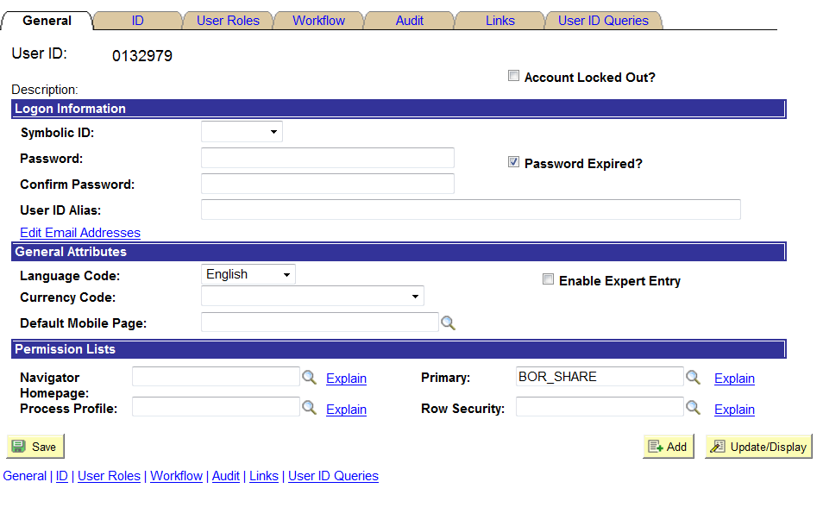
Multi Campus User Tips
  When Security Administrators are terminating a user that will be going to another institution, populate the User ID Alias field with OPRID-EMPLID.
Notes:
KATE

Slide 14
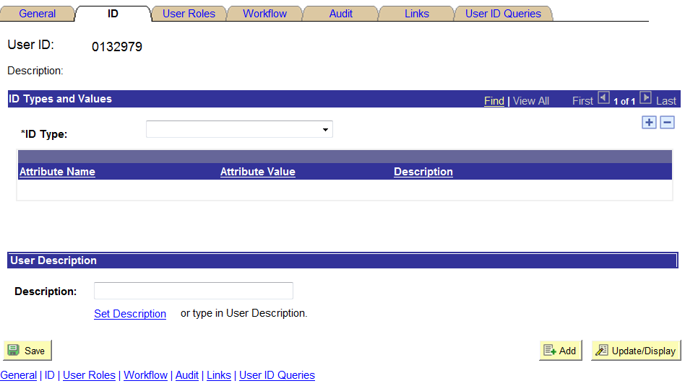
Multi Campus User Tips
Then on the ID Tab, in the ID Type field, select None. Save.
Notes:
KATE

Slide 15
Multi Campus User Tips
  When setting up an approver in Expenses, if you find that the employee is a multi campus user, open a ticket with ITS including the EMPLID and Name of the employee. ITS will make some changes so they can use their existing User ID.
Notes:
KATE

Slide 16
Updating Bank Information
Employee Data Load from ADP
  What it populates and when it occurs
How to update banking information
  EFT and System Check
Notes:
KATE

Slide 17
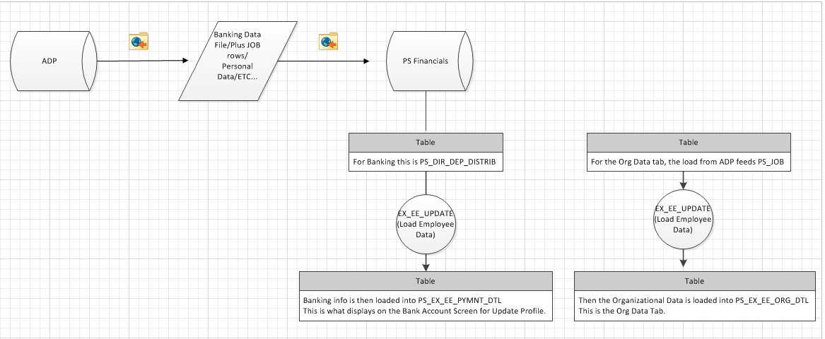
Information Feed from ADP to PeopleSoft Expenses
Notes:
KATE

Slide 18

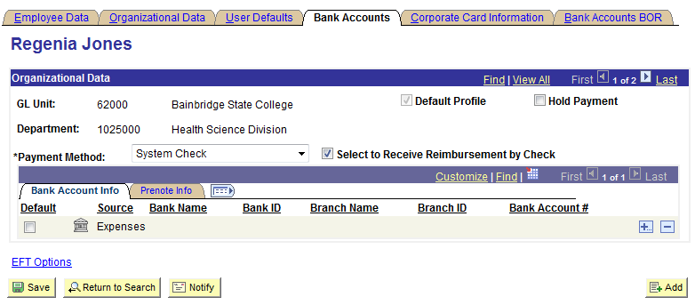
Expenses Update Profile
Bank Accounts Tab
Employee Name
Notes:
KATE

Slide 19
Information Feed from ADP to PeopleSoft Expenses
Notes:
KATE

Slide 20
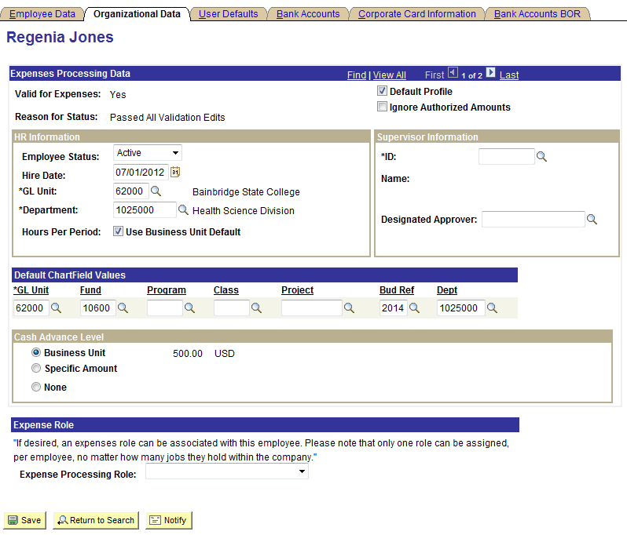
Expenses Update Profile
Organizational Data Tab
Employee Name
Notes:
KATE

Slide 21
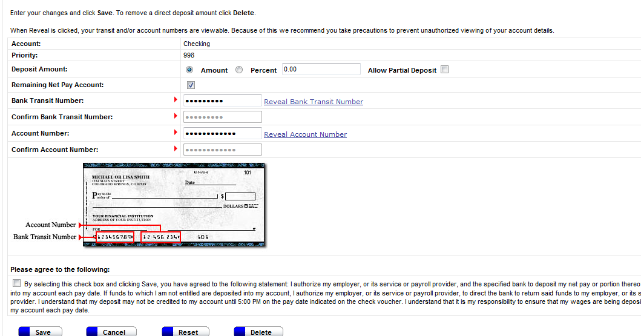
ADP Self Service for Employee
Notes:
KATE

Slide 22
How to Update Bank Information
Changing Bank Account Number
Employee should make the change in ADP Self Service and Save the changes.
This information feeds from ADP to Expenses each day at 7:00 AM and 3:00 PM (it takes about 1 hour) Remember that the load must occur before the information will show in the Expenses profile.
Notes:
KATE

Slide 23
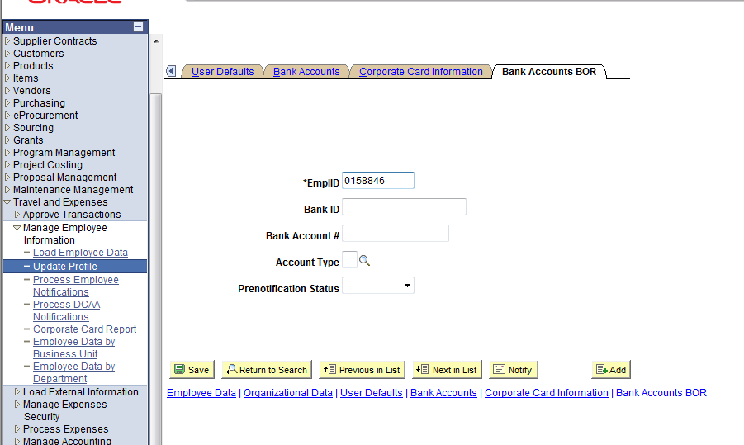
Bank Accounts BOR Tab
The Bank Accounts BOR Tab was created for times when the correct bank information does not feed from ADP.
Entering the banking information here will insert rows into PS_DIRECT_DEP_DISTRIB just like the feed from ADP. Then when the employee data load runs, it will update the Bank Accounts Tab automatically.
Notes:
KATE
This is a way to insert banking information without using ADP.

Slide 24
Change Payment Method
To change from EFT to Check, log in to PeopleSoft Expenses Update Profile. Select Payment Method of System Check and check the box next to Receive Reimbursement by Check. This box must be selected to prevent the ADP load from changing the Payment Method back to EFT.
To change from Check to EFT, log into PeopleSoft Expenses Update Profile and remove the check next to Select to Receive Reimbursement by Check and Save. Let the ADP load process occur, then log back into Expenses and change the Payment Method to EFT.
Notes:
KATE

Slide 25
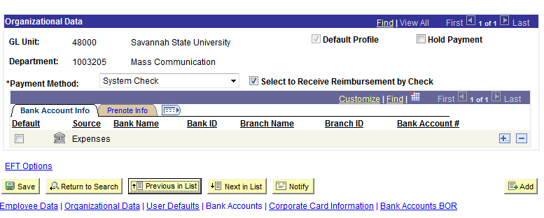
Receive Reimbursement by Check
If an employee wishes to receive their reimbursement by check, they must check the box reading Select to Receive Reimbursement by Check, as well as change the Payment Method to System Check.
Notes:
KATE

Slide 26
Other Expense Reminders
Per diem amounts are updated once a year.
There is an issue with deleting lines that causes workflow and approval status to get out of sync. Instead of deleting lines, mark them as Non Reimbursable.

Slide 27
PeopleSoft 9.2 Application Upgrade
Fit Gap Coming Soon
  Be thinking about configuration changes
  We will be examining things like budget checking before or after the approval of a report.
Notes:
KATE

Slide 28
Training & Documentation
Online Expenses Training
www.usg.edu/gafirst-fin/training/online_expense
Archived Expenses Presentations
www.usg.edu/gafirst-fin/training/archives
Travel and Expenses Guides & Documentation
www.usg.edu/gafirst-fin/documentation/category/travel_and_expenses
Notes:
KATE

Slide 29
Questions?
Thank you for attending!

Slide 30



University System of Georgia
Information Technology Services

