Slide 1
sciquest business automation solutions
Turn Spending into Savings
Andy Waligowski
Account Executive
Notes:
Turn spending into savings.
Gain control with SciQuest cloud-based business automation solutions for spend management.

Slide 2
Sciquest TODAY
Market leader with $540M market cap
SciQuest is the largest public provider of cloud-based business automation solutions for spend management – offering deep domain knowledge and a solid, customer-driven portfolio.
500+ customers worldwide
170+ Higher Education customers
Proven ROI within months
Customer-focused development
Acquired CombineNet
2013
Founded
1995
New Management
2001
Taken Public
2010
Acquired Upside
2012
SciQuest GROWTH
1999
IPO
2004
Taken Private
2011
Acquired AECsoft
2012
Acquired Spend Radar
Notes:
SciQuest is the largest public provider of cloud-based spend management solutions with deep domain knowledge and a solid, customer-driven portfolio.
We are 400+ customers strong
We address a multi-billion dollar, and growing, spend management software market with differentiated cloud-based platform
We have proven ROI and customer success with highly-satisfied customer base
We are based in Cary NC, and have 450 global employees
Brief history:
SciQuest was founded in 1995 as an eCommerce business-to-business exchange for scientific products and conducted an initial public offering in 1999.
In 2001, we brought in a new management team, exited the business-to-business exchange model and began selling our on-demand strategic procurement and supplier enablement solution.
SciQuest was subsequently taken private in 2004.
In January 2011, we acquired all of the capital stock of AECsoft, a leading provider of supplier management and sourcing technology.
In July 2012, we acquired Upside Software, Inc., a worldwide leader in contract lifecycle management (CLM) solutions.
In September 2012, we acquired Spend Radar LLC, a rapidly growing provider of fast, easy and flexible spend analysis software.
Today, we deliver cloud-based business automation solutions that help you manage your spending, suppliers, contracts, sourcing, shopping, inventory, and accounts payable more efficiently. Our solutions enable greater visibility and compliance organization-wide to help you gain control, optimize efficiencies, and reduce spend.

Slide 3
Making history
How Georgia First and SciQuest came to be
UGA was initial client and then the State of Georgia – 2008
Georgia Tech and USG spearheaded program for the entire USG in 2009 and BOR signed an agreement for all
Live April 2011
Goals were to reel in control over vendors and to provide USG schools with a proven, easy to use solution.
Notes:
SciQuest partners with global procurement and finance leaders to improve visibility and management of their bottom line. We present your spend in a way you’ll discover new savings and reduce costs on an ongoing basis and allow your staff to focus on the student.
We’ve discovered through our commitment to customer success the practices needed to improve insight and management of spend across the enterprise. We provide our customers with advanced technology to uncover savings opportunities and implement consistent spend management improvements.
We are confident about the value we bring to customers and our experience shows changes are most successful with support from executive leadership who desire a change to implement savings.

Slide 4
Why sciquest
Driving Factors for USG
Commitment to Higher Education
Ease of Use = High Adoption
Rapid Deployment = Find what you need, fast!
Spend Visibility = Identify Savings and Negotiate New Contracts
Contract Compliance = Ensure contracted price
Consortium = Multi-university use/ access
Peoplesoft Partner

Slide 5
It needs to be intuitive
A source-to-settle solution that has been developed together with your peers and supports how your organization shops and manages approvals.
A solution that offers a consumer-like user experience and maximizes user adoption, contract compliance and savings.
Internal customers don’t have the time to figure out how to buy products and services from your preferred vendors.
Understanding their challenges and needs, and delivering solutions that make it easy for them to shop and approve are critical to driving user adoption of your solution.
It will maximize contract compliance and keep them focused on their organizational goals.

Slide 6
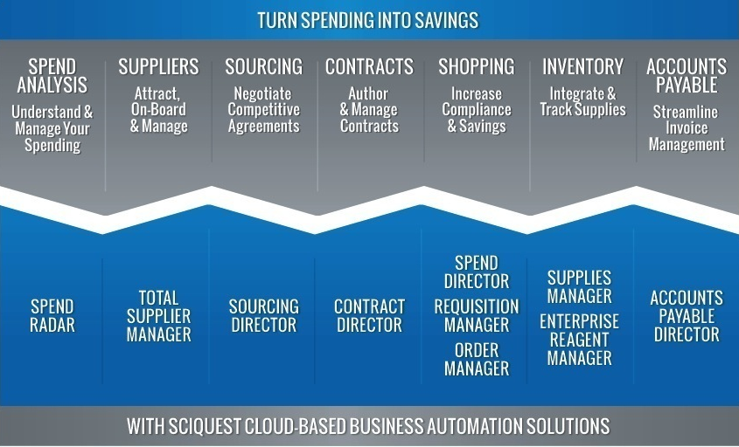
What do you have?
Modules

Slide 7
SciQuest Products
eProcurement: Spend Director
Automate shopping and direct spend to approved vendors and negotiated prices.
Confidential – Internal Use Only

Slide 8
SciQuest Products
eProcurement: Order Manager
Automate the transmission of orders to the supplier via fax, email or CXML.
Confidential – Internal Use Only

Slide 9
All the cool kids are doing it
Who’s Live with SciQuest
BU ID | BU Name | PO Spend |  |  |  | PO Lines |  |  |  | POs
 |  | 2011 | 2012 | 2013 | 2014 | 2011 | 2012 | 2013 | 2014 | 2011 | 2012 | 2013 | 2014
54 | University of West Georgia (54000) | $190,123 | $1,154,380 | $1,582,393 | $197,353 | 483 | 3,902 | 9,176 | 1,147 | 101 | 908 | 2,504 | 338
58 | Kennesaw State University (43000) | $737,848 | $830,603 | $1,504,318 | $110,679 | 162 | 3,330 | 3,966 | 553 | 106 | 679 | 1,165 | 164
59 | Georgia Southern University (39000) |  | $52,305 | $725,082 | $195,819 |  | 258 | 8,527 | 2,369 |  | 105 | 2,170 | 615
65 | Valdosta State University (51000) | $59,293 | $730,116 | $561,199 | $71,274 | 155 | 4,678 | 5,471 | 1,128 | 59 | 1,163 | 1,435 | 268
53 | Georgia Perimeter College (71000) | $172,410 | $633,474 | $410,302 | $82,636 | 2,140 | 7,459 | 4,052 | 1,014 | 226 | 1,244 | 923 | 198
67 | Middle Georgia College (84000) |  | $31,729 | $108,718 |  |  | 150 | 595 |  |  | 48 | 138
69 | Georgia Gwinnett College (40000) | $50,590 | $119,321 | $106,759 | $8,752 | 290 | 935 | 880 | 145 | 41 | 157 | 168 | 30
70 | South Georgia College (87000) |  | $8,826 | $104,991 |  |  | 144 | 1,412 |  |  | 34 | 401
72 | Georgia College and State University |  |  | $69,141 | $680 |  |  | 200 | 11 |  |  | 34 | 3
73 | Gordon College (76000) |  | $9,768 | $47,993 | $24,255 |  | 51 | 456 | 320 |  | 16 | 107 | 77
74 | Georgia Highlands College (73000) |  | $54,137 | $47,262 | $24,802 |  | 179 | 210 | 83 |  | 27 | 39 | 11
76 | Macon State College (81000) |  | $29 | $2,007 |  |  | 3 | 21 |  |  | 2 | 4
77 | Coastal Georgia Community College (63000) |  |  | $726 |  |  |  | 11 |  |  |  | 4
83 | Clayton College and State University (28000) |  |  | $137 |  |  |  | 14 |  |  |  | 1
84 | Fort Valley State University (33000) |  |  | $27 |  |  |  | 2 |  |  |  | 1
85 | Augusta State University (27000) | $76 |  |  |  | 3 |  |  |  | 2
1407 | South Georgia State College |  |  |  | $7,318 |  |  |  | 149 |  |  |  | 23
1409 | Middle Georgia State College |  |  |  | $6,580 |  |  |  | 39 |  |  |  | 17
Grand Total | Total | $1,210,832 | $3,699,578 | $6,136,316 | $752,603 | 3,246 | 21,138 | 35,481 | 7,023 | 538 | 4,409 | 9,232 | 1,779

Slide 10
cloud-based business automation
Visibility and compliance organization-wide help you gain control and efficiencies to manage & reduce spend
SciQuest provides cloud-based solutions that are easier to implement and feature high-touch support for seamless integration
SciQuest enables organization-wide analysis and reporting that is proven to deliver measurable, sustainable results
SciQuest helps streamline and automate business processes and supplier management so that you can focus on strategy
Notes:
What can you expect from SciQuest cloud-based business automation?
Visibility and compliance across your organization.
The result?
Control and the ability to drive efficiencies to help you manage and reduce spend.
How do we do it?
SciQuest provides cloud-based solutions that are easier to implement and high-touch support for seamless integration
SciQuest enables organization-wide analysis and reporting that is proven to deliver measurable, sustainable results
SciQuest helps streamline and automate business processes and supplier management so that you can focus on strategy

Slide 11
cloud-based business automation
Visibility and compliance organization-wide help you gain control and efficiencies to manage & reduce spend
analyze & report
implement & integrate
streamline & automate
Adaptable, scalable
Experienced service/support
Redundant, reliable, secure
Regular software updates
99.9% availability 24x7x365
Organization-wide
Classification done in days
Data accuracy > 95%
More spend managed
Manage risk/performance
150,000 active suppliers
80%+ contract compliance
50% contract cycle time cut
100% electronic invoicing
66% cut order cycle time cut
Notes:
We help you achieve these benefits through cloud-based business automation.
SciQuest provides cloud-based solutions that are easier to implement and high-touch support for seamless integration
Adaptable, scalable: modular point solutions or source-to-settle solutions suite
Experienced SciQuest service team
Low cost of IT ownership
Enhances your ERP investment
Redundant, reliable, secure
Regular and timely software updates
99.9% availability 24x7x365
Dedicated support to maximize value
SciQuest enables organization-wide analysis and reporting that is proven to deliver measurable, sustainable results
Identify and analyze spending across departments, business units and locations
Spend classification done in days not months
Data accuracy greater than 95%
Increase spend under management
Manage risk and performance against KPIs
SciQuest helps streamline and automate business processes and supplier management so that you can focus on strategy
>20% increase in user adoption due to ease of use
150,000 active suppliers in network; free participation attracts more suppliers
80%+ contract compliance
50% reduction in contract cycle time
100% electronic invoicing
66% reduction in order cycle time

Slide 12
TURN SPENDING INTO SAVINGS
With SciQuest cloud-based business automation solutions
Gain control
Greater visibility, identify savings opportunities, manage risk
Optimize efficiency
Immediate, sustainable value, eliminate waste and errors
Reduce spend
Organization-wide transparency, automation, compliance, and analysis
Notes:
You can turn spending into savings
With SciQuest cloud-based business automation solutions
We can help your company realize these benefits:
1. Gain control SciQuest solutions provide greater visibility into how suppliers, contracts, purchases and payments are managed to help you identify savings opportunities and manage risk.
2. Optimize efficiency SciQuest solutions deliver immediate, sustainable value through process transformation that reduces complexity, eliminates waste and errors, and promotes ease of use.
3. Reduce spend SciQuest solutions ultimately help you reduce your spend through organization-wide transparency, automation, compliance, and analysis.

Slide 13
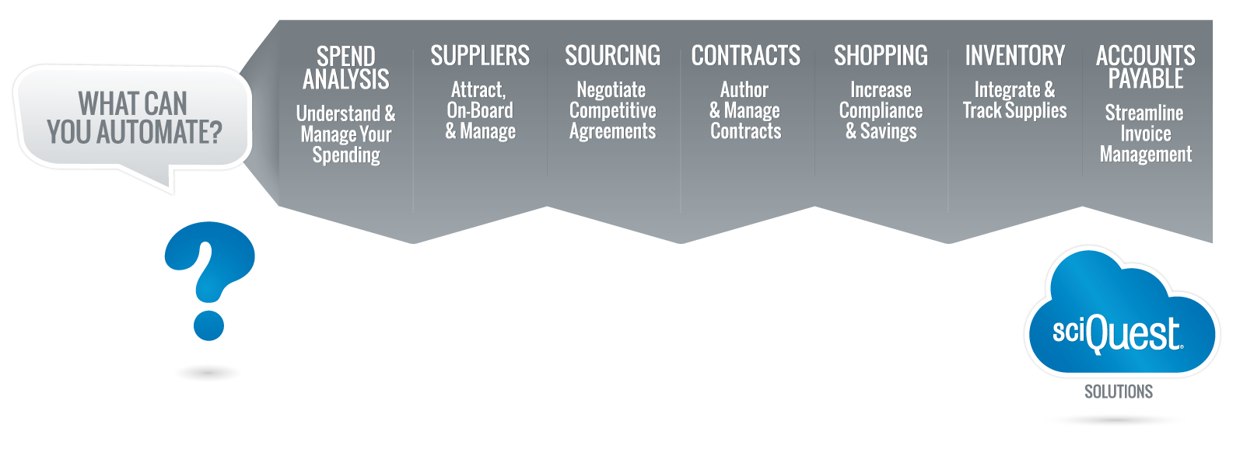
Turn spending into savings
Explore SciQuest business automation solutions
Notes:
What can you automate to turn spending into savings?
Your challenges are unique to your organization. And so should the solution you use to solve them. With our cloud-based business automation solutions, you can automate the complete procure-to-pay process or simply deploy a point solution such as a shopping platform for your ERP system or our Accounts Payable solution. SciQuest solutions enable greater visibility and compliance organization-wide to help you gain control, optimize efficiencies, and reduce spend.
Let’s explore the breadth and depth of offerings from SciQuest.
<View in presentation mode. Click on a solution category to explore the SciQuest products that address that category. Or click next to view each and every product.>

Slide 14
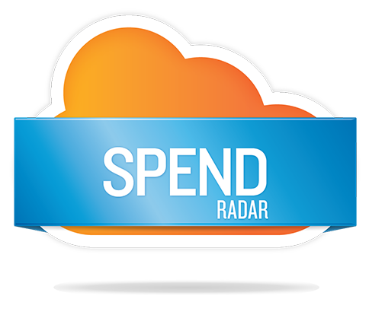
Organization-wide view of your spend data
Easy-to-use visual reporting and analysis module
A single source of truth
Consolidated, categorized spend in one language
Data Manager: collect, cleanse, & classify data
Refresh Manager: self-sufficient data refreshes
Performance Manager: Enter and track performance objectives against cleansed and classified data
Reporting & Analysis: standard and customized views
Gain business-changing insights quickly and easily with accurately cleansed and classified spend and spend-related data
Notes:
SCIQUEST SPEND RADAR
Gain business-changing insights quickly and easily with accurately cleansed and classified spend and spend-related data
With our solution, you can expect:
Organization-wide view of your spend data
Easy-to-use visual reporting and analysis module
A single source of truth
Consolidated, categorized spend in one language
What are the product features?
Data Manager – flexible, high-quality master data management module that has been specifically tailored for ongoing management of organization-wide spend and spend-related data and is the starting point for all of the Spend Radar extension modules. All data is collected, cleansed and classified within Data Manager. Enrich your existing spend data with third-party supplier and market content, increasing data quality and reliability.
Refresh Manager – manage changes to your supplier structure and spend data classifications.
With Refresh Manager, you have the power to quickly process your own spend data refreshes on your own schedule. Refresh in one day instead of two weeks.
Performance Manager – Enter and track performance objectives against cleansed and classified data
Reporting and Analysis – standard, pre-built, and customized reports provided in an easy-to-use graphical user interface for all of your organization’s spend. Reporting and Analysis provides you with accurate and complete spend-related data, allowing you to make business decisions based on the most complete and up-to-date information available.
--------
Additional info:
Every spend analysis is comprised of three areas, or steps:
Collecting and aggregating all of your spend and spend-related data.
Cleansing, classifying, normalizing, standardizing, and enriching your data…Basically, managing and maintaining all the data you’ve collected.
Reporting and analyzing the data you’ve classified.
Data Acquisition:
Collect ALL of your organization’s spend and spend-related data: AP, PO, eProcurement, ERPs, Contract systems, Supplier files
No rigid templates necessary, flexible formats acceptable, for any data field
Any currency, any language accepted (including double-byte)
Some spend analysis providers and spend analysis tools will only collect certain fields, such as PO, AP, and GL. Spend Radar will accept any data element you want to analyze.
Some spend analysis providers and spend analysis tools require that you manipulate your data to conform to rigid templates, requiring that customers spend an inordinate amount of time forcing their data to match the vendor’s template. Spend Radar does not use rigid templates. We will accept data in just about any form, as long as it’s in an acceptable data format. (no pdfs, no scanned images)
Spend Radar will collect global data, with any currency, in any language, including double-byte characters.
Data Processing:
There is no limit to the amount of data that can be cleansed and classified
Multiple taxonomies can be supported, simultaneously
Spend and spend-related data can be translated and stored in a single language
Data is cleansed and classified to your unique requirements, there is no one-size-fits all classification methodology
Classification can be done at the line item level
Spend Radar has collected, cleansed, and classified, ginormous amounts of spend and spend-related data
We do not force customers to classify to UNSPSC, we will support any taxonomy the customer needs, including home-grown taxonomies, and we can support multiple taxonomies simultaneously.
Cleansing and classification is extremely flexible and configurable to a customer’s unique business requirements. We do not use a one-size-fits-all classification methodology – meaning you don’t have to classify a laptop as a computer accessory. You can classify it as an office supply if you’d like.
Some spend analysis vendors and spend analysis tools only classify spend at the supplier level. We classify spend all the way down to the individual line item transaction level.
Reporting and Analysis:
Visual, easy-to-use reporting module
Little to no training is necessary
Analyze any spend or spend-related data element that has been provided
Translated data can be viewed for global reporting
Ability to export data
Very pretty, colorful, graphical reporting module.
If you’re familiar with a computer and a mouse, you can easily learn the reporting module.
Any data element that has been collected can be analyzed. If buyer names were collected, you can include that in your reporting and analysis. If region was collected, you can include that information in your reporting and analysis. If plant location was collected…
Some spend analysis vendors and tools only work in one language, meaning that all the reporting and analysis is done in that language. Wish Spend Radar, each country or region can view their spend and spend-related data in their native language, gaining the same insight and analysis organization wide.

Slide 15
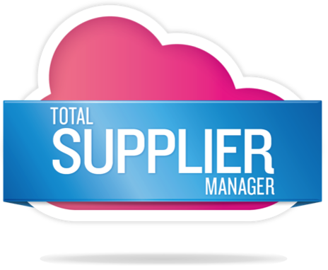
Web-based, centralized repository
Pre-qualification and diversity certification verification
Automated onboarding and communications
Supplier compliance and sustainability tracking
Supplier scorecard and performance management
2nd tier and total spend reporting
SciQuest Supplier Network: instantly enable hundreds of catalogs and thousands of suppliers
Streamline registrations, reduce risk, track performance, and power supplier diversity programs
Notes:
SCIQUEST TOTAL SUPPLIER MANAGER
Streamline registrations, reduce risk, track performance, and diversity
Supplier management begins before the first purchase order is cut. Best-in-class programs incorporate upfront regulatory and business process compliance. With Supplier Information Management from SciQuest, the process of supplier discovery, information gathering, registration, qualification and selection just got easier – and more automated – than ever. SciQuest Total Supplier Manager spans the supplier life cycle, using intelligent questionnaires, streamlined workflows and process automation to manage supplier registration and onboarding, reduce supplier risk and enhance your sourcing process. It also powers supplier diversity programs by giving your organization complete visibility into local and global diverse and non-diverse suppliers.
With our solution, you can expect:
Web-based, centralized repository
Reduced supplier risk with pre-qualification and diversity certification verification
Enhanced sourcing process with automated management of supplier registration and onboarding
Supplier compliance and sustainability tracking
Supplier scorecard and performance management
2nd tier and total spend reporting
At the heart of SciQuest’s supplier enablement function is the SciQuest Supplier Network. The network boasts a widespread supplier base that can support any industry and commodity. The SciQuest Supplier Services team ensures the enablement of suppliers, and supports supplier diversity programs, the Science Catalog and GPO relationships that offer instant enablement of hundreds of catalogs and thousands of suppliers.
We also offer SciQuest Managed Network Services, so that you can outsource the day-to-day burden of supplier enablement and focus on strategic procurement initiatives like preferred supplier positioning, contract management and supplier sourcing.
Take your supplier relationships — and your company’s performance — to the next level.
-----
Additional info:
Toolset
Total Supplier Registration Portal creates a web-based centralized repository of your entire supplier base including both diverse and non-diverse suppliers.
Pre-Qualification Management gives you insight into supplier capabilities during the initial registration process by incorporating commodity/category specific questions.
Diversity Certification Tracking & Verification tracks suppliers’ electronic copies of their diverse certificate types and expiration dates.
Automated Email /Fax and Batch Communication allows managers to automatically request updates, notify suppliers of certification expirations and generate email requests for monthly, quarterly or yearly 2nd tier spend from Primes. Email schedule and content are fully configurable.
Onboarding & Enablement automates supplier setup processes for payables from prospect to active paying supplier. Functionality includes payment information collection, W8/9 document collection, and TIN matching.
Dynamic Qualification & Risk Compliance enables you to easily manage collection, validation and renewal requirements of risk-related documentation through a formalized supplier vetting process.
Social Responsibility Compliance and Sustainability lets you collect, review and manage supplier compliance and sustainability information.
Supplier Scorecard & Performance Management lets you strategically monitor and assess your supplier performance.
2nd Tier Reporting lets you manage your 2nd tier program by giving Primes online reporting of direct, indirect, or project-based sub-spends. Track associated 2nd tier goals and compliance.
Total Spend Reporting generates automated analysis views of spend data based on commodity categories, diversity, locations, business units, top vendors and top spends. Federal SBA Compliance Reports provide auditable spend views based on government classifications and reporting standards.

Slide 16
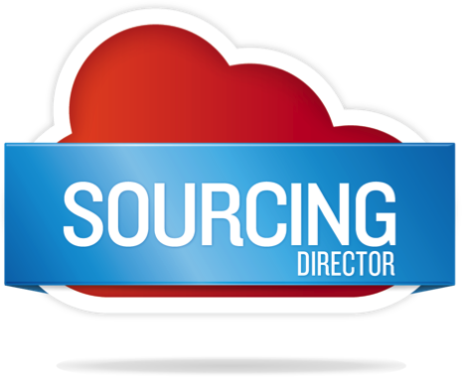
Intuitive, web-based interface
Self-service access for registered suppliers
Create auctions, invite suppliers, monitor, and award
Secure support for sealed bidding, informal quotes and reverse auctions
Easily analyze event outcomes
RFx Process: Bid creation from a single platform
Reverse Auction: Manage in real-time, open to close
Supplier Portal: Reduces administrative overhead
Analyze Events: Create graphs and highlights
Automate the bid process from start to finish – you’ll be done in days, instead of weeks
Notes:
SCIQUEST SOURCING DIRECTOR
Automate the bid process from start to finish and streamline supplier recruitment
SciQuest Sourcing Director is an on-demand bid management solution that helps you achieve significant process efficiencies and cost savings over traditional paper-based bid and auction processes. By automating the entire bid process from start to finish, you will be done in days instead of weeks.
With our solution, you can expect:
Intuitive, web-based interface
Self-service access for registered suppliers
Create auctions, invite suppliers, monitor, and award
Secure support for sealed bidding, informal quotes and reverse auctions
Easily analyze event outcomes
SciQuest Sourcing Director has been proven in both large global environments and small organizations.
RFx Process - Manage and expedite the bid creation process for RFxs – all from a single platform.
Reverse Auction Capability - Create auctions, invite supplier participants, monitor and control the reverse auction process in real-time from open to close.
Supplier Portal - Provide self-service access for registered suppliers to view events, enter responses, review award decisions and manage their own profiles. Our intuitive, Web-based interface reduces administrative overhead for your purchasing personnel.
Analyze Events - Easily graph and highlight key event information.

Slide 17
Highest rated CLM solution, Forrester Research, 2011
Buy-side, sell-side and non-monetary contracts
Dynamically create contracts from “smart templates”
Microsoft Word and email integration
Native integration of DeltaView comparison technology
Highly configurable workflow for approvals
Clause analysis feature shortens contract creation and maintenance cycles
Manage the complete contract lifecycle online – it’s the most efficient way to author and manage contracts
Notes:
SCIQUEST CONTRACT DIRECTOR
The most efficient way to author and manage contracts.
The process involved with contract management is still largely a manual operation in most organizations. Research from industry analysts says that as much as 2-5% of total annual costs can be saved by eliminating contract inaccuracies and non-compliance, and much more if you consider the risk avoidance of large legal suits.
SciQuest Contract Director is designed to improve the contracting process and sets the standard for enterprise contract management best practices. Recognized by industry analysts, Forrester Research, in June 2011 as the highest-rated contract lifecycle management solution, SciQuest Contract Director enables users to manage the complete contract lifecycle online.
With our solution, you can expect:
Buy-side, Sell-side and Non-monetary contracts
Dynamically create contracts from “Smart Templates”
MS-Word and email integration
Native integration of DeltaView comparison technology
Highly configurable workflow for approvals
Clause Analysis feature shortens contract creation and maintenance cycles
----
Additional info:
Advanced user-configurable interface enables rapid user adoption while robust security features ensure information and functions are granted only to the appropriate people.
Contract Director’s ‘Smart Template’ and advanced document hierarchy technologies simplify management of contracts across the enterprise while flexible role and organizational hierarchy-based security ensures each user has access to the documents and functionality they need.
Contract management functions, including event, compliance, performance and delivery, assessment and management, maximize the value of business agreements through the entire lifecycle.
Highly-configurable workflow engine that dynamically routes agreements to the right internal approver or reviewer based on a comprehensive set of contract variables, including monetary value, type, commodity, and risk level.
Flexible reporting capabilities provide easy access to the contract portfolio, in depth insight into upcoming events and superior management control.
Native integration of DeltaView, the leading document comparison technology by Workshare, streamlines the collaboration between negotiating business partners and minimizes potential litigation risks to your organization.
Contract Director’s Clause Analysis features shorten contract creation and maintenance cycles by giving you actionable insights into which contract templates and clauses are negotiated the most, and the type of changes.

Slide 18
The seamless purchasing experience eliminates inefficiencies and reduces cost
Enhances existing procurement systems
Increases on-contract spending and enables spend management
Automate the complete procure-to-pay process, or simply deploy a point solution
SciQuest eProcurement pre-configured solutions: stand-alone solutions for quick implementation
SciQuest eProcurement transforms manual and labor intensive procurement processes
Combine SciQuest Spend Director Enterprise, SciQuest Requisition Manager and SciQuest Order Manager for best-in-class eProcurement
Notes:
SCIQUEST ePROCUREMENT
An eProcurement solution offers organizations an opportunity to transform a manual and labor-intensive procurement process into a best-in-class center of excellence that can deliver significant cost savings and efficiencies. It can also help organizations better meet the financial and operational challenges of a rapidly changing global economy.
BENEFITS:
Delivers a seamless purchasing experience to every user, achieving greater cost savings to propel your mission
Designed to enhance existing procurement systems
Increase on-contract spending
Eliminate inefficiencies
Enable spend management
Elevate procurement from being a transactional function to being a strategic initiative
When you’re ready to turn spending into savings, call us. We are a leading provider of business automation solutions for organizations of all sizes. We have become experts in knowing what buyers demand from their solution – what works and what doesn’t work.
With SciQuest cloud-based eProcurement solutions, you can automate the complete procure-to-pay process, or simply deploy a point solution such as a shopping platform for your ERP system. These industry-leading solutions from SciQuest help make procurement easy.
SciQuest Spend Director Enterprise
SciQuest Requisition Manager
SciQuest Order Manager
Choose a stand-alone, pre-configured solution for quick implementation
SciQuest eProcurement Express offers an eprocurement solution that’s standalone, pre-configured, and comprehensive for quick implementation and minimal IT support. Users can intuitively shop from your online catalogs, create point-and-click requisitions, electronically submit those requisitions for approval, and acknowledge receipt of goods – all from their desk.
SciQuest eProcurement for Banner provides a seamless, efficient integration between your procurement transactions and your financial system of record, Banner Finance. It empowers your institution to enhance its procurement strategies and deliver a seamless purchasing experience to every user on campus, achieving greater cost savings to propel your mission.
SciQuest eProcurement Express for Banner offers a comprehensive eprocurement solution integrated into SunGard Higher Education Banner Finance that is pre-configured for quick implementation and minimal IT support. Users can easily shop from online catalogs; electronically create, track, and approve requisitions; send orders to suppliers; and acknowledge receipt of goods – all from their desks.

Slide 19
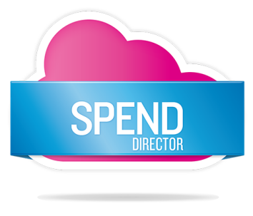
Easy-to-use internet based shopping experience mimics popular e-commerce websites
Designed to enhance existing procurement systems
Purchase directly from pre-negotiated contracts
Promote contract compliance
pCard: Pre-approved member shopping
Consortium: Source together, share contracts, and consolidate reporting
Multi-Business Unit: Centralize contracts, processes, and technology
Make shopping for goods and services simple and intuitive
Combine with SciQuest Requisition Manager and SciQuest Order Manager for best-in-class eProcurement.
Notes:
SCIQUEST SPEND DIRECTOR
Make shopping for goods and services simple and intuitive.
The unique SciQuest Spend Director Marketplace is a user-friendly, intuitive shopping environment for goods and services that mimics popular eCommerce shopping sites. It addresses the most critical spend challenges and offers a powerful bundle of supplier enablement, catalog management, contract management and end-user shopping platform.
With our solution, you can expect:
Easy-to-use internet based shopping experience mimics popular e-commerce websites
Designed to enhance existing procurement systems
Purchase directly from pre-negotiated contracts
Promote contract compliance
Through pCard Marketplace group purchasing organizations (GPOs), states, industry organizations and other sourcing enterprises can open up their library of contracts to their general membership for simple internet based shopping. A smart and powerful way to achieve efficiency and compliance, member users simply sign up, get approved, and use their credit card to buy from the best group contracts.
University systems, state governments and other multi-institution organizations can realize significant savings and efficiencies by consolidating their procurement resources. Consortium Community provides the technology framework that lets organizations source together, share and publish contracts, shop in your own or shared marketplace, and consolidate reporting.
The procurement function in large organizations is often distributed across different units or departments of the business. However, there is a growing trend of centralizing procurement contracts, processes and technology in large organizations to gain operational efficiencies and to grow organizational buying power. The Multi-Business Unit functionality (MBU license) was developed to support this trend.
Together with the comprehensive SciQuest Requisition Manager and SciQuest Order Manager products, this best-in-class eProcurement environment is seamlessly integrated into your financial system of record.

Slide 20
Online approval workflow and requisition tracking
Electronic routing based on any requisition attribute
Flexible approval options and 24/7 remote access for buyers and managers
Consolidate requisitions to minimize shipping fees and maximize discounts
Data analysis for savings opportunities and contract compliance
Budget Tracker: add-on feature for managing and monitoring budgets
Create accurate requisitions to reduce errors and delays
Combine with SciQuest Spend Director Enterprise and SciQuest Order Manager for best-in-class eProcurement.
Notes:
SCIQUEST REQUISITION MANAGER
SciQuest Requisition Manager combines electronic requisition routing with a powerful approval workflow engine to automate even the most complex business processes, including budget confirmation and hazardous materials clearance. When used with catalog content, Requisition Manager assists employees in creating accurate requisitions to reduce order errors and fulfillment delays.
It provides a positive requisitioning experience, encouraging employees to drive all purchases through a paperless process allowing you to capture valuable data about enterprise-wide purchasing.
Approvals move faster and errors/delay are reduced
With our solution, you can expect:
Online approval workflow and requisition tracking
Electronic routing based on any requisition attribute
Flexible approval options and 24/7 remote access for buyers and managers
Consolidate requisitions to minimize shipping fees and maximize discounts
Data analysis for savings opportunities and contract compliance
Budget Tracker is an add-on feature for Requisition Manager that assists your organization in managing and monitoring budgets within your existing purchasing processes.
Combine with SciQuest Spend Director Enterprise and SciQuest Order Manager for best-in-class eProcurement.

Slide 21
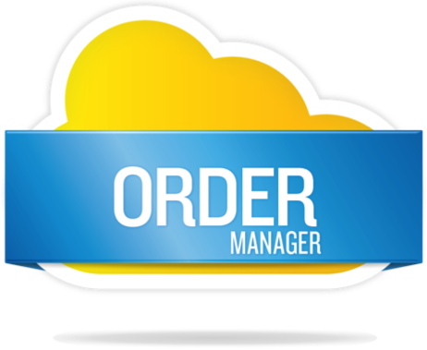
Secure, electronic document exchange with suppliers
Online order status tracking and automated communications with suppliers and requisitioners
Eliminates paper processes
Integrates directly with SciQuest Requisition Manager or existing ERP and financial systems
Data analysis to identify savings opportunities
Streamline purchase order placements, tracking and management
Combine with SciQuest Spend Director Enterprise and SciQuest Requisition Manager for best-in-class eProcurement.
Notes:
SCIQUEST ORDER MANAGER
Streamline Order Processing
SciQuest Order Manager is a configurable order processing solution that automates and streamlines purchase order placement, tracking and management. It leverages the SciQuest Supplier Network for secure electronic order distribution to all of your organization’s suppliers through a single integration point.
With our solution, you can expect:
Secure, electronic document exchange with suppliers
Online order status tracking and automated communications with suppliers and requisitioners
Eliminates paper processes
Integrates directly with SciQuest Requisition Manager or existing ERP and financial systems
Data analysis to identify savings opportunities
This on-demand module can be integrated with SciQuest Requisition Manager or existing ERP systems and financial applications.

Slide 22
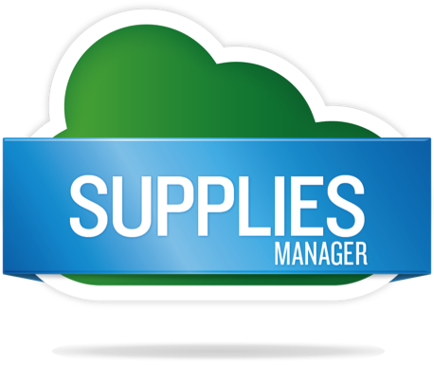
Streamlines all processes related to internal order fulfillment
Simple, user-friendly ordering experience
Promotes internal inventory above external vendors
Ideal for multiple stockrooms, substantial vendor-managed inventory, unifying software programs, integrating inventory into broader procurement system
Manage inventory across multiple stockrooms with a single, unified system
Manage chemical reagents and research supplies with SciQuest Enterprise Reagent Manager.
Notes:
SCIQUEST SUPPLIES MANAGER
Unique ways to manage stockrooms, supplies, enterprise reagents, & ERM.
Organizations that have implemented e-procurement solutions may still be challenged to extend their savings and efficiency to isolated stockrooms and internal stores. Some stockrooms are managed internally, and some by vendors. Users can’t tell what supplies or materials are in stock, which causes frustration and leads to overspending by purchasing more of what you already have in-house.
SciQuest Supplies Manager allows your organization to streamline all processes related to internal order fulfillment. Now you can manage multiple stockrooms using a simple single application that is fully integrated with our e-procurement application, providing a unified system for all internal and external goods and ordering.
The SciQuest Supplies Manager is ideal in these situations:
Multiple stockrooms need to be managed.
Organizations have a lot of vendor-managed inventory.
Multiple software programs are managing the inventory.
There is a need to integrate inventory items into the organization’s procurement system.
With our solution, you can expect:
Streamlines all processes related to internal order fulfillment
Simple, user-friendly ordering experience
Promotes internal inventory above external vendors
Ideal for multiple stockrooms, substantial vendor-managed inventory, unifying software programs, integrating inventory into broader procurement system

Slide 23
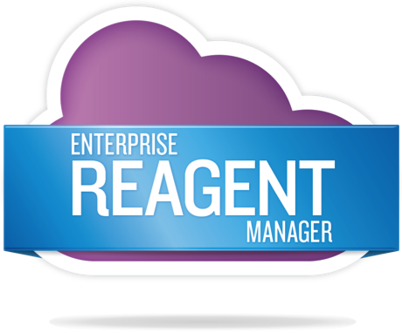
Integrates with procurement systems to promote compliance and manage risk
Single search spans internal inventory, libraries, commercial databases, supplier catalogs, and negotiated preferred pricing
Orders are automatically routed for review/approval and transmitted to suppliers
Available on-premise or hosted (new)
Catalogue Integration: add-on feature for simple access to SciQuest and eMolecules catalogues
Find, source and track chemical reagents and research supplies from a single application
Notes:
SCIQUEST ENTERPRISE REAGENT MANAGER
Find, source and track from a single application
SciQuest Enterprise Reagent Manager (ERM) is the material management and procurement tool for chemical reagents and other materials used in the research process. Researchers developing compounds rely on rapid access to appropriate reagents and supplies.
In addition to making it easier and faster for researchers to get the reagents they need, a key benefit of ERM is its close integration with procurement. It optimizes inventory use and promotes regulatory compliance while managing the risks associated with hazardous materials. Supplier catalogs and, where negotiated, preferred pricing are available to your scientific staff alongside internal inventory, libraries and commercial databases through a single search.
Orders for new containers placed through ERM are automatically routed for review and approval, and transmitted to suppliers fast and without redundant (and often error prone) data entry. This type of procurement integration has enabled some of the world’s largest Life Science companies to save an additional 10% on annual reagent spend.
With our solution, you can expect:
Integrates with procurement systems to promote compliance and manage risk
Single search spans internal inventory, libraries, commercial databases, supplier catalogs, and negotiated preferred pricing
Orders are automatically routed for review/approval and transmitted to suppliers
Available on-premise or hosted (new)
Catalog Integration is an add-on feature for simple access to SciQuest and eMolecules catalogues

Slide 24
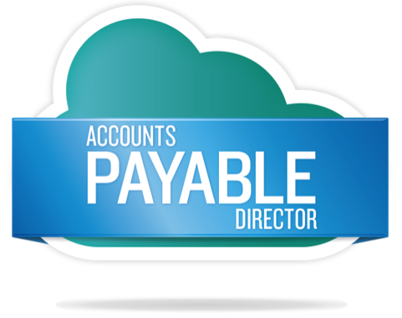
Automated to reduce errors, costs and cycle times
Digitally convert paper invoices
Comprehensive receipt management & reminders
Self-service supplier registration & management
Eliminate late payment penalties and duplicate payments
Realize prompt payment discounts
Digital Mailroom: eliminate paper with electronic invoice capture
Automate invoice receipt, matching and approval
Notes:
SCIQUEST ACCOUNTS PAYABLE DIRECTOR
Automate the capture, approval, and payment of invoices.
Manual, inefficient accounts payable processes cost you a fortune. According to the Aberdeen Group, it can be as high as $25 per invoice and take up to 41 days due to invoice processing cycle times, data entry errors, inability to capitalize on prompt payment discounts, lack of visibility into outstanding liabilities, and increased risk to your supply chain as a result of frustrated key vendors.
SciQuest Accounts Payable Director offers best-in-class automation that can be easily integrated with your existing financial systems or are available as part of SciQuest’s complete procure-to-pay suite.
With our solution, you can expect:
Automated to reduce errors, costs and cycle times
Digitally convert paper invoices
Comprehensive receipt management & reminders
Self-service supplier registration & management
Automated W-9 collection
Eliminate late payment penalties and duplicate payments
Realize prompt payment discounts
Digital Mailroom is an add-on that helps eliminate paper with electronic invoice capture

Slide 25
Business automation suite
Strong point solutions can be combined for a seamless procure-to-pay solution
Notes:
What can you automate?
Your challenges are unique to your organization. And so should the solution you use to solve them. With our cloud-based business automation solutions, you can automate the complete procure-to-pay process or simply deploy a point solution such as a shopping platform for your ERP system or our Accounts Payable solution. SciQuest solutions enable greater visibility and compliance organization-wide to help you gain control, optimize efficiencies, and reduce spend.
When you’re ready to turn spending into savings, call us. We are a leading provider of business automation solutions for organizations of all sizes. We have become experts in knowing what buyers demand from their solution — what works and what doesn’t work.

Slide 26
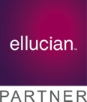
We partner for your success
To deliver tightly integrated solutions and specialized expertise
Platform & Technology Vendors provide ERP connectivity that helps us deliver a high return on you ERP investment
Consulting Partners enable us to offer a complete, integrated procure-to-pay solution
Consortia & GPO offer purchasing contracts that increase your buying power and result in cost savings
Notes:
We partner for your success
By collaborating with the industry’s leading providers, we can help you benefit from tightly integrated solutions and specialized expertise.
Our platform & technology ERP partners provide a financial foundation for customer accounts. Together with SciQuest’s strategic procurement software, ERP customers gain the advantage of robust supplier content and connectivity that delivers a high return on ERP investment. Sound architecture, established integration protocols and planned product roadmaps are customer benefits of the SciQuest and ERP Partner relationship.
SciQuest and its consulting partners provide customers with a comprehensive approach to their procure-to-pay needs. SciQuest seeks other best-in-class providers of complementary applications or adjacent technologies that will help SciQuest broaden and deepen our ability to offer a complete and integrated procure-to-pay solution.
Our buying consortium & GPO partners are associations or groups that orchestrate group purchasing contracts on behalf of their members with a common set of purchasing needs, suppliers, goods or services. These consortia leverage their SciQuest relationship to offer a more strategic procurement environment to the members of their associations. When consortium pricing is enabled through the SciQuest solution, you realize increased buying power and significant cost savings.

Slide 27
Sciquest platform and integration
Some typical and easily adaptable models include Procurement & ERP
Full Suite Model
Common ERPs integrated are SunGard, CGI/AMS, FMS, and other legacy systems. Also used for Oracle or SAP if the purchasing toolset has not been implemented.
Partial Suite / ERP Integration
Common ERPs with their own purchasing technology integrated with the Partial Suite Architecture are Oracle-iPro, Oracle/PeopleSoft-ePro, and SAP-SRM.
Shopping Platform Only
Generally for customers with in-house resources dedicated to order & invoice integrations. Common ERPs are Lawson, Ariba/SAP.

Slide 28
SciQuest for Oracle | PeopleSoft eProcurement Sandwich Model Solution Concept
eProcurement
SHOP
REQUEST /
APPROVE
ORDER
SETTLE
SOURCING and CONTRACT MANAGEMENT
SUPPLIER NETWORK and MANAGED SERVICES
“Shopping” Marketplace;
Catalogs / Content Services
PO Distribution
PO Acknowledge
Adv. Shipping Notice
Electronic Invoicing
Connectivity / Validation

Slide 29
Oracle | PeopleSoft Integration to ePro
Complete
Cart
Approve
Req.
Create PO
Transmit
PO
Record
Receipt
Receive
Invoice
Login
Shop
Hosted
Catalogs
Punchout
Catalogs
Send Via:
cXML
Email
Fax
Accept
E-Invoice:
cXML
EDI
Portal
Click
“Return
Cart”
HigherMarkets
Stockroom
Items
Custom
Forms
Non-Catalog
Items
Post
PO
Click
on
HM
Link
Complete
&
Validate
Requisition
Financial
Approval
Workflows
Log In
Create
PO
Manual / Auto
Desktop or
Central
Receipt
Matching
&
Payment
e-Procurement
System Of Record: Supplier, Chart,field Commodity Code, Ship-To

Slide 30
Integration Approach - PeopleSoft
SciQuest
Integration-as-
Service
SciQuest
PSFT
Message
Translation
PeopleSoft
Integration
Broker
PeopleSoft
ePro /
ERP
User GUI
Supplier Network
Managed Services
SciQuest performs document transformation and validation through Integration-as-a-Service
Leverages existing PeopleSoft standards with customer-specific adaptations (e.g. extrinsic fields)
No additional hardware or software installed at customer site
PeopleSoft setup/support: Customer
SQI and Integration Service setup/support: SciQuest

Slide 31
We will help you get results
Proven results for healthcare and public sector business automation
$5,000,000/year returned by Material Management to research center mission
37% or $4M Savings (SciQuest Spend Director)
20% or $170K Staff Savings (SciQuest Order Manager)
87% PR find rate in hosted content and 81% PO distribution
2% or $234K/year requisition savings (Aberdeen Group)
$216K in 2/10 net-30 discounts
302 suppliers enabled and 90%+ of spend under management
Reduced inventory by 70% to $300K by outsourcing warehousing
Supplier enablement time reduced from one year to one month
State of Georgia increased spend under management from 6% to nearly 80% in 18 months
Negotiated new discounts from suppliers ranging from 5% to 20%
Reduced paper-based expenses and some departments are paperless

Slide 32
We will help you get results
Proven results for higher education business automation
Will generate a significant portion of their $200 million savings goal by utilizing a SciQuest solution suite
Saved 40% (several hundred thousand dollars) in a reverse auction
Successful integration across 7 separate and unique ERP systems
More than $24.3 million in savings
Saved $7 million alone through better negotiated rates with suppliers
Bridged culture gap through an easy-to-use shopping interface
Annual budget of $110 million
Saved 35% over three month measurement period on top 50 items purchased via SciQuest solutions
Expect to obtain additional savings in the coming year
100% of spend goes through the SciQuest solution
35% of total spend is to preferred suppliers
Average 19% discount on $1.4M spend
$100,000 savings on freight costs for catalog purchases

Slide 33
Notes:
What can you automate?
Manage your spending, suppliers, contracts, sourcing, shopping, inventory, and accounts payable more efficiently, and contribute to the bottom line!
With SciQuest cloud-based business automation solutions for spend management.

Slide 34
ERP alone vs Sciquest
Feature/Benefit | ERP Alone | Sandwich
On-line requisition | X | In ERP
On-line approvals | X | In ERP
Advanced workflow | Custom | In ERP
Supplier content / shopping | On your own | Best in Class
Supplier connectivity | On your own | Best in Class
End user adoption | Difficult | Proven
Services spend / forms | Module / Custom | Partial
Pre-built spend reports with category-level detail | On your own | Included
Installation & configuration | Complex | Straightforward
Maintenance & upgrades | On your own | Included

