Slide 1
Dotting Your I’s and Crossing Your T’s: Preparing for an IT Audit
David Nisbet & Shelia Sloan
Information Technology Services
Board of Regents of the University System of Georgia

Slide 2
Agenda
Why Audits Matter
Learning from the Past Two Years’ Audits
Knowing What Auditors are Looking For
ITS-developed Tools and Processes
How You Can Prepare for Your Next IT Audit
Q&A

Slide 3
Why Do Audits Matter?
University of Hawaii faces lawsuit after a security breach in 2009
Names, academic performance, disabilities, and other sensitive information of 40,000 former University of Hawaii students was online for nearly a year.
Notes:
University officials told the Associated Press that a faculty member inadvertently uploaded files containing the information to an unprotected server on Nov. 30, 2009.
Exposed names, academic performance, disabilities, and other sensitive information of 40,101 students who attended the flagship Manoa campus from 1990 to 1998 and in 2001.

Slide 4
Why Do Audits Matter?
Ohio State University is notifying up to 760,000 students, professors and others that their names and Social Security numbers might have made it to cyberspace in one of the largest and most costly breaches to hit a college campus.
Ohio State expects to spend about $4 million to pay for the forensic investigation and credit-protection services for those whose personal information was on a server that was hacked.

Slide 5
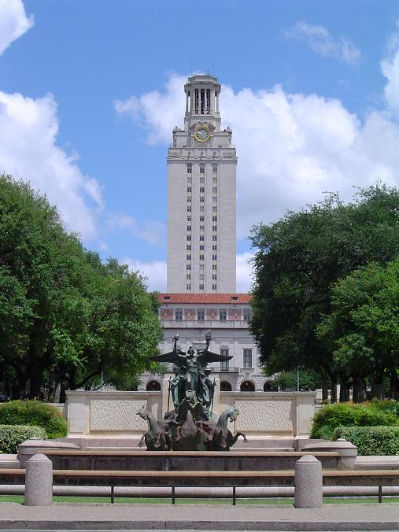
Why Do Audits Matter?
University of Texas at Austin acknowledged that the names, e-mail addresses and Social Security numbers of some 59,000 students, alumni and employees were obtained through a brute force attack on a University database.
According to the University, the incident could have been prevented if additional security measures were taken.

Slide 6
Why Do Audits Matter?
Headline: Two Charged with Hacking PeopleSoft to Fix Grades
Two California men are facing 20 years in prison on charges they hacked into a California state university's PeopleSoft system to change their grades.
IT staff finally caught wind of the problem during a routine audit.

Slide 7
What is an IT Audit?
An examination of the checks and balances, or controls, within an information technology (IT) group
Collects and evaluates "evidence" of an organization's information systems, practices, and operations
Determines if the information systems are:
safeguarding the information assets
maintaining data integrity
operating effectively and efficiently to achieve the organization's business goals or objectives

Slide 8
Previous Years’ Audits
2010 focused on:
2011 focused on:
Change management issues
Supporting documentation
Approvals
Terminated employee access in PeopleSoft Financials
Security forms and approvals for user access
More concentrated campus focus
PeopleTools access
Shift in focus to Banner

Slide 9
Auditors are interested in insuring data integrity, availability and confidentiality.
Auditors are looking for:
General and application controls
Backup procedures
Monitored and documented job scheduling

Slide 10
General and Application Controls include Logical Access, Change Management, and IT Operations.
9
There are
ways to help maintain general and application controls…

Slide 11
Nine General and Application Controls
Strong Password Settings
Minimum lengths
Complex password composition
Lock accounts
Frequently force changes

Slide 12
Nine General and Application Controls
2. Limit Privilege Functions to appropriate personnel
Review your security administrators on campus.
Look at users with full access.
Do users have access to system utilities/resources such as database tools, sql tools and crystal reports?

Slide 13
Nine General and Application Controls
Maintain Segregation of Duties by separating the following roles:
Requesting Access
Approving Access
Setting up Access
Monitoring Access and Violations
Performing Rights as a privileged user, and
Monitoring a privileged user

Slide 14
Nine General and Application Controls
4. Ensure Appropriate User Access and Authorization
Is there an authorization form on file with the appropriate approvals in place?
Are these periodically reviewed for changes or updates?
Are terminated employee accounts locked or removed?

Slide 15
Nine General and Application Controls
Maintain General Security Settings
Firewalls
Anti-Virus software
Re-authentication
Encryption
Time-outs

Slide 16
Nine General and Application Controls
Control Access
Physical access of computer hardware
Access to the data center
Environmental controls such as fire suppression, temperature control, and UPS

Slide 17
Nine General and Application Controls
7. Change Management
Are the changes to the application approved, tested, monitored, and authorized?
What are the types of changes?
Updates
Bugs
Functionality
Report changes

Slide 18
Nine General and Application Controls
8. Change Management - Maintain Separation of Duties
Requester of change
Developer of change
System Tester of change
Person who migrates the change in and out of production
Person who monitors the program development and changes

Slide 19
Nine General and Application Controls
9. Testing should involve User Testing
F89UAT was created for the purpose of user testing.
Changes are migrated here after system testing is complete.
Users validate the changes in a test environment and provide approval that it has met their requirements.

Slide 20
Backup Procedures
Ensure Back up Procedures are in Place
Frequency
location
Testing
Monitoring

Slide 21
Backup Procedures
Have a Disaster Recovery Plan
Procedures for restoration
Key personnel/processes
Vendor for equipment
How to return to normal operations

Slide 22
Job Scheduling
Job Scheduling includes:
Backup Processes
Batch Processes
Responsible Personnel
Resolution procedures
Requirements

Slide 23
ITS-developed Tools and Processes
Monthly, ITS performs an internal security review. This review focuses on:
Super User Access
Security Admins
Terminations
Are the accounts locked and base role removed?
Uses query BOR_SEC_TERMINATED_USERS
User Access
User Page Access report:
Main Menu > BOR Menus > BOR Utilities > User Access Report
There is also a ROLE PAGE access report to cross reference
Notes:
After the audit of 2010, ITS created a query for internal use to run on a monthly basis to review Super User Access. This query will return any user with the Local Security Administration role. We look for things such as generic accounts, non employee local security administrators, and campuses that have more than two local security administrators. With release 2.18, we delivered a new read only role for local security administration that can be given to those users in the business office that only need to review security to ensure segregation of duties and job responsibilities.
Also on a monthly basis, we review any terminations using the terminated users query. We also cross reference the results to the user profiles, to ensure that they are not multi campus users. If they are truly terminated, we lock the user account and remove the base role. In the next two slides you will see an example of this.
On a yearly basis ITS performs a thorough review of all security request forms on file, as well as performing the above mentioned items. We look for things such as job responsibility changes. Does their function, still match their security. Do they have enough access or too much. Also, we have a cover page that is signed by the manager, stating that they have reviewed the security request form.
Another tool to use in review access is the user page access report, in conjunction with the role page access report. The role page access report can be printed one time, and it will show role names, and what pages they can access. The user access report will show all users and what roles are assigned to them.

Slide 24
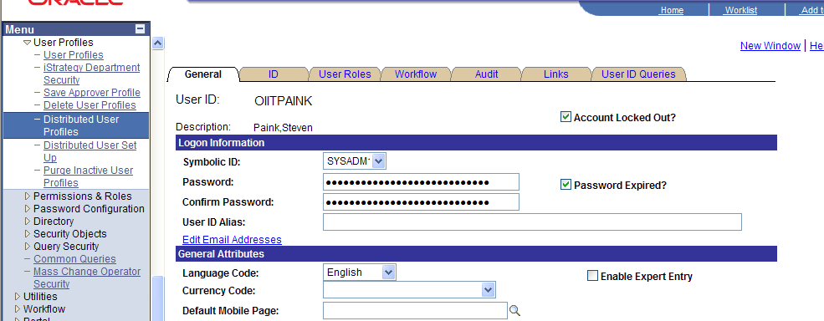
ITS-developed Tools and Processes
Locking Accounts
Notes:
This is an example of Locking a terminated user account.

Slide 25
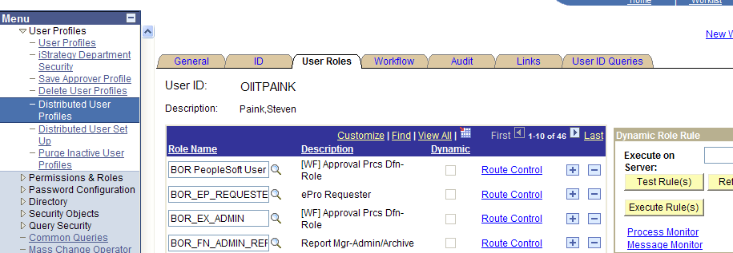
ITS-developed Tools and Processes
Remove the Base Role
Notes:
The base role is circled here. This role contains the sign in privileges. Without this role, users cannot sign in at all. Upon termination, remove this role only.

Slide 26
Prepare for an Audit with Monthly Monitoring
Review documentation and security request form
Is there a security request form on file for all users, and does it match their access in the system?
http://www.usg.edu/gafirst-fin/documentation/job_aids/category/security/
Update PeopleSoft and security forms for users whose jobs have changed
Ensure appropriate approvals are in place
Review terminations
Notes:
So, what can you do at the campus level to ensure you are ready for an audit? Always ensure for any users in the system that you have a valid security request form on hand. This would be for any users who has more roles than what is granted when they self register. If a user self registers and only enters travel authorization and a security admin never has to update their roles, then a form is not needed. Periodically review the form to ensure their access is still correct and cross reference the form to the roles they have in PeopleSoft to ensure they still match.
Always have the appropriate level of authorization on the forms.
For terminations, at least monthly review the termination list you receive from ADP and cross reference that with the users in PeopleSoft. Run the termination query and validate that there are no terminated users there that still have access.

Slide 27
Prepare for an Audit with Monthly Monitoring
Review user preferences and role assignments for control and segregation of duty issues.
Review budget security
Limit approvals to certain individuals
Notes:
Not only do you need to review role access, you need to review users (user preferences). Is the same person that is adding a vendor approving it? Carefully review these preferences for any segregation of duties issues. Review users that have budget security access. Can they override budget errors? Ensure that the appropriate personnel have this authority. And limit the approval responsibility to a few individuals and ensure that you periodically review this access.

Slide 28
Questions?

