Slide 1

Georgia State University’s Grants System:
PeopleSoft Grants and Beyond
Tonia Davis-Greenway
University Research Services and Administration
Office of Research Resolutions
September 17, 2015

Slide 2
OBJECTIVE
This session will provide a broad overview of the applications used by Georgia State University to support key business processes in research administration.

Slide 3
About GSU
Sponsored Research Administration at GSU
-$100.9 Million Awarded Research in FY15
-60% Federal Awards
-About 2,065 active awads
-About 320 Unique Funding Sources
-Processed 620 proposals in FY15

Slide 4
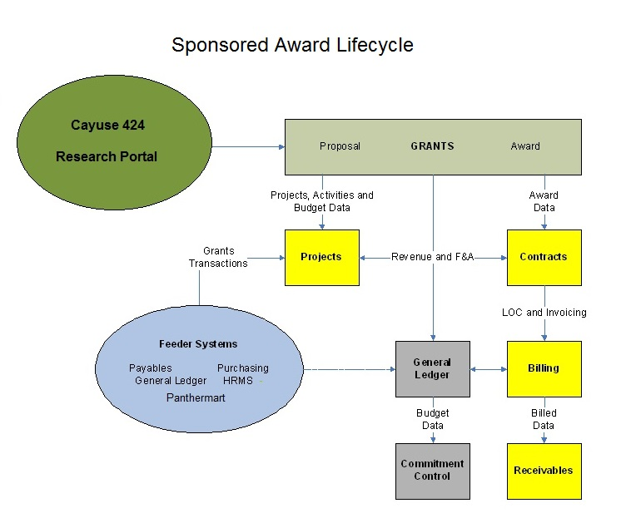

Slide 5
Applications and their Uses
Cayuse424 | Proposal Development Federal Grants Submission
Research Portal | Routing, Task Tracking & Reporting Dashboard
PeopleSoft Grants | Proposal Data, Post-Award Financial Data Project Budgets and Expenditures, Billing and AR

Slide 6
Cayuse 424
Cayuse 424 is a fast easy-to –use Web application created specifically to simplify the creation, review, approval and electronic submission of grant proposals.
-Auto fill
-Error Validation
-Copy & Transform Proposals
-Budget Development
-Automating Subawards
-Document Repository

Slide 7
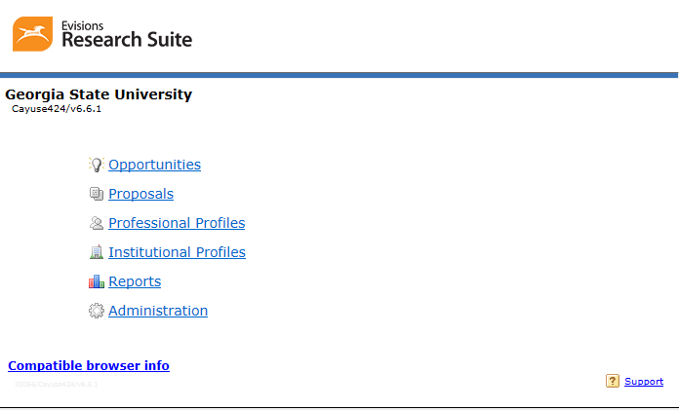
Cayuse 424

Slide 8
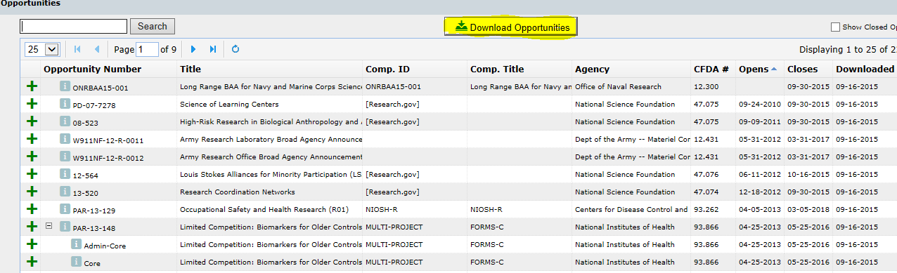
Cayuse 424

Slide 9
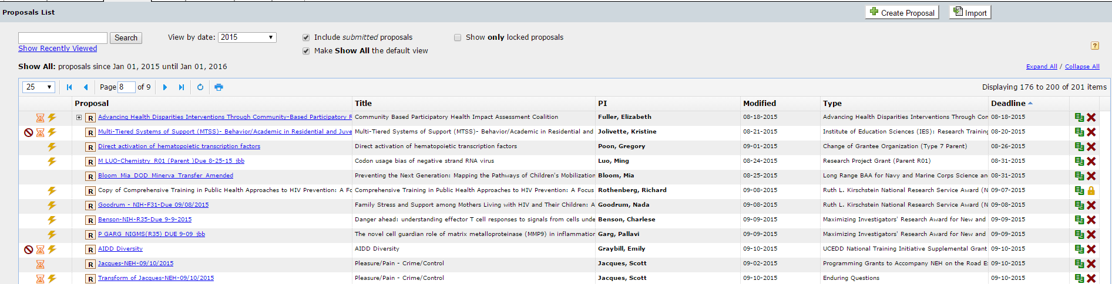
Cayuse 424

Slide 10
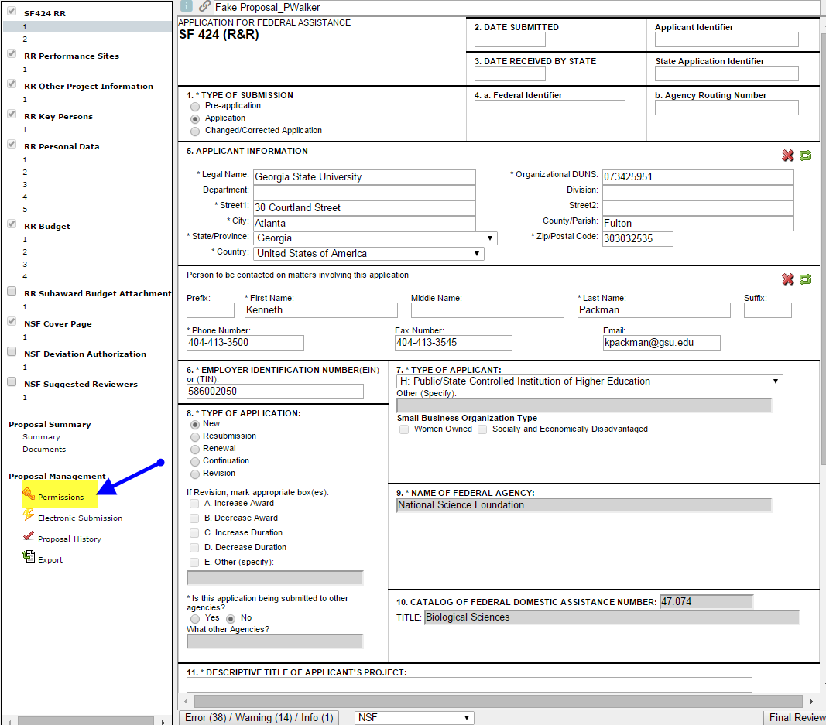
Cayuse 424

Slide 11
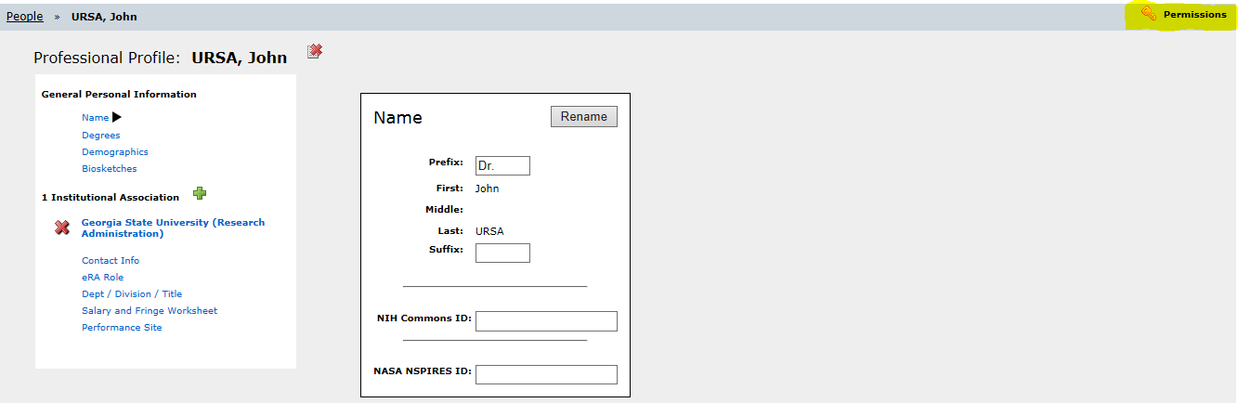
Cayuse 424

Slide 12
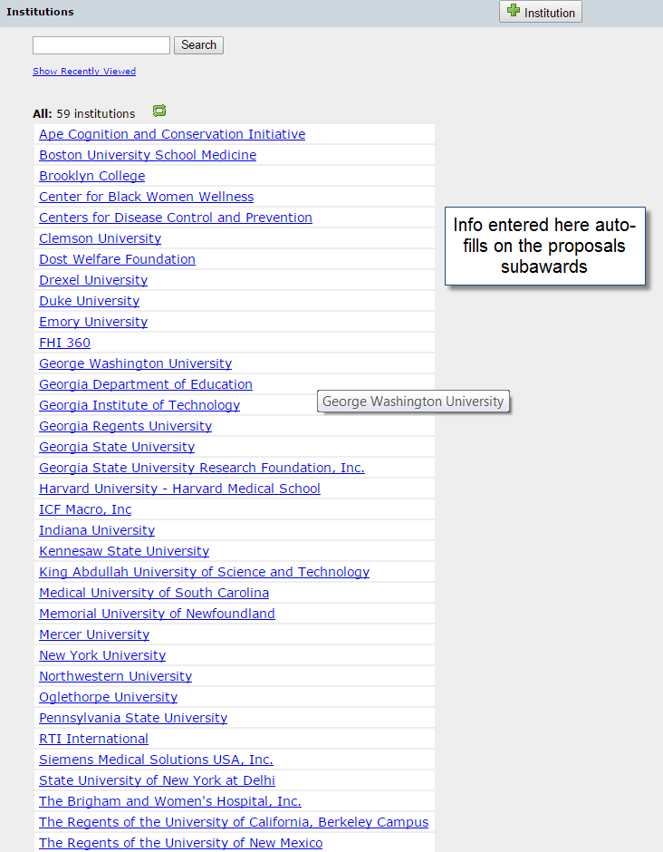
Cayuse 424

Slide 13
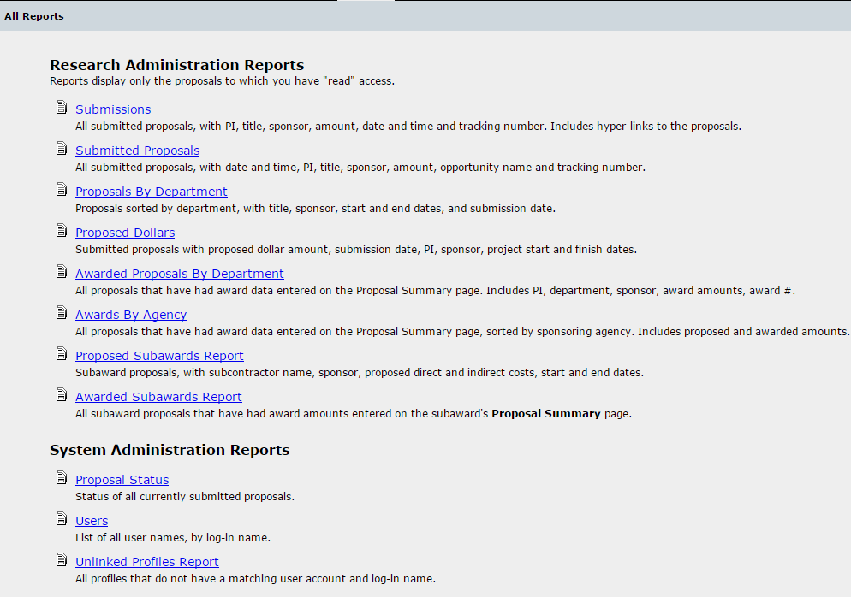
Cayuse 424

Slide 14
The Research Portal
Georgia State University’s Research Portal is an online system that promotes transparency and process efficiency across many areas of research administration at our institution. The portal is utilized by faculty, university administrators and grants management support staff.

Slide 15
The Research Portal
PIs can access to track details about their awarded research projects
Research Deans can monitor college’s progress toward meeting research funding goals
Departments can initiate tasks needed, route the requests and monitor the progress of those request
Allows for communication and transparency regarding action items for projects

Slide 16
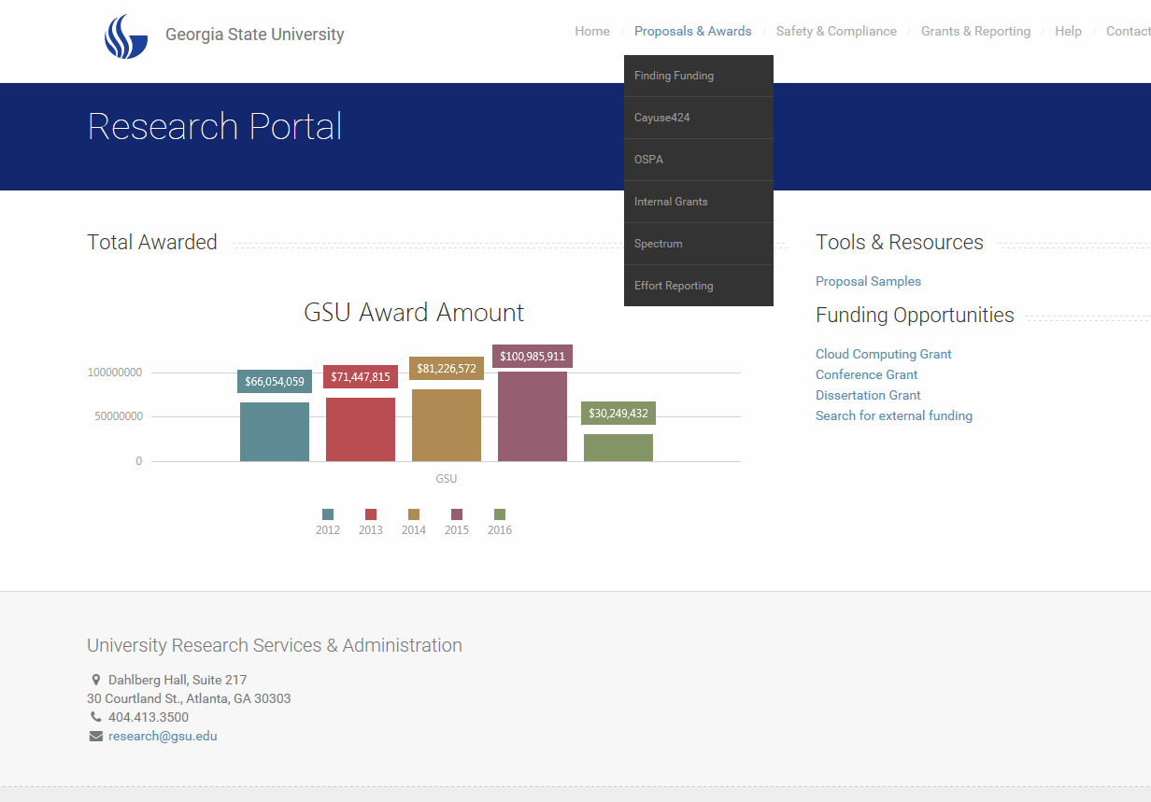

Slide 17
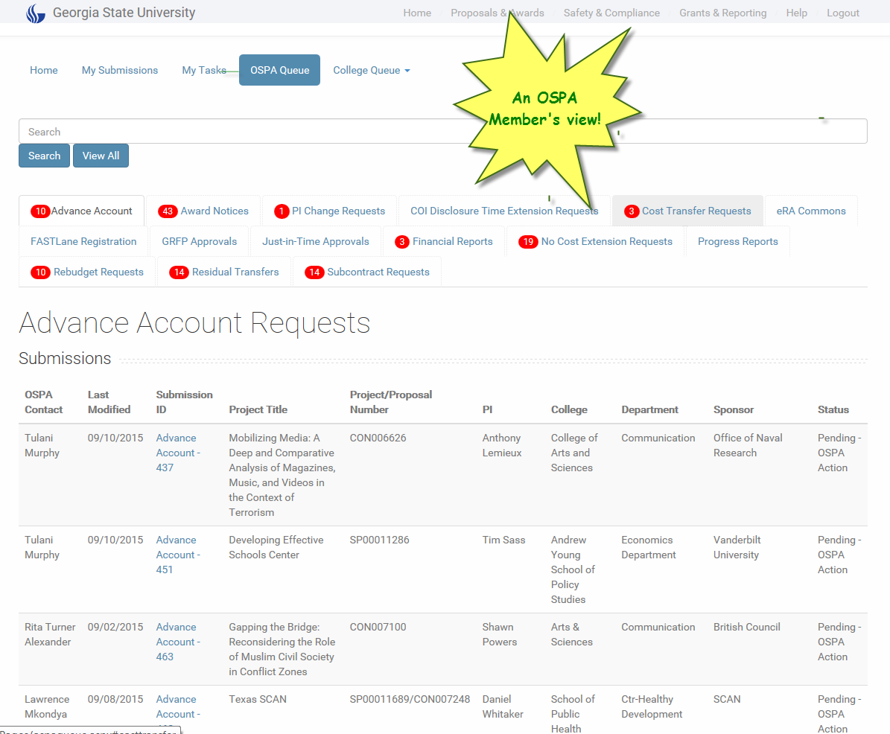
The Research Portal

Slide 18
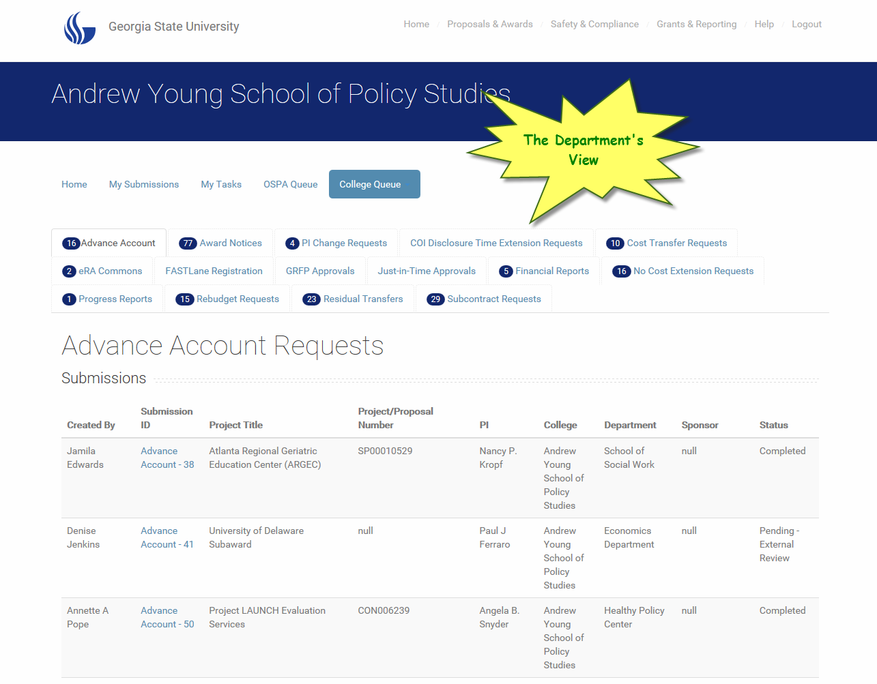
The Research Portal

Slide 19
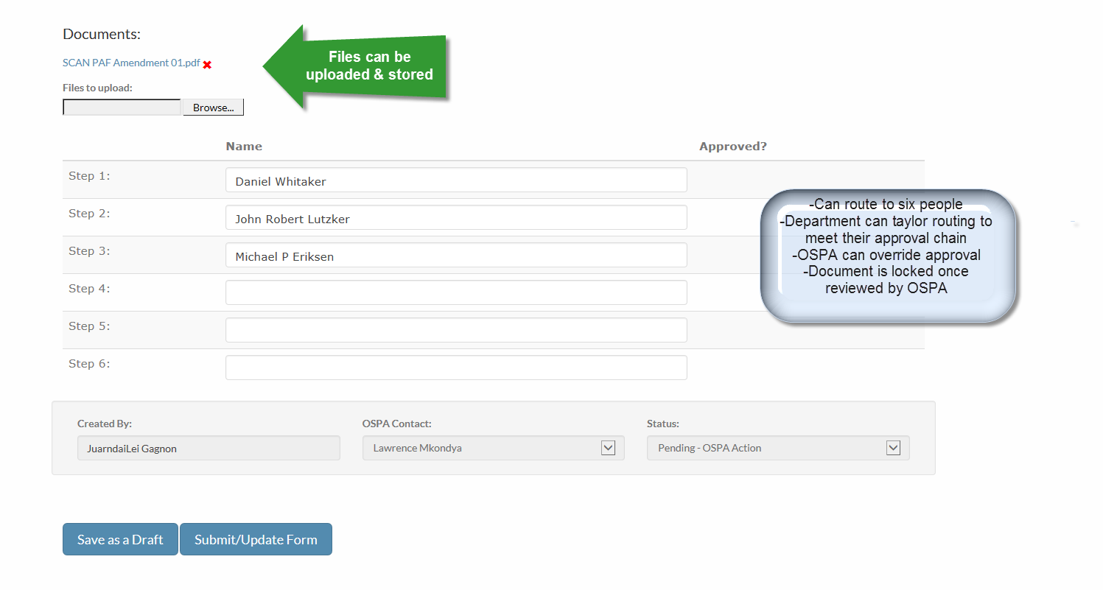
The Research Portal

Slide 20
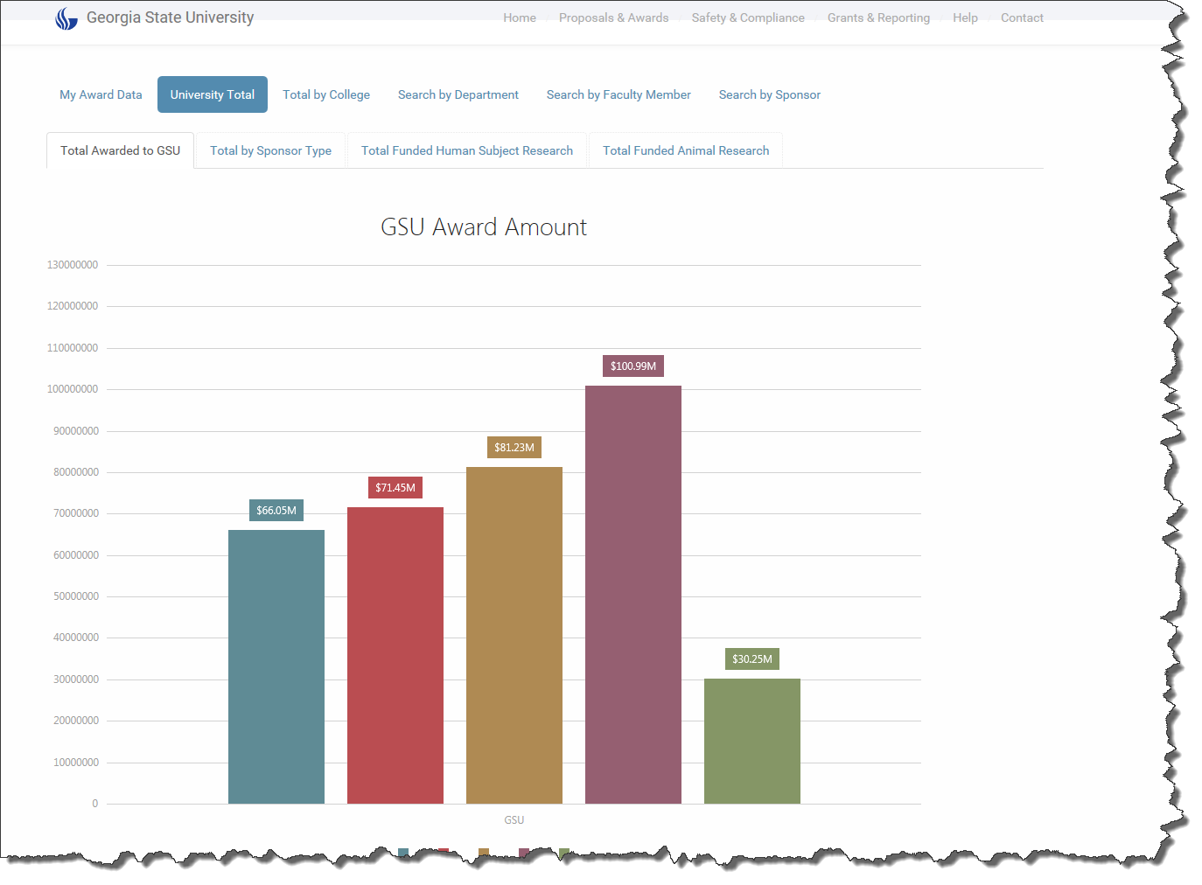
The Research Portal

Slide 21
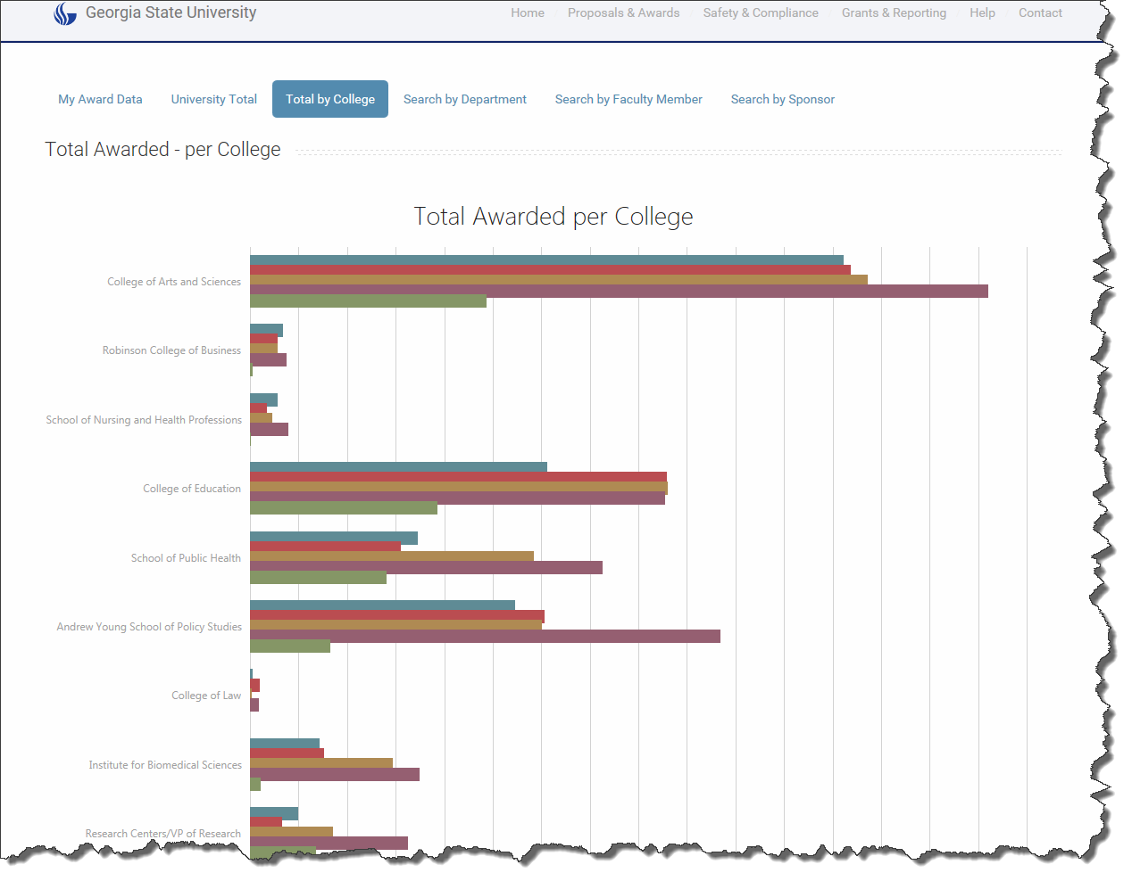
The Research Portal

Slide 22
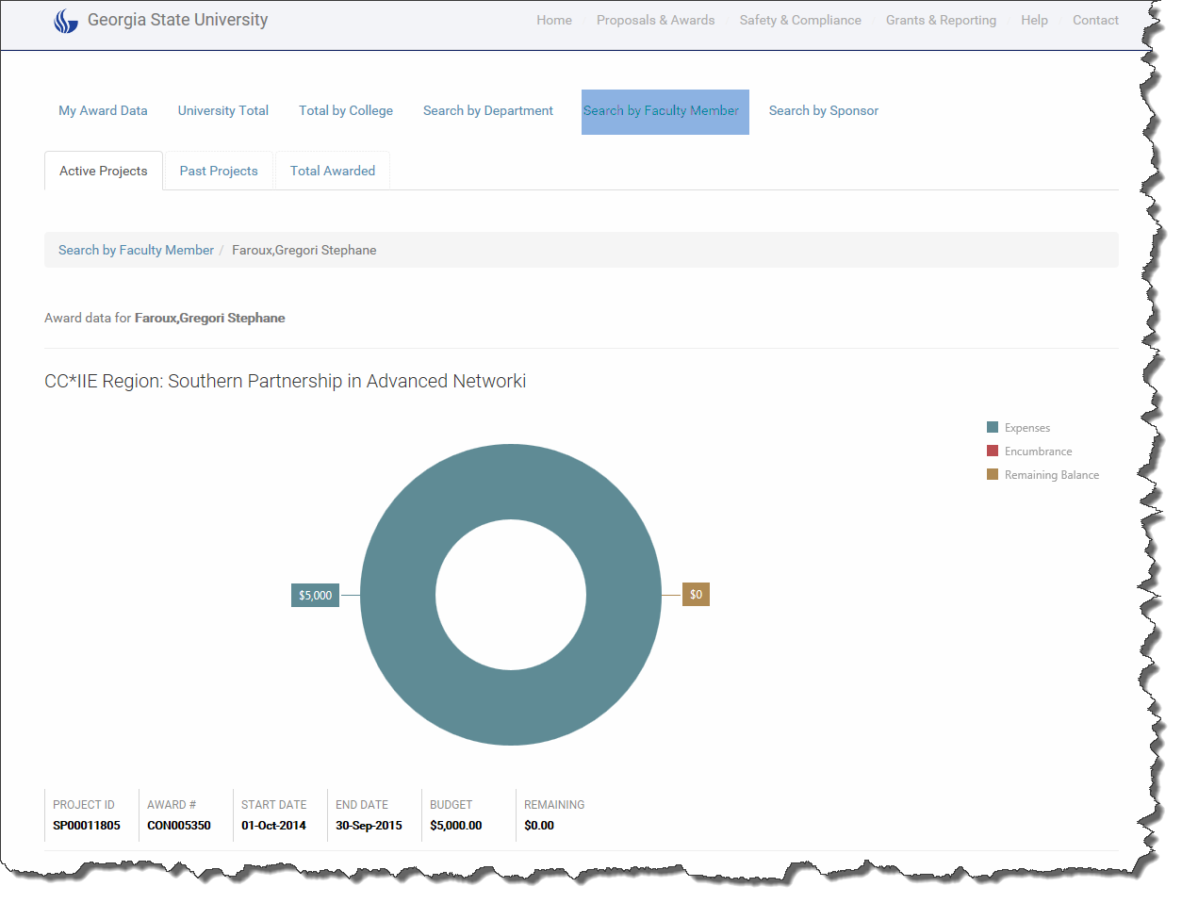
The Research Portal

Slide 23
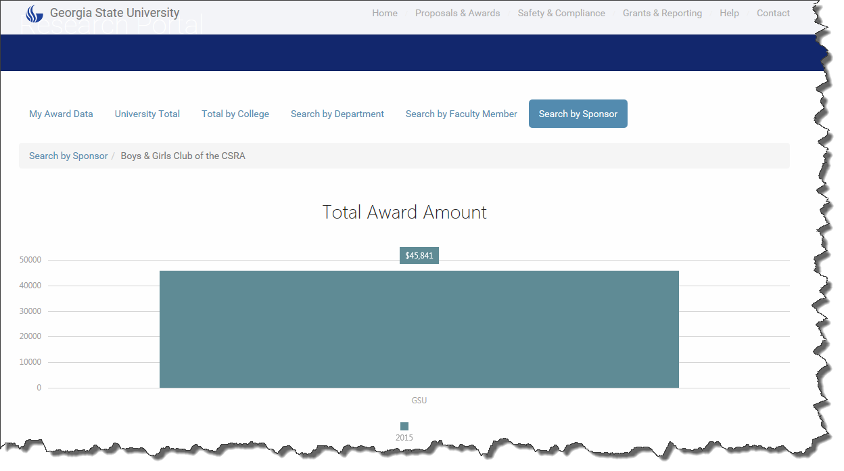
The Research Portal

Slide 24
The Research Portal
Also Used to:
-Track Internal Grants Programs
-Track Significant Financial Interest Disclosures
-Track and Maintain Animal Resources
-Medical Monitoring Program for Vertebrate Animal Exposure(MMPVAE)

Slide 25
PeopleSoft Grants
PeopleSoft Grants Support the key business processes that are associated with the administration of sponsored research activities;
-Not a stand-alone application-”Grants Suite”
-Leverages functionality that is within
*Contracts
*Project Costing
*GL
*Billing

Slide 26
PeopleSoft Grants
The Grants Module
-Supports the Proposal Preparation Process
*Maintains the Proposal Budget
*Maintains administrative & personnel information
-Contains information to need for the:
*Award Profile
*Project Costing
*Contracts
-Assigns a proposal number and version ID

Slide 27
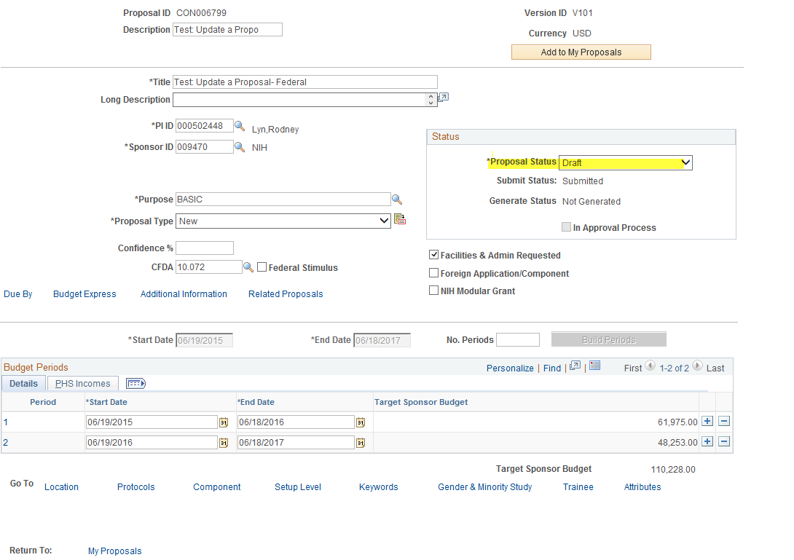
PeopleSoft Grants
Proposal
Projects
Budgets
Resources
Certifications
Reports

Slide 28
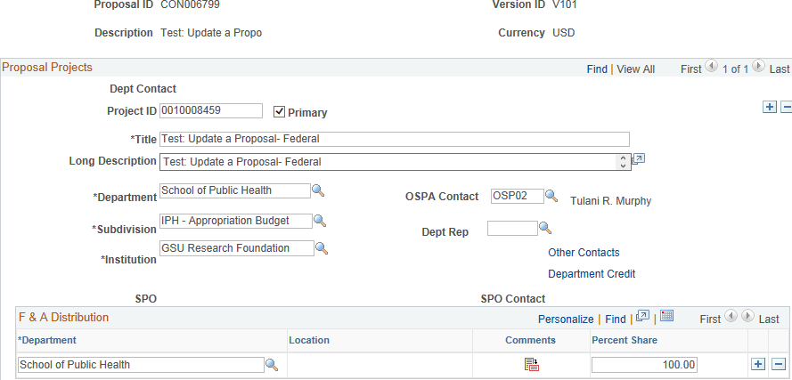
PeopleSoft Grants
Proposal
Projects
Budgets
Resources
Certifications
Reports

Slide 29
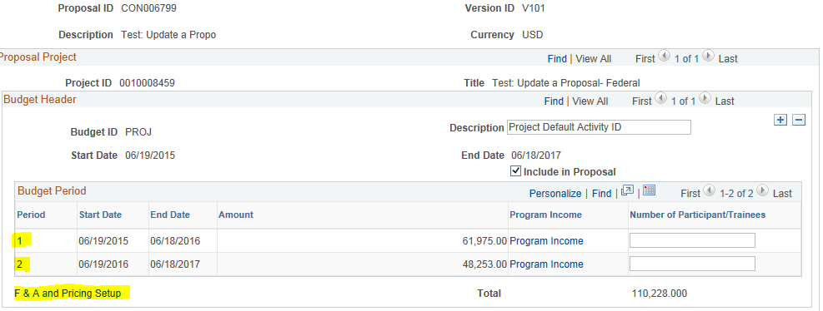
PeopleSoft Grants
Proposal
Projects
Budgets
Resources
Certifications
Reports

Slide 30
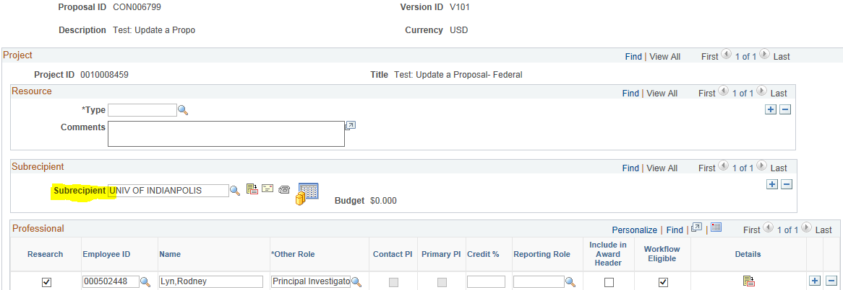
PeopleSoft Grants
Proposal
Projects
Budgets
Resources
Certifications
Reports

Slide 31
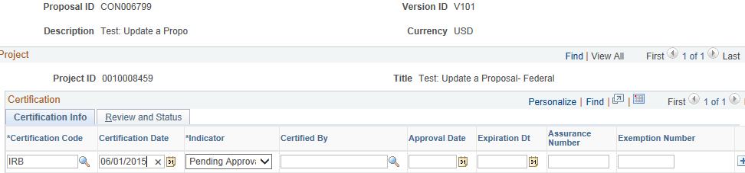
PeopleSoft Grants
Proposal
Projects
Budgets
Resources
Certifications
Reports

Slide 32
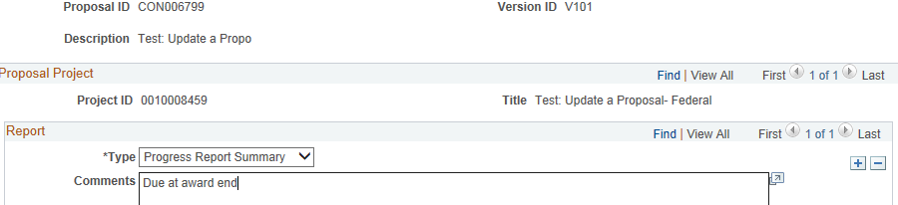
PeopleSoft Grants
Proposal
Projects
Budgets
Resources
Certifications
Reports

Slide 33
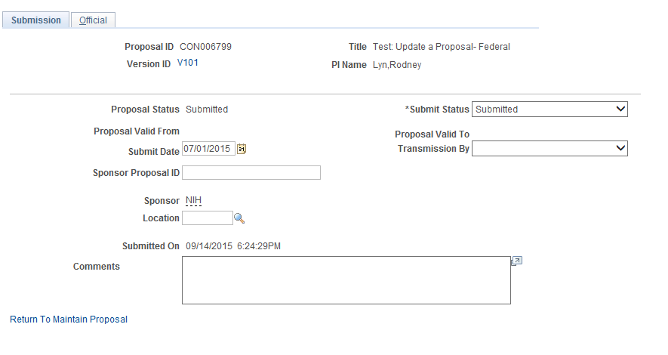
PeopleSoft Grants
Once V101 proposal is created, it must processed as submitted.
No changes can be made to the V101 once submitted.

Slide 34
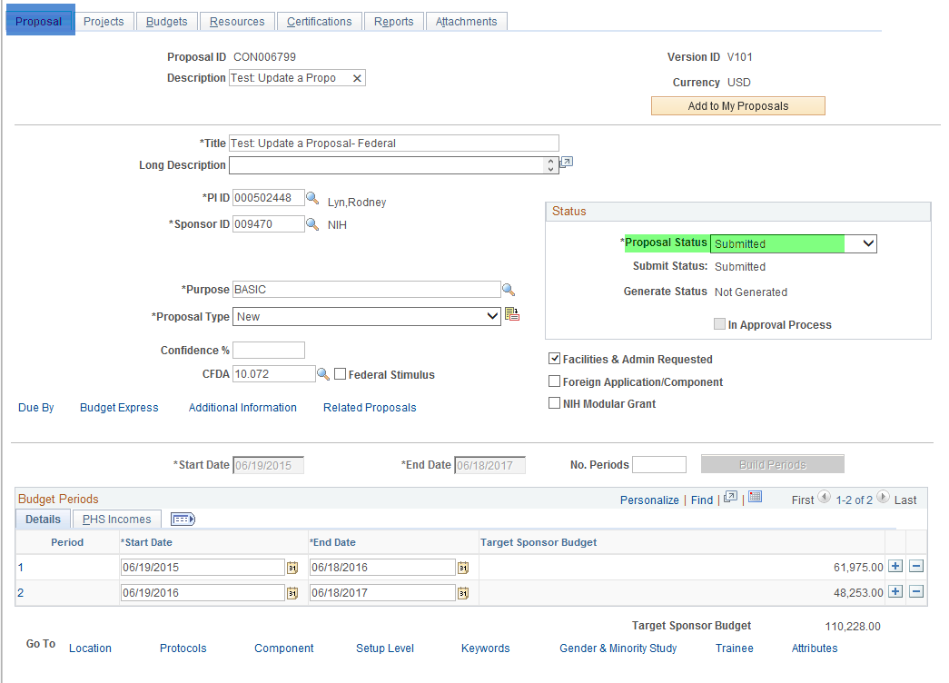
PeopleSoft Grants

Slide 35
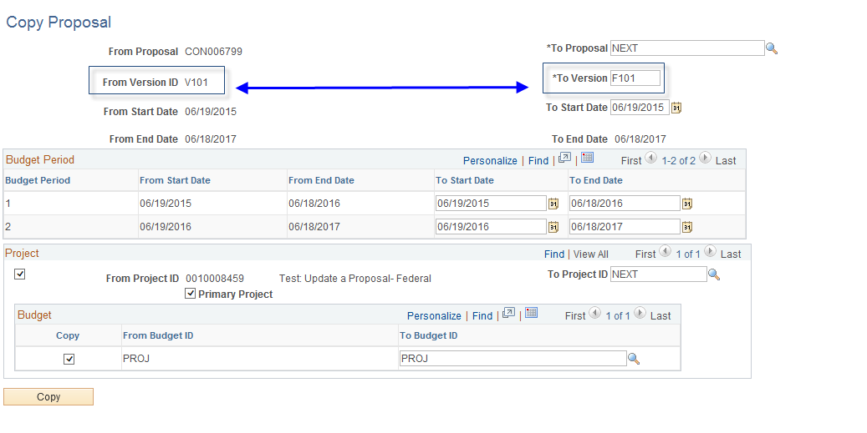
PeopleSoft Grants
When the Proposal is Awarded.
The V101 has to be copied to a version F101 to update.

Slide 36
PeopleSoft Grants
Award Profile
-The Award Profile serves as the primary record of an award notification and award details.
Award Generation Process
Flows information to:
*Award Profile
*Projects Costing
*Contracts
-Assigns a project number
-Used to Distribute Official Award Notification

Slide 37
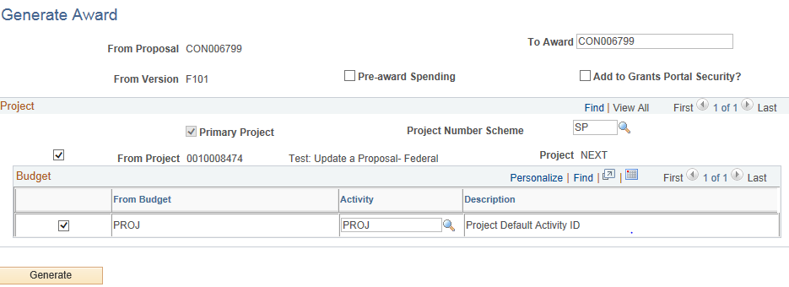
PeopleSoft Grants

Slide 38
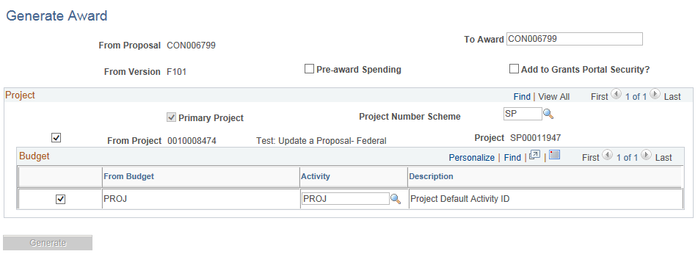
PeopleSoft Grants

Slide 39
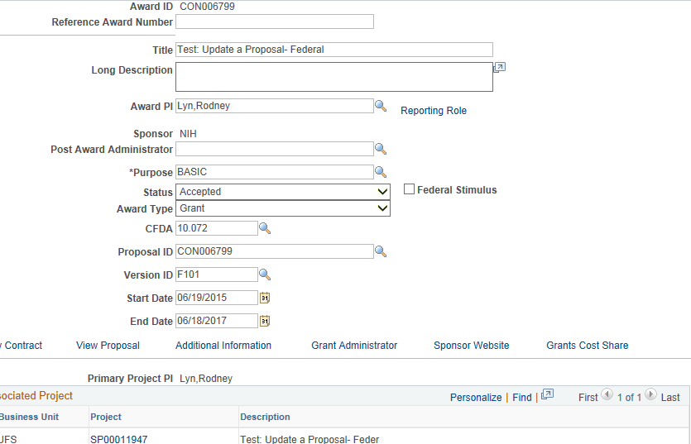
PeopleSoft Grants
Award
Funding
Resources
Certifications
Terms
Related Proposals
Award Mod
GSU Grants Admin

Slide 40
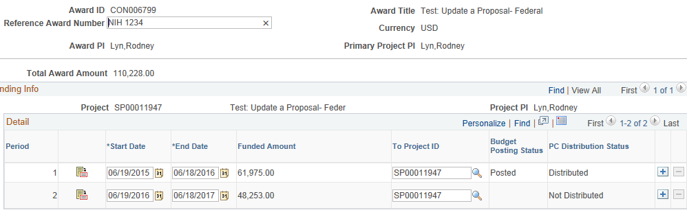
PeopleSoft Grants
Award
Funding
Resources
Certifications
Terms
Related Proposals
Award Mod
GSU Grants Admin

Slide 41
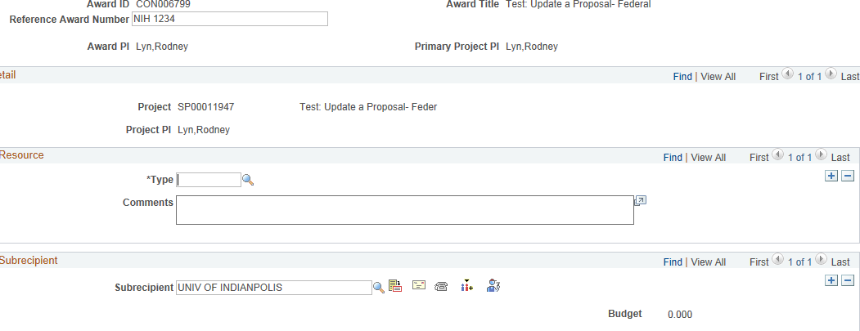
PeopleSoft Grants
Award
Funding
Resources
Certifications
Terms
Related Proposals
Award Mod
GSU Grants Admin

Slide 42
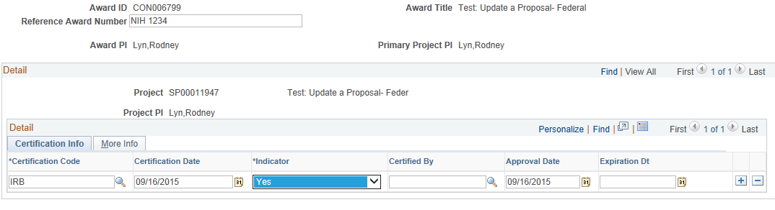
PeopleSoft Grants
Award
Funding
Resources
Certifications
Terms
Related Proposals
Award Mod
GSU Grants Admin

Slide 43
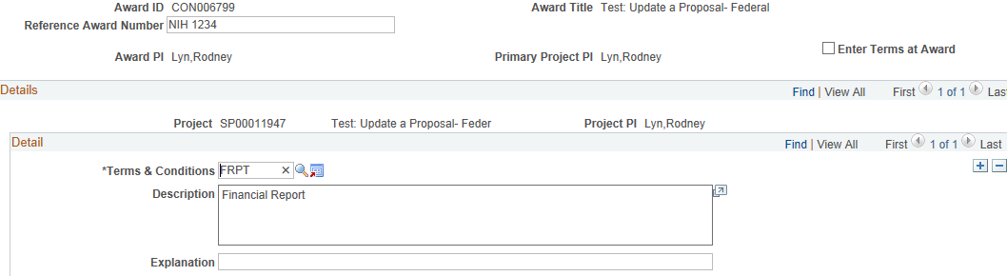
PeopleSoft Grants
Award
Funding
Resources
Certifications
Terms
Related Proposals
Award Mod
GSU Grants Admin

Slide 44
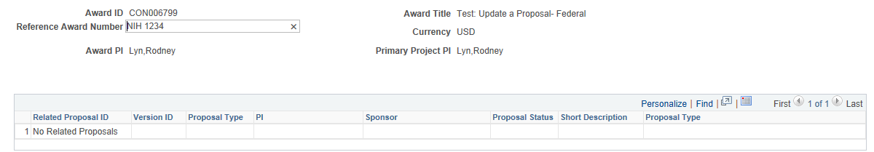
PeopleSoft Grants
Award
Funding
Resources
Certifications
Terms
Related Proposals
Award Mod
GSU Grants Admin

Slide 45
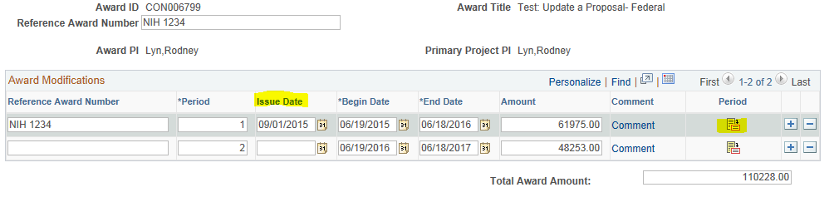
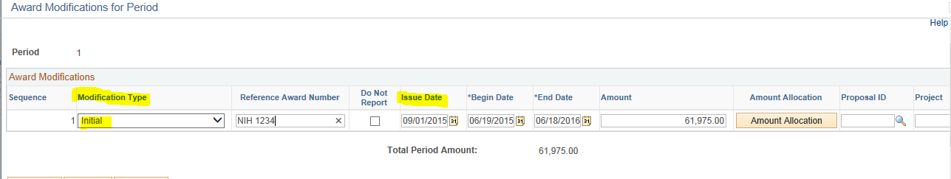
PeopleSoft Grants
Award
Funding
Resources
Certifications
Terms
Related Proposals
Award Mod
GSU Grants Admin

Slide 46
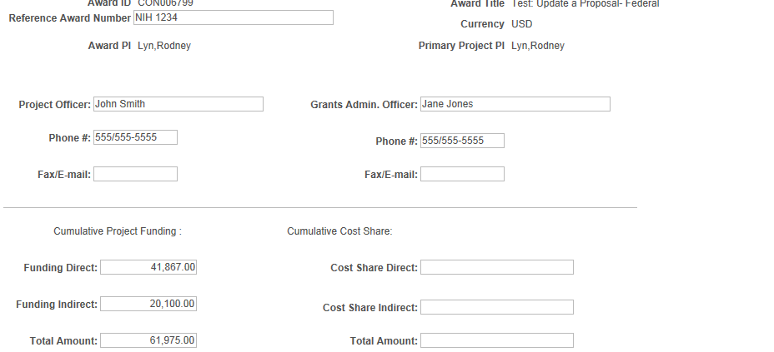
PeopleSoft Grants
Award
Funding
Resources
Certifications
Terms
Related Proposals
Award Mod
GSU Grants Admin

Slide 47
PeopleSoft Grants
Projects Module
The Project Costing (or Projects) module’s primary purpose for award management is to collect financial transactions associated with sponsored projects.

Slide 48
PeopleSoft Grants
Projects Module
-Stores information applicable to a single project
-Establishes the “speedtypes” to equal the project IDs
-Maintains project IDs and activity IDs to manage award costs
-Repository of project activity and transactions for budgeting, F&A processing and billing
-Maintains project budget and chartfield information using the “finalization” process
*Rows are populated in PROJ-Resource table & KK after finalization*

Slide 49
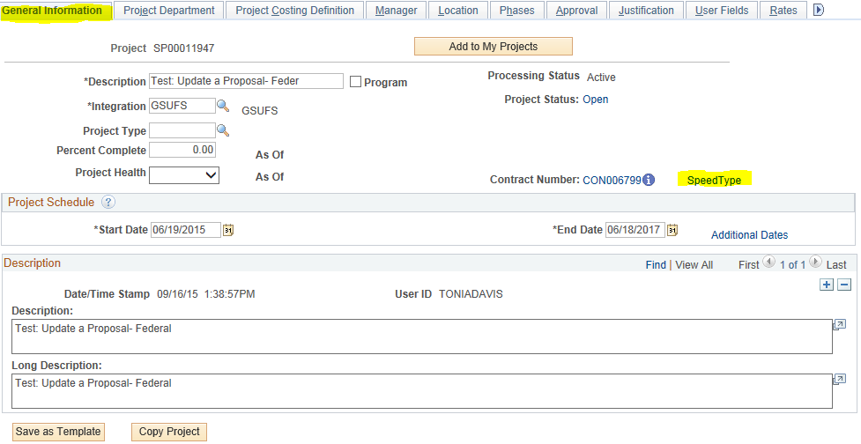
PeopleSoft Grants

Slide 50
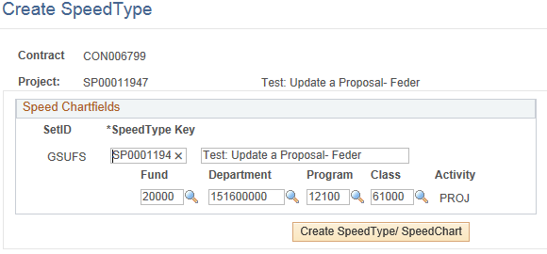
PeopleSoft Grants

Slide 51
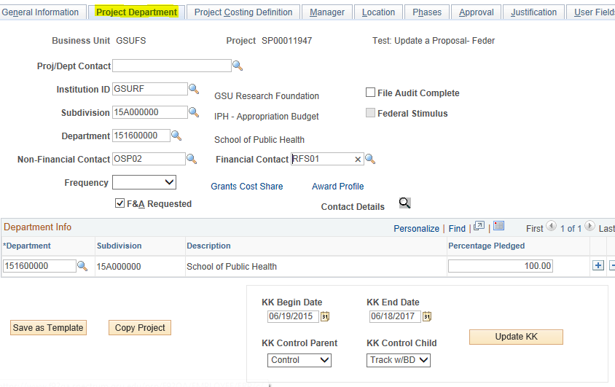
PeopleSoft Grants

Slide 52
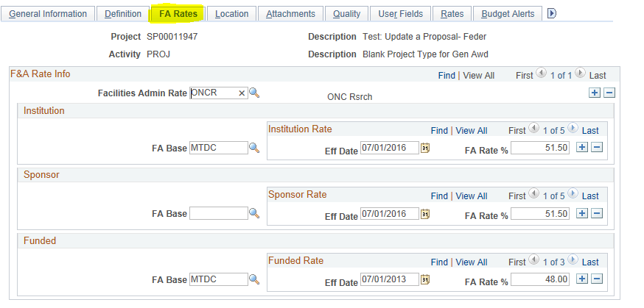
PeopleSoft Grants

Slide 53
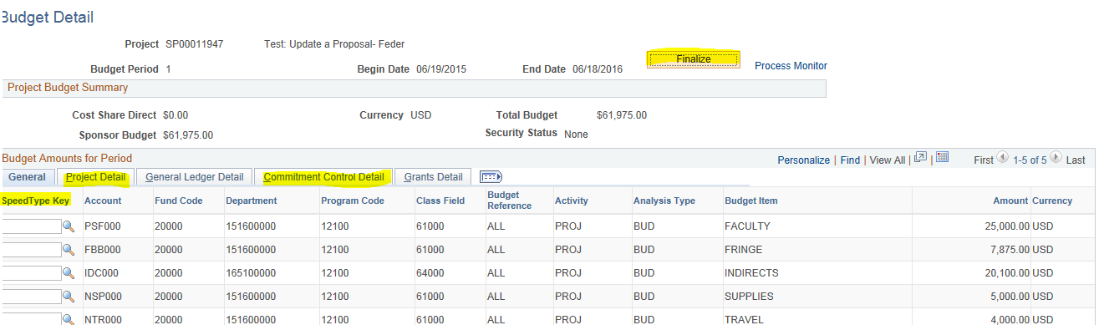
PeopleSoft Grants

Slide 54
PeopleSoft Grants
Contracts Module
The Contracts module’s primary purpose for award management is sponsored billing and revenue recognition.

Slide 55
PeopleSoft Grants
Contracts Module
-Maintains billing parameters
-Maintains “product” type
*Grants_Fixed: amount based billing
*Grants_Reimbursable: as-incurred billing
-Defines billing and revenue plans
-Relates more than one to a single award for consolidation billing
-Considered the gateway between projects and billing upon “ Activation”
*Once marked “Active” Contract is ready for billing.*

Slide 56
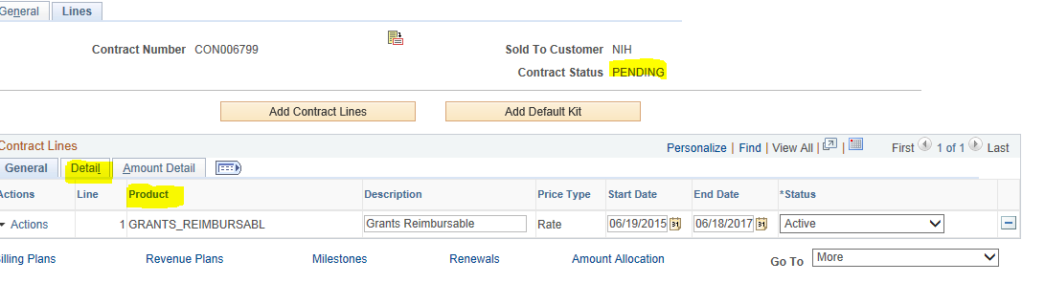
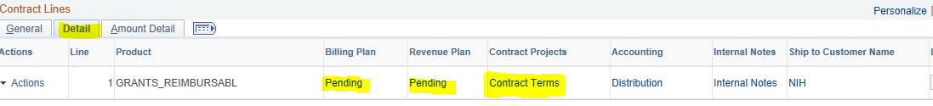
PeopleSoft Grants

Slide 57
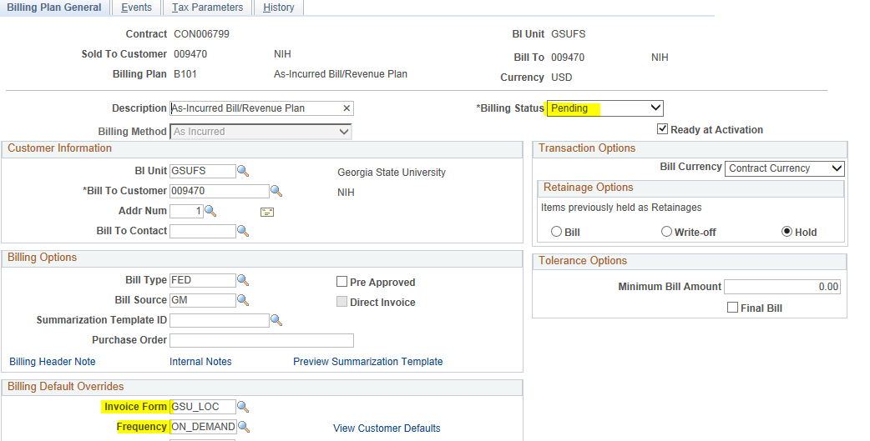
PeopleSoft Grants

Slide 58
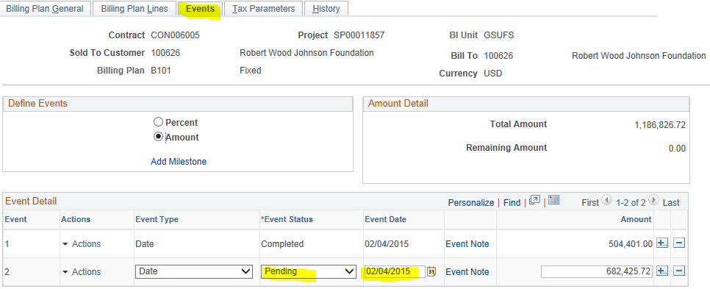
PeopleSoft Grants

Slide 59
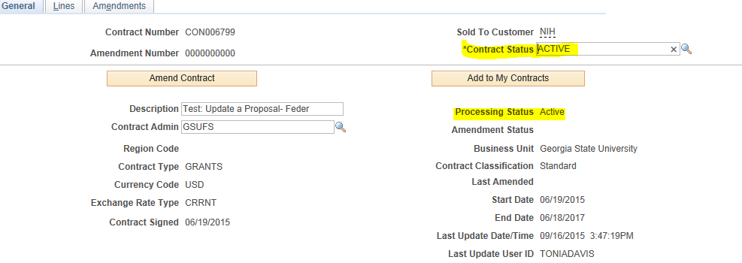
PeopleSoft Grants

Slide 60
PeopleSoft Grants
Billing Module
The Billing module’s primary purpose for award management is to approve and generate invoices to sponsors for reimbursement of expenses on sponsored project.
-Leverages project costs and F&A expenses in Projects
-Leverage billing parameters and plans in Contracts

Slide 61
PeopleSoft Grants
Billing Module
Pre-Billing Processes:
*Cost Collection
*Facilities and Administration
*Pricing
-Managed using Nightly, Monthly or Ad hoc Batch Processes

Slide 62
PeopleSoft Grants
Grants_Reimbursable Invoice
*As-Incurred Billing
*Generated based Cost Collected for AP, GL & F&A
on the transactions collected from the feeder
*Revenue Recognition based on “Billed” Expenses
*Processed in Monthly Batch
Grants_Fixed Invoice
*Amount –Based Billing
*Generated based on Events in Contract
*Revenue Recognition based “Billed” Event”
*Processed in Nightly Batch

Slide 63
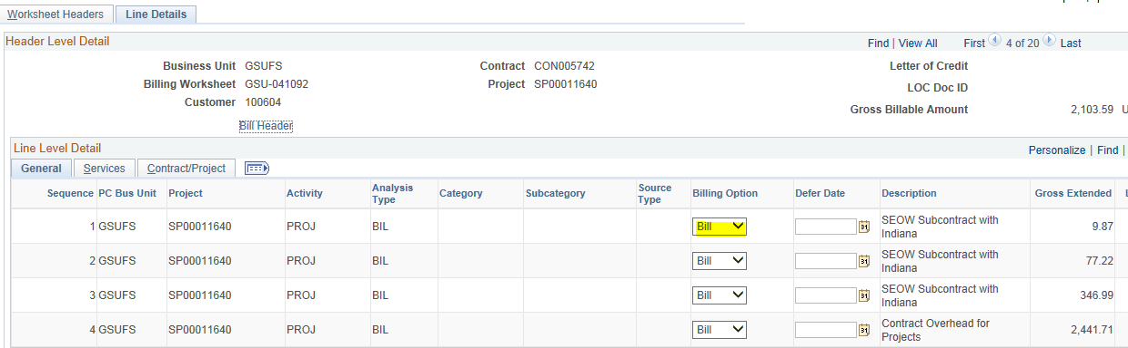
PeopleSoft Grants

Slide 64
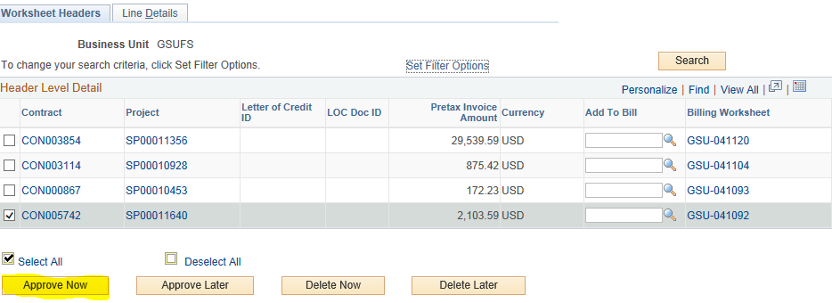
PeopleSoft Grants

Slide 65
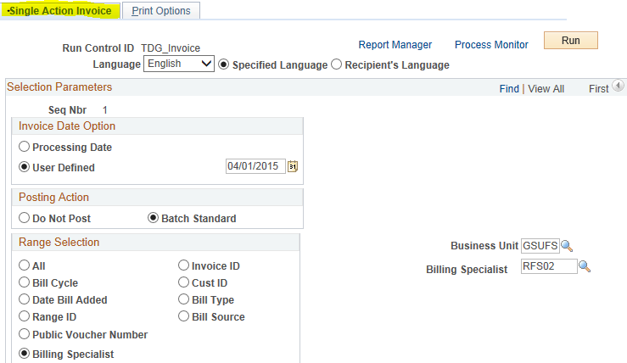
PeopleSoft Grants

Slide 66
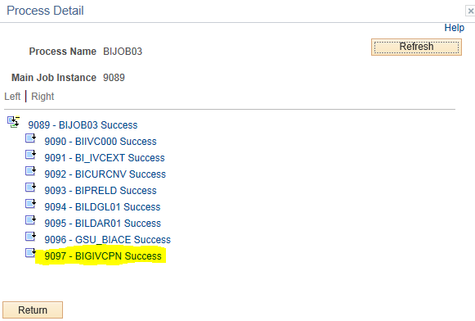
PeopleSoft Grants

Slide 67

PeopleSoft Grants

Slide 68
PeopleSoft Grants
AR Module
The Accounts Receivables module’s primary purpose for award management is to track incoming payments of expenses on sponsored project.
-Two Step Process:
*Create Deposits
*Apply Payments
-Accounting Distribution
*Processed in Nightly Batch

Slide 69

PeopleSoft Grants

Slide 70

PeopleSoft Grants

Slide 71
PeopleSoft Grants
Award Modifications
-Impacts Grants, Project and Contracts
*Award Modification Tab is updated in Award Profile
*Project Dates and Budgets are updated
*Process Contracts Amendments
*GSU Admin Tab is Updated

Slide 72
PeopleSoft Grants
Reporting
*Delivered Reports
*Custom Queries
*Award & Summary Reports
*Project Drilldown Report
-Fiscal Year or Project Budget Year

Slide 73
Questions
??????
Tonia Davis-Greenway
toniadavis@gsu.edu

