Slide 1
ePro and The GeorgiaFirst Marketplace Round Table Discussion
Thursday, September 18th
10:50 to 11:40
Oglethorpe F&G

Slide 2
Panel Facilitators
Jim Barnaby, Director of Logistical Services, Georgia Perimeter College
Sheryl Lewis, Lead Procurement Specialist and Addie Edwards, Procurement Specialist, Georgia Southern University
Catherine Storey, and JoAnn Bryant, Senior University Buyers, Valdosta State University
Barbara Burns, Purchasing Director, Middle Georgia College
Debbie Lasher, Special Projects, USO
Teresa Page, GFM Support, ITS
Liz Lemerande, Business Systems Analyst, ITS
Andy Waligowski and Jessica Taylor, Account Managers, SciQuest
Kurt Collins, Project Manager, USO

Slide 3
Goals of Meeting
Provide an opportunity for peers to share and learn from others on institution practices, policies and experiences
Inform institutions not currently using the GFM of some of the benefits of the system and encourage them to join the project
Provide the USO and SciQuest teams an opportunity to discuss current tickets and system enhancements

Slide 4
Statewide Content in GFM
Availability of Statewide contract content inside GFM
Search capabilities of information
Content in one location without having to utilize Team Georgia Marketplace
Various ways to drill down information, i.e. by contract name, contract number, supplier, etc.
Content information on those contract vendors that have their own punchout
Lenovo, Dell and HP – ability to provide institution specific content

Slide 5
GFM vs use of P-Card
Decrease in the number of P-Card transactions
Reduces the credit liability risk on Cards, i.e. Cardholder limit is reduced to an amount that is the median for spend during a 6 mo to 12 mo time period
Transactions are approved prior to items being ordered
Department budgets reflect a “true/real” balance

Slide 6
Deliveries & Receipts
Challenges
Identifying the source: Is this a P-card, Special or GFM order????
Communications between, Purchasing, Central Receiving & Requester.
Determining delivery locations. (building, campus & requester)
Creating Receipts.
Lost Packages.
Asset Management.

Slide 7
Deliveries & Receipts
GFM vs Special Orders
GFM
Requester’s name indicated on shipping labels. (Originates from Requester’s Profile)
Requester can modify name on shipping label
Desktop delivery from Staples. (Fuel Savings)
Note: UPS/FedEx at time will cover the delivery info from vendor.

Slide 8
Deliveries & Receipts
Special Orders
Access to review PO information for receiving staff.
Copies of Purchase Orders to receiving staff.
Additional delivery information placed in the remarks of the PO.
Require vendors to indicate PO number.
Workflow Approvals for both Special & GFM orders. (Great for Asset Management)

Slide 9
FedEx
UPS
DHL
Georgia Perimeter College
Clarkston
Campus
*Packages tracked & delivered by GPC couriers daily.
*Requesters desktop receive
*Purchasing Admin monitors match exceptions
Decatur
Campus
Central Receiving
Lakeside
Campus
Newton
Campus
Dunwoody Campus
Alpharetta
Campus

Slide 10
Implementation Suggestions
Must have the Executive Team Support.
Start training with your departments that create the most orders. (These folks will become your biggest supporters)
Phase in by departments then open the training all others.
Make training a requirement for access for both approvers and requesters.
Establish a target date (12 months).

Slide 11
Implementation Suggestions
Emphasize the Benefits
Transparency.
Budget Control.
MarketPlace Orders. (Easy for requesters to pick-up, most have shopped on line)
Turn-around time on office supplies.
Purchasing life cycle review.
Purchasing Staff can focus on complex procurements.
Reduces the amount of orders waiting on a Buyer increasing turn around times for special orders.
Attachments move through workflow. (Quotes, SOW, agreements & etc…) pdf & jpeg.
Contract data review.

Slide 12
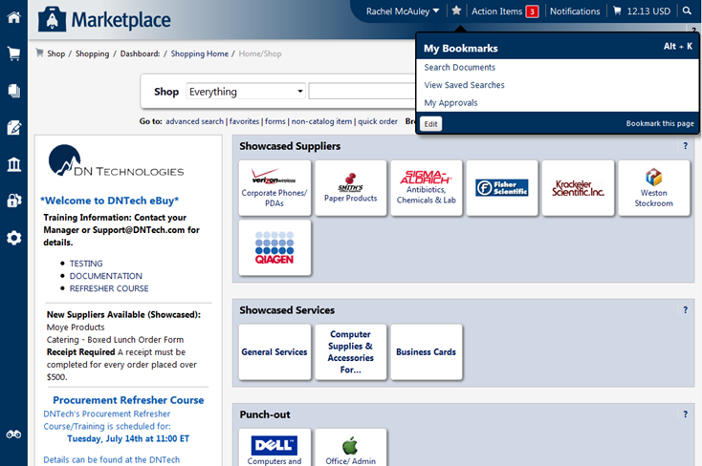
Bookmarks
You can Tag your Most Frequently Used Pages
You can Easily go to your Most Frequently Used Pages (Alt-K)

Slide 13
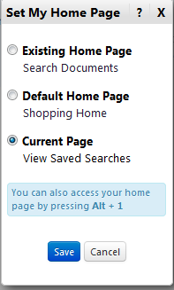
Choose Your Landing Page
You can Choose Your Landing Page
Configuration set at a per-user basis in the banner at the top of the page.
New hotkey combination to access home page: Alt +

Slide 14
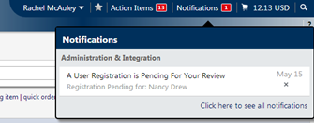
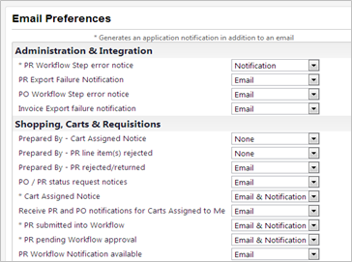
Notifications
At the Top of the Page, Easy to Review
No competition with the Org Message
You can receive communications through in-application notifications or email.
Additional in-application notifications
You can select “how” You like to receive communications

Slide 15
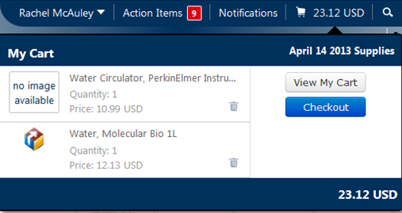
Better Cart Preview
You Can View Your Cart Without Leaving Your Current Page
Added Cart Name at top right of cart preview
Added ability to go straight to checkout

Slide 16
Common Support Tickets and Possible Enhancements
Adding attachments to document
Closing/canceling a single line on a multiple line requisition
The Finalize/Unfinalize Document icon on a PO
Receiving assets with multiple distrib lines

Slide 17
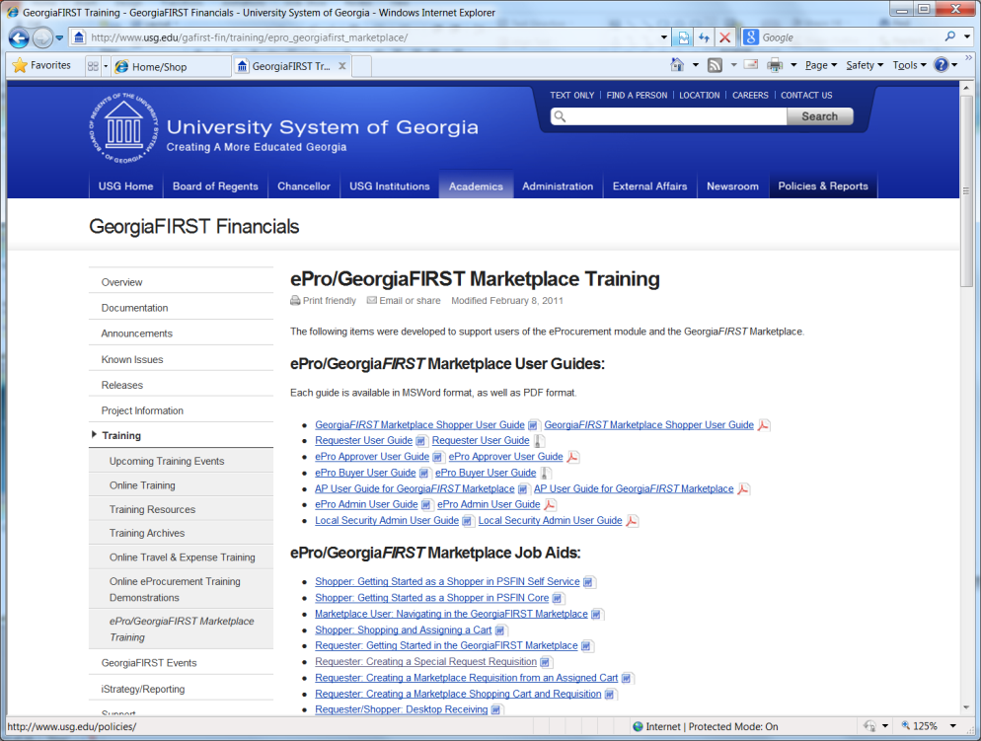
Training Opportunities
New Enablement Approach
Documentation and Training Materials:
http://www.usg.edu/gafirst-fin/training/epro_georgiafirst_marketplace/
User Guides
Job Aids
Online video sessions

Slide 18
Questions

