Slide 1
GeorgiaFIRST Financials PeopleSoft 9.2 ePro & Purchasing Not So New, But Improved!
Teresa Page

Slide 2
Agenda
Personalization Options
New Features
New Configuration Option
User Preferences

Slide 3
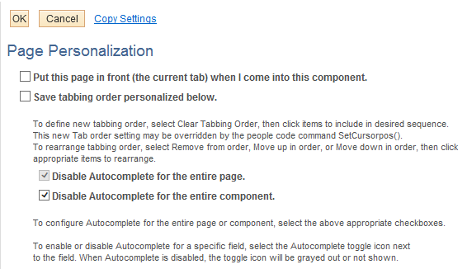
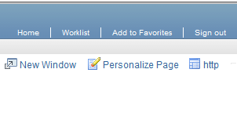
Disable Autocomplete (Type Ahead)

Slide 4
Main Menu Sort Order
Can select arrow found at top of Main Menu

Slide 5
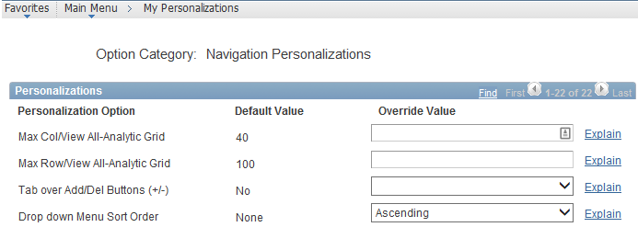
My Personalizations
Menu Sort Order and Autocomplete can also be defined here.
To permanently sort, select Ascending or Descending
To turn off Autocomplete entirely, select No

Slide 6
New Features in 9.2
eProcurement
Create Requisition
New Layout
‘Requisition Settings’ replaces ‘Line Defaults’
Supplier Name has been added to the Special Request pages
Amount Only option available on Requisition Line
Modify Line / Shipping / Accounting option now ‘Mass Change’
Pre-Budget Check

Slide 7
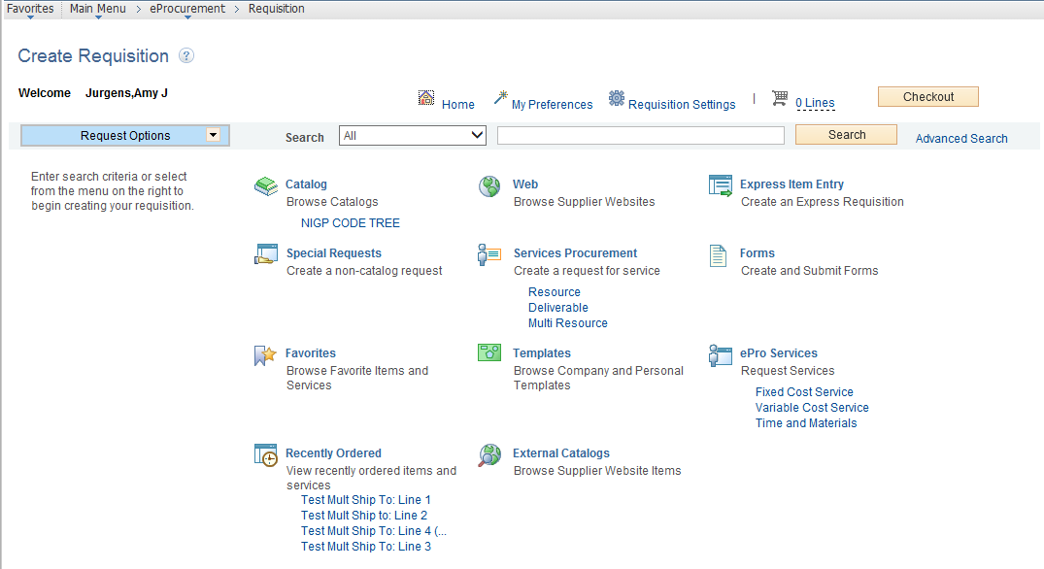

Slide 8
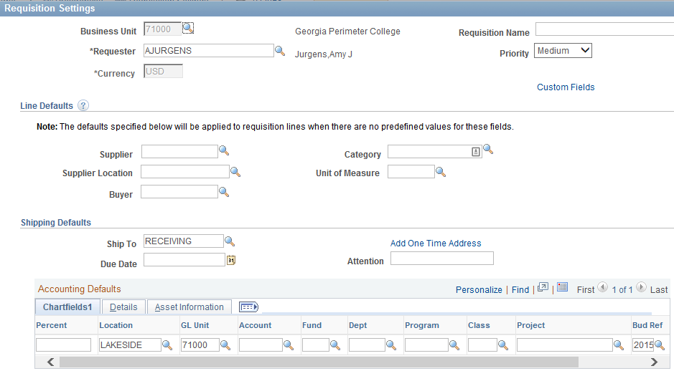

Slide 9
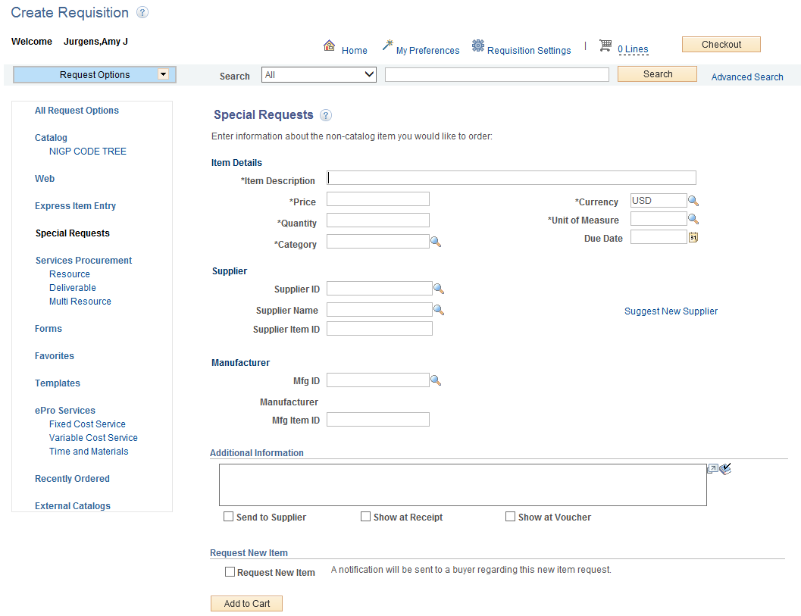

Slide 10
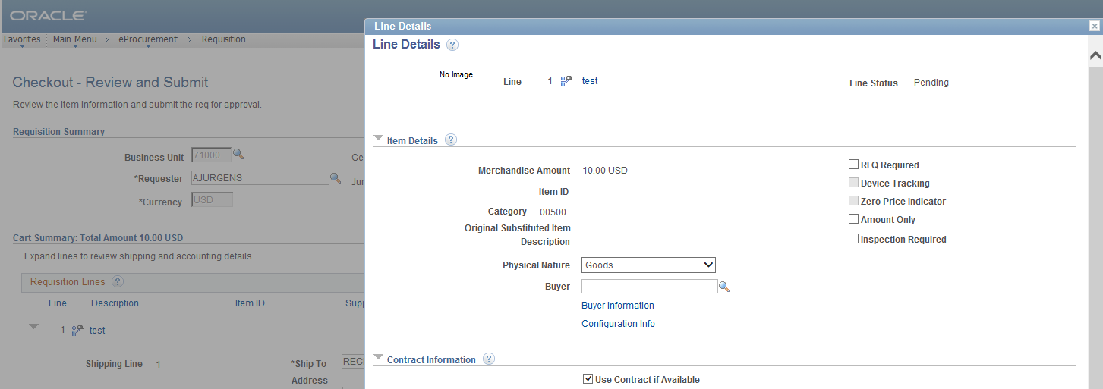

Slide 11
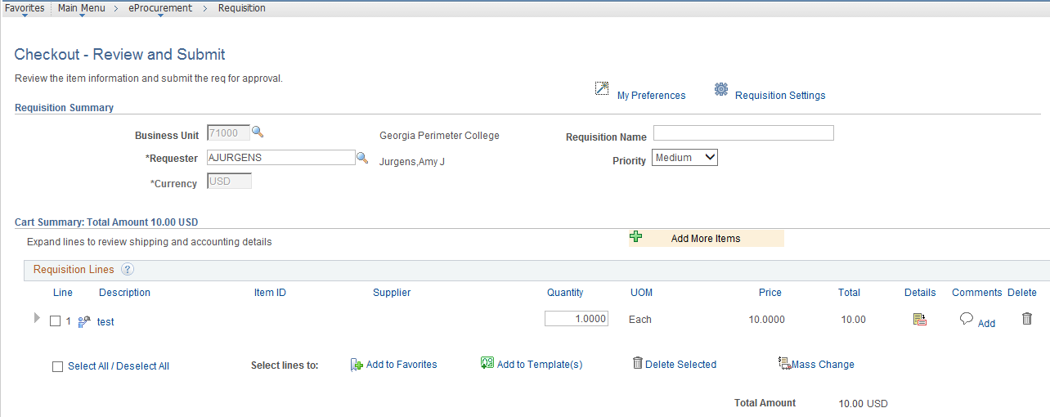

Slide 12
Pre Budget Check
ePro & Purchasing Modules
Does not create Pre-Encumbrance / Encumbrance entries in KK
Located on ‘Check Out – Review and Submit’ page of ePro Requisition

Slide 13
New Features in 9.2
eProcurement
Manage Requisitions
Manage Requisitions – New Action Options
Create a new Requisition by copying an existing requisition
Pre-Encumbrance balance of Requisition
Manage Requisitions – ‘Requisition Status’ has changed to ‘Request State’ and more accurately displays the correct status (Approved, PO’s Created, PO’s Dispatched, PO’s Completed, Complete)

Slide 15
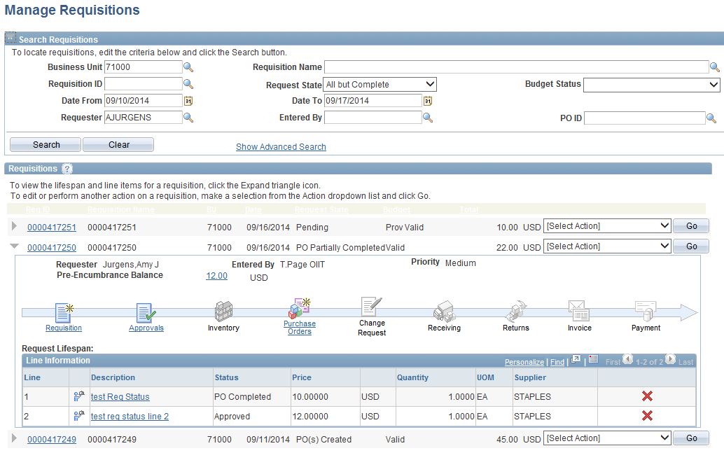

Slide 17
New Features in 9.2
Purchasing
Pre-Budget Check
Encumbrance Balance on PO
Mouse Over Popup
Attention To field
Buyer’s Workbench
Buyer Mass Change
Core Requisitions > Requester’s Workbench

Slide 18
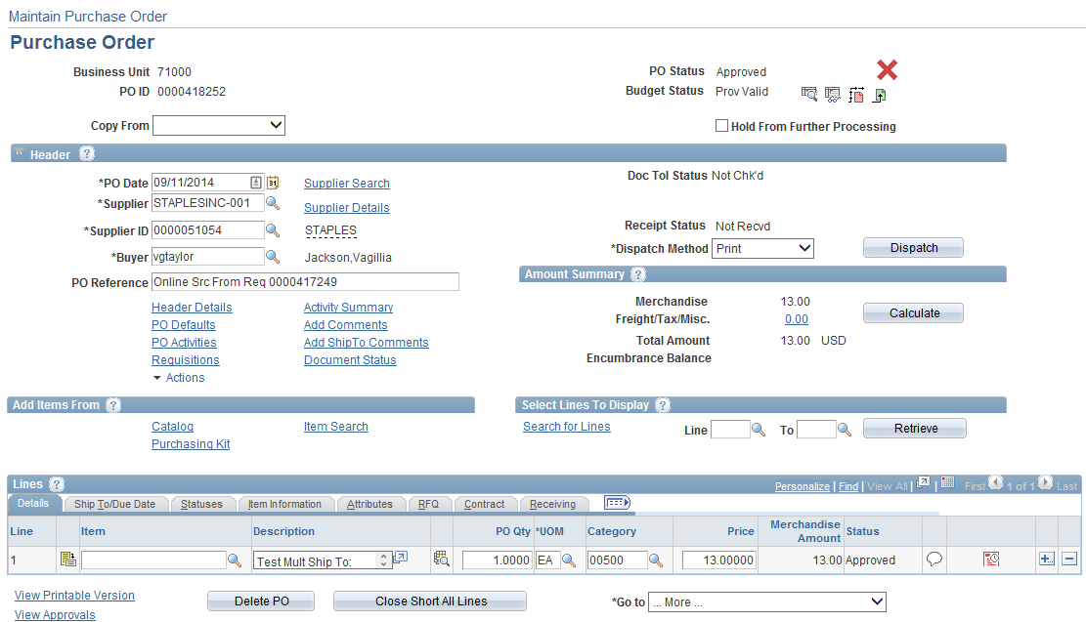
New Features in 9.2

Slide 19
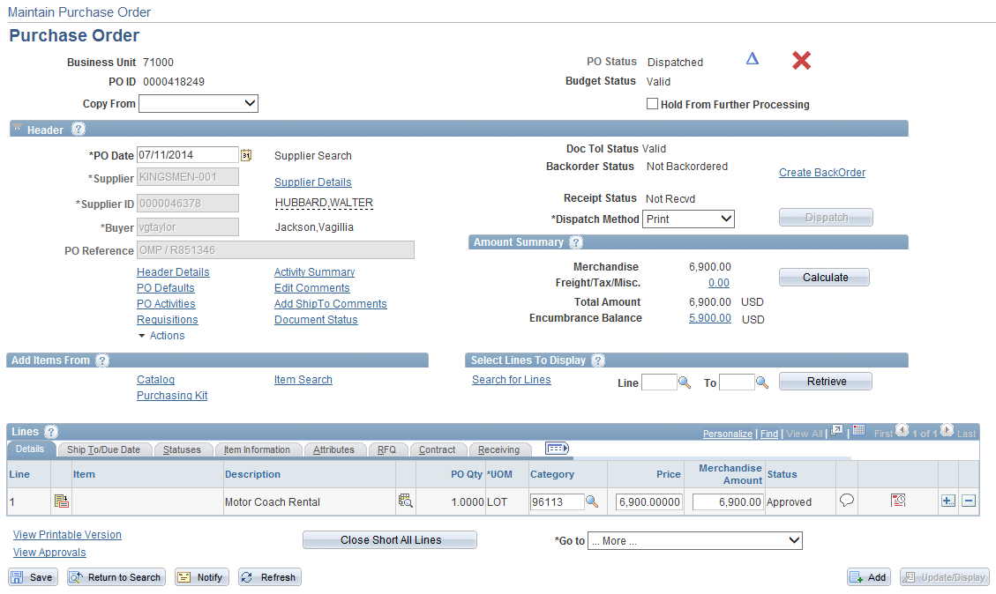
New Features in 9.2

Slide 20
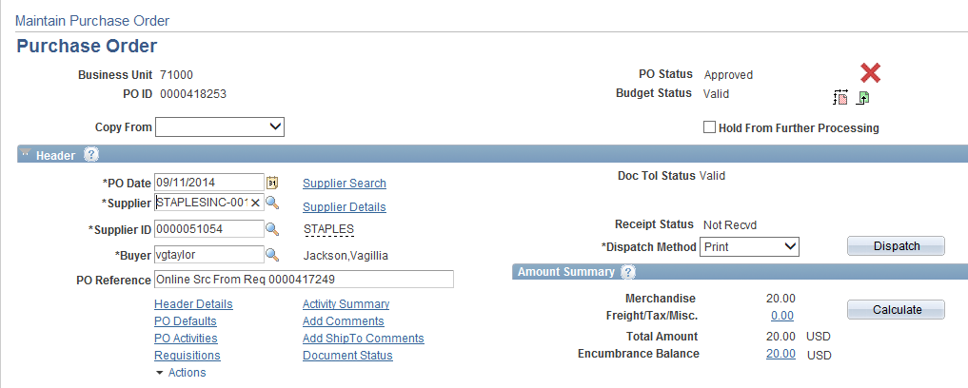
Mouse Over Popup
Displays additional information when you hover over
This feature is found on different pages throughout the modules

Slide 21
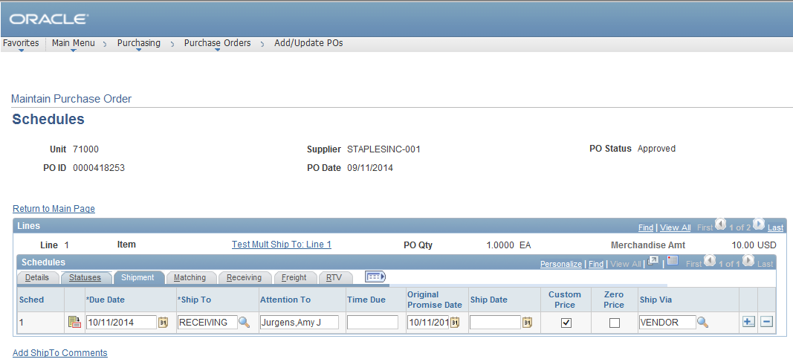
New Field: Attention To

Slide 22
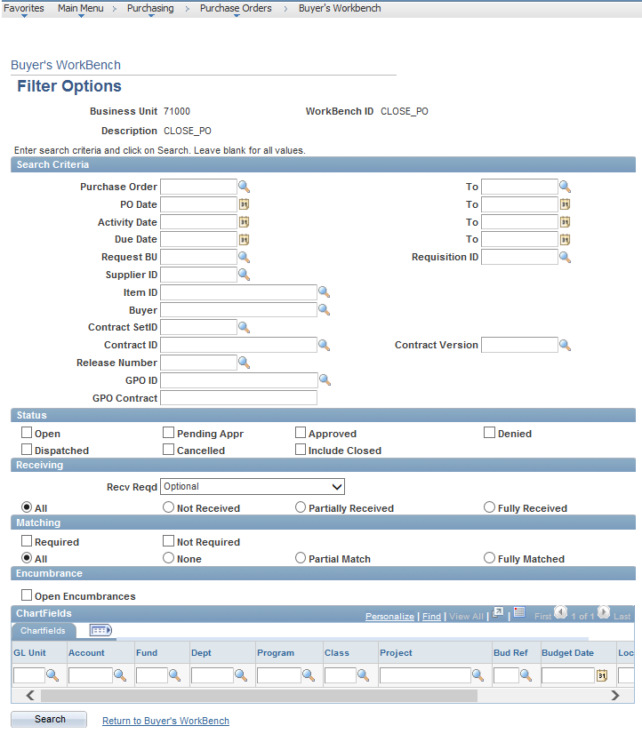
Buyer’s Workbench
Replaces PO Reconciliation Workbench

Slide 23
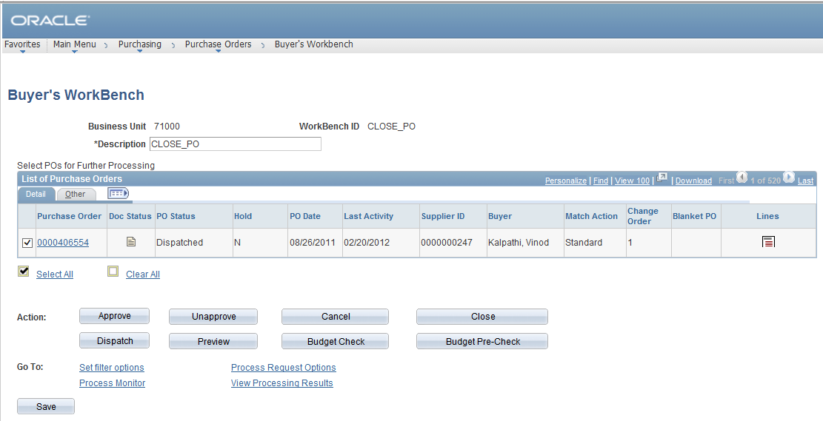

Slide 24
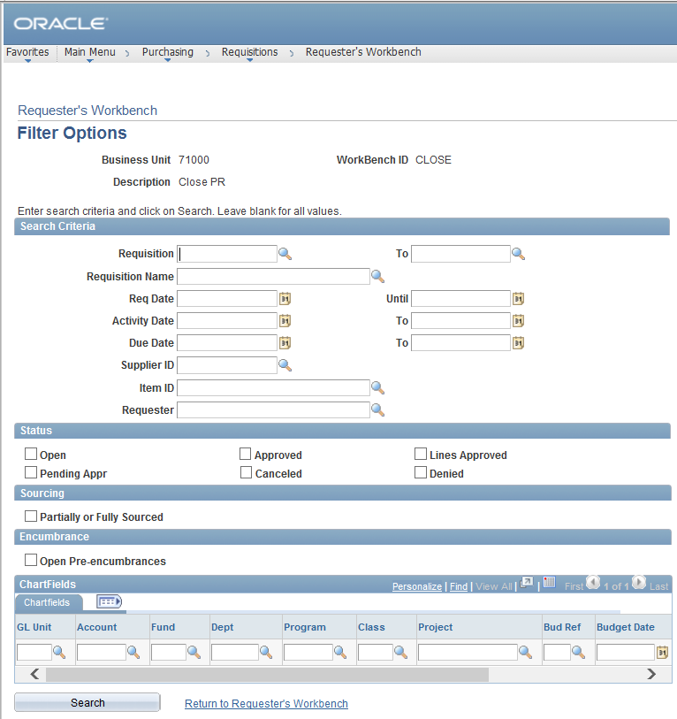
Requester’s Workbench
Replaces Requisition Reconciliation Workbench

Slide 25
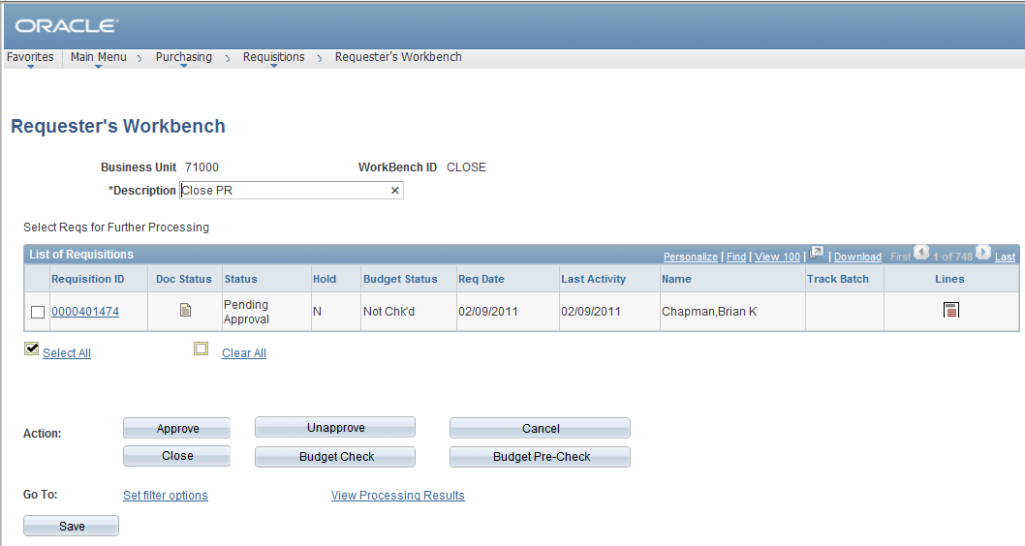

Slide 26
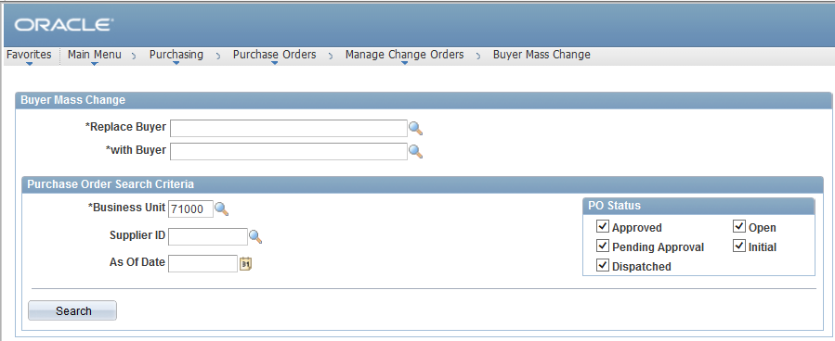
Buyer Mass Change

Slide 27
PO Approval Workflow
3 Stages of Approval
Asset Approval (replacing 8.9 Mods)
Will route to approver if:
Account is an Asset account and the Profile ID is blank
Account ranges 800000 – 899999
OR Account ranges 743000 – 743999
AND Amount is greater than $3,000
Profile ID exists, but account is NOT an Asset account

Slide 28
PO Approval Workflow
Budget Ref Approval
Will route to approver if:
Budget Ref entered on PO Distribution Line is different than current fiscal year
If a Req exists and the Budget Ref entered on PO Distribution Line is different than what is on the Requisition Distribution Line.

Slide 29
PO Approval Workflow
Buyer Approval (replacing Chartfield and Amount Approval steps)
Will route to approver if:
PO manually entered
Will NOT route to approver if:
PO was sourced from an Approved Requisition

Slide 30
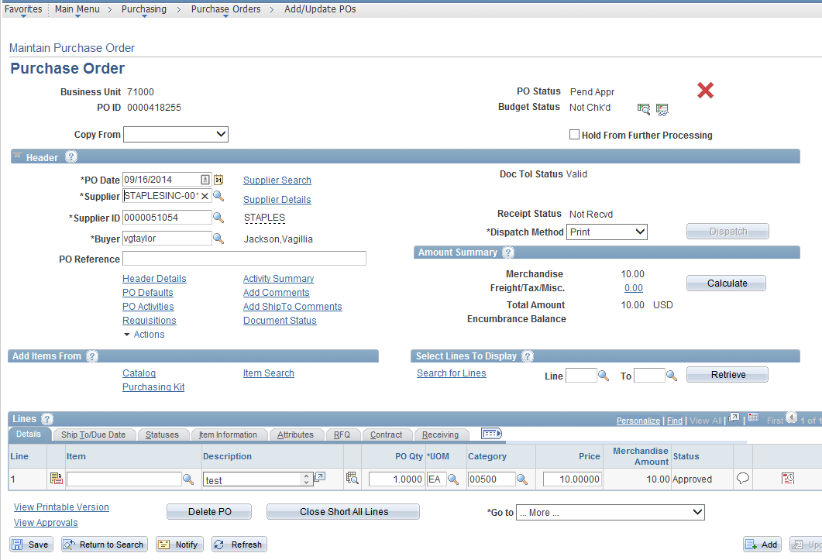
View Approvals link

Slide 31
New Features in 9.2
Suppliers
Payment Notification (Location tab, Payables link)
Split PO by Ship To (Location tab, Procurement link)

Slide 32
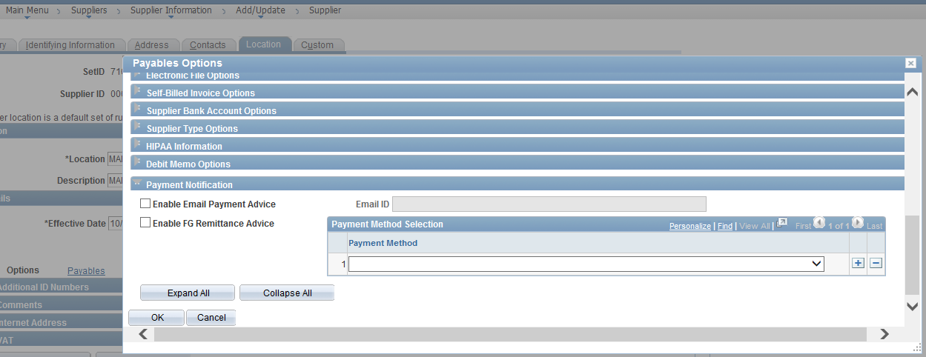

Slide 33
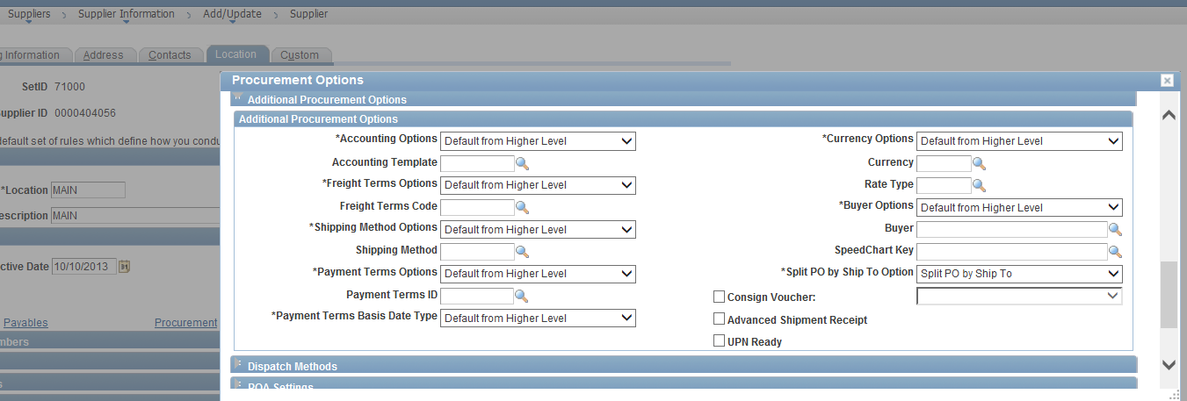

Slide 34
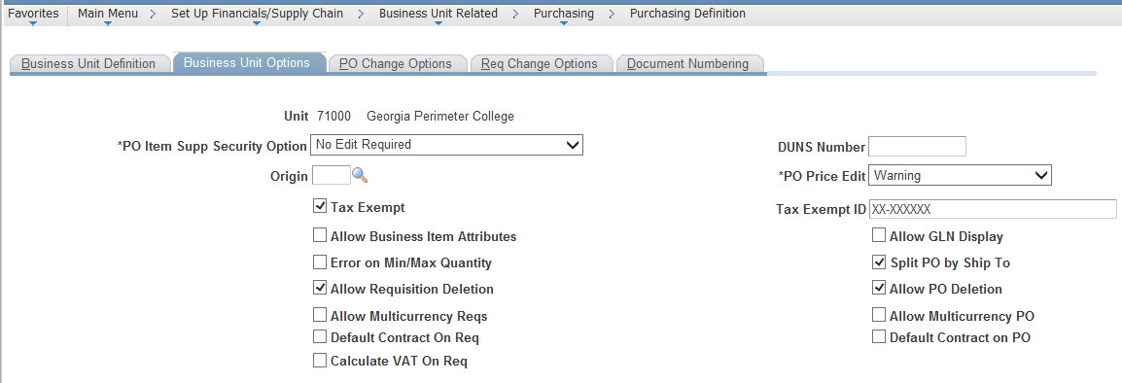
New Configuration Option

Slide 35
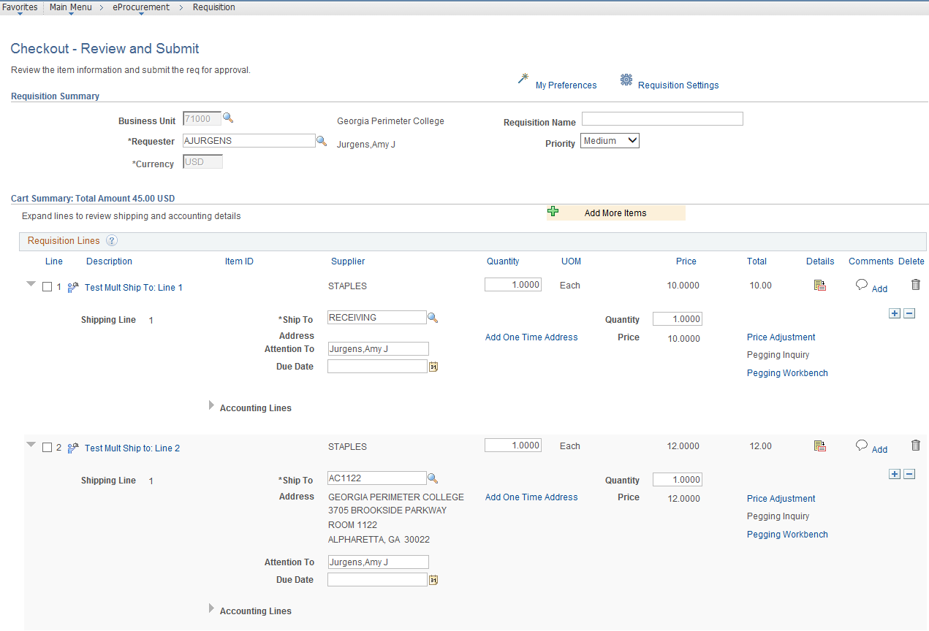
Ship To Req Line 1: Receiving
Ship To Req Line 2: AC1122

Slide 36
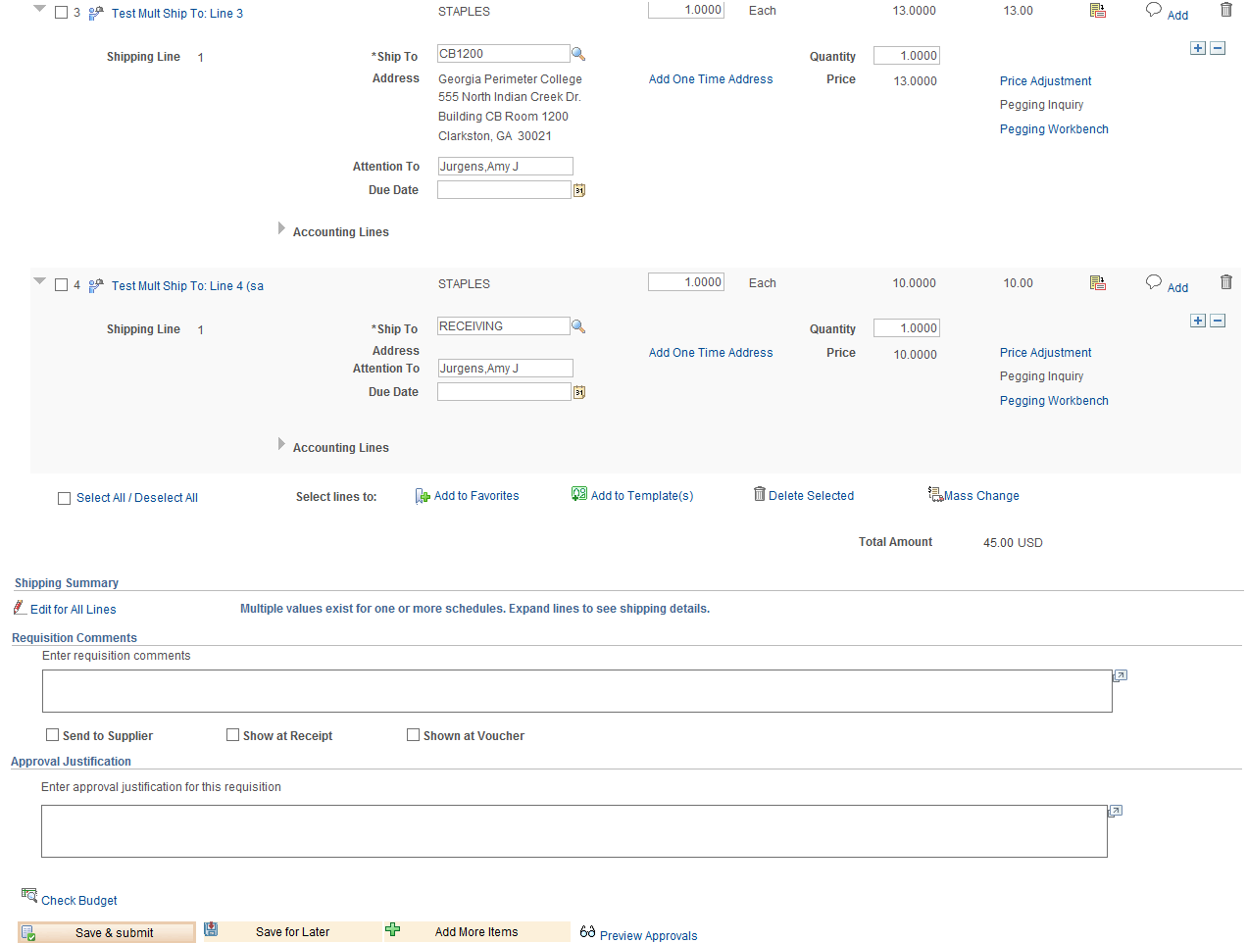
Ship To Req Line 3: CB1200
Ship To Req Line 4: Receiving

Slide 37
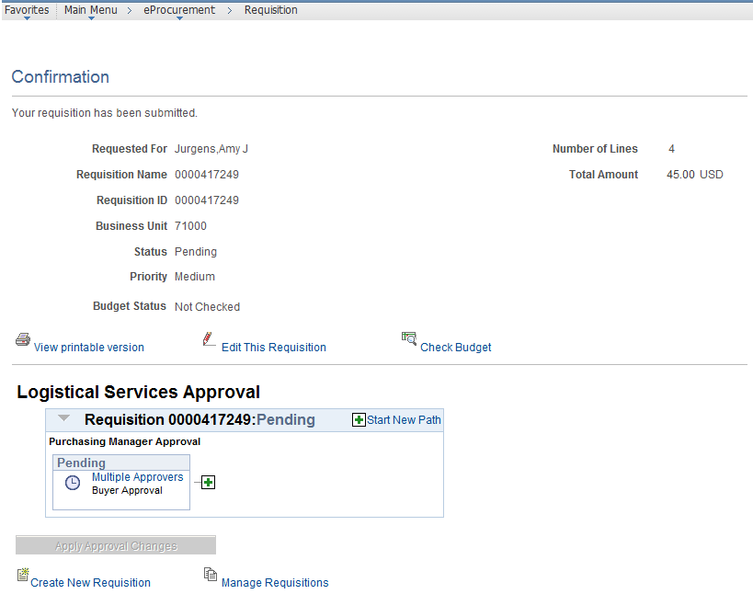

Slide 38
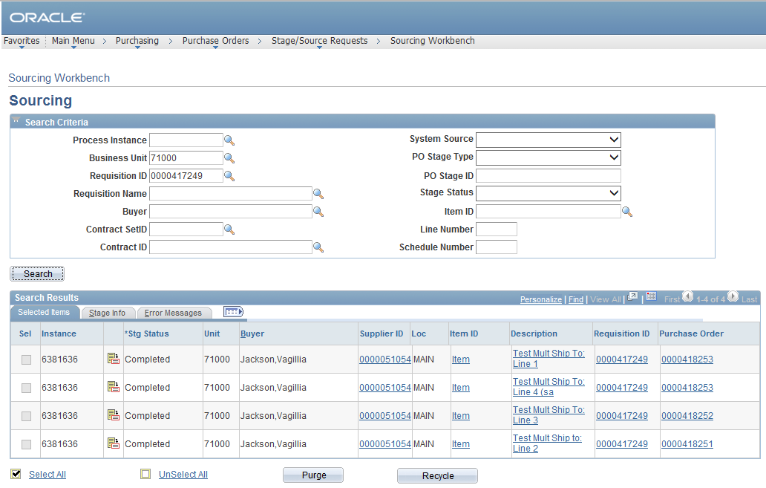
3 PO’s created:

Slide 39
Printed PO
Suggested Changes (add contract #, remove fax #, add e-mail, add requester name)
Option to include distribution information for each line when printing
Electronic Signature on PO

Slide 40
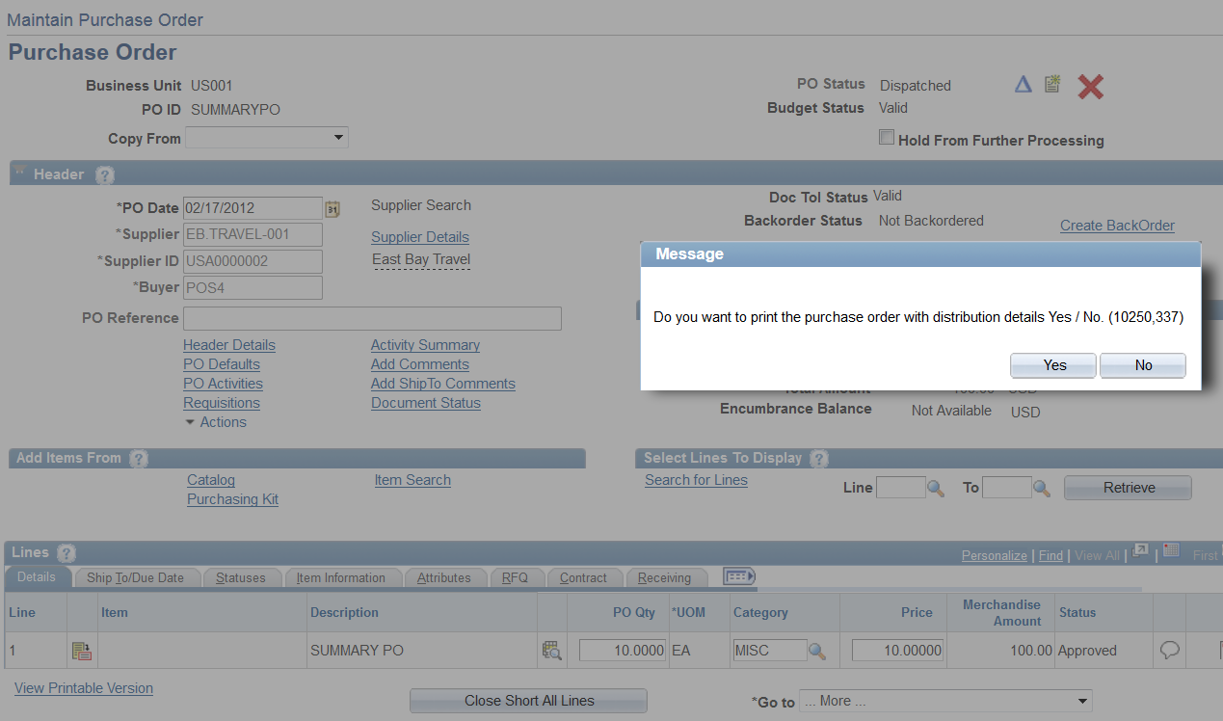

Slide 41
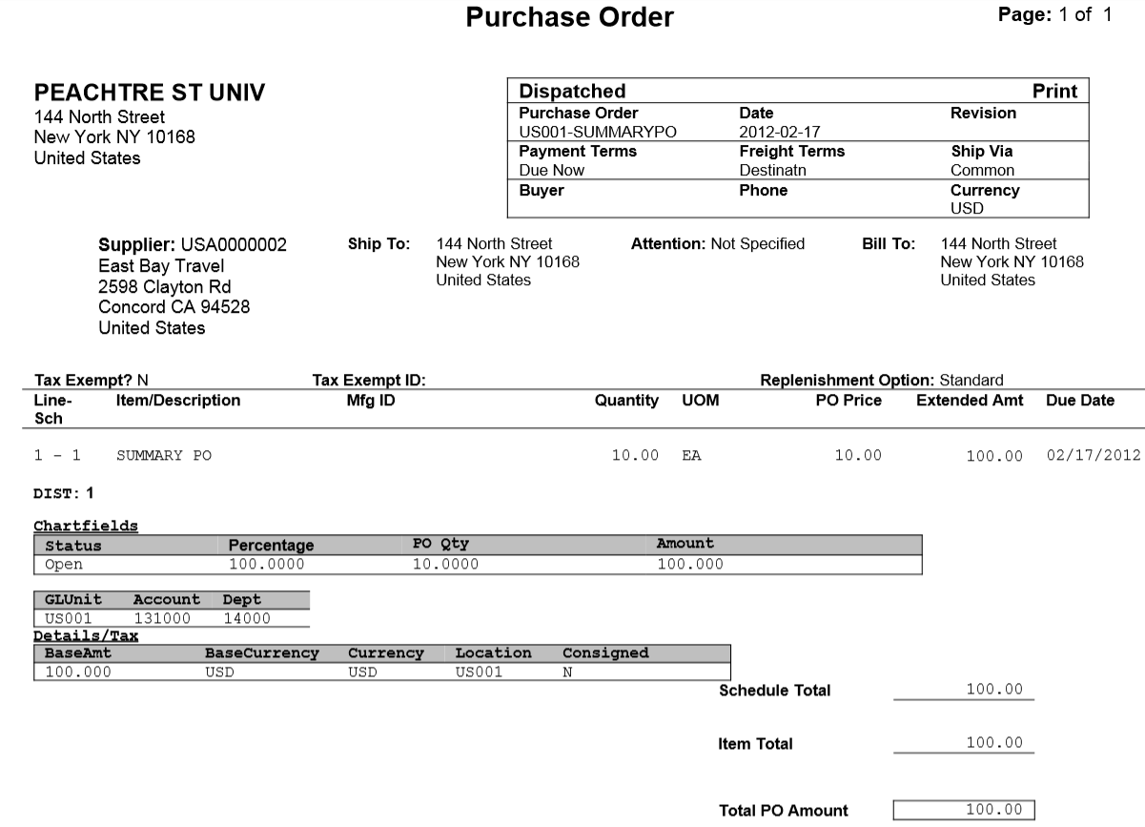

Slide 42
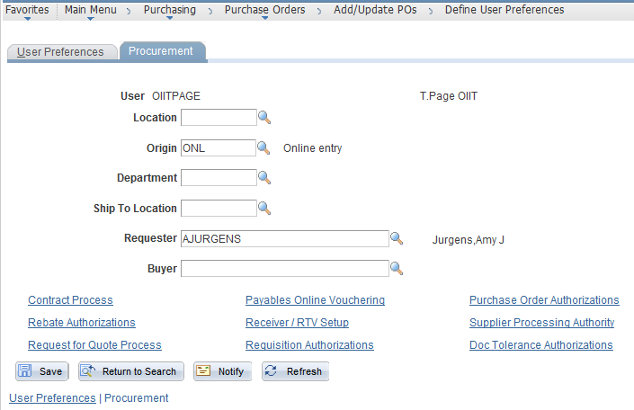
User Preference Change
Requester field MUST be populated, or you will be unable to create a Requisition

Slide 43
Questions?

Slide 44
University System of Georgia
Information Technology Services

