Slide 1

GeorgiaFIRST Financials PeopleSoft Query:
Basics and Best Practices
Michael Casuccio
Business Analyst

Slide 2
50-minute Crash Course on PeopleSoft Query for Beginners

Slide 3
Agenda
Overview of PeopleSoft Query
Best Practices
Upgrade
Training Resources

Slide 4
PeopleSoft Query
An end-user reporting tool that allows you to retrieve information from the PeopleSoft database tables.
Instead of writing code (SQL statements), you use a graphical user interface to extract the precise information that you are looking for.

Slide 5
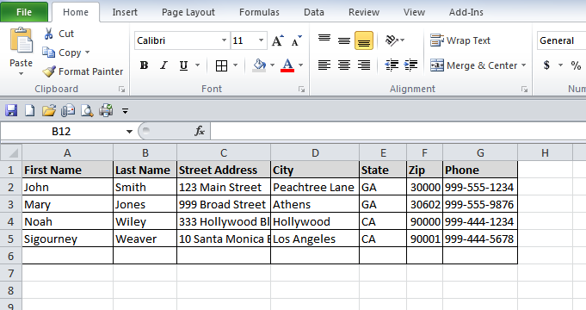
Data Basics
What is a Table or Record
  A record is a collection of data items
Notes:
What you need to know:
Query Basics. What is a Table or Record
A record is not a vinyl LP with songs from your favorite artist.
A record is a collection of data items.
If you ever created a basic name and address list in Excel, you basically have a simple database record/table.
PeopleSoft has literally thousands of theses behind the scenes where all the data is stored that you enter and process.
AND -Just like you can do a find in Excel, you can create a query to find specific data within the PeopleSoft records.

Slide 6
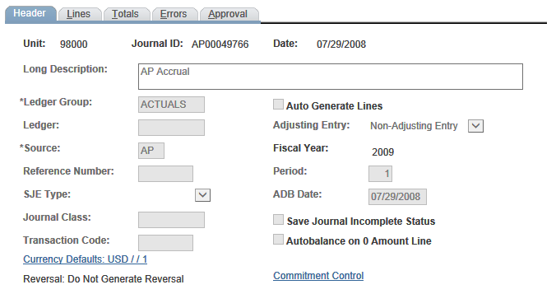
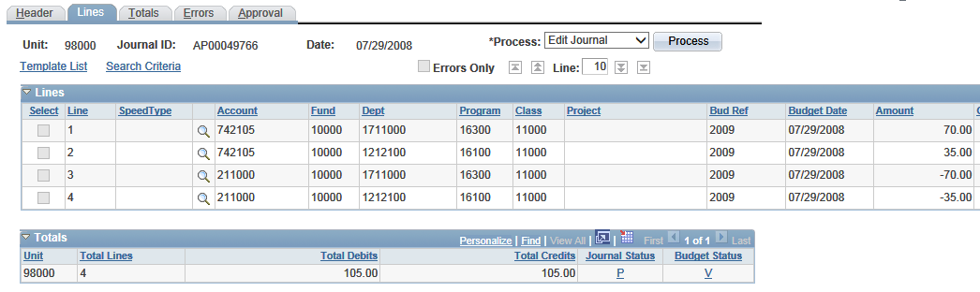
Notes:
Let’s look at an example in PeopleSoft.
The Journal Header and Journal Line Page

Slide 7
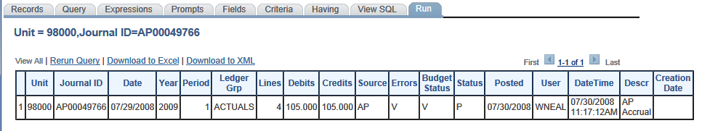
Journal
Header
PS_JRNL_HEADER record
Notes:
Let’s look at an example in PeopleSoft.

Slide 8
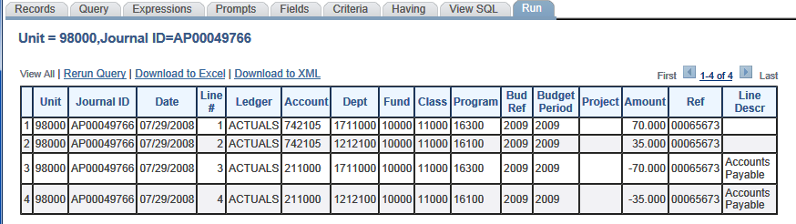
PS_JRNL_LN record

Slide 9
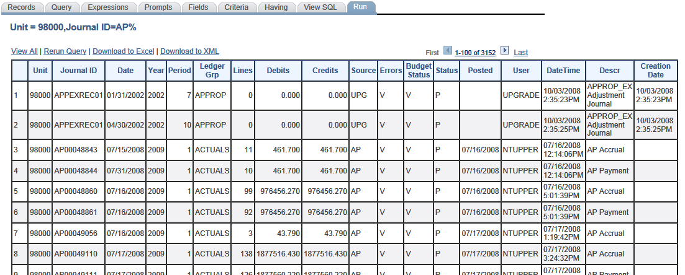
PS_JRNL_HEADER

Slide 10
Table and Field Names
Look at an existing query
List or Commonly Used Tables (Records)
ERDs
Entity Relationship Diagram
http://www.usg.edu/gafirst-fin/documentation/category/general_job_aids_and_reference_documents
Notes:
So, starting point: When you go to create a new query you need to select the records you want to query on, you need to know the name of the records.
How do you find the names. ..
What is an ERD? Basically it is a data blue print for PeopleSoft.
View a sample diagram: http://www.usg.edu/gafirst-fin/documents/PeopleSoft_Enterprise_8_9_Account_Payables_Entity_Relationship_Diagrams__2005_Oracle.mht

Slide 11
Security Roles
BOR_PT_QRY_ALLACCGRPS: You must have this role in order to access the records you need to query.
And 1 of the following roles (Only one)
    BOR_PT_QRY_VIEWER (Gives a user access to run public queries).
    BOR_PT_QRY_PRIVATE (Gives a user access to create private queries only, run private and public queries.)
    BOR_PT_QRY_PUBLIC (Gives a user access to create private and public queries, run private and public queries.)
Notes:
Before you access and use the PeopleSoft Query Tool… you will need a few things in place.

Slide 12
Security Roles
Other roles that may be necessary:
  BOR_QRY_SENSDATA ( gives query access to sensitive data records that may contain things such as SSN#s, emplids, etc.)
  BOR_PT_QRY_BUDPREP (Gives access to the budget prep records)
  BOR_QRY_XXXXX (each institution has a query specific role that allows access to their banner views)
  BOR Reconciliation User provides access to ADP data (Limit to those only working with ADP data).
Notes:
See your PeopleSoft Security Administrator to add the needed query roles

Slide 13
Navigation
Reporting Tools > Query > Query Manager
or
Reporting Tools > Query > Query Viewer
Depending on your security roles

Slide 14
Dissecting a query
Notes:
Query parts and pieces OR dissecting a query
Switch to PeopleSoft database (FPLAY)
Review an existing query and show the various parts and pages

Slide 15
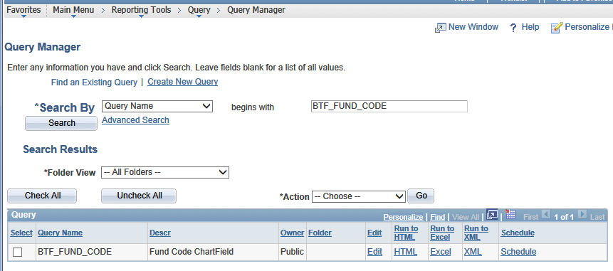

Slide 16
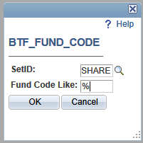

Slide 17
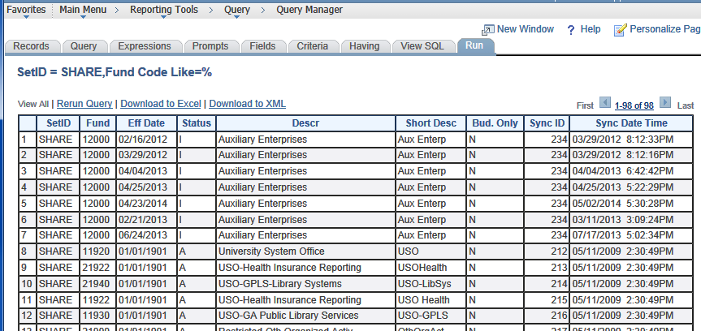

Slide 19
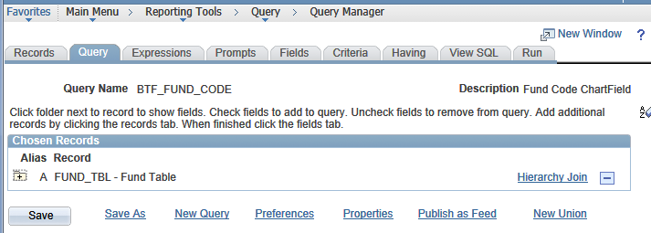

Slide 20
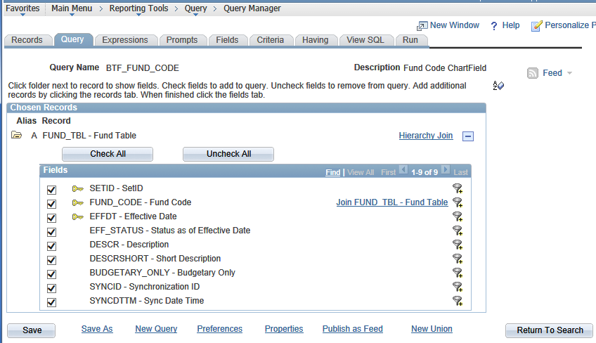

Slide 21
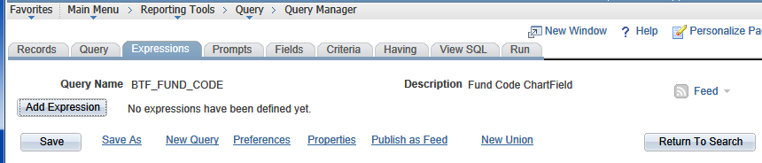
Notes:
For Instance: apply an aggregate function to your query. Within Web Query, you can use aggregate functions such as SUM, COUNT, etc.

Slide 22
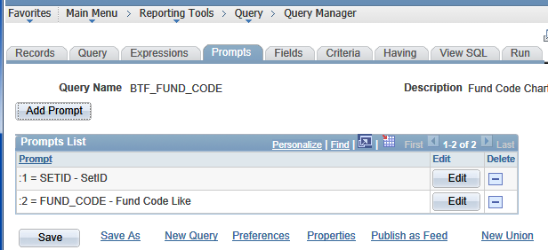

Slide 23
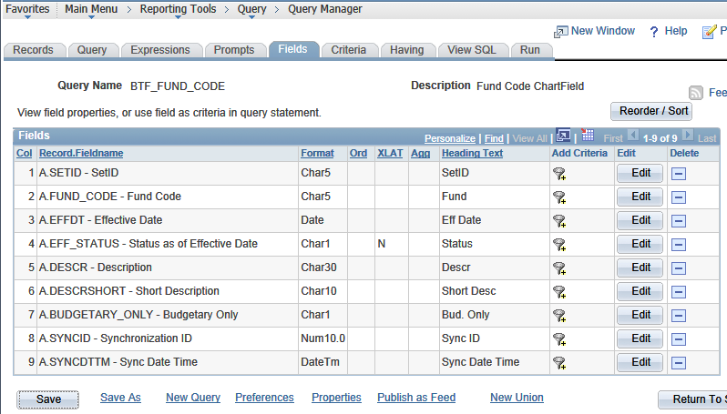

Slide 24
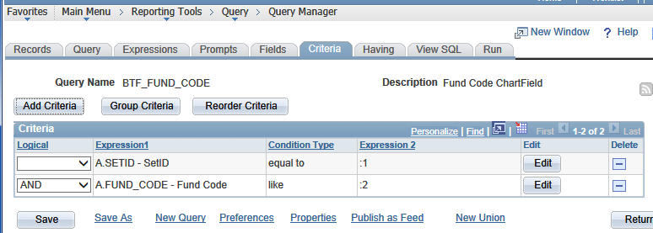

Slide 25
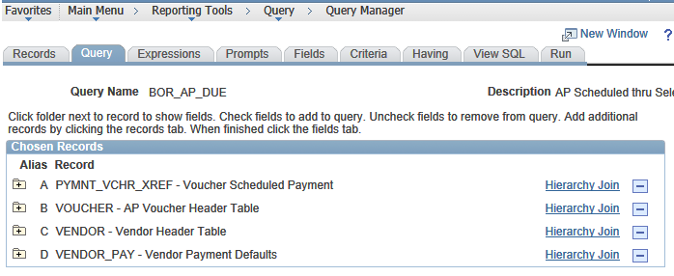

Slide 26
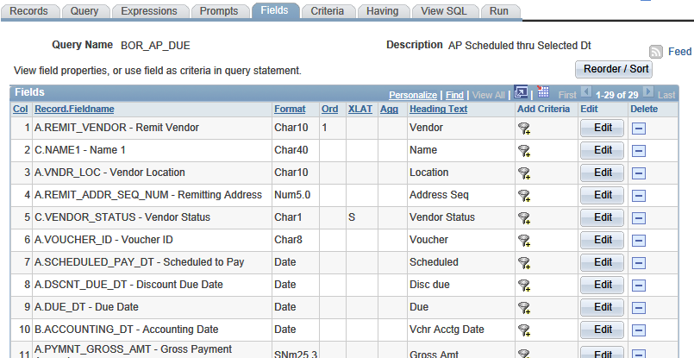
Notes:
Note:
Sort Order
Column Order

Slide 27
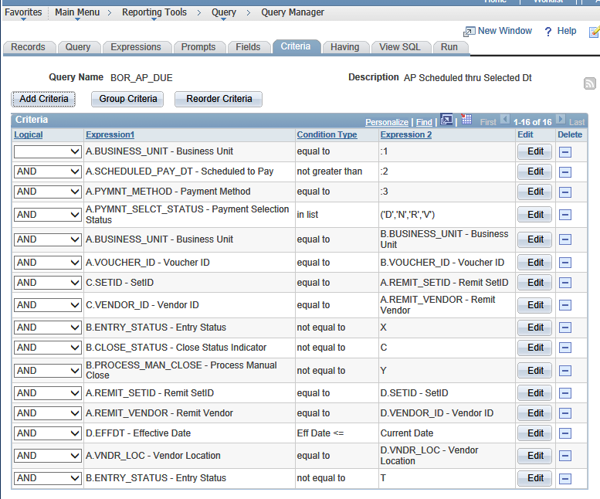
Notes:
Note:
Prompts
In List
Join Criteria
Etc.

Slide 28
Modify a Query

Slide 29
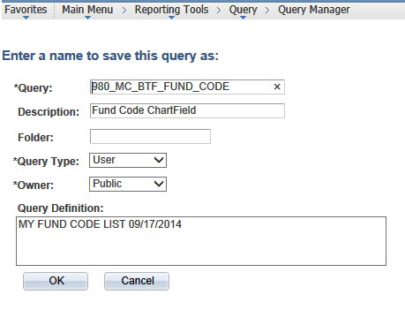
Saving your Query

Slide 30
Public vs. Private Queries
PUBLIC: Anyone can use a public query.
  Anyone with public or private query security roles can change that query
PRIVATE: Only the person who created a private query can use it or delete it.
Notes:
If you create a query and save it as a private query, only you will have access to it, to run it or change it.
If you save your query as a public query, anyone can view it and run it and change it.
Again, depending on the query security role assigned to you, you may only be able to
view existing queries
only create private queries
create both private and public queries

Slide 31
Public vs. Private Queries
When you create a query
  Save a private copy for yourself
  Then save a public version with a unique name for everyone else.
  If someone changes or deletes the public query you created, you will still have the private version.
Notes:
When you create a public query, consider creating a private copy with a unique name for yourself (see the next section for naming conventions). Then, if someone mistakenly changes or deletes a public query you created, you will still have a copy of the original.

Slide 32
Do not make changes to a public query you did not create. Save a copy of the query and make changes to your copy.
*

Slide 33
Do not make changes to a public query you did not create. Save a copy of the query and make changes to your copy.

Slide 34
Naming Queries
980_JD_OUTSTANDING_CHECKS
Do NOT use BOR_
You can rename your queries
Business Unit
Your Initials
Name of Query
Notes:
Why is this important: During upgrade, we will transfer queries that begin with a Business Unit number.
We went through this exercise last year with the foundations upgrade so hopefully you all have continued to follow this pattern.

Slide 35
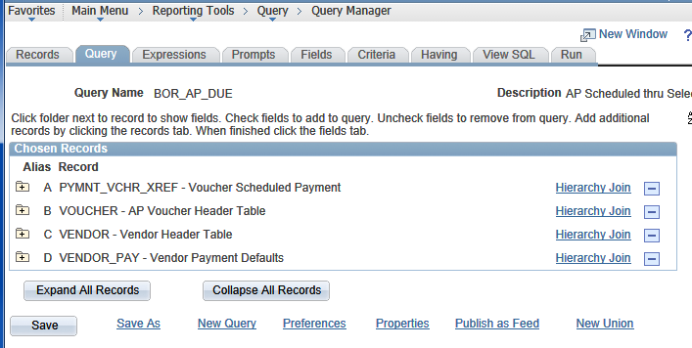
Query Properties
Notes:
Review additional property fields of a query.

Slide 36
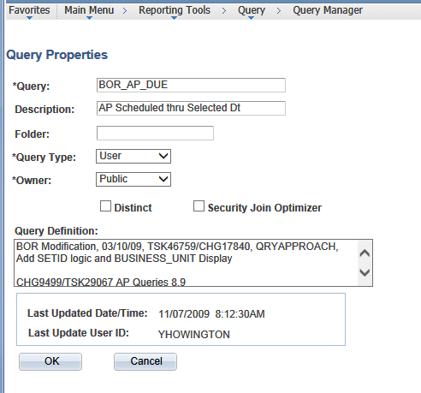
Query Properties
Notes:
Review additional property fields of a query.

Slide 37
Sharing a Query
Save it as your private version first
Save As, change the name, make it a Public Query - Seen by everyone
  OR
Copy it to a specific user

Slide 38
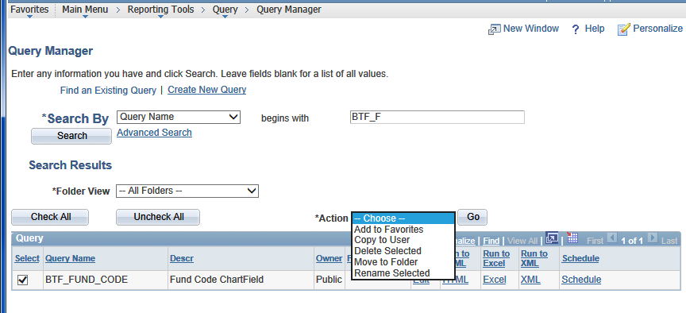

Slide 39
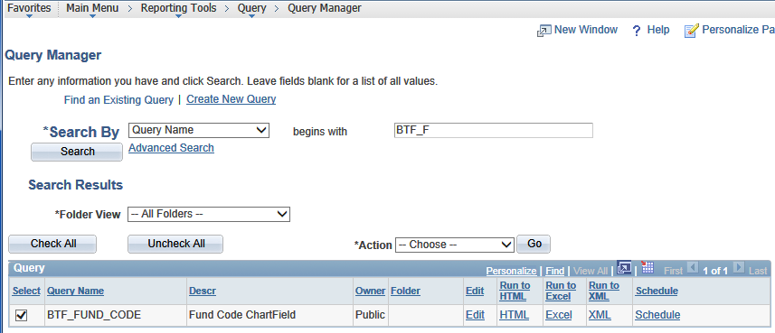

Slide 40
Running Queries
Edit: Review/Change query parameters
HTML: Runs the query to browser window
Excel: Runs the query, results open in Excel
Schedule: Runs the query in the process monitor. Results in XLS, PDF, TXT, XML
Notes:
Demonstrate using BTF_FUND_CODE

Slide 41
Running Queries
See Job Aid:
Query changes in PeopleTools 8.52 and Instructions for Scheduling a Query
Notes:
Some issues when running queries. See the posted document.

Slide 42
PeopleSoft 9.2 Upgrade
Cleanup existing queries
  Proper Naming
  Delete unused queries

Slide 43
UPGRADE & Query Maintenance
Cleanup existing queries
Deleting a query
  For cleanup purposes, delete queries you no longer use…get rid of the clutter.
Renaming a query
  Make sure all the queries you want to keep have the correct naming convention
Notes:
For cleanup purposes, delete queries you no longer use…get rid of the clutter. Again, we went through this exercise last year.

Slide 44
PeopleSoft 9.2 Upgrade
Institution created queries will need to be tested PS 9.2.
List Table Changes to be provided by ITS
Institution Development
  Time frame: December to January

Slide 45
Future Features
Drilling URLs
Results show as links that open a new window:
  A page within PeopleSoft (Voucher Inquiry)
  Results of another query
  An external page or attachment
Notes:
Benefits: Similar to nVision drill down
The results show up as links which can show you:
A page within PeopleSoft (Voucher Inquiry) for example: Clicking on a voucher number will take you to the voucher inquiry page for that voucher.
Results of another query for example: clicking on a row of summary data can take you to the results of a query that shows the supporting detail
An external page or attachment for example: ???
Our future goal: Where appropriate and helpful, we will start adding these features to BOR queries.

Slide 46
Future Features
Subqueries: A query within a query
Pivot Grids (similar to Excel Pivot Tables)
Connected Query (output in structured XML)

Slide 47
Query Resources
GeorgiaFIRST Online Training
  http://www.usg.edu/gafirst-fin/training/online
  Complete enrollment form and email to ITS Helpdesk
ORACLE University
  http://education.oracle.com

Slide 48
Query Resources
Query Maintenance Best Practices
Query changes in PeopleTools 8.52 and Instructions for Scheduling a Query
Key records for Queries
Entity Relationship Diagrams
  http://www.usg.edu/gafirst-fin/documentation/category/general_job_aids_and_reference_documents

Slide 49
Demonstration
Changing and saving a query
Notes:
BTF_FUND_TABLE

Slide 50

Questions

Slide 51



University System of Georgia
Information Technology Services

