Slide 1
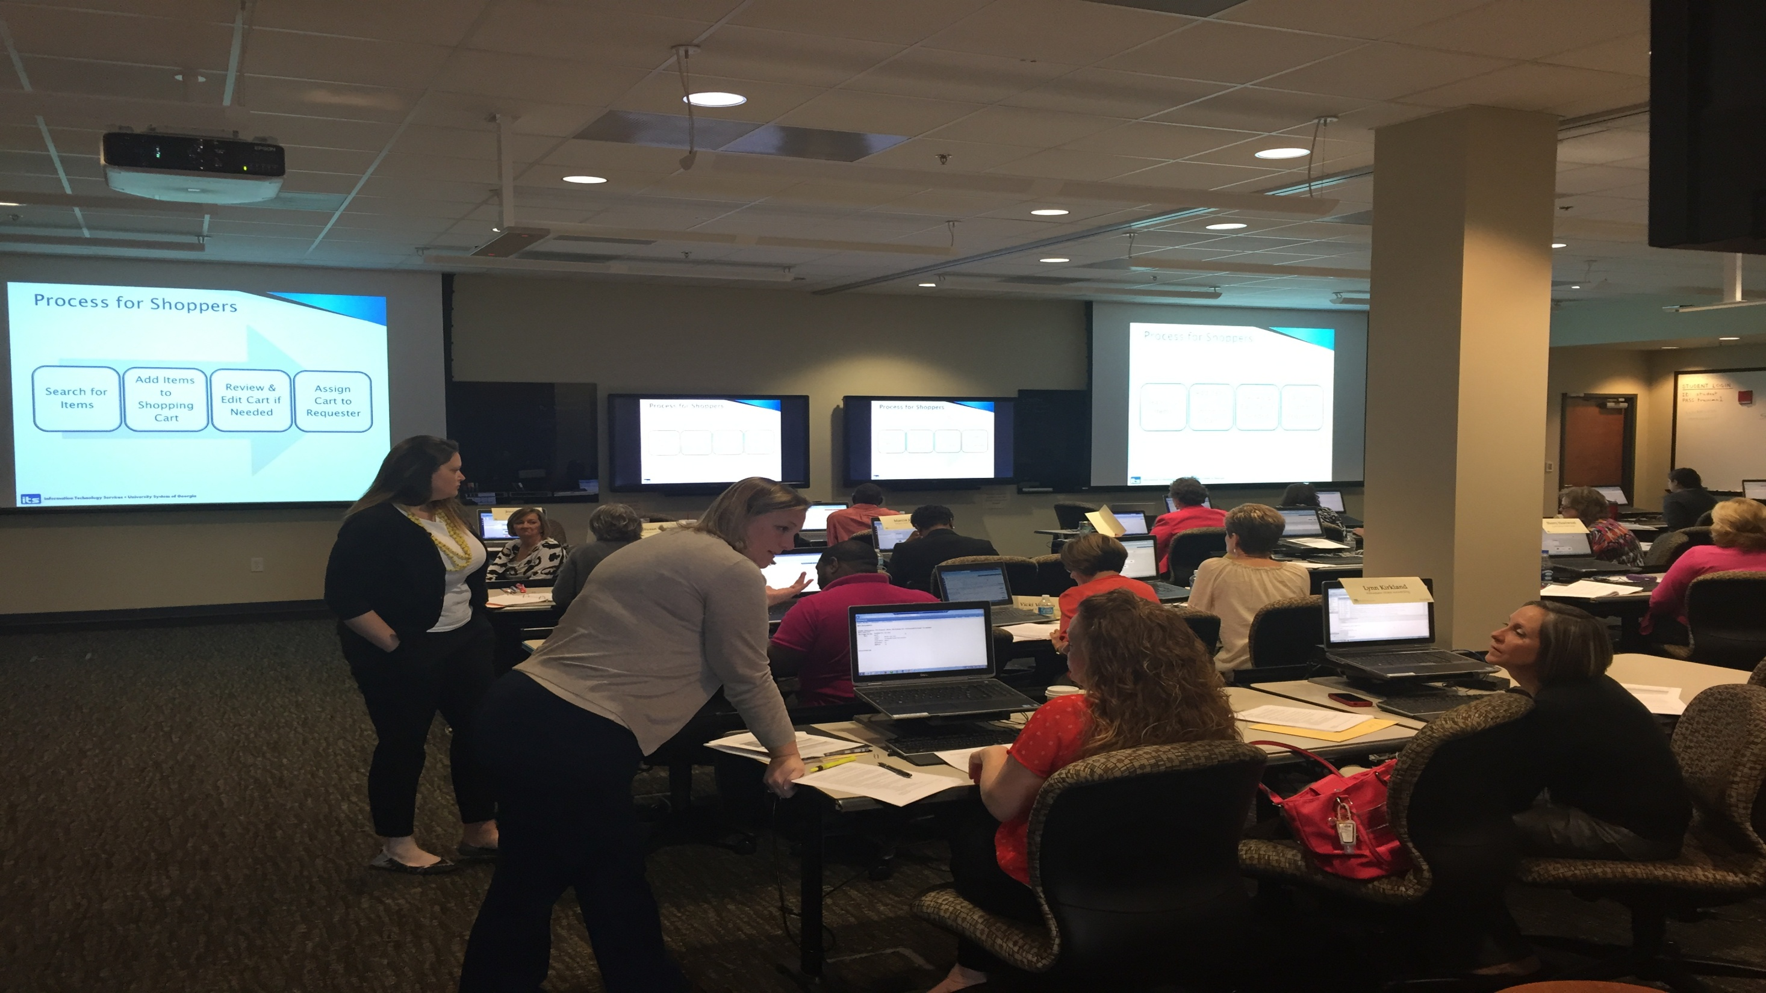

2015 Georgia Summit
GeorgiaFIRST Year in Review and Roadmap Update – David Nisbet ITS
Notes:
This is a Title Slide with Picture and Logo slide ideal for including a picture and partner or product logo with a brief title, subtitle and presenter information.
To customize this slide with your own picture:
Right-click the slide area and choose Format Background from the pop-up menu. From the Fill menu, click Picture and texture fill. Under Insert from: click File. Locate your new picture and click Insert.
To Replace the LOGO on this sample slide:
Right-click the sample LOGO and choose Change Picture. Navigate to the location where the new logo is stored, select desired logo file and click on the Open button to replace the sample logo.

Slide 2
Program Agenda
1
PeopleSoft 9.2 Upgrade Goals and Results
Upcoming Release Schedule
Production Support
Model Change Request Process
Looking into the Future
Questions
2
3
4
5
6

Slide 3
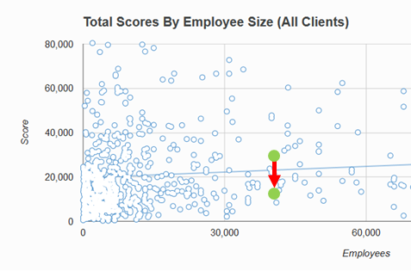
Upgrade Goals
Goal #1: Reduce Modifications (35% Reduction Target)
Results:
The overall benchmarking score for total customizations decreased from 27,019 to 14,510. A 46% decrease in total customizations.
Even more impressive is the decrease in modified customizations (customizations to delivered objects…which contribute to higher ongoing costs):
The benchmarking score for modified customizations decreased from 12,415 to 2,489. A 80% decrease in modified customizations!
Before
After

Slide 4
Upgrade Goals
Goal #2: Reduce complexity
Goal #3: Increase standardization
Results:
Decommissioned Reporting Instance
Will go live with more PeopleSoft delivered functionality as opposed to customizations.
Also evaluated customizations for simplicity and efficiency.
Results:
Accounts Payable check printing significant modification was removed as a result of getting check printing more standard
Moving towards account chartfield standardization across all institutions

Slide 5

Upgrade Goals
Goal #4: Improve Efficiency of Business Processes
Results:
Went through Business Process Analysis and will include Job Aids & Business Process Guides Documentation
Develop and enhance PeopleSoft module Training and roll-out
USG Pre-Go Live Training

Slide 6
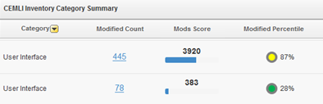
Upgrade Goals
Goal #5: Improve navigation and user interface
Results:
PeopleSoft Version 9.2 includes a greatly enhanced user interface and much more intuitive navigation i.e. workcenters
Before
8.9
After
9.2
CEMLI Benchmarking score for modified User Interface Objects (Pages, Components) reduced from 3920 to 383 resulting in a 90% decrease in User Interface customization complexity!

Slide 7
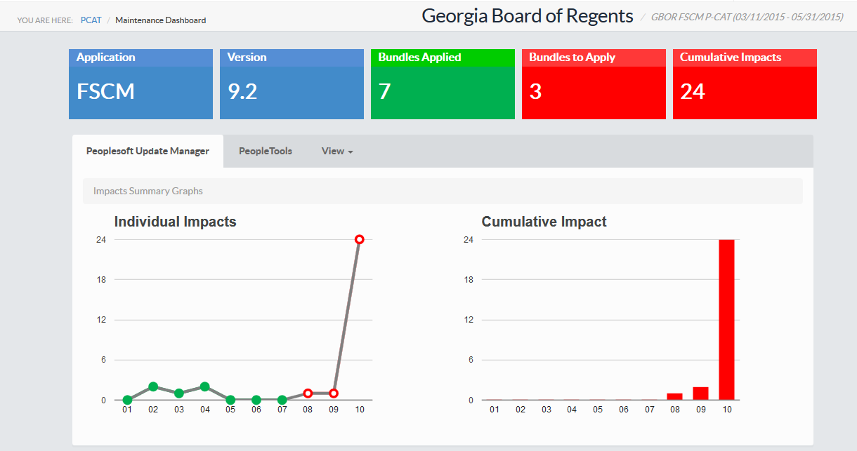
Upgrade Goals
Goal #6: Better align support resources with PeopleSoft 9.2
Results:
Will be completing a reorganization whereby the support team is better aligned with new processes including the addition of patches and fixes methodology
Low customization impact numbers due to lower numbers of customizations in USG environment after 9.2 upgrade.

Slide 8
Program Agenda
1
PeopleSoft 9.2 Upgrade Goals and Results
Upcoming Release Schedule
Production Support
Model Change Request Process
Looking into the Future
Questions
2
3
4
5
6

Slide 9
Upcoming Release Schedule
5.00 11/14/2015 Upgrade to PeopleTools version 8.54. Annual PeopleSoft update. Changes as a result of OneUSG
5.10 12/12/2015 1099 Oracle delivered patch. Changes as a result of OneUSG
5.20 1/09/2016 Required “one off” patches from Oracle images from our last annual update into production. Any BOR patches.
5.30 February Budget Preparation Release
5.40 May Fiscal Year-end Release
5.50 September Annual Oracle delivered image update into production
5.60 December 1099 delivered patch and required “one off” Oracle delivered patches

Slide 10
Program Agenda
1
PeopleSoft 9.2 Upgrade Goals and Results
Upcoming Release Schedule
Production Support
Model Change Request Process
Looking into the Future
Questions
2
3
4
5
6

Slide 11
9.2 Production Support

Slide 12
9.2 Production Support

Slide 13
Program Agenda
1
PeopleSoft 9.2 Upgrade Goals and Results
Upcoming Release Schedule
Production Support
Model Change Request Process
Looking into the Future
Questions
2
3
4
5
6

Slide 14
Model Change Request Process

Slide 15
Program Agenda
1
PeopleSoft 9.2 Upgrade Goals and Results
Upcoming Release Schedule
Production Support
Model Change Request Process
Looking into the Future
Questions
2
3
4
5
6

Slide 16
Future Project and Initiatives
R1 Model Build-out
Start with Georgia State
  - Kick-off in November 2015
  - Will include Grants Application Suite (5 modules)
  - Will include input from other R1 schools

Slide 17
Future Project and Initiatives
PeopleSoft Travel & Expense Implementations
  - Currently have 17 schools using it
  - Targeting to have 2-3 more schools within the next 6 months
GeorgiaFIRST Marketplace
  - Currently have 16 schools using it
  - Targeting to have 4 more schools within the next 6 months
  Only 1 committed at this point

Slide 18
Future Project and Initiatives
Operational Business Intelligence Solution
  - iStrategy Replacement
  - Currently exploring potential solutions
  - Target to have 2-3 pilot schools live by March 31, 2016

Slide 19
Future Project and Initiatives
Budget Preparation Solution
  - Need for enhanced functionality to GeorgiaFIRST Budget Prep module
  - Currently exploring potential solutions. Looking at both internal developed and purchased solutions

Slide 20
Future Project and Initiatives
Fluid Interface and Mobile Technology Roll-out
  - Currently exploring potential strategies
  - Fluid interface for mobile targeted for possibly January 2016
  - Mobile rollout of approvals to begin January – July 2016
  Looking for a couple of schools to help in a pilot
  - Fluid interface for desktop possibly in fall of 2016

Slide 21
Future Project and Initiatives
GeorgiaFIRST Training
        - In the final homestretch of hiring a new Training and Communications Administrator
        - Developed and delivered PeopleSoft Security 101 class as a pre- conference workshop
        - Will start developing PeopleSoft Query class next
        - Develop and rollout training strategy by December 2015

Slide 22
Q U E S T I O N S
Thank You

