Slide 1
PEOPLESOFT EXPENSES
Tips & Tricks
Daphne Burch
Armstrong State University

Slide 2
TOPICS
Differences between 8.9 and 9.2
Tips/Tricks for End Users and Admins
Known Issues

Slide 3
DIFFERENCES 8.9 vs 9.2
Expense Reports on Hold
Hold will not allow end of month reset of accounting date
BOR Menus > BOR Expenses > BOR EX Month End > Reset Expense Report
Hold will prevent budget checking

Slide 4
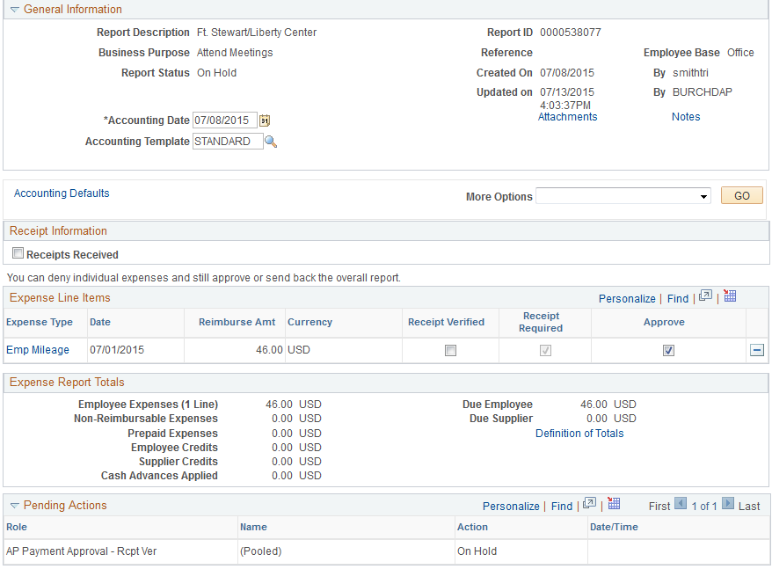

Slide 5
Expense Reports on Hold
To remove Hold:
Select the Transaction from Worklist or Approve Transactions
If necessary, change Accounting Date
Click Save Changes

Slide 6
TIPS/TRICKS
Creating Expense Reports
Actions Menu features that are new or in a new location
Copy Lines
Default Accounting for entire report

Slide 7
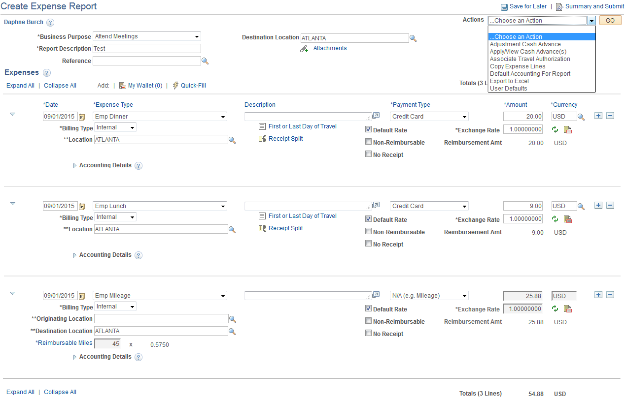

Slide 8
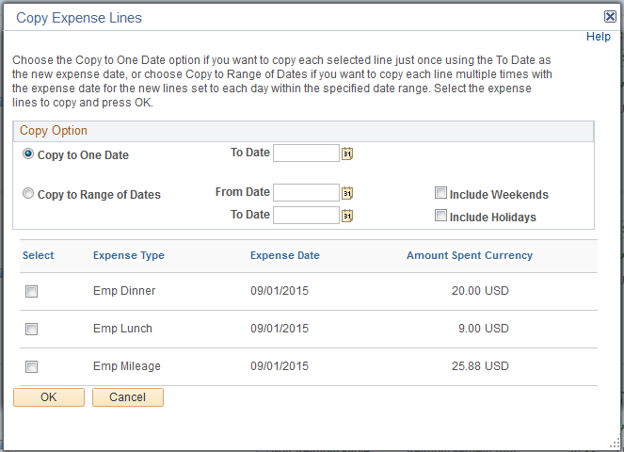
Copy Expense Lines

Slide 9
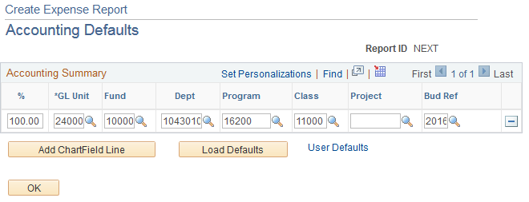
Default Accounting For Report

Slide 10
Creating Expense Reports
Adding comments in Notes section
Must click Add Notes then OK button or notes will not be saved

Slide 11
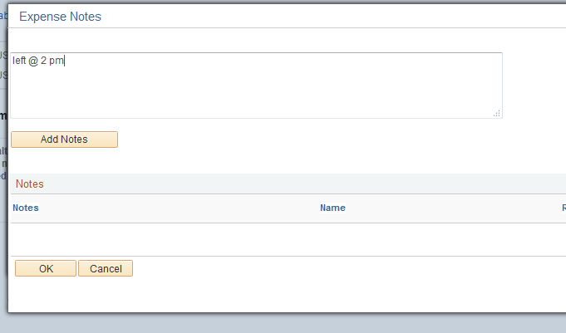

Slide 12
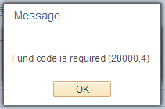
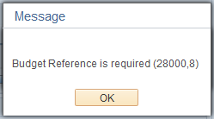
Employee Profiles
Making changes to an Employee Profile for an employee that moved from 1 USG institution to another
Error message if Fund and/or Bud Ref is blank

Slide 13
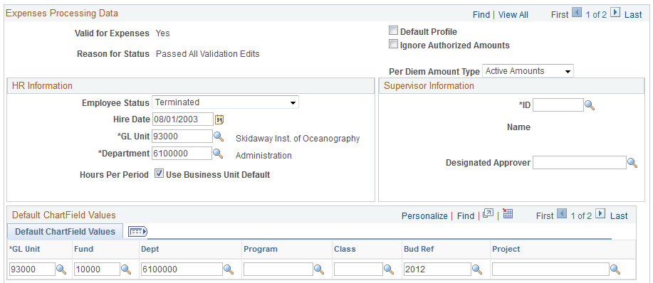
Employee Profiles
Multiple Job Rows

Slide 14
Employee Profiles
Multiple Job Rows

Slide 15
Error message if Payment Method is incorrect for Terminated job row
This means that the Payment Method for the Terminated job row is incorrect.
Just change it.

Slide 16
TIPS/TRICKS
Year End Cleanup
Travel Authorization encumbrances
Monitor throughout the year - do not wait until fiscal year end
BOR_KK_OPEN_TAUTH_ENC query

Slide 17
Adjust Paid Expenses
Travel and Expenses > Manage Accounting > View/Adjust Accounting Entries > Adjust Paid Expenses
Can be used to correct errors, make adjustments to expense report payments, create reversal accounting entries, and to synchronize the expense system and general ledger

Slide 18
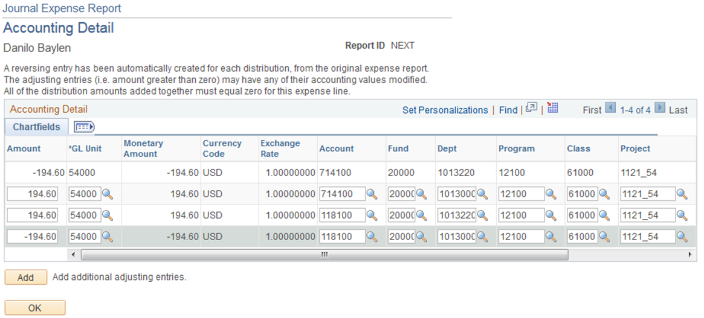
Adjust Paid Expenses
If the Accrual account for the new chartstring is different from the accrual account for the old chartstring, must add two additional rows to adjust the payment side of the original transaction

Slide 19
Adjust Paid Expenses
Other Notes:
It is imperative that you enter a valid chartstring before clicking Submit for Posting
Only one Journal Expense Report can be created per Expense Report
Post Liabilities in Expense Processing will need to be run to post the new accounting entries

Slide 20
KNOWN ISSUES
http://www.usg.edu/gafirst-fin/known_issues
Active Issues
Expenses Workflow Routing Issue for Designated Approvers
KI 9.2-11
Active Service Request open with Oracle and they are researching

Slide 21
KNOWN ISSUES
Known Issues that will be fixed in Release 5.00 on 11/14/2015
EX-1: Quick-Fill Window Displays Twice
EX-3: Lines on Printed Expense Report not displaying in Date order

Slide 22
KNOWN ISSUES
Other Issues that were not published Known Issues that will be fixed in Release 5.00 on 11/14/2015
NULL error on Update Unposted Expense Report
Print Cash Advance via Printable View link (core users)
Toggle between Detail page and Summary page and employee name disappears

Slide 23
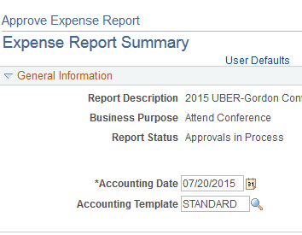
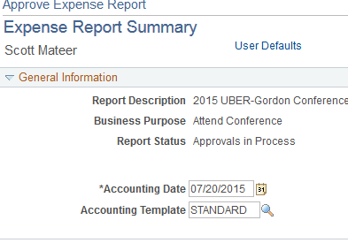
Toggle between Detail page and Summary page and employee name disappears

Slide 24
QUESTIONS?

