Slide 1
PeopleSoft Asset Management Answers to Key Questions
Christy Todd
ITS

Slide 2
Agenda
What, Where, When, How, and Why?
Your Questions

Slide 3
What happens when an asset is added?
Tables updated:
Asset table - asset id and asset specific information (description, tag number, serial number, asset status, profile id)
Asset Acquisition Detail - quantity and cost
Asset Location – location information
Asset Custodian – custodian emplid

Slide 4
What happens when an asset is Capitalized?

Slide 5
What happens when an asset is Capitalized?
Book table is populated.
The Profile Id is used to create entries for Useful Life
Transaction date on Asset Acquisition Detail is used to determine In Service Date
Cost table is populated
The Profile Id is used to determine the Category
The Cost, Quantity, and Chartfields entered on the Asset Acquisition Detail page is transferred to the Cost table

Slide 6
What is an Open Transaction?
Each time an asset is added or changed, PeopleSoft Asset Management creates an Open Transaction. This transaction indicates that the asset needs to have depreciation calculated and accounting entries created.

Slide 7
What is an Open Transaction?

Slide 8
What is the difference between an “Open Transaction” and a “Pending Transaction”?
An Open Transaction is any transaction (financial and non-financial) that requires depreciation calculation. No changes can be made to the Open Transactions page.
A Pending Transaction is any financial transaction (addition, adjustment, transfer, and recategorization). These transactions can be changed or possibly deleted prior to running Depr Calc if needed by going to the Change/Delete Pending Transactions page.

Slide 9
Change/Delete Pending Trans

Slide 10
What is Depreciation Calculation?
Depreciation Calculation (Depr Calc) picks up any Open Transaction that is Pending Depr Calc and uses the Useful Life and In Service Date to create a Depreciation Schedule (Depreciation table) that the asset will use for the remainder of its useful life.
If a change is made to the asset that results in an another Open Transaction, Depr Calc will rebuild the Depreciation table based on the change.

Slide 11
Where can I see the Depreciation Schedule that is created by Depr Calc?
Tables in PS Query
Depreciation (by year)
Depr_All_PD2_Vw (by month)
Review Depreciation Information page
(Asset Management →Depreciation →Review Depreciation Info)

Slide 12
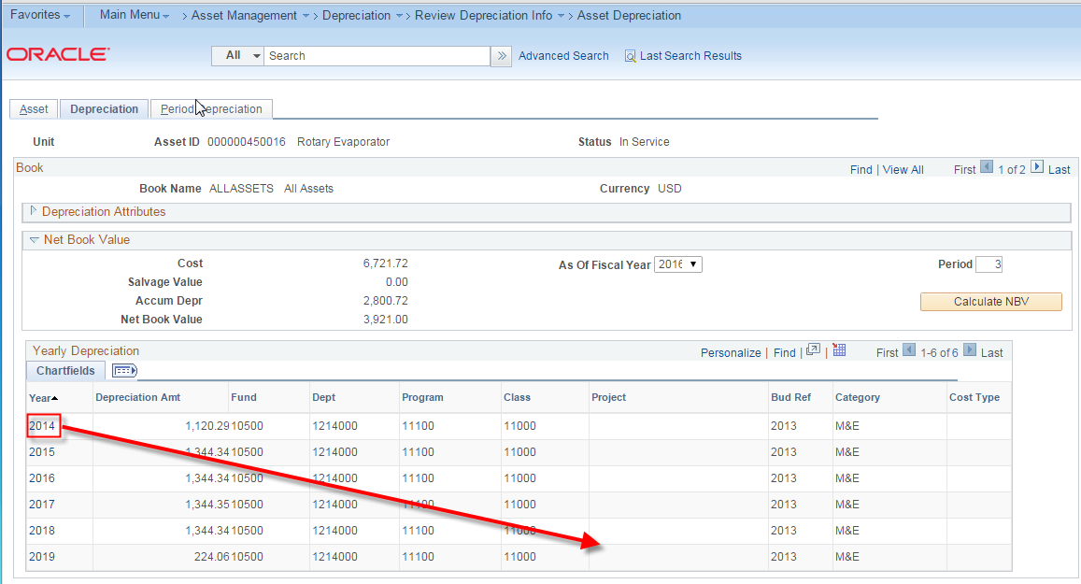

Slide 13
How does Depr Close work?
Depr Close will use the Depreciation table and post Depreciation based on what is in the Depreciation table once per month per asset
Depreciation is posted to the Dist_Line table
Dist_Ln is the accounting lines table in the AM module

Slide 14
Depr Close

Slide 15
When can I “re-run” Depr Close?
If the original depreciation entries created in Dist_Ln have not been journal generated. When the entries have been journal generated*, Depr Close cannot be re-run
Generating the journal sets the GL Distribution Status in the Dist_Ln table to “Distributed”. The re-run option will not work if the GL_Distrib_Status is “Distributed”
*If the journal has not been posted, it can be deleted and it will set the GL _Distrib_Status back to “Not Distibuted”

Slide 16
When should I “re-run” Depr Close?
When using the “re-run” option, Depr Close will delete your existing Depreciation rows in Dist_Ln and replace them with the current monthly depreciation in the Depreciation Schedule.
Depr Close should be re-run when changes have been made in AM that result in updated Depreciation for assets in the current period.

Slide 17
When should I “re-run” Depr Close?
Example: You have already run Depr Close for August and realize that a cost adjustment was made with an August transaction date after Depr Close was run.
The cost adjustment will result in a change in August Depreciation for the asset
The asset has already had depreciation posted once in August

Slide 18
I have completed my monthly processes but need to retire an asset. Do I need to run Depr Close using the “re-run” option?
Yes. This asset was included in the prior Depr Close process. Since the retirement transaction will likely affect the monthly depreciation, Depr Close should be run using the “re-run” option.
Please note that if the original depreciation journal has been journal generated, the original (and now incorrect) depreciation entries will remain in Dist_Ln.

Slide 19
I have completed my monthly processes but need to add an asset. Do I need to run Depr Close using the “re-run” option?
No. Since this is a new asset that has not had depreciation posted in the current month, Depr Close can be run normally without using the “re-run” option.
Remember that Depr Close will post depreciation once per month per asset.

Slide 20
One more thing about Depr Close…
If you have an asset change that is needed after Depr Close and are unsure of what to do, please submit a ticket with ITS.
Ideally Depr Close will be the last thing you will run in AM each month.

Slide 21
What is NBV?
In PeopleSoft, Net Book Value is a calculated value:
Cost
(from the Cost table)
Less
Accumulated Depreciation
(from the Depreciation Table/Schedule)
Equals
Net Book Value

Slide 22
Why is my NBV in PS incorrect?
NBV is typically incorrect because data was entered when the asset was added or adjusted that resulted in an incorrect depreciation calculation.
Example:
Asset was originally added with an in-service date of January and an incorrect cost.
In June, a cost adjustment is made to correct the cost but is made with a June transaction date (rather than January)
Depreciation for the cost adjustment begins in June rather than in January

Slide 23
How do I correct NBV?
Most of the time, an incorrect NBV can be corrected functionally by making a correcting adjustment or adjusting accumulated depreciation which results in an accurate depreciation schedule.

Slide 24
Why are NBV and Dist_Ln different?
Asset changes after month end processes were run
For asset additions, can result in a missed first month of depreciation
For retirements, can result in an accumulated depreciation balance in Dist_Ln after retirement
Missed month end process (more typical “back in the day”)

Slide 25
My NBV and Dist_Ln are out of balance. What do I do?
It depends……
Submit a ticket to ITS
ITS will work with Fiscal Affairs to determine the best resolution depending on the dollar amount, type of asset, and date that the out of balance occurred. Resolutions will typically be:
a manual, correcting journal
DBI to Dist_ln to insert the missing entries

Slide 26
What is the correct way to make a book adjustment?
Changes in useful life and in-service date are made by a Book Adjustment
Book Adjustments should be made using the Life-to-Date calculation type
Life to Date causes the asset to recalculate from the beginning of the asset’s life
Remaining Value is the default and will result in the depreciation only begin recalculated over the remaining periods of the asset’s life.

Slide 27
Book Adjustment

Slide 28
When do you add cost using the Asset Acquisition Detail pages?
Typically the Asset Acquisition Detail pages are used when adding component cost
Transaction type will be ADD
Depreciation from the transaction will begin the following month like any asset addition transaction.

Slide 29
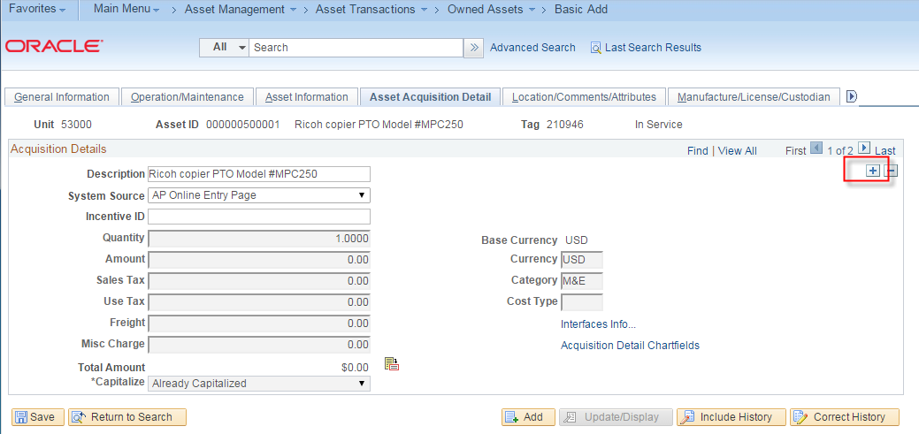
Asset Acquisition Detail

Slide 30
When do you use the Cost Adjustment pages?
Addition (ADD) transactions can also be made on the Cost Adjustment pages.
When making an ADD transaction, the depreciation convention should be changed manually to “following month”.
Adjusments (ADJ), Recategorizations (RCT) and Transfers (TRF) should follow the depreciation default convention of “actual month”.

Slide 31
Cost Adjustment

Slide 33
Your Questions

