Slide 1
Accounts Payable Best Practices
Michael Casuccio, ITS
Michelle McGinty, Kennesaw State University

Slide 2
Agenda
Best Business Practices
  Approvals
  Internal Controls
  Invoices
  Stipends
  Petty Cash
  Vendors

Slide 3
Agenda
GeorgiaFIRST Financials – PeopleSoft
  Vendor settings
  Invoices and Voucher processing
  Payments and Paycycles

Slide 4
Approvals
Accountability, Authorization and Approval
    Department Table is used to determine who has authority to approve expenditures for the department.
    Project Table is used to determine who has authority to approve expenditures for the project.
    Other approvals include:
        ITS for computer purchases
        Asset Management
        Audio Visual Equipment
        Hazardous Materials
        Human Resources (on-payroll, qualified Independent Contractor status)

Slide 5
Controls in Place?
The Controller approves payments over $5,000 and payments to individuals.
Consultant, Lecturer (Speaker) and Performance Agreements have standard templates which are approved by Legal. The routing form allows all departments to view the agreements before they are paid.

Slide 6
Other Controls
Employees are never paid as a consultant, speaker or for services through AP. This must be reviewed by HR and the payment must go through Payroll.
Anyone, who was on payroll, needs to be paid consistently on payroll. This includes student assistants who are paid a stipend for additional work on campus.

Slide 7
Stipends/Sponsored Funds
Stipends should include timesheets for dates worked.
Consultant or Contractors on Sponsored Fund agreements must include a statement of work and resume of the consultant/contractor.
Stipends for work performed are taxable.

Slide 8
Valid Invoice?
Best Practice: valid invoice (not a quote)
Duplicate Invoice Checking
  Set up Financial/Supply Chain
  Business Unit Related
  Payable/Payable Options
  Vouchering Options 2 – Duplicate Invoice Checking
    Invoice Number, Business Unit, Vendor ID

Slide 9
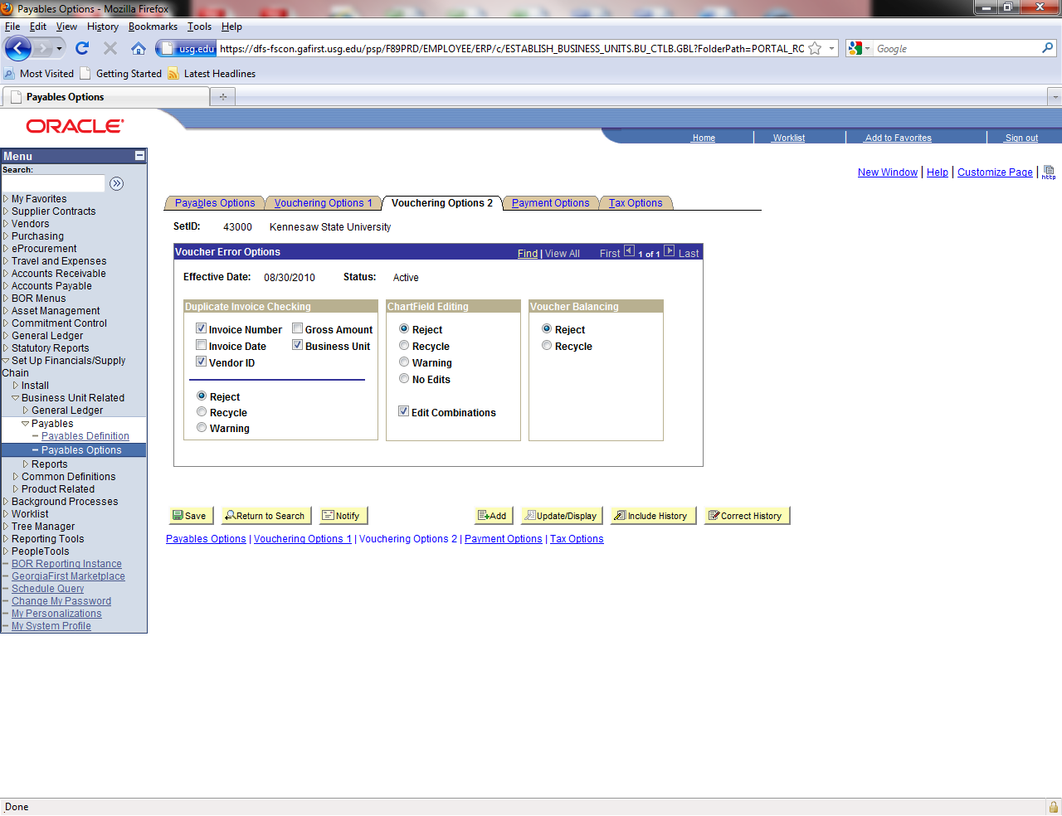

Slide 10
No Invoice Number?
Establish procedures for recording invoice numbers.
No invoice number?
  Identify a method that will allow the ERP system to capture duplicate payments.
  Travel: first day of travel + letter for multiples MMDDYY or MMDDYYA or MMDDYY-1
  Utility/Cell Phone Invoices: account number + date
  Service Contracts: date of service MMDDYY.

Slide 11
Where Do Your Invoices Go?
Best practice: have all invoices directed to Accounts Payable.
Purchase Order should specify remit address for invoices.
Statements should come to Accounts Payable to verify there are no outstanding invoices.

Slide 12
Petty Cash
No Student payments from petty cash.
No independent contractor for services.
Receipts must be attached.
Sales Tax is not reimbursed.
Flyers and list of attendees are required.
Compliance with food policy.

Slide 13
Vendor Maintenance
Separation of Duties. The employee who maintains the vendor files should not be able to process vouchers or issue purchase orders.
W-9 should be required.
Only one vendor per W-9/FEI number.
Use remit to address to handle different payment addresses.

Slide 14
Vendor – Legal Status
Corporate Vendors: Verify legal status at: http://www.coordinatedlegal.com/SecretaryOfState.html
If status is Active/Compliant or Active/Noncompliant - continue processing
If Admin. Dissolved, follow up with campus contact.

Slide 15
International Vendors
W-9 - applies to US Citizens/Permanent Resident only.
W8BEN and Foreign National Information Form with copies of requested immigration documents.
KSU uses the name “*****” five stars in the name2 field on the vendor master page.
Query: 430_AP_VERIFY_INTL_VENDOR

Slide 16
Vendor Location
From PeopleBooks:
It is Not a physical address.
It is a default set of rules, or attributes.
Defines how you conduct business with a particular vendor.
There can be multiple ‘locations’ for each vendor.

Slide 17
Peoplesoft Vendor Options
Vendor/Location/Options “Payables”
    Payment Control
    Matching/Approval Options
    EFT Options
    Fund Transfer Details
    Vendor Banking Account Options
    Vendor Type Options – EMP for Employee?
    Location Main? Your remit to address?

Slide 18
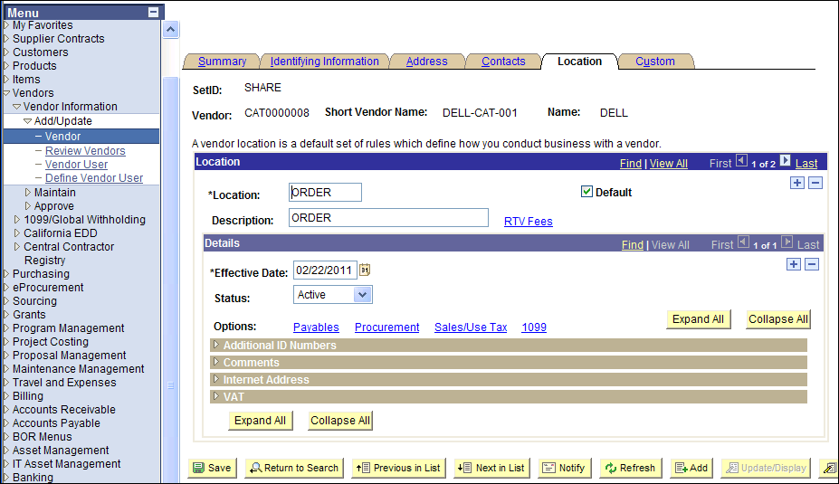

Slide 19
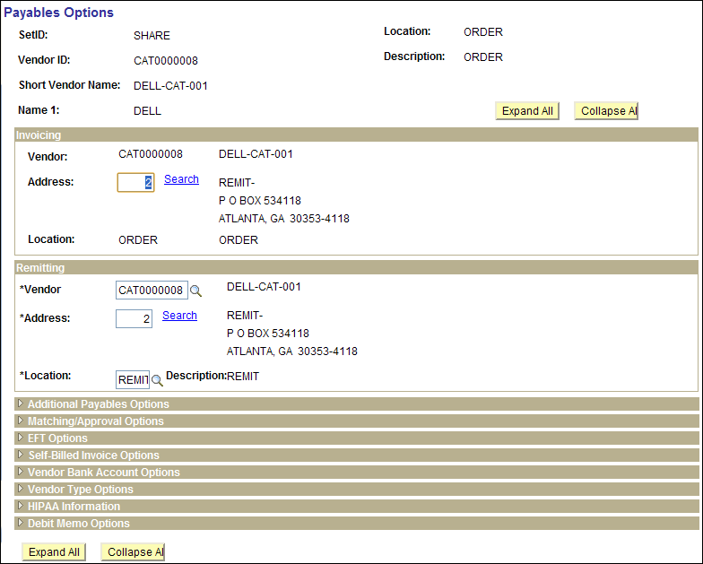

Slide 20
Payables Default Hierarchy
Business Unit
Origin
Control Group
Vendor
Voucher

Slide 21
Peoplesoft Vendor – Cont.
Identifying Information
    Duplicate Invoice Indicator. KSU uses “Default”
    Withholding Vendor?
    Persistence
      Regular
      One Time – Only one payment is generated and then the system will “I” inactivate the vendor ID. Good for International Vendors and one-time payments.
      Single Pay – Good for refunds where AP has the control to add the vendor’s address/name. Strong Internal Controls should be used with this option. No 1099 reportable payments.
Contacts
    Description ACH/EFT.. Use Email ID for Remit to information.

Slide 22
1099 Reportable
1099 reportable activity accounts:
    7278%, 719xxx, 7481xx, 751xxx
      Royalties
      Rental of Non-Real Estate
      Real Estate Rental
      Per Diem & Fees – Expense (not reimbursed expenses)
        Architect, Attorney, Consultant, Engineer, Physician, Interpreters, Veterinarian, Speaker, IT Consultant,
        752100 for Reimbursed Expenses to Consultants should be used or Non-Employee expense account 65XXXX.
    International Vendors 1042s

Slide 23
Internal Control Practices
Separation of Duties (should not be performed by Accounts Payable)
    Approve purchase (Budget Manager)
    Receive ordered materials
    Approve invoice for payment
    Review and reconcile financial records. This means that the person who can print the check should not be the one reconciling the bank account.

Slide 24
Match receipts to Invoices
All PO invoices must have some sort of receiving notification.
  This may be as simple as an email from the end user who says the product was received.
Issue Payment/Check Request is based on an assumption that the product was received by the end user.

Slide 25
Automatic Three Way Matching
Purchase Order must be set to Receiving Required.
Match the invoice by copying in the purchase order.
Match exceptions will occur when there is no open receiver for the purchaser order.
Assets must be copied in from a receipt.

Slide 26
Matching Process
Setting | Matching
PO: Do Not Receive or Optional | 2-way matching Compares voucher to PO
PO: Receiving Required | 3-way matching Compares voucher - PO - Receipt

Slide 27
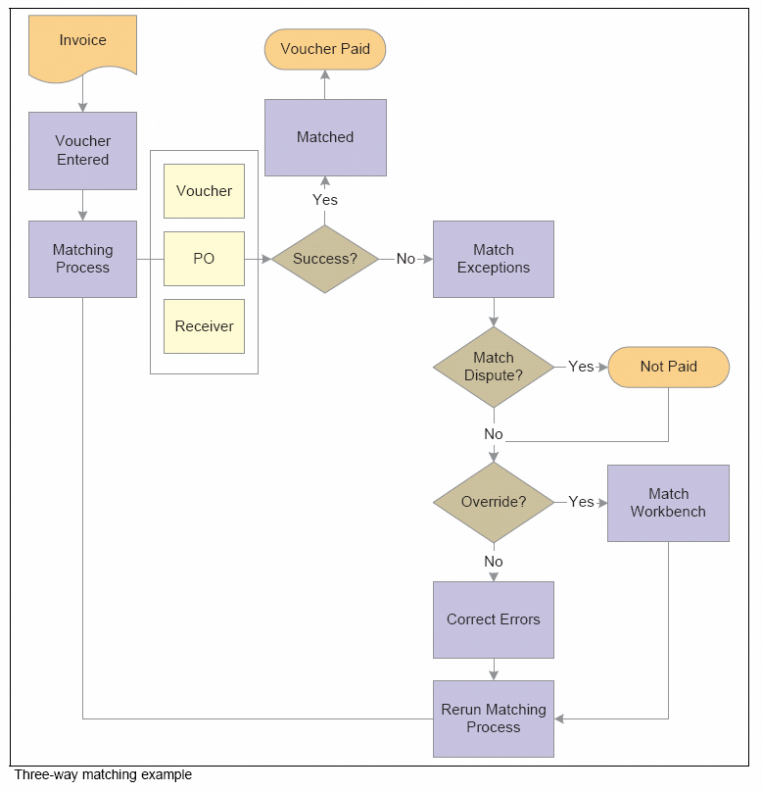

Slide 28
Matching Exceptions
PeopleBooks Note:
  Organizations typically correct a problem instead of overriding it. In general, it is best to rectify and reprocess incorrect associations and vendor differences rather than override them.

Slide 29
Match Exceptions
Query to identify Match Exceptions
  BOR_AP_UNPOSTED_VCHR
  Matching Workbench
What are common Match Exceptions
  Missing Receiving
  PO set at “Receiving Required” in error.
  Receiving not equal to PO amount/Qty.

Slide 30
Document Tolerance
Allowable difference between a PO and Voucher
Percentage or Amount
Default setting by business unit
  The lesser of $500 or 10%
Can be changed on the PO distrib lines

Slide 31
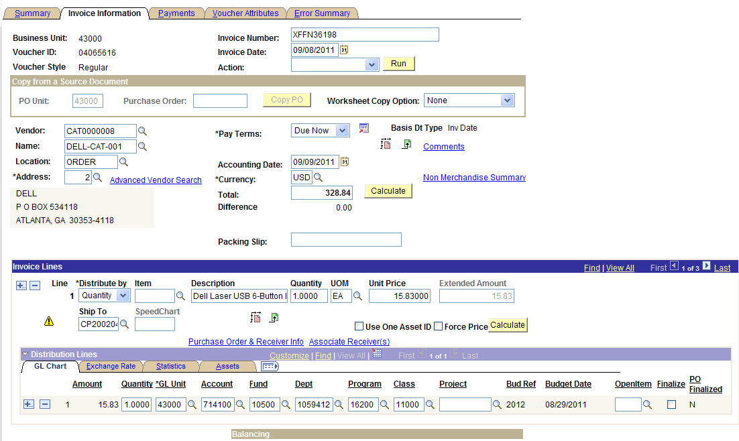
To Finalize or Not

Slide 32
To Finalize or Not
What does it do?
  Finalizes the predecessor PO line
  Final liquidation of the KK distribution line
Advantages:
  Eliminates the need to run PO reconciliation process to determine the closing of a PO or PO line
  Quickly frees up funds.

Slide 33
To Finalize or Not
When to use it:
  Vouchering the last invoice for a PO or PO line but the amount or quantity is less than the original
When not to use it:
  If you are fully vouchering a PO or PO line
    PO Close process will finalize the PO or PO line

Slide 34
To Finalize or Not
Example:
* Not necessary if you run PO close.
PO | Prior Invoices | Final Invoice | Finalize ?
$100 | $0 | $90 | Yes
$100 |  | $100 | No*
$100 | $80 | $20 | No*

Slide 35
Distribution Lines
PO vs Voucher
Changes:
  Do NOT Change PO lines that that have been vouchered.
  Changing Distribution lines
  If receipts exits, the receipt must be changed, too.

Slide 36
Voucher Post
Can not post vouchers
  Verify Control Group settings
  Verify Voucher Attributes Tab on the voucher

Slide 37
Voucher Upload Process
Voucher Upload Spreadsheet
  Large volume, low dollar payments to multiple vendors.
  One-to-one distributions such as stipends, board checks or UPS.

Slide 38
Payment Method
Payment Method linked with Banking Information and Pay Cycles.
  MAN - Manual payments keyed such as wires, direct debits from the bank are keyed using the “Manual” payment process.
  ACH (Commercial / Business)
  EFT (Personal)
  CHK

Slide 39
ACH / EFT
New to ACH/EFT?
  Contact ITS for instructions to get started
See Job Aid:
RUNNING EFT/ACH PAY CYCLES
Payment Advices

Slide 40
ACH / EFT
PRENOTING
  What is it?
  Changing the default # of wait days
  Run an ACH / EFT pay cycle to trigger the prenotes
  Or Manually Confirm

Slide 41
Pay Cycle Monitoring
Trial Register
  Vendor Name/Address matches invoice.
  Dollar amount matches invoice.
  Invoice number keyed correctly.
Trial Register verified to Detailed Check Register
  Performed by individual who does not have vouchering/payment security (outside AP area).

Slide 42
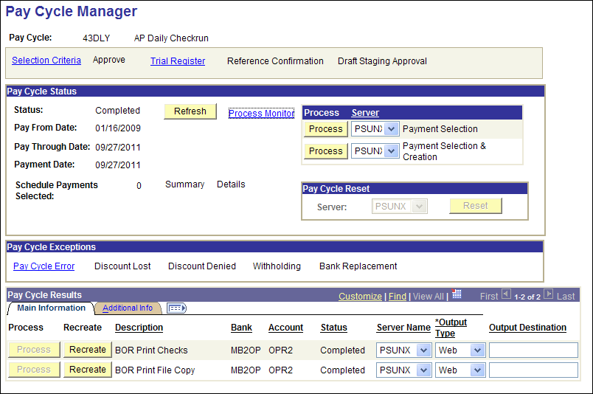
Check the Pay Cycle Exceptions

Slide 43
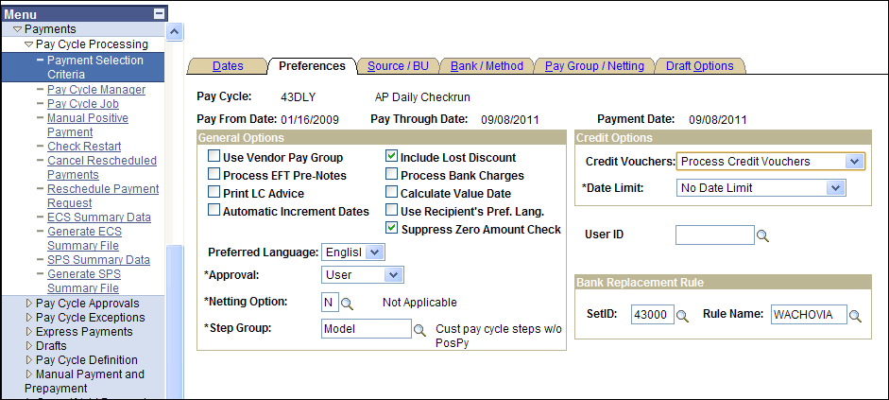

Slide 44
Payment Selection Criteria
Credit Vouchers
  Example: voucher $80 and credit vchr $100
  Option: Process When DRs >= CRs
    Nothing happens because debits are not greater than credits
  Option: Process Credit Vouchers
    Voucher paid / zero $ payment row / accounting entries
    Credit / payment row $80 / remaining $20

Slide 45
Positive Payment
Notifies bank of checks that will be presented for payment.
Contact ITS for assistance in getting started
Review Wimba presentation.

Slide 46
Positive Payment
Note the pay cycle ID you are using: POSPY1-9
Verify that you POSPY# runs to completion

Slide 47
Positive Payment
GeorgiaFIRST Training Archives
Wimba Session:
Using Positive Payment, August 31 2010
  Archive: http://gbor.wimba.com/launcher.cgi?room=PSFIN_TRNG_2010_0831_1430_53
  Slides and Handout

Slide 48
Month End Close
Run Query: BOR_AP_UNPOSTED_VCHR
Run Query: BOR_AP_UNPOSTED_PYMNTS
Reconciling the Open Payables to the General Ledger.
  Aging Payables Report vs. 211000 GL Account
  Reconciling Items
    Match Exceptions
    Un-posted Voucher
    Budget Exceptions

Slide 49
Training Resource
GeorgiaFIRST Training Archives
  http://www.usg.edu/gafirst-fin/training/archives/
Wimba Session: Using the PO Workbench and Monthly PO Cleanup Processes, March 23 2010
  Archive: http://67.202.210.69/launcher.cgi?room=PSFIN_TRNG_2010_0323_1430_53
  Slides and Handouts

Slide 50
Training Resource
GeorgiaFIRST Training Archives
  http://www.usg.edu/gafirst-fin/training/archives/
Wimba Session: Using Positive Payment, August 31 2010
  Archive: http://gbor.wimba.com/launcher.cgi?room=PSFIN_TRNG_2010_0831_1430_53
  Slides and Handout

Slide 51
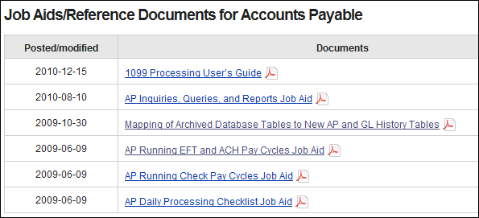
Documentation
http://www.usg.edu/gafirst-fin/documentation/job_aids/category/accounts_payable/

