Slide 1
Service Connect Training Session 2 - Report Functionality Board of Regents, University System of GA

Slide 2
Meeting Housekeeping/Highlights
Introduction of Facilitators – Jennifer Kennington, Theresa Wood and Maritza Almodovar
Please place all phones on Mute to avoid feedback and background noise
The webinar is being recorded and the recorded file will be stored and available on the ‘OneUSG Connect Smart Sheet’
We have blocked 2 Hours for this session. We will try to answer all of your questions as we go along. If we do not get to your question, feel free to email me after. A copy of this deck has been included in the meeting invite. My email address is: theresa.wood@aonhewitt.com
Although we are showing you how to access the Service Connect Tool using eCS, you all will have access from your own personal Connect-Benefits portal through Single Sign On (SSO) by navigating to the ‘contact us’
The webinar will train new users on how to access the tool, view and download the available reports

Slide 3
Agenda
Service Connect Overview
Demo/Hands On Practice:
Common Scenario 1 – Available Reports
Reports
Executing and Exporting Data
Discussion and Questions
Notes:
Instructor notes: Review agenda with client

Slide 4
Common Scenario 1: Available Reports
Reports Tab
Type of Reports, i.e. By Request , activities, etc.
Notes:
Instructor Notes: you will first show the client team Requests from their point of view and access. You will then show them what one of their employees will experience so they can see the difference.

Slide 5
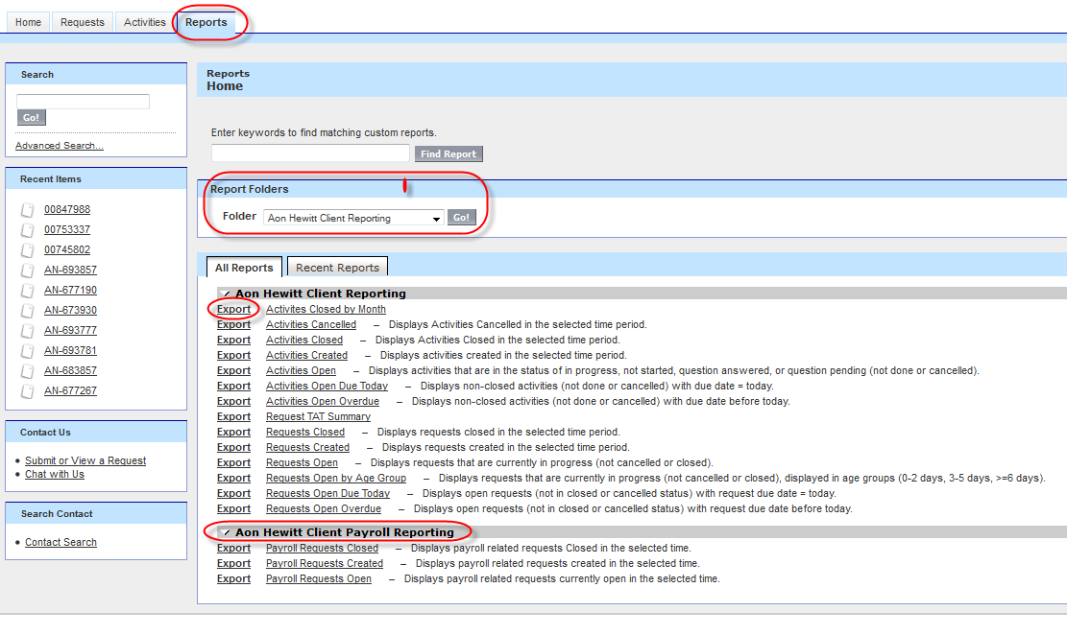
Reports Tab – Client Partner View
Key Features:
Can search for a base Aon Hewitt Client Report by entering a keyword in the search box
You can immediately Export a report to excel by clicking the Export link next to the Report name
See the Report descriptions which details out what the report pulls
Reports you run often can be located in the Recent Reports tab
Service Connect has a customer-facing portal available to employees, managers, and client partners. These users access Service Connect via a Single Sign-on (SSO) link from HR Connect
No separate Service Connect credentials.
Notes:
Instructor note: Review content on slide

Slide 6
Available Reports - Aon Hewitt Client Reporting
Activities Closed by Month
Activities Cancelled – Displays Activities Cancelled in the selected time period.
Activities Closed – Displays Activities Closed in the selected time period.
Activities Created – Displays activities created in the selected time period.
Activities Open – Displays activities that are in the status of in progress, not started, question answered, or question pending (not done or cancelled).
Activities Open Due Today – Displays non-closed activities (not done or cancelled) with due date = today.
Activities Open Overdue – Displays non-closed activities (not done or cancelled) with due date before today.
Request TAT Summary -
Requests Closed – Displays requests closed in the selected time period.
Requests Created – Displays requests created in the selected time period.
Requests Open – Displays requests that are currently in progress (not cancelled or closed).
Requests Open by Age Group – Displays requests that are currently in progress (not cancelled or closed), displayed in age groups (0-2 days, 3-5 days, >=6 days).
Requests Open Due Today – Displays open requests (not in closed or cancelled status) with request due date = today.
Requests Open Overdue – Displays open requests (not in closed or cancelled status) with request due date before today.

Slide 7
Common Scenario 2: Export data into excel
How to export
Saving report- (Real time data)
Notes:
Instructor Notes: Explain the agenda for Common Scenario 2

Slide 8
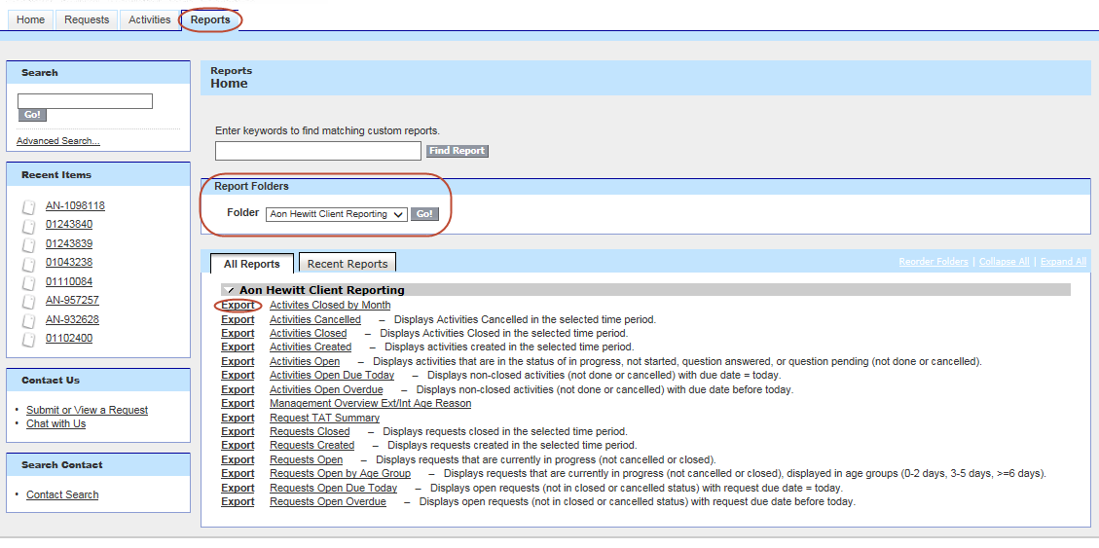
Demonstration
Notes:
Instructor Notes – provide demo in tools of information just shared. Please refer to the Word document with scenarios

Slide 9
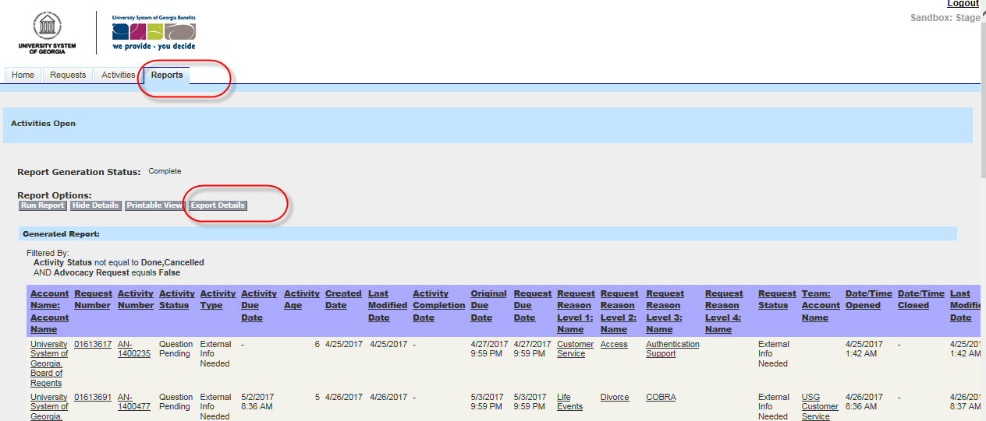
Reporting for Client Partners
Client Partners have access to reports that can be run at will
A report will only display Records the user would normally see
Reports can be exported into Excel (max of 20,000 rows)
Only 2000 rows of data appear in Service Connect, but if the report contains more, additional data is visible when exported
Note: Some reports may not be applicable (Payroll Requests…) and will be removed soon

Slide 10
Reports - Troubleshooting
If you get a blank report:
1. Open Excel 2. Click on File > Options 3. Select Trust Center > Trust center settings 4. Select Protected view 5. Uncheck all the options under Protected View > OK 6. Restart Excel and try to Export again

Slide 11
Discussion and Questions
Notes:
Instructor Notes: Take this time to answer any questions the client may have or review items that have been placed on the “parking lot”. Set expectations as to when those questions will be answered and shared with the client.

