Slide 1
Working Together
Roles, Interactions, Support Tools and Handoffs
June 2017

Slide 2
Meeting highlights and housekeeping
Introduction of Facilitators—Jennifer Kennington, Theresa Wood, Maria Markiewicz and Maritza Almodovar.
Please place all phones on Mute to avoid feedback and background noise.

Slide 3
Process flow: working together support model—getting to know us!
Our Core Values:
People Matter—We believe in the power of people and know that the best ideas come from everywhere. We act with respect and accountability, mindful that our actions affect the lives of others in meaningful ways.
Excellence Every Day—We believe that every day is an opportunity for growth and are energized by going above and beyond what’s expected. We are one team, hungry for results. We focus on what matters and know that for even the most difficult challenges, there is a solution.
Think Forward—We continuously reimagine what the future could be and believe that tomorrow is created by actions we take today.
Act Now—We are brave in spirit, act decisively, learn quickly and get it done
Be Real—We are forthright and genuine when we speak.

Slide 4
Process flow: working together support model—getting to know us!
How we Deliver:
Impactful Advisors—As a steward of your success we deliver based on our understanding of your unique goals and proactively advise on how to achieve the best outcomes in the simplest ways possible.
Operational Excellence—We understand the importance of what we do and are detailed-driven.
Breakthrough Solutions—Our approach is solution driven. We are inventive in using technology, data and our partnership to deliver solutions.
Engaging User Experiences—We bring a deep understand of people manage their daily lives and engage with technology to power more valuable, intuitive and engaging user experiences.

Slide 5
Process flow: working together support model—role description
HR/Benefit Practitioner Role
Support employees
Guide employees to the right tools and resources
Educate employees on benefits programs/resources through:
New hire orientations
Employee meetings
Open Enrollment meetings/communications
Benefits Fairs
Campus events
Work with Aon/SSC/System Office on issues that have to be researched – more to come on processes

Slide 6
HR and benefit practitioner tool summary

Slide 7
Support tool inventory
Tool Acronym | Detailed Description | Restricted Access | Business Purpose and URL
eCS | Electronic Customer Service | Y | Web-based support tool for viewing employee account information URL: http://resources.hewitt.com/oneusg/ecs
Service Connect | Service Connect | N | Users will Single Sign On through the OneUSG Connect-Benefits portal. Service Connect is used to track calls and for case management
PSP | Plan Sponsor Portal | Y | Web-based analytics and reporting support tool, used to view, download and create reports URL: http://www.hewitt.com/psp
DVS | Dependent Verification Services | N | Web-based support tool that allows HR Practitioners to view the status or progress of the dependent verification process URL: https://www.yourdependentverification.com/plansmart

Slide 8
USG support model—day to day interactions

Slide 9
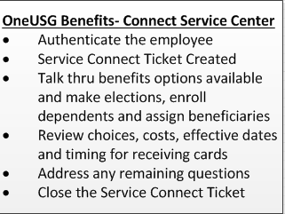
Process flow: working together support model—scenario #1
Employee contacts the OneUSG Connect—Benefits Service Center to request Assistance with New Hire Enrollment:

Slide 10
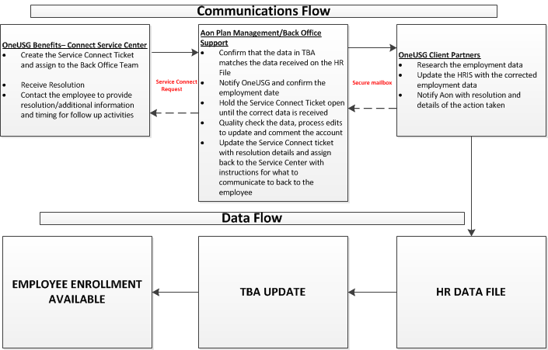
Process flow: working together support model—scenario #2
Employee contacts the OneUSG Connect—Benefits Service Center and informs that he should be eligible for benefits but he does not see an option to make elections. Employment data shows that the employee is hired in a benefits ineligible employment status:

Slide 11
Process flow: working together support model—scenario #3
Employee contacts the OneUSG Connect—Benefits Service Center and informs that his pay check was deducted $100 more for the health plan than he expected. TBA shows that the cost of the health plan is $75 per pay period:

Slide 12
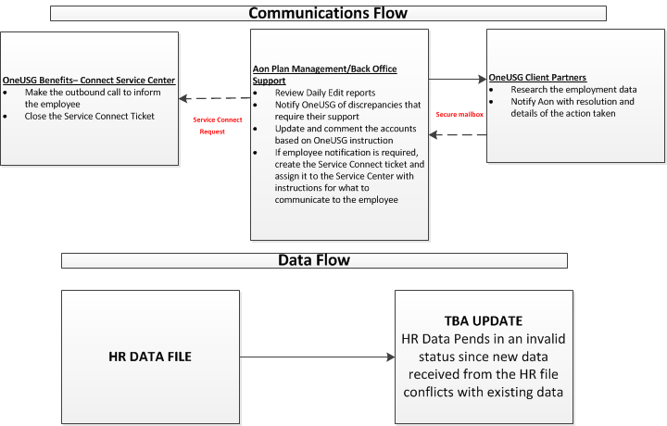
Process flow: working together support model—scenario #4
Data Discrepancy:
Plan management team received notification on the daily edit report with data that conflicts with what is currently in TBA. Aon needs to know what information is correct.

Slide 13
Stabilization Rules of Engagement— Interaction
Topic | Contact Method | Responder/Requestor
Day to Day Employee Requests that require additional research or minor account updates | Service Connect or Assist the employee with contacting the OneUSG Connect-Benefits Call Center | Customer Service/Institution HR Benefits Practitioners
USG initiated Red Escalation | Initial Phone call/Email follow up To: OneUSG.Connect.Escalations@aonhewitt.com | Alight Back-Office/USG Process USO
Alight initiated Red Escalation | Initial Phone call/Email follow up From: OneUSG.Connect.Escalations@aonhewitt.com | USG Process owner, SSC, USO/ Alight Back-Office
USG initiated Yellow Escalation | Service Connect/Follow up with email | Customer Service/SSC, USG Process Owners, HR Benefits Practitioners
Alight initiated Yellow Escalation | Administrative Secure Mailbox From: OneUSG.Connect.Escalations@aonhewitt.com | USG Process owner, SSC, USO/ Alight Back-Office
USG initiated Expedited/Exceptions | Service Connect | Customer Service/Authorized USG Process owner
Alight initiated Expedited/Exceptions | Administrative Secure Mailbox From: OneUSG.Connect.Escalations@aonhewitt.com | Alight Back-Office/USG Authorized Process Owner
HR File Data discrepancies/Payroll File or Financial Manager issues/Report questions, unique population special handling | Administrative Secure Mailbox From: OneUSG.Connect.Escalations@aonhewitt.com | Alight Back-Office/USG Authorized Process Owner, SSC, USO
Notes:
Theresa

